Slide 1







Plotly Dash dashboard results slides
Thippeswamy MN
26-06-20254

Slide 2
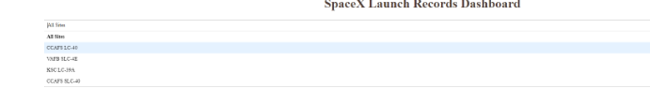
TASK 1: Add a Launch Site Drop-down Input Component

Slide 3
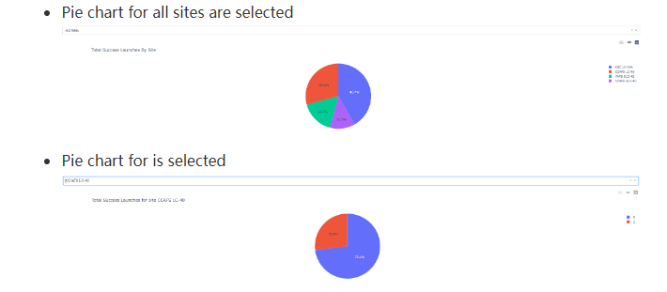
TASK 2: Add a callback function to render Success pie chart based on selected site dropdown

Slide 4
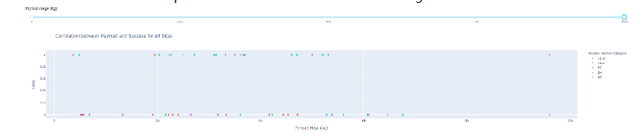
TASK 3: Add a callback function to render the success payload chart scatter plot

