Slide 1







predictive analysis (classification) results
Thippeswamy MN
27-06-2024

Slide 2

Task1 : Create a NumPy array from the column Class in data.

Slide 3
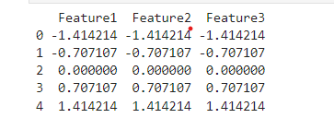
Task2 : Standardize the data in X then reassign it to the variable X using the transform

Slide 4
Task3 : Fit the object to find the best parameters from the dictionary

Slide 5
TASK 5 : Calculate the accuracy on the test data using the method Score

Slide 6
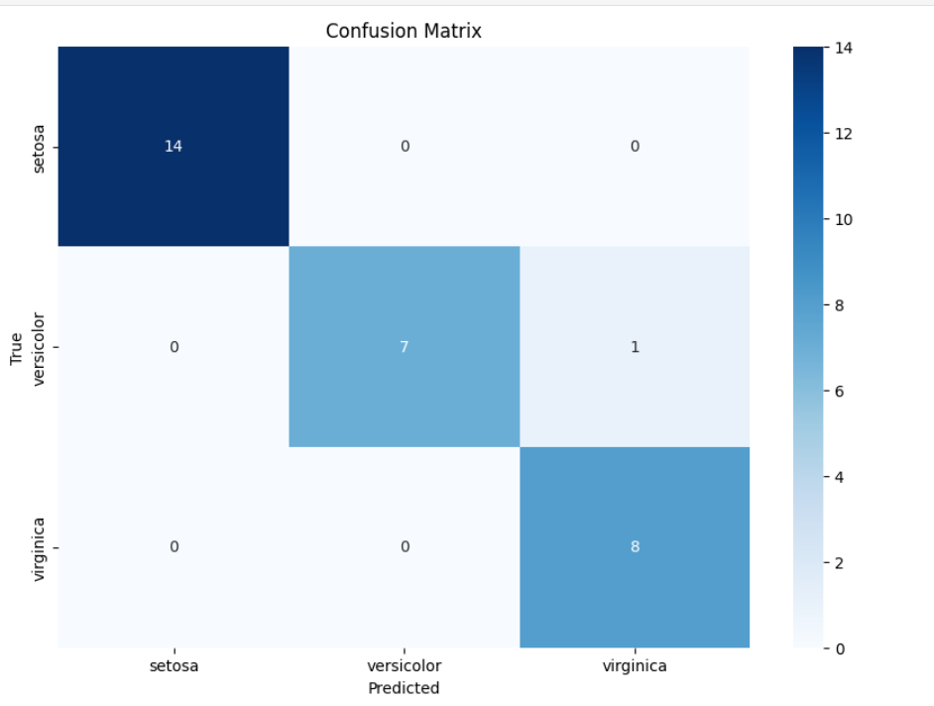
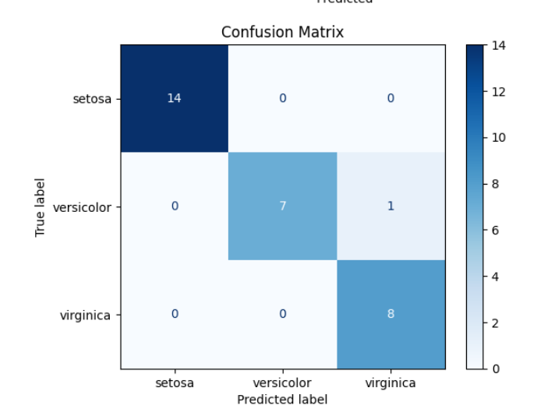
Confusion Matrix

Slide 7

Task6: Create a support vector machine object

Slide 8

Task7: Calculate the accuracy on the test data using the method Score:

Slide 9
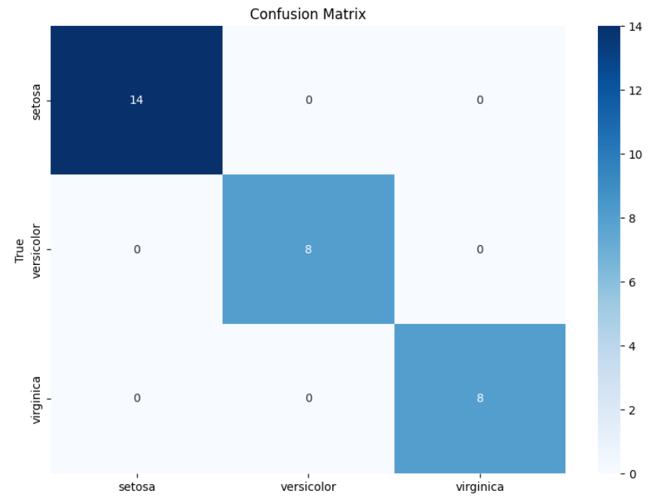
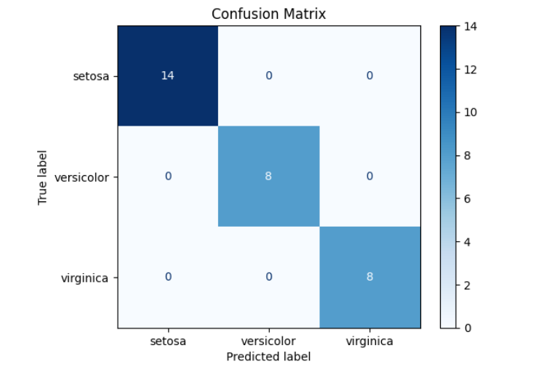
confusion matrix

Slide 10
Task8 : Create a decision tree classifier object then create a GridSearchCV object tree_cv with cv = 10 Fit the object to find the best parameters from the dictionary parameters

Slide 11

Task9 : Calculate the accuracy of tree_cv on the test data using the method Score

Slide 12
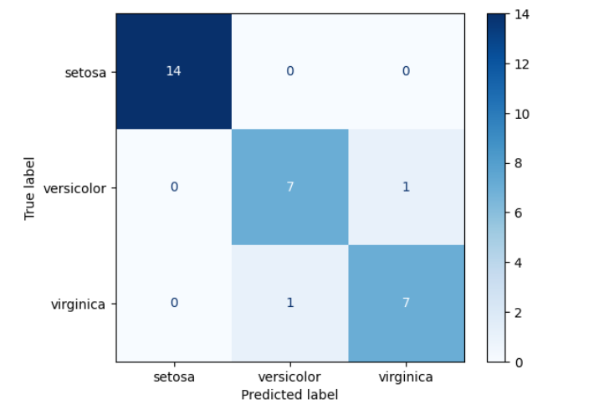
confusion matrix

Slide 13
Task10 : Create a k nearest neighbors object then create a GridSearchCV object knn_cv with cv = 10. Fit the object to find the best parameters from the dictionary parameters

Slide 14
Task11: Calculate the accuracy of knn_cv on the test data using the method

Slide 15
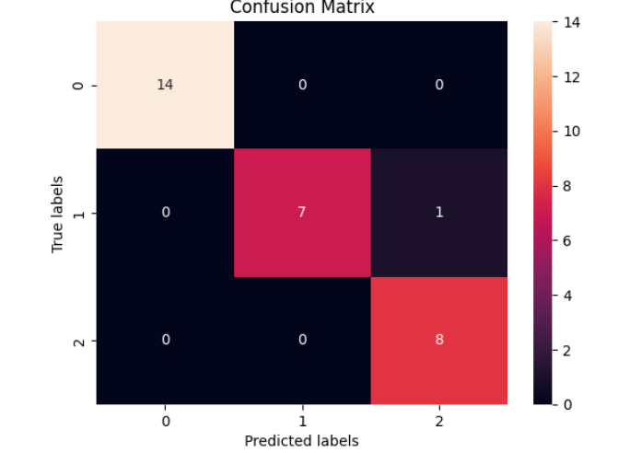
confusion matrix

Slide 16
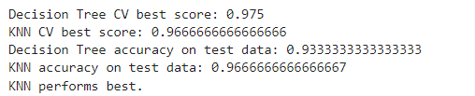
Task12: Find the method performs best:

