Slide 1


Computer/Console Video Game Addiction
By Thip Rattanavilay
Bellevue University, Masters Data Science
Milestone 3

Slide 2


Addiction Defined
Categorized as an “impulse control disorder” and can be defined as ‘‘an individual’s inability to control their Internet use/dependence, which in turn leads to feelings of distress and functional impairment of daily activities
(Pies, 2009)

Slide 3
Why are Video Games Addictive?
Research has attempted to explore why video games are addictive. One reason is that video games are designed to entice players to play them. Video games must be challenging enough to keep players playing, but not so challenging that they cause players to give up. Some video games have no final goal or definitive end, which allows players to continue to play them indefinitely.

Slide 4
Many addictive video games encourage people to electronically connect with each other, which can promote continued gameplay. Some video games operate on leveling and variable reward systems, where people earn skills or rewards by beating certain levels without knowing exactly when it will occur. Knowing that a big reward will come eventually and playing to reach the next level can increase their overall playing time.

Slide 5
There are several emotional and physical warning signs of video game addiction that can be indicative of a problem. Individuals may be consumed with thoughts about playing and show signs of impatience and agitation when they are unable to play. People may be dishonest about the amount of time that they spend playing video games and isolate themselves to play for longer. Physical symptoms include:
Tiredness
Headaches and migraines
Carpal tunnel syndrome
Lack of personal hygiene.
(Gaming Addiction Statistics 2020)

Slide 6
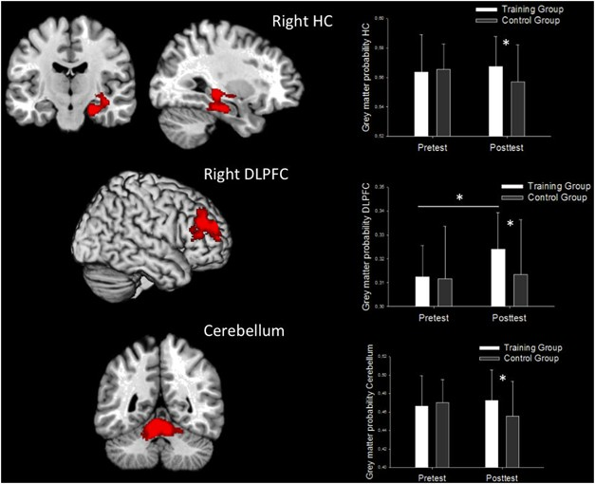
This is your brain on video games

Slide 7
Creating Addictive Games
Compulsion loop: A habitual, designed chain of activities that will be repeated to gain a neurochemical reward: a feeling of pleasure and/or a relief from pain.
Basically, each action taken by the player feeds into the next and provides enough reward and/or anticipation to motivate the player to follow the chain.
Compulsion loops are made most effective in games by carefully scheduling the release of rewards with a perceived increase in difficulty, so that the sense of challenge and accomplishment is maintained evenly throughout gameplay.
The player is constantly engaged in a state of motivation to seek reward and then given enough reward to continually renew her motivation to seek it.
(The Compulsion Loop in Game Design Explained 2020)

Slide 8
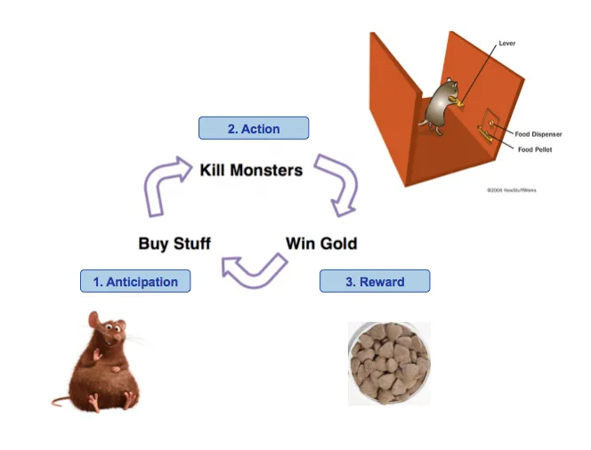
Concept Origins
(The Compulsion Loop in Game Design Explained 2020)

Slide 9
Is Technology an Addictive Substance?
According to Griffiths (1995), technological addictions, including the Internet, are a branch of behavioral addictions which engage the six criteria for addiction:
Salience
Mood modification
Tolerance
Withdrawal
Conflict, and
Relapse
(Griffiths Mark 1995)

Slide 10
Salience: refers to the importance and dominance that a particular activity has in one’s life
Mood modification: the subjective experience one has when engaging in a particular activity, and is synonymous with a coping strategy
Tolerance: the process of increasing amounts of an activity for the purpose of remaining satisfied
Withdrawal: and the unpleasant feelings that occur when the activity is discontinued
Conflict: refers to interpersonal and intrapsychic issues an individual may experience,
Relapse: the repeated reversions that may occur after one has discontinued an activity
Griffiths found that, “as with most forms of behavioral addiction, Internet Addiction has a psycho-physiological affect on those afflicted with the condition. That is, disturbances in both mental processes, particularly thoughts, emotions, and behaviors, and bodily actions especially in relation to withdrawal symptoms from the vice (for example, tremors) can be experienced.”
(Griffiths Mark 1995)

Slide 11
Concept Origins
Reward (content/currency)
Action
Progress/upgrade/
recognition
Anticipation
(The Compulsion Loop in Game Design Explained 2020)

Slide 12
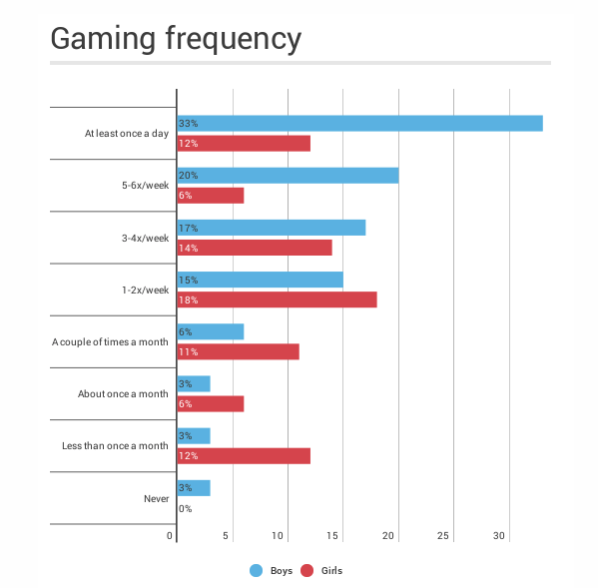

Slide 13
Video Games and Neurology: cause or effect?
Charité University Medicine in Berlin study (Feb 2015) has found a correlation between frequent gaming and enlarged reward centers in the brain.
What is not clear is whether individuals with this trait are more likely to engage in gaming (because they may experience gaming as more rewarding in the first place), or whether this increased reward sensitivity develops through game use.
Particularly notable in the study was that even when a player failed in the game, they still experienced stimulation in the reward center. This connection has also been identified in those with gambling problems and is correlated with a lowered deliberation time in betting or risk-taking.
(Lorenz, Gleich, Gallinat, & Kühn, 2015)

Slide 14
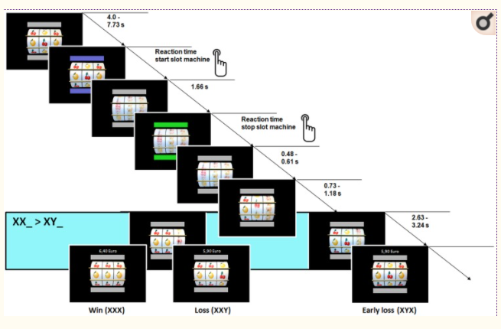
SLOT MACHINE PARADIGM
(Gaming Addiction Statistics 2020)

Slide 15
Gamer Demographics
More than 2 billion people play video games globally, including 150 million in the United States. Online video game addiction statistics show that anywhere from 1–10% of gamers have compulsive addiction issues.
Other gamer demographics include:
64% of the U.S. population are gamers
The average male gamer is 33 years old.
The average female gamer is 37 years old.
Males between the ages of 18–24 are most at risk for gaming addiction
94% of males and 6% of females represent the gender breakdown for gaming addiction
69% Caucasian, 13% Asian and 18% of other ethnicities is the ethnicity breakdown for gaming addiction.
(Gaming Addiction Statistics 2020)

Slide 16
Video Game Addiction and Co-Occurring Disorders
Gaming and Depression: There is a significant correlation between video game addiction and depression. One study found that 9% of elementary and secondary school students were classified as pathological gamers and were using video games as a coping strategy when already depressed and anxious. Individuals who are depressed may isolate themselves and attempt to escape from stressors with video games.
Gaming and ADHD: ADHD and video game addiction also have a connection. Individuals with ADHD may play excessively due to poor time management and have the ability to hyper focus on a video game, which tend to reward brief spurts of attention. A study found that individuals with ADHD had an elevated rate of compulsive and problematic video game usage.
Gaming and Autism: The correlation between autism and video game addiction suggests that people with autism can become overly involved in gaming due to repetitive behaviors, resulting in inattentiveness and obsessive behaviors leading to addictive playing patterns. One study found that the average time of male children ages 8 to 18 with an autism spectrum diagnosis was 2.4 hours per day and those who played role-playing games were more likely to display oppositional behaviors.

Slide 17
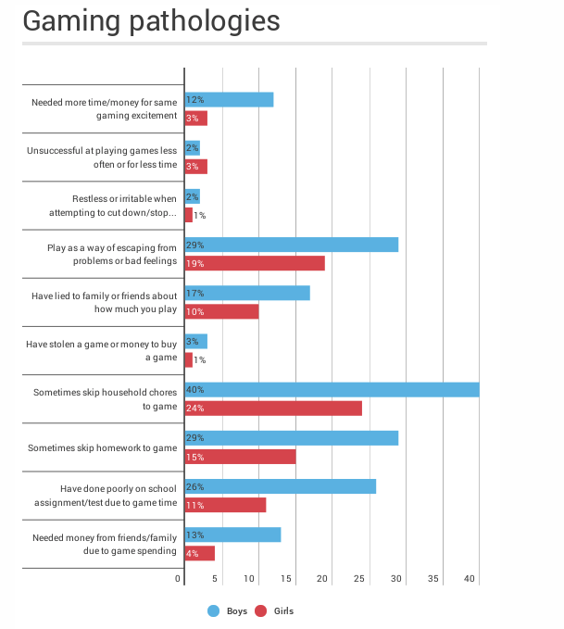

Slide 18
Addictive Games – Good or Evil?
Is it ethical to create games that have the sole purpose of keeping users playing and spending for as long or as much as possible?
What are the dangers of allowing firms to combine data mining with addictive game features and, potentially, personalized gaming experiences? Or is this just the ultimate end result of modern gaming developments (e.g. fully individualized virtual reality games)
What are the harms (economic vs societal vs personal)?
Should we introduce regulations, and if so, how?
Is this a parallel situation to Irwin Toy, or distinguishable?
(The Compulsion Loop in Game Design Explained 2020

Slide 19
References
About Joseph Kim Mobile game philosopher and entrepreneur. Watch my game dev relaated videos at GameMakers on YouTube and listen to my podcast on Deconstructor of Fun. View all posts by Joseph Kim. (2020, June 27). The Compulsion Loop in Game Design Explained. Retrieved October 11, 2020, from https://gamemakers.com/the-compulsion-loop-explained/ (
Gaming Addiction Statistics. (2020, January 28). Retrieved October 11, 2020, from https://www.therecoveryvillage.com/process-addiction/video-game-addiction/related/gaming-addiction-statistics/
Pies, R. (2009, February). Should DSM-V Designate "Internet Addiction" a Mental Disorder? Retrieved October 11, 2020, from https://www.ncbi.nlm.nih.gov/pmc/articles/PMC2719452/
Griffiths, Mark. (1995). Technological addictions. Clinical Psychology Forum. 76. 14-19. https://www.researchgate.net/publication/284665745_Technological_addictions
Lorenz, R., Gleich, T., Gallinat, J., & Kühn, S. (2015, February 5). Video game training and the reward system. Retrieved October 11, 2020, from https://www.ncbi.nlm.nih.gov/pmc/articles/PMC4318496/
Images
https://daily.jstor.org/is-video-game-addiction-a-boy-problem/

