Slide 1

Data Analysis Modeling
Thip Rattanavilay
DSC500 - Introduction to data science

Slide 2
Requirements analysis
Requirements analysis
Specifies software’s operational characteristics
Indicates software's interface with other system
Elements establishes constraints that software must meet
Requirements analysis allows the software engineer (called an analyst or modeler in this role) to:
elaborate on basic requirements established during earlier requirement engineering tasks
build models that depict user scenarios, functional activities, problem classes and their relationships, system and class behavior, and the flow of data as it is transformed.

Slide 3
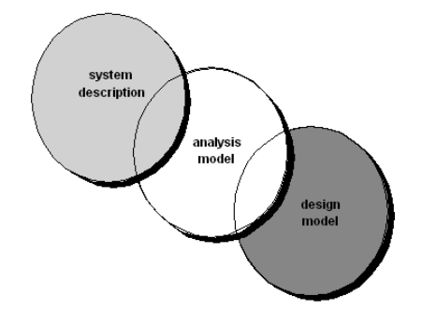
ANALYSIS MODEL
ANALYSIS MODEL: a representation of requirements in terms of text and diagrams depicting requirements for data, function and system behavior in a way easy to understand and review for correctness, completeness and consistency
(Redirect Notice)

Slide 4
Rules of thumb
The model should focus on requirements that are visible within the problem or business domain. The level of abstraction should be relatively high (focus on the “WHAT”, not “HOW”). Each element of the analysis model should add to an overall understanding of software requirements and provide insight into the information domain, function and behavior of the system. Delay consideration of infrastructure and other non-functional models until design. Minimize coupling throughout the system. Be certain that the analysis model provides value to all stakeholders.

Slide 5
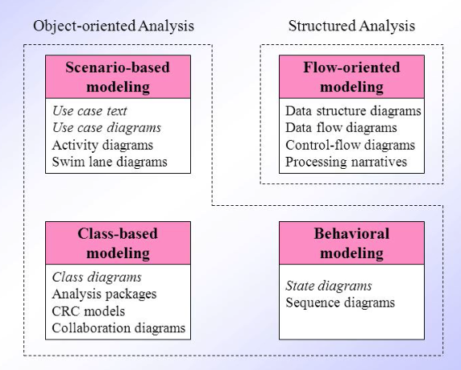
Modeling Type
Requirements analysis
Flow-oriented modeling
Scenario-based modeling
Class-based modeling
Behavioral modeling
(Redirect Notice)

Slide 6
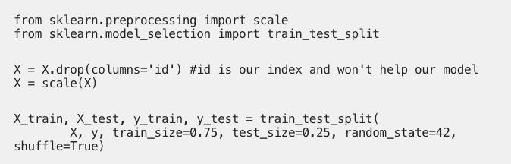
Logistic Regression Model
Logistic Regression is great for multiclass classification because Scikit-learn encodes encodes the target labels automatically if they are strings (Smith, 2019).

Slide 7
Overall Objectives Three primary objectives
To describe what the customer requires
To establish a basis for the creation of a software design
To define a set of requirements that can be validated once the software is built
All elements of an analysis model are directly traceable to parts of the design model, and some parts overlap

Slide 8
References
Smith, K. (2019, February 09). Predictive Modeling: Picking the best model. Retrieved November 19, 2020, from https://towardsdatascience.com/predictive-modeling-picking-the-best-model-69ad407e1ee7
(Smith, 2019)
Redirect Notice. (n.d.). Retrieved November 19, 2020, from https://www.google.com/url?sa=i

