Slide 1

2020 Crimes in Los Angeles
DSC530
Data Exploration and Analysis
Los Angeles Crime rate
Thip Rattanavilay

Slide 2
Instructions
A minimum of 5 variables in your dataset used during your analysis (for help with selecting, the author made his selection on page 6 of your book). Consider what you think could have an impact on your question – remember this is never perfect, so don’t be worried if you miss one (Chapter 1).
Describe what the 5 variables mean in the dataset (Chapter 1).
Include a histogram of each of the 5 variables – in your summary and analysis, identify any outliers and explain the reasoning for them being outliers and how you believe they should be handled (Chapter 2).
Include the other descriptive characteristics about the variables: Mean, Mode, Spread, and Tails (Chapter 2).
Using pg. 29 of your text as an example, compare two scenarios in your data using a PMF. Reminder, this isn’t comparing two variables against each other – it is the same variable, but a different scenario. Almost like a filter. The example in the book is first babies compared to all other babies, it is still the same variable, but breaking the data out based on criteria we are exploring (Chapter 3).
Create 1 CDF with one of your variables, using page 41-44 as your guide, what does this tell you about your variable and how does it address the question you are trying to answer (Chapter 4).
Plot 1 analytical distribution and provide your analysis on how it applies to the dataset you have chosen (Chapter 5).

Slide 3
Project Goals My final project I want to figure what type of crimes are in Los Angeles, therefore I want to investigate the following questions:
Is there a particular crime in Los Angeles that has become more prevalent?
What are the total crimes reported since 2020 in Los Angeles?
What city in Los Angeles is more prevalence to crime?
What area are crimes committed?
What are the ages of the victims?
Which gender is more prevalent in committing a crime?

Slide 4
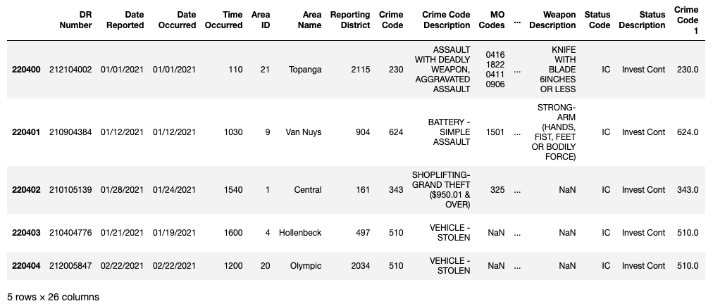
Datasets provided by the city of Los Angeles

Slide 5
Data Variables Used
“Crime Code Description" Column contains the types
of crime committed
"Victim Descent” Value of the victim descent
"Victim Gender" - Value of the Gender crime
"Year Reported" Value of the year for the crime
"Hour Occurred" Value of the Hour for the crime
"Area Name" Neighborhood name of the crime

Slide 6
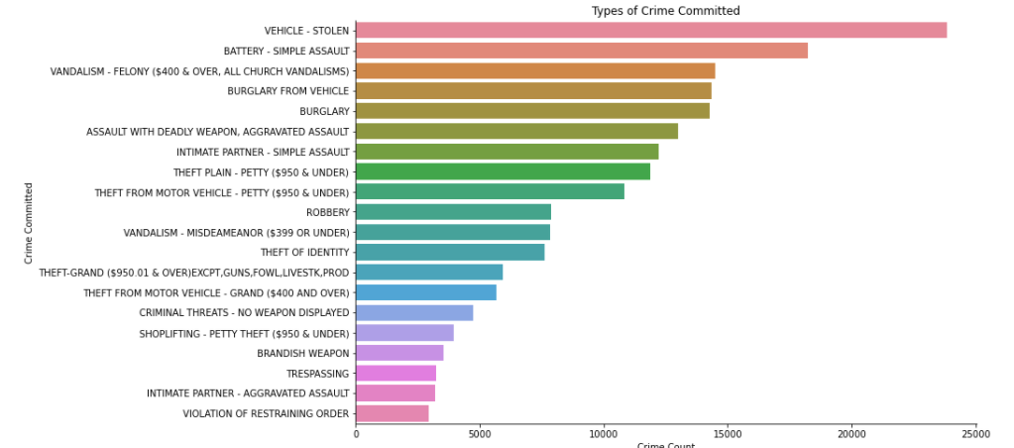
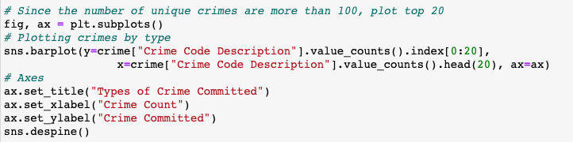
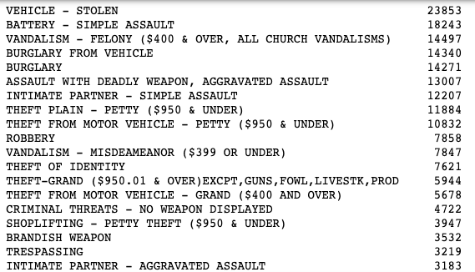
Top 20 Types Of Crime Committed Variable
For this dataset, it looks likes that
Theft from Vehicle has the most incident
Occurrence and listed as the top 20 crimes committed. No outliers present from this
graph. Descriptive statistics shown below.

Slide 7
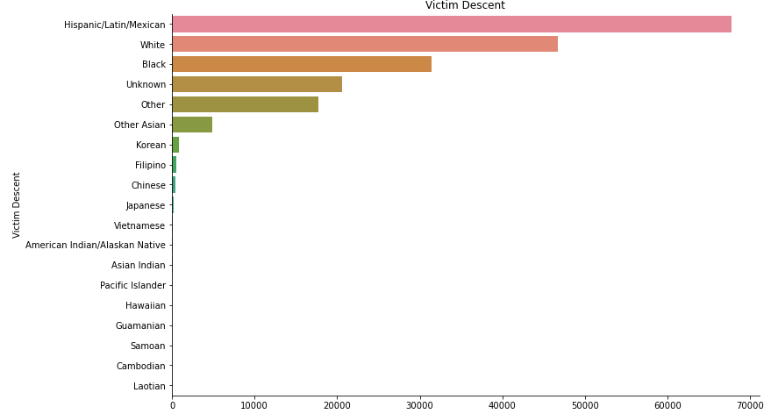
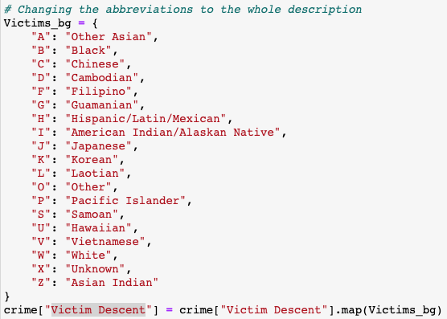
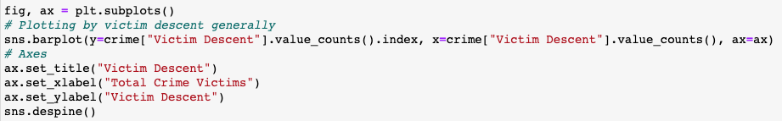
Victim Descent Variable
For this dataset, it looks likes that Hispanic /Latin/ Mexican had the most incident occurrence. There are some outliers present from this graph. Descriptive statistics shown below.

Slide 8
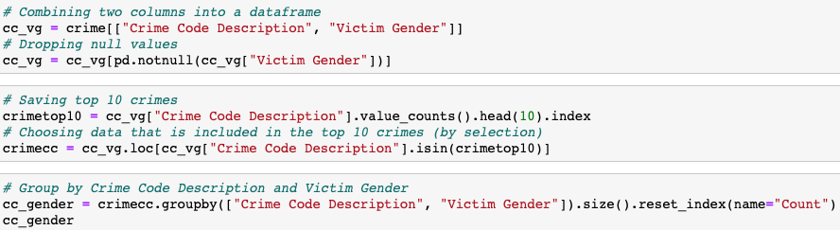
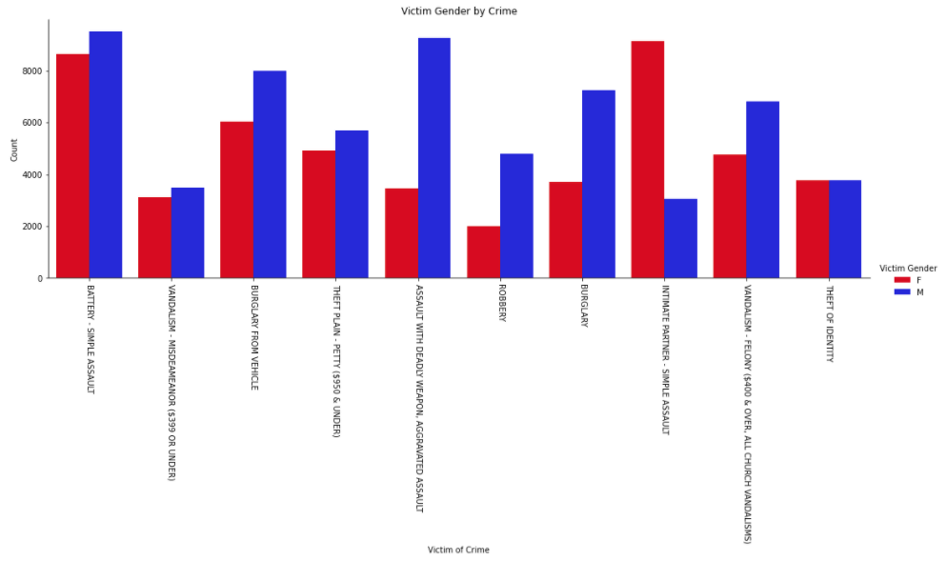
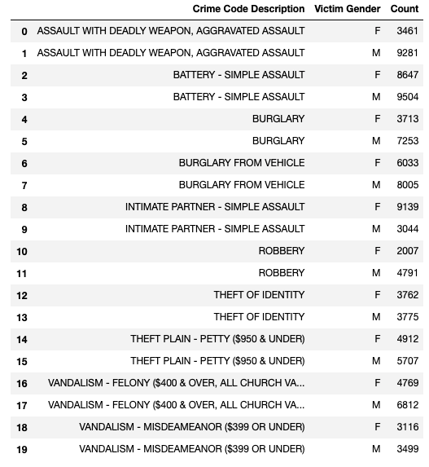
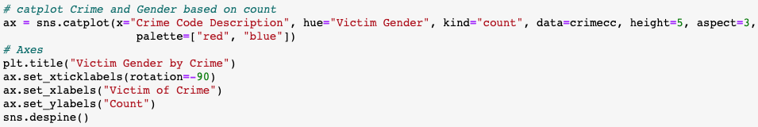
Victim Gender Variable
From this dataset, it looks likes Men had the most incident occurrence than Women. No outliers present from this graph. Descriptive statistics shown below.

Slide 9
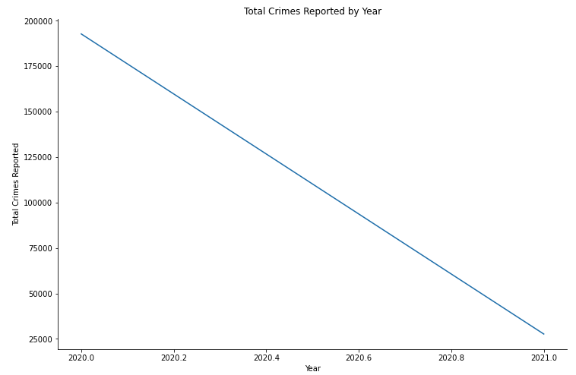
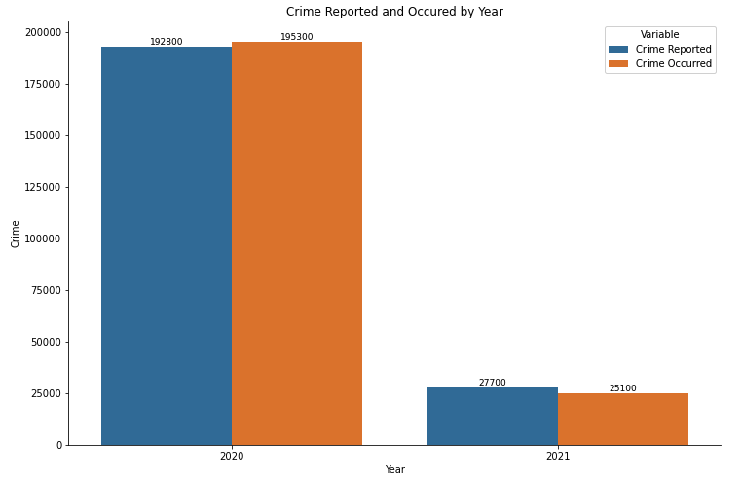
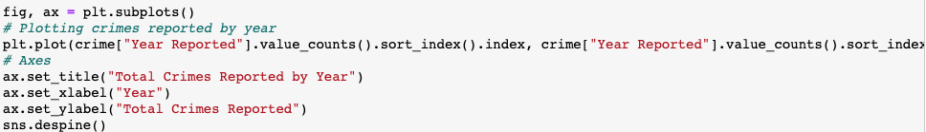
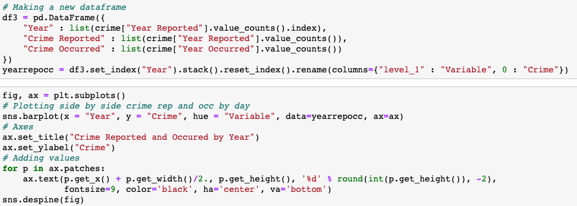
Year Reported Variable
From this dataset, it looks likes that
2020 had the most incident occurrence, but 2021 is still a few months in. No outliers present from this graph. Descriptive statistics shown below

Slide 10
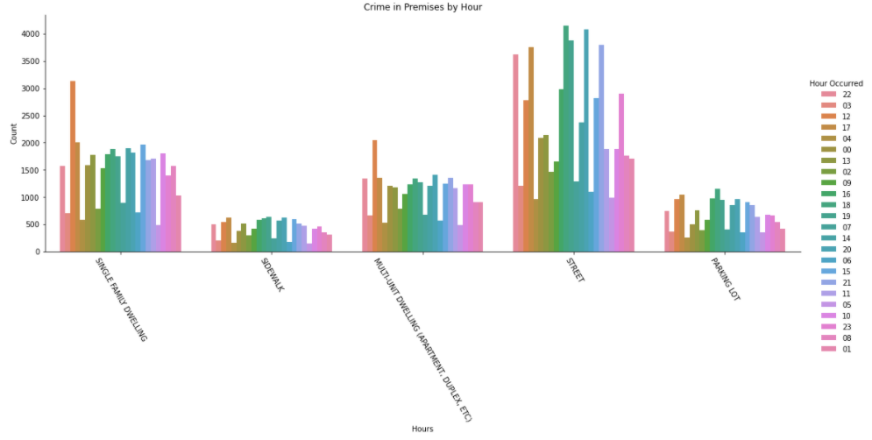
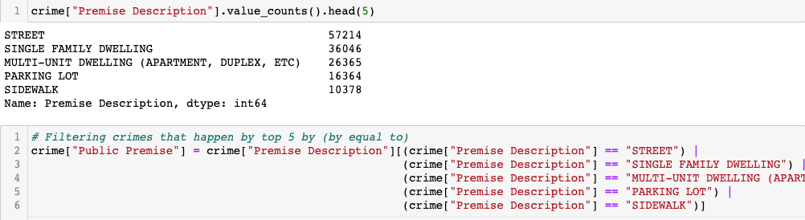
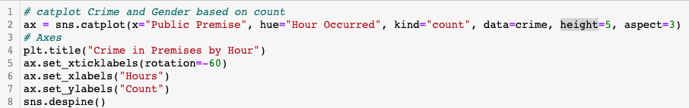
Hour Occurred Variable
This dataset shows that 2020 had the most
crimes throughout the years, I was curious
to see which Hour from the year 2020 and it had the highest crime incidents. It looks
likes that the street and single-family dwelling hour had the most incident occurrence. I found that 0 was an outlier that was present in the initial graph for the hour, but we removed to get a better understanding. Descriptive statistics shown below.

Slide 11
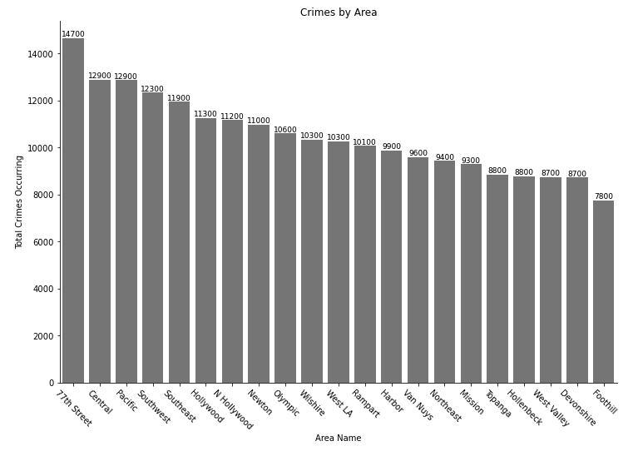
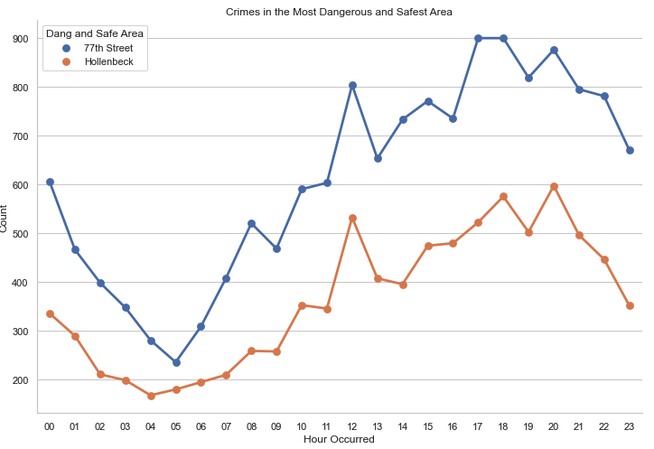
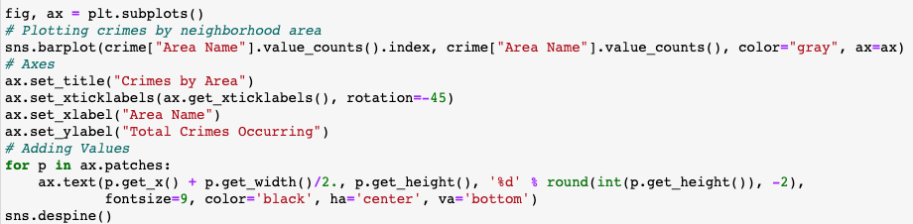
Area Name Variable
This dataset, it looks likes that the
neighborhood of 77th Street had the most incident occurrence. No outliers present from this graph. Descriptive statistics shown below.

Slide 12
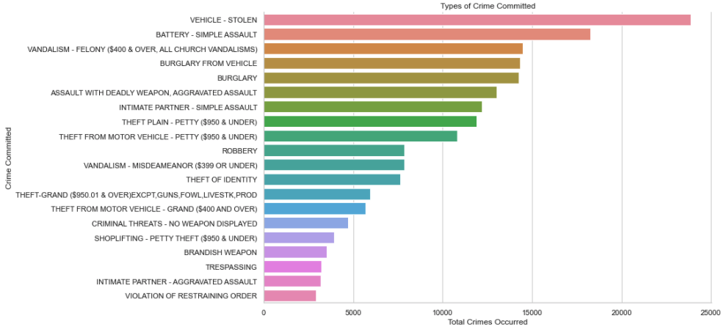
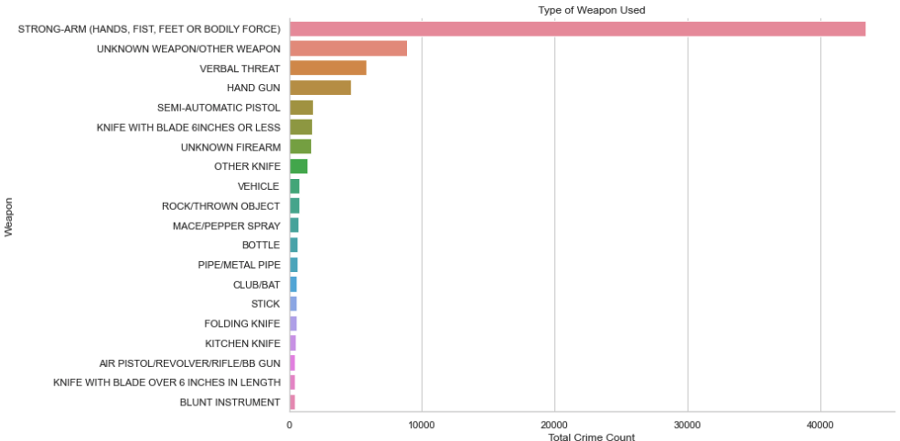
Compare two scenario data using a PMF
Comparing Types of Crimes to Other Type of Weapon Used

Slide 13
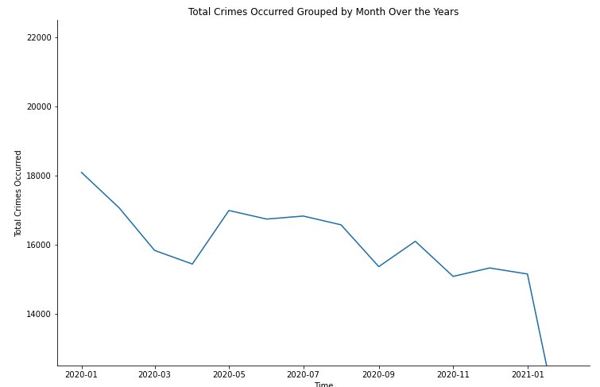
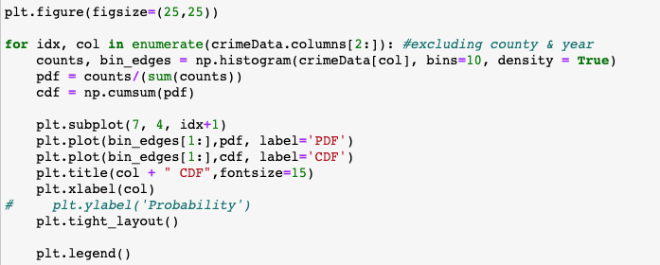
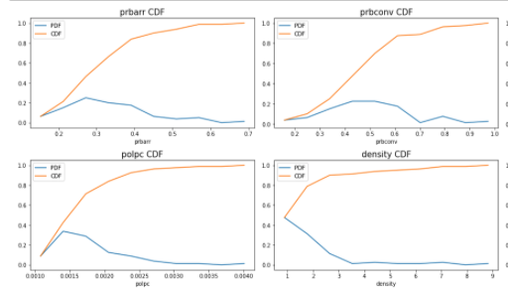
CDF with one variables
When I created this CDF it had helped me answer my other question which is. Is crime increasing throughout the years in Los Angeles, CA? Looking at the step size at the beginning the steps were larger so crimes were for frequent in 2020, but then in the middle show a slow down of crime because the steps got smaller, and then towards the end the steps are drop down further.

Slide 14
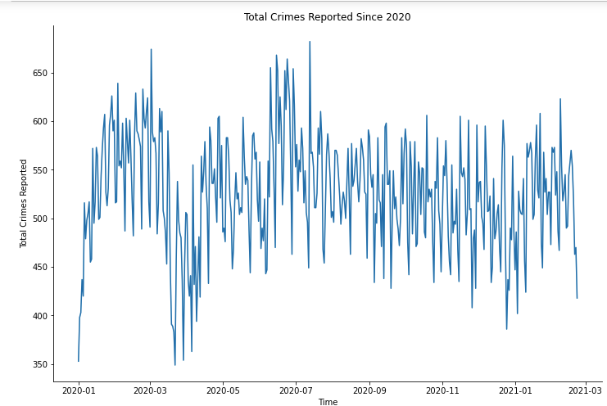
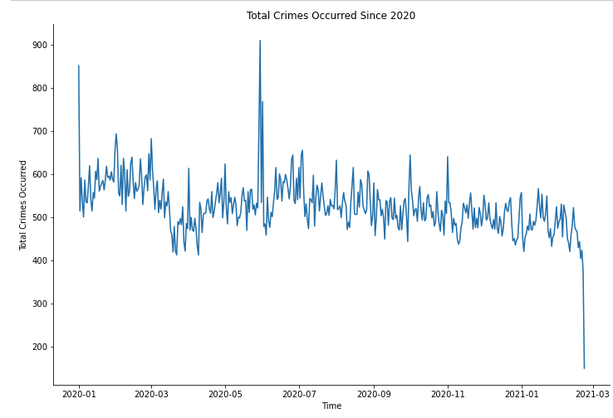
Plot 1 Analytical Distribution with analysis
The Plot shown total crimes reported with the most crime. Therefore, I decided to plot a CDF to a normal model. Also generated a normal probability plot of total crimes occurred. The normal plot model seems to follow the data, whereas the linear scale model doesn’t quite fit.

Slide 15
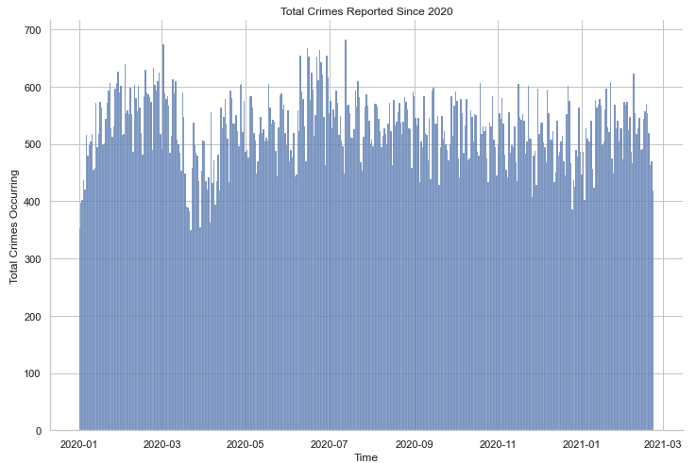
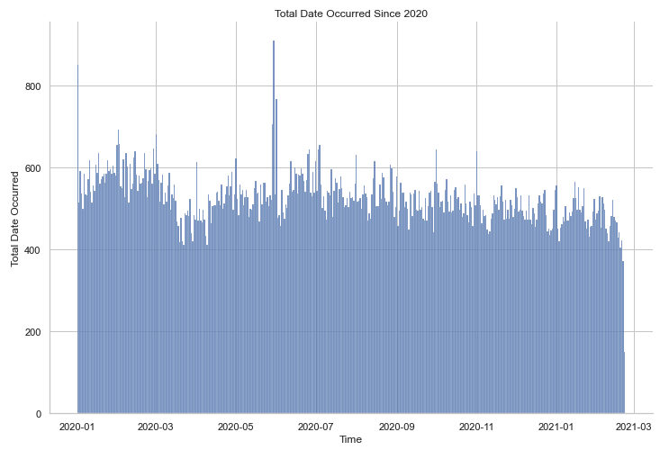
Plot 1 Analytical Distribution with analysis
PART 2

Slide 16

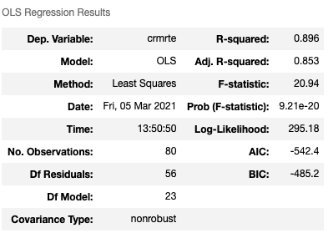
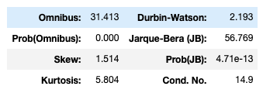
Variable & Regression
First, I build two models predicts the number of possible crimes based on location, month, date, and hour. In order to check whether mean square error for linear regression model is reasonable, I build baseline model, which divides test set into five groups based on its average of 4 values (number of crimes of each factor: location, month, date, hour) in descending order. If given features belong to first group, the model predicts. As the p-value of density is 0 (small), the changes in crime rate has got close relation with changes in density.
R-squared value is found to be 0.525 with only density as predictor variable. This means that 52.5% variability of crime rate is explained by density feature.
Co-effient estimate of 0.0086 indicates one value increase of density would cause 0.0086 value increase in crime rate.
Standard Errors assume that the covariance matrix of the errors is correctly specified.The condition number is large, 3.28e+06. This might indicate that there are strong multicollinearity or other numerical problems.

Slide 17
Conclusion
Is there a particular crime in Los Angeles that has become more prevalent?
According to the histograms, Theft from Vehicle shows to be most prevalent
What are the total crimes reported since 2020 in Los Angeles?
According to the CDF, and histogram overall crime has gone down between 2020 and 2020, but crime has drop slowly starting 2021.
What city in Los Angeles is more prevalence to crime?
The hypothesis test showed that we can reject the null hypothesis, and therefore conclude that Foothill have less crime prevalence in Los Angeles , CA.
What area are crimes committed?
According to the histogram, 77th Street had the most crime incident occurrence in Los Angeles, CA.
What are the ages of the victims?
According to the histogram, Mean of the victims are infants, 35, and is supported by a median of 34
Which gender is more prevalent in committing a crime?
According to the histogram, it shows that Hispanic/Latin/Mexican are higher to be victims of crimes in Los Angeles, CA

Slide 18
References:
Downey, A. B. (2015). Think Stats. Sebastopol, CA: O’Reilly Media, Inc.
Statistical data. (n.d.). Retrieved March 05, 2021, from https://www.lapdonline.org/statistical_data
Crime data from 2020 to present. (2020, December 02). Retrieved March 05, 2021, from https://catalog.data.gov/dataset/crime-data-from-2020-to-present

