Slide 1
Wk 5 – Ch 8 -10 Collaborative Filtering

Slide 2
Chapter 8: Handling Images
We will not be covering Chapter 8 in this class but please browse through the chapter if you are interested in specifically working with images and photographs.

Slide 3
Chapter 9: Dimensionality Reduction Using Feature Reduction
Features and Targets – in very simple terms, features and targets are the different variables in your data
Target is the variable you are specifically looking at
Features are the rest of the variables (they may or may not have anything to do with the target)
Example: What determines a person’s economic class?
Variables: Income, #Children, Education, Age, Economic Class, MaritalStatus, Distance to Work
Target: Economic Class
Features: all the rest of the variables
Most data has hundreds…thousands….even hundreds of thousands of features. For example, even though we do not cover Chapter 8 in this class, imagery, especially color images, have over 200,000 features.
Fortunately, not all features are created equal so we can use feature extraction to reduce the number of features with only a small loss of the data’s ability to generate high-quality predictions.
Chapter 9 discusses covers a number of feature extraction techniques. However, the new features that are generated are not interpretable by humans…they will appear to be a collection of random numbers. So, to be able to interpret the models, dimensionality reduction through feature selection is a better option.
How many and which variables to eliminate? There are algorithms you can apply to the data to determine how many to eliminate and the impact that reducing the features will have on the final results. In this example, you can probably eliminate Distance to Work with no impact on the final prediction!

Slide 4
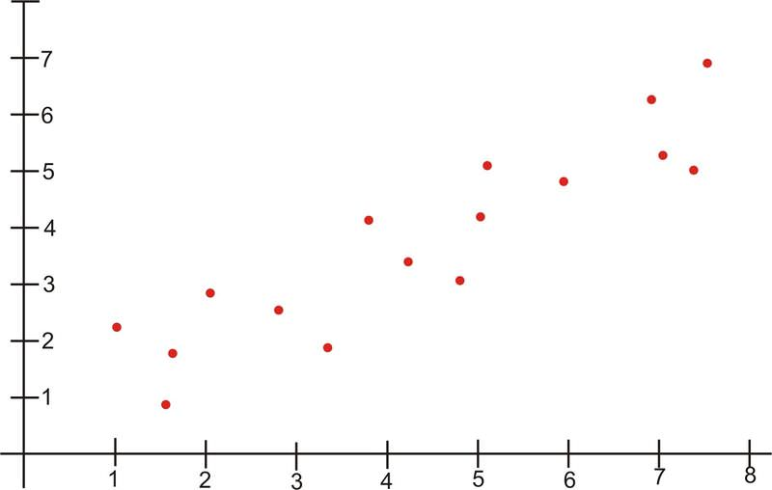
PCA – Principal Component Analysis
Principal component analysis (PCA)
Unsupervised technique
It does not use the information from the target vector, it only considers the feature matrix
Simplified, if your data contained only 2 features (x1 and x2) and was depicted on a scatterplot, there would be data points on either side of the bisecting axis (red line). The data points would be high in quantity for length but low in quantity for width resulting in an oblong shape (blue line). The variance of the length is significantly greater than the height.

Slide 5
PCA continued…
In PCA, we refer to these (length and width) as directions. The greater one is called first principal component, the lesser one is called second principal component.
One strategy to reduce features might be to eliminate the second principal component (effectively going from 2D to 1D), totally ignoring the second set of data…and in some situations, this is acceptable because it’s a smaller set.
PCA as it is implemented in scikit-learn retains 95%-99% of the original features.
Sample code for 9.4 is available in the Weekly Resources Data Files

Slide 6
Chapter 10 – Dimensionality Reduction Using Feature Selection
Chapter 9 discussed ways to reduce dimensionality using Feature Extraction
Chapter 10 discusses ways to reduce dimensionality using Feature Selection

Slide 7
10.1 – Thresholding Numerical Feature Variance
Variance Thresholding (VT): With this method, you will be removing the numerical features with low variance
The assumption is that those with low variance contain little useful information
Considerations:
The feature sets must contain the same units (one cannot be years while the other is dollars…they both must be the same)
The VT is selected manually so you must use your own judgment for a good value to select (in example 10.1, the threshold value is .5 – run this sample code and see the results…then change the threshold value so you can see the different results!)
Sample code for 10.1 is available in the Weekly Resources Data Files

Slide 8
10.2 Thresholding Binary Feature Variance
For this method of Feature Selection, you have a set of binary categorical features and want to remove those with low variance.
Select as subset of features with the Bernoulli random variable variance above a given threshold.
Var (x)= p (1-p)
P = proportion of observations of class 1: remove features where the vast majority of observations are one class
In the sample code, the percentage (p) is .75….try changing this variable until you see (and understand) what the code is doing!
For example, if most of the data for Marital Status was “Married” with only a few observations with a different Marital Status, you could probably eliminate this variable because there is not enough variance to make a significant difference on the overall prediction.
Sample code for 10.2 is available in the Weekly Resources Data Files

