Slide 1
Service Management Monthly Report
Result as of May 2026
4 June 2026
NMT-IS RQM, SMO

Slide 2
Agenda
Monthly Incident Report
SLA Monthly Monitoring Report
Monthly Resource Status Report

Slide 3
Monthly Incident Report

Slide 4
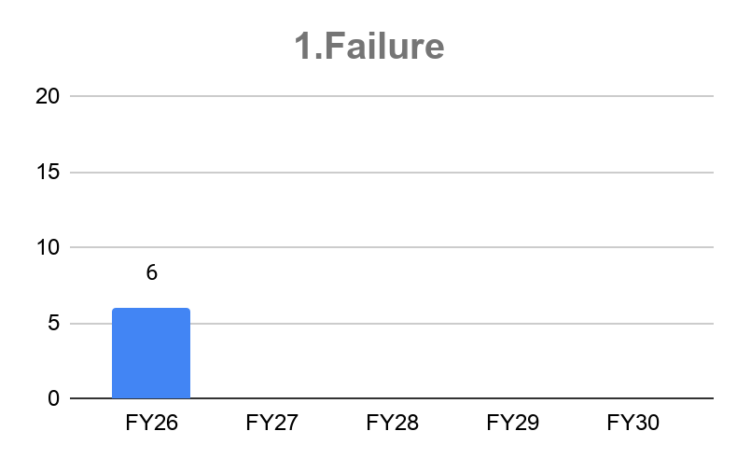
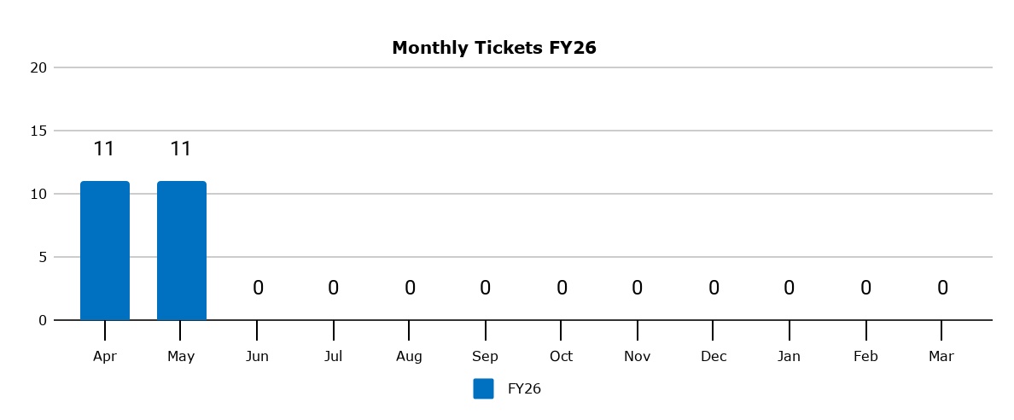
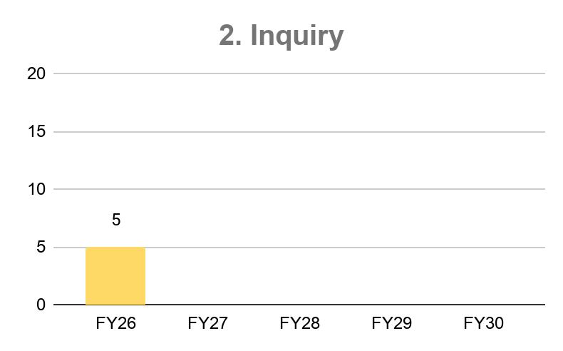
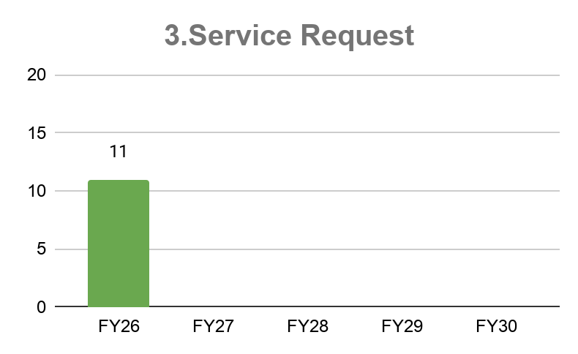
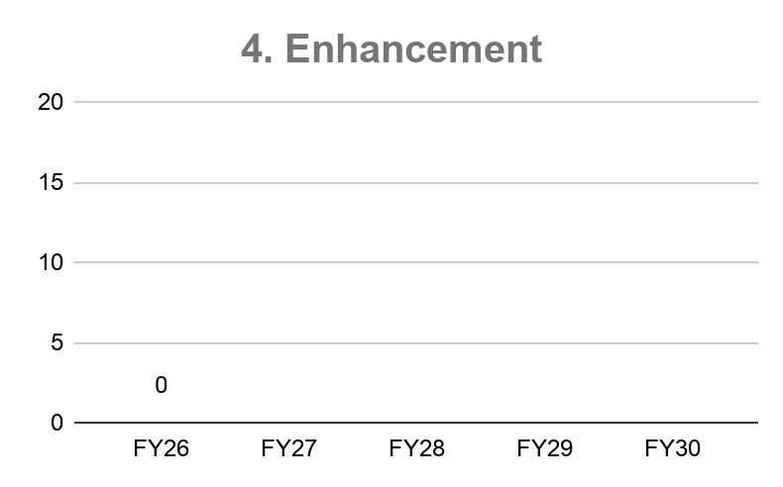
Executive Summary:
FY26
- Muze started MA for MyNissan Application on 3 Apr 2026

Slide 5
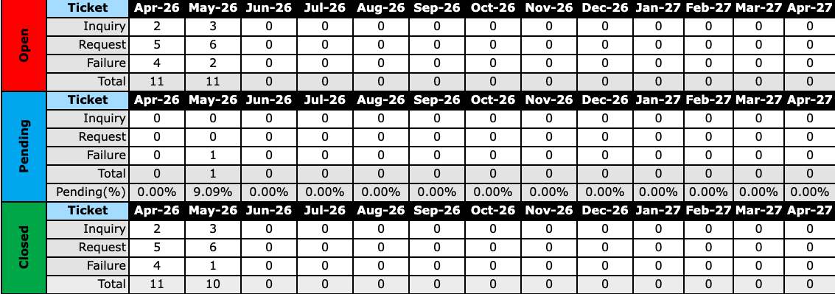
Overall Ticket Activity

Slide 6
Incident summary (1-31 May)
Total incident = 11 incidents
Category | Last month | This month
 | Carry over (A) | Started (B) | Closed/Cancelled (C) | On process(D=A+B-C)
1. Incident Summary Failure Inquiry Service request | 0 0 0 | 2 3 6 | 2 3 6 | 0 0 0
2. Problem MGMT | 0 | 0 | 0 | 0
3. Enhancement (Change request) | 0 | 0 | 0 | 0
4. Change/Release MGM | 0 | 0 | 0 | 0
# | Module | No. of incident
1 | All Module | 11
Failure (2/2)
Application Problem (1/2)
Service Request (6/6)
Operation (6/6)
Inquiry (3/3)
Application (1/1)
Specification Inquiry (1/1)
Operation inquiry (1/1)

Slide 7
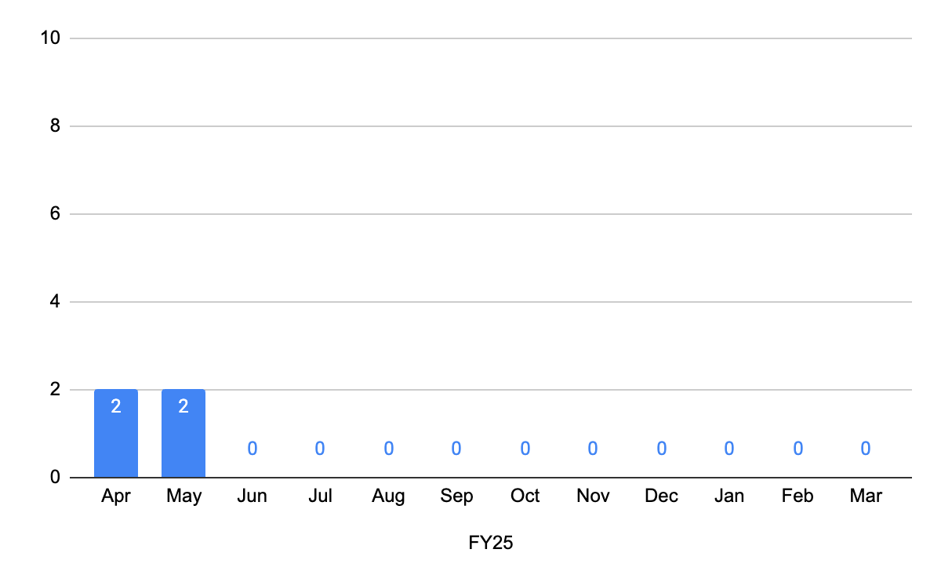
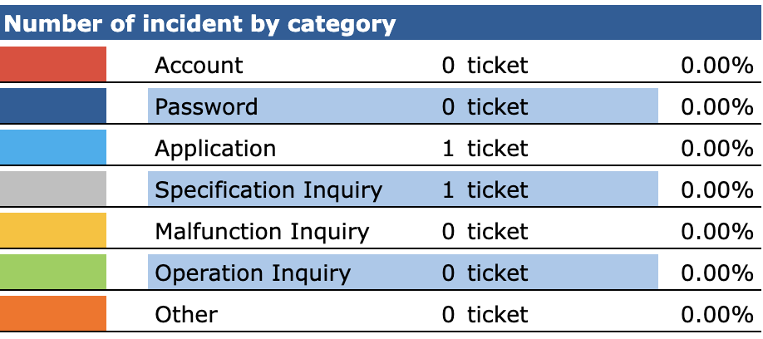
Event summary – Inquiry
FY25 | Apr | May | Jun | Jul | Aug | Sep | Oct | Nov | Dec | Jan | Feb | Mar
 | 2 | 2 | 0 | 0 | 0 | 0 | 0 | 0 | 0 | 0 | 0 | 0

Slide 8
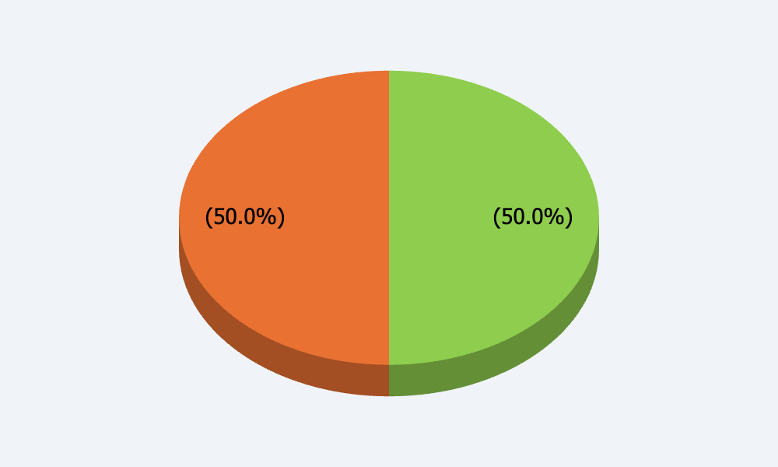
Event summary – Top 5 Inquiry
Operation inquiry
1 | Application | 1
Operation inquiry
1 | Specification Inquiry | 1

Slide 9
Inquiry
No | Open date | App | Short description | Route Cause | Countermeasure | Current Status/CM | Plan Date
 |  |  |  |  |  |  | Actual Date
Carry over incident from last month (Closed)
- | - | - | - | - | - | - | -
 |  |  |  |  |  |  | -
No | Open date | App | Short description | Route Cause | Countermeasure | Current Status/CM | Plan Date
 |  |  |  |  |  |  | Actual Date
Carry over incident to next month (Opened)
- | - | - | - | - | - | - | -
 |  |  |  |  |  |  | -

Slide 10
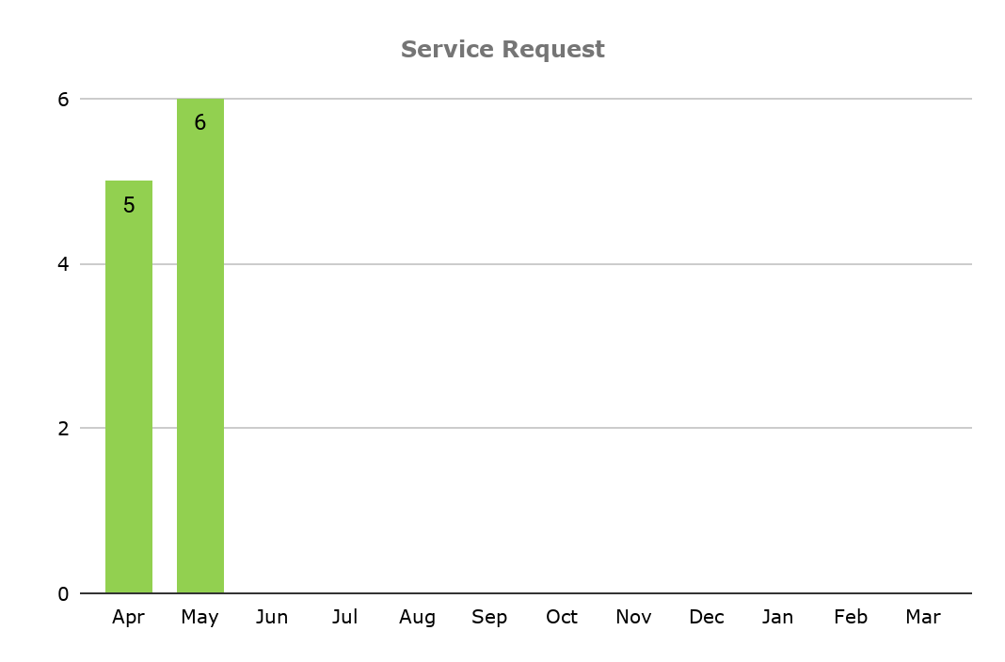
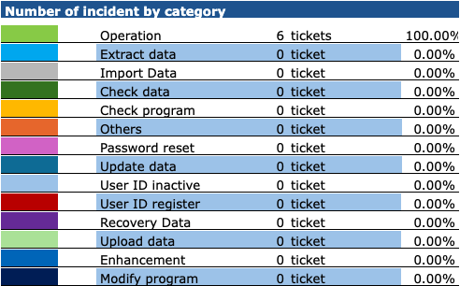
Event summary – Service Request
FY25 | Apr | May | Jun | July | Aug | Sep | Oct | Nov | Dec | Jan | Feb | Mar
 | 5 | 6 | 0 | 0 | 0 | 0 | 0 | 0 | 0 | 0 | 0 | 0

Slide 11
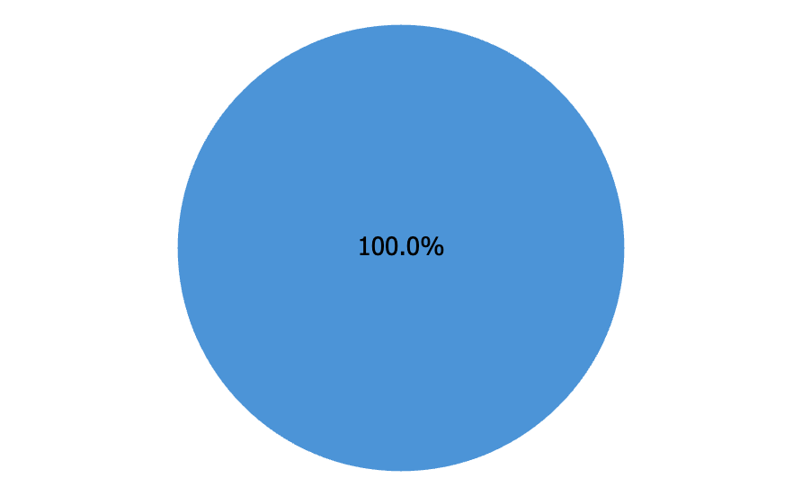
Event summary – Top 5 Service Request
Operation
1 | Request setup interest in CMS | 1
2 | Request Update Brochure for Nissan Kicks | 1
3 | Request setup campaign | 1
4 | Request edit License Plate | 1
5 | Request update Dealer Service | 1

Slide 12
Service Request
No | Open date | App | Short description | Route Cause | Countermeasure | Current Status/CM | Plan Date
 |  |  |  |  |  |  | Actual Date
Carry over incident from last month (Closed)
- | - | - | - | - | - | - | -
 |  |  |  |  |  |  | -
No | Open date | App | Short description | Route Cause | Countermeasure | Current Status/CM | Plan Date
 |  |  |  |  |  |  | Actual Date
Carry over incident to next month (Opened)
- | - | - | - | - | - | - | -
 |  |  |  |  |  |  | -

Slide 13
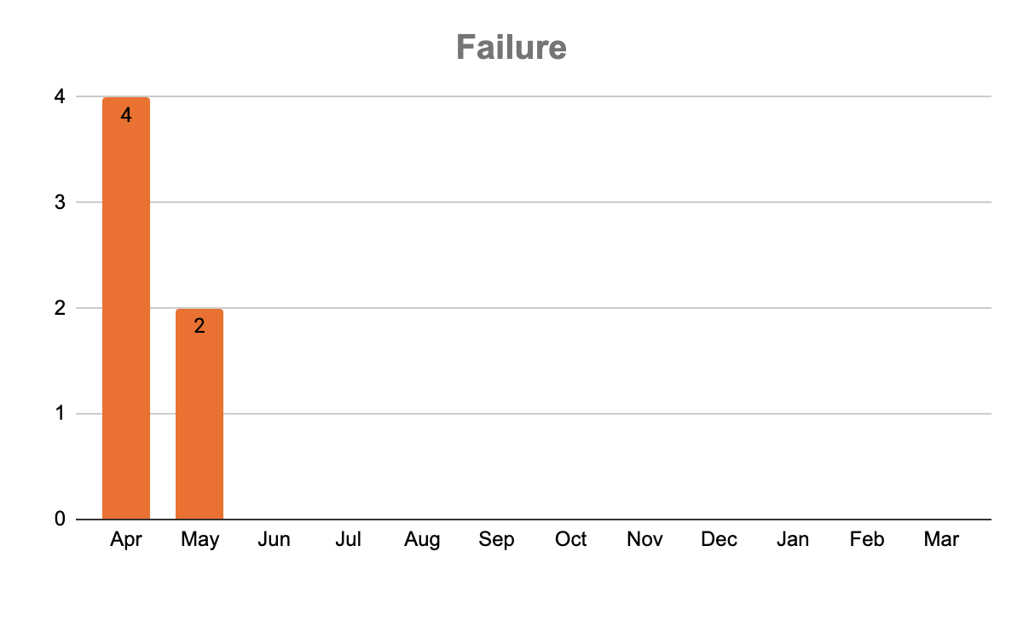
Event summary – Failure
FY25 | Apr | May | Jun | Jul | Aug | Sep | Oct | Nov | Dec | Jan | Feb | Mar
 | 4 | 2

Slide 14
Failure detail
There is no failure in this month
Impact level | Sub Category | Problem Title | Cause | C/M | Open date | Status | Close date
4 | Application Problem | Error screen when user selected Promotion type not equal Special Interest Rate | Incorrect Coding Logic | Temporary Solution Setup default Special Interest to Avoid the Error Permanent Solution Modify Coding | 13/May/26 11:56 AM | Opened
4 | Application Problem | The vehicle maintenance history is not being displayed on the MyNissan App. | Under investigation | Request more information from the customer for the phone number which links to the MyNissan App | 27/May/26 12:18 PM | Opened

Slide 15
Change request - Enhancement
There is no CR in this month
No | # | Change request | Module | Request by | Start | Deploy Plan | Status

Slide 16
Problem management
There is no problem to operate on this period
No | Problem ID | App | Short description | Route Cause | Plan Date Route Cause | Permanent Countermeasure | Plan Date Permanent Countermeasure | Remark

Slide 17
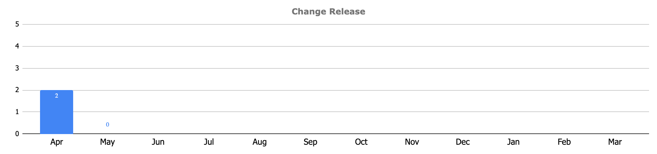
Change Release Management
There is no Change Release in This Month
FY26 | Carry over (A) | Received (B) | Closed/Cancelled (C) | Opened (D=A+B-C)
 | 0 | 0 | 0 | 0

Slide 18
Privilege User Permission
Application privileged-level access(Application Scope)
NO | Access | USERNAME | FULL_NAME | ROLE_NAME | ACTIVE_STATUS | LAST_LOGIN
1 | CMS | admin2@nissan.co.th | Noppasit Kingsaignam | Administrator | Active | 2026-05-07 17:17:51
2 | CMS | admin@nissan.co.th | Waraporn Supapa | Administrator | Active | 2026-05-07 17:17:51
3 | Database QA | muze-mynissan-ma@nissan.co.th | Shinnakrit Jirasopon | Administrator | Active | 2026-04-09 10:11:21
4 | Database Prod | muze-mynissan-ma@nissan.co.th | Shinnakrit Jirasopon | Administrator | Active | 2026-04-09 15:12:59
5 | Github | shinnakrit.j@muze.co.th | Shinnakrit Jirasopon | Administrator | Active | 2026-04-09 10:11:21
6 | AWS | shinnakrit.j@muze.co.th | Shinnakrit Jirasopon | Administrator | Active | 2026-04-09 10:11:21
7 | Firebase | shinnakrit.j@muze.co.th | Shinnakrit Jirasopon | Administrator | Active | 2026-04-09 10:11:21
8 | Google Play Console | shinnakrit.j@muze.co.th | Shinnakrit Jirasopon | Administrator | Active | 2026-04-09 10:11:21
9 | Apple Console | shinnakrit.j@muze.co.th | Shinnakrit Jirasopon | Administrator | Active | 2026-04-09 10:11:21

Slide 19
Monthly SLA Monitoring Report

Slide 20
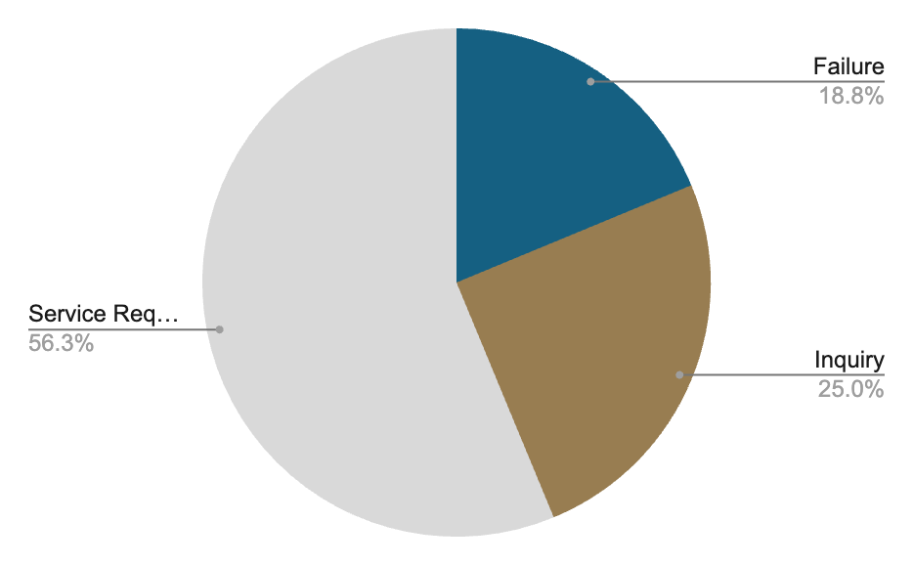
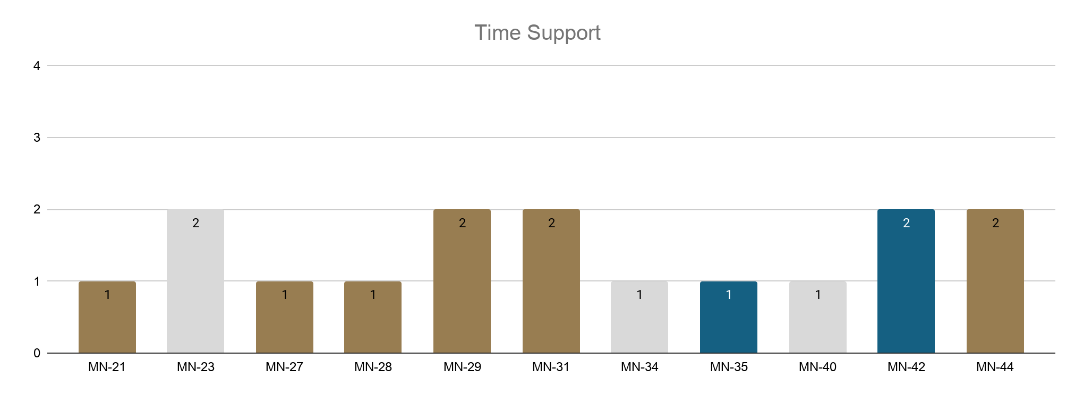
SLA Analysis for April 2026
Service Level Agreement (SLA)
Failure recovery time
L1: Within 4 hrs.
L2: Within 6 hrs.
L3: Within 8 hrs.
Inquiry support time 2 working day.
Service request support 3 working day.

Slide 21
Monthly Resource Status Report

Slide 22
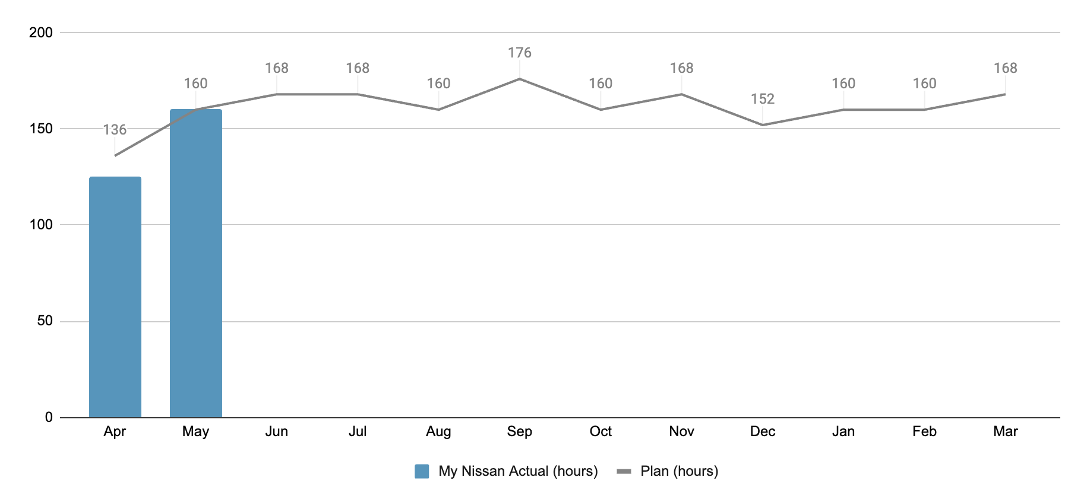
AMO Summary man-hour for FY26 (As of May 2026)
Module | No# of Man-Days during APR, 2026 – MAR, 2027
 | MD Plan / Month | APR’26 | MAY’26 | JUN’26 | JUL’26 | AUG’26 | SEP’26 | OCT’26 | NOV’26 | DEC’26 | JAN’27 | FEB’27 | MAR’27 | Total
 |  |  |  |  |  |  |  |  |  |  |  |  |  | Plan | Actual
MyNissan
Working day | 20 | 17 | 20 | 21 | 21 | 20 | 22 | 20 | 21 | 19 | 20 | 19 | 23 | 240 | 243
MyNissan Support Team | 20 | 15.62 | 19.75 |  |  |  |  |  |  |  |  |  |  | 240 | 35.64

Slide 23
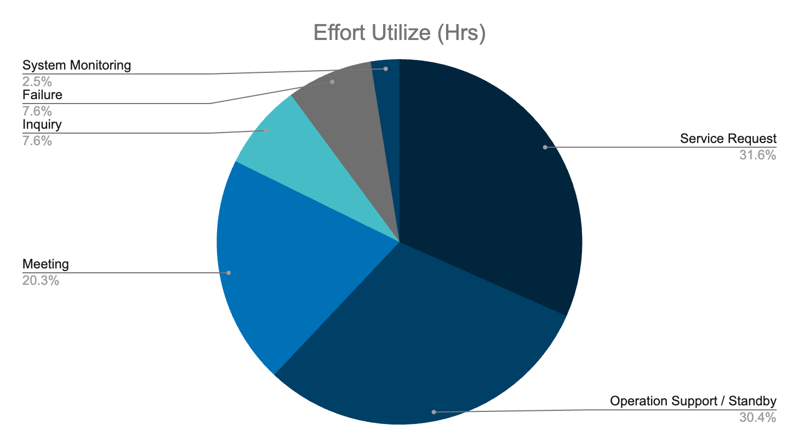
Working Day(s) | 20
Working Hour(s) (20*8) | 160
Utilize Hour(s) | MyNissan 158 (98.75%) of Total 160
Category | Rank | Effort Utilize (Hrs)
Service Request | 1 | 50
Operation Support / Standby | 2 | 48
Meeting | 3 | 32
Inquiry | 4 | 12
Failure | 5 | 12
System Monitoring | 6 | 4
Leaves | 7 | 0
Enhancement | 8 | 0
Change Request | 9 | 0

Slide 24
Thank you

