Slide 1
TECHNICAL ARCHITECTURE · v7
WS-Sale-App Technical Architecture
1
2
3
4
C4
DATA
FLOW
OPS
Context
Topology
Contracts
Run
C4 · Data Topology · Integration Contracts · Security · Operations
Technical Architecture · v7

Slide 2
01 · ARCHITECTURAL INTENT
ทำระบบใหม่โดยไม่รื้อระบบบัญชีเดิม
WS-Sale-App เป็น operational layer บน WINSpeed ไม่ใช่ ERP replacement
Design driver
Main constraint
Integration style
ลด manual handoff และสร้าง traceability ระหว่าง Sales–Warehouse–Accounting
WINSpeed เป็นระบบบัญชีหลัก
ห้ามเขียน GL/Invoice โดยตรง
JOIN/read + controlled write
+ import/evidence sync
i
Core principle: non-invasive, evidence-first, audit-friendly, phaseable.

Slide 3
02 · C4 CONTEXT
ใครใช้ระบบและระบบภายนอกที่เกี่ยวข้อง
Context focuses on users, WINSpeed and TruckScale
Sales / Counter
Accounting / Approver
user role
user role
WS-Sale-App
Operational workflow layer
Warehouse / Weighbridge
Admin / IT
user role
user role
WINSpeed
TruckScale
system of record
weight evidence
i
System context: users collaborate in App; accounting records stay in WINSpeed; weight evidence comes from TruckScale.

Slide 4
03 · CONTAINER VIEW
React frontend, Express backend, SQL Server and MySQL pools
The backend is the control point for RBAC, audit, database boundary and integration logic
React Frontend
Express API
Vercel · Tablet-first UI
Railway · JWT · Socket.IO
SQL Server dbo
SQL Server wf
MySQL TruckScale
WINSpeed read/controlled write
App schema read-write
read-only weight records
i
Add planned hardening: centralized logs, CI/CD checks, secret manager, migration tracking.

Slide 5
04 · DATA TOPOLOGY
3 data domains with clear ownership
Ownership and write authority are more important than physical database location
WINSpeed dbo
wf schema
TruckScale MySQL
Master, SO/Invoice/CN/GL, vouchers. Read mostly;
controlled exception writes.
SO state, audit, rebate, paper trail, giveaway, control ticket, weigh ticket.
tblscale, tbl_keyone, tblproduct_detail, movebill and weight records.
Read-only.
Master read
Operational write
Controlled write
Evidence read
Financial post
dbo views
wf tables
SOHD/SODT/prices
TruckScale
WINSpeed
i
Data rule: if it affects accounting, WINSpeed must remain source of financial truth.

Slide 6
05 · SALES ORDER STATE MACHINE
สถานะของ SO ควบคุมทั้ง UI, data writes, paper trail and rebate
ทุก transition ต้อง audit
DRAFT
VERIFIED
CONFIRMED
PICKING
SHIPPED
editable
counter checked
rebate accrual
warehouse
locked
Unlock path
Audit data
Invoice boundary
PICKING → Request → Approve → CONFIRMED + reverse ledger
actor, IP, timestamp, before/after JSON, approval result
Shipped triggers evidence sync/import; WINSpeed posts invoice/GL
i
State machine is the core control model; avoid direct DB updates outside API/state transition logic.

Slide 7
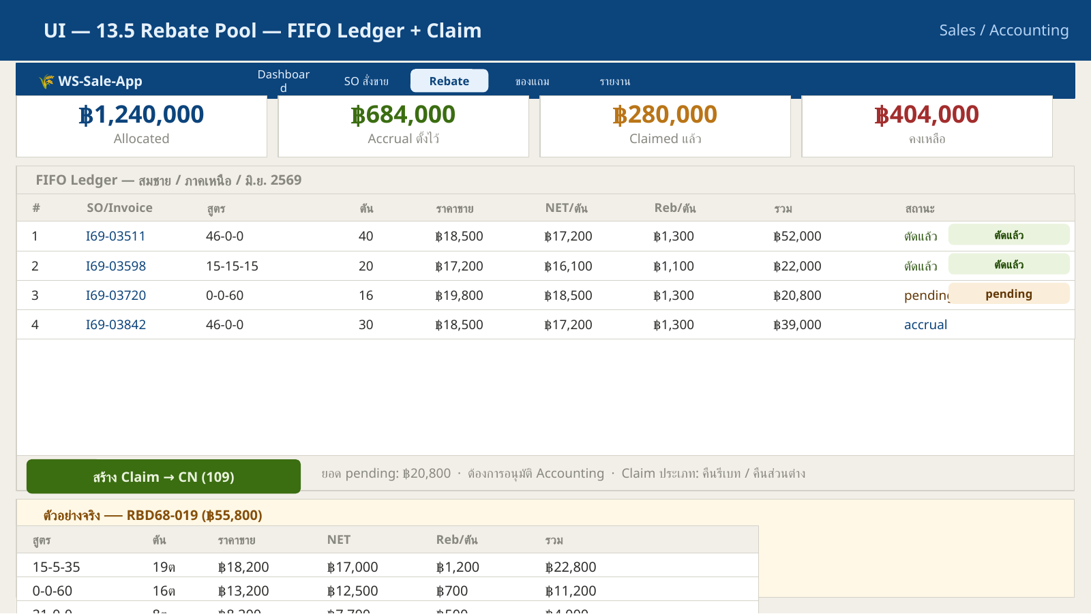
06 · REBATE FIFO ARCHITECTURE
Rebate is a ledger, not a simple discount field
The design turns a pooled manual process into traceable entries
Price Book
Plan
Pool
Ledger
Claim
CN
NET/month
policy
Sales allocation
accrual
FIFO cut
financial evidence
Ledger invariant
ทุกบาทต้อง link กลับ: Plan → Pool → SO Line → Ledger → Claim → CN. Unlock ต้อง reverse ไม่ลบรายการเดิม.
Rebate pool UI evidence

Slide 8
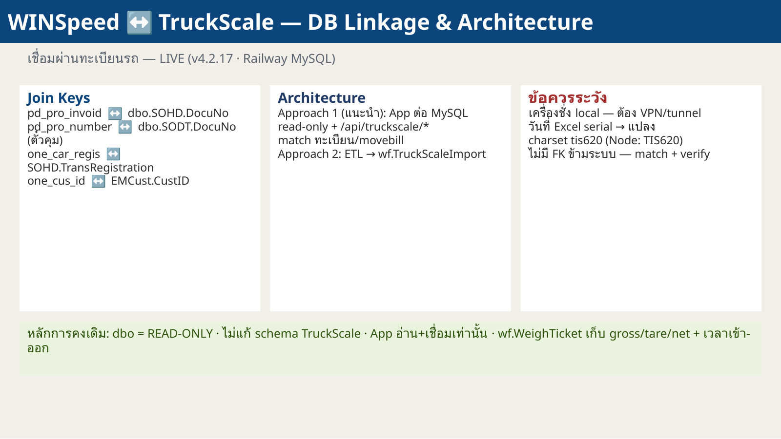
07 · TRUCKSCALE INTEGRATION
TruckScale provides weight evidence and product movement details
Phase current: read-only lookup with matching by truck plate / movebill
Core tables
tblscale (~403k), tbl_keyone (~408k),
tblproduct_detail (~550k)
Key fields
one_car_regis, movebill, weight_in/out/net,
date/time, product detail
Data quality
TruckScale architecture
Excel serial dates, charset mix, no FK,
duplicate/dirty truck plates
i
Recommended canonical matching: truck plate + recent date + movebill confirmation; do not trust invoice number alone.

Slide 9
08 · API AND PAGE CONTRACT
Every page should have known API, SQL source and migration ownership
This is what makes maintenance possible
Dashboard
Sales POS
Paper Trail
/so/stats · /master/aging
/master/* · POST /so
/papertrail/board · scan
Rebate
TruckScale
Admin/Master
/rebate/pools · claims
/truckscale/*
/auth/users · /master/prices
i
Maintain the Pages → API → SQL → Migration map as part of every release.

Slide 10
09 · SECURITY ARCHITECTURE
Security control must protect legacy integration and financial evidence
Minimum posture before Full Production
Authentication
Authorization
Secrets
JWT access + refresh, bcrypt,
token expiry, audit auth events
Role-based + backend enforcement
+ field/action constraints
No default secrets, no SA/root,
env vars only, rotation log
Network
Audit
Data protection
HTTPS, CORS restricted, rate limit, helmet headers
Append-only, 7-year retention, before/after JSON
PDPA, least privilege, backup encryption, sensitive field policy
i
Security is currently the primary P0 gate before unrestricted production.

Slide 11
10 · DEPLOYMENT ARCHITECTURE
Deployable on cloud or on-prem with the same operational principles
Vercel/Railway is current; Docker Compose supports on-prem packaging
Git
Build
Migrate
Deploy
Smoke
Monitor
source
frontend/backend
SQL
Vercel/Railway
health/login/SO
logs/alerts
Cloud path
On-prem path
Release control
Vercel frontend + Railway backend
+ SQL/TruckScale connectivity
Docker Compose frontend/backend
+ direct LAN/VPN database access
version, changelog, rollback,
health check and evidence
i
VITE_API_BASE_URL is baked at frontend build time; changing API URL requires rebuild.

Slide 12
11 · OBSERVABILITY AND DR
Production architecture is incomplete without operations architecture
Monitoring and backup are part of the system, not optional add-ons
99.5%
<4h
<1h
7y
Availability target
RTO
RPO
Audit retention
business hours
restore service
restore data
immutability
Observability backlog
DR evidence
centralized logs, alerting, uptime checks,
error tracing, DB latency dashboard
backup schedule, restore drill, runbook,
owner and recovery report
i
A system is not production grade until restore and incident response have been tested.

Slide 13
12 · PERFORMANCE ENGINEERING
Legacy SQL requires deliberate query design
Avoid correlated subqueries and OR conditions that force scans
Problem pattern
Fix pattern
Target
Correlated subquery per SO row + OR condition on large tables
Pre-aggregate, JOIN once, split OR with UNION, add indexes
API P95 <1s, reports <3s, master lookup <500ms
Scan-heavy query
Index + rewrite
Cache / top limit
Measure
6 minutes
<5 seconds
UI stable
P95 + logs
i
Keep SQL performance decisions documented; future developers must know why queries look structured this way.

Slide 14
13 · OPEN ARCHITECTURE DECISIONS
ข้อที่ต้องตัดสินใจเพื่อขยายจาก Pilot เป็น Product
ไม่ใช่ blocker ทุกข้อ แต่ควรมี owner
LINE intake
Credit master
TruckScale source
Phase 2: webhook/LIFF
หรือยังคงใช้ web-first
สร้าง wf Credit Master หรือ
ยกเลิก Credit Hold
Railway MySQL vs local tunnel/VPN
vs ETL to SQL Server
CI/CD maturity
Monitoring stack
Commercial packaging
เพิ่ม automated tests, lint, build gate, migration check
เลือก Sentry/Logtail/Grafana/
Prometheus ตามงบ
Pilot / Production Core / Enterprise Assurance tiers
i
Architecture should remain phaseable: solve operational pain now, expand governance and automation as adoption grows.

Slide 15
ARCHITECTURE SUMMARY
Non-invasive operational layer
that makes sales execution traceable
Core invariant
No direct GL write from App
Keep WINSpeed as financial system of record
· Add wf as operational evidence layer
· Read TruckScale for weight truth
Core evidence
Every transition has audit
Core gate
P0 before Full Production
World Fert · WS-Sale-App

