Slide 1
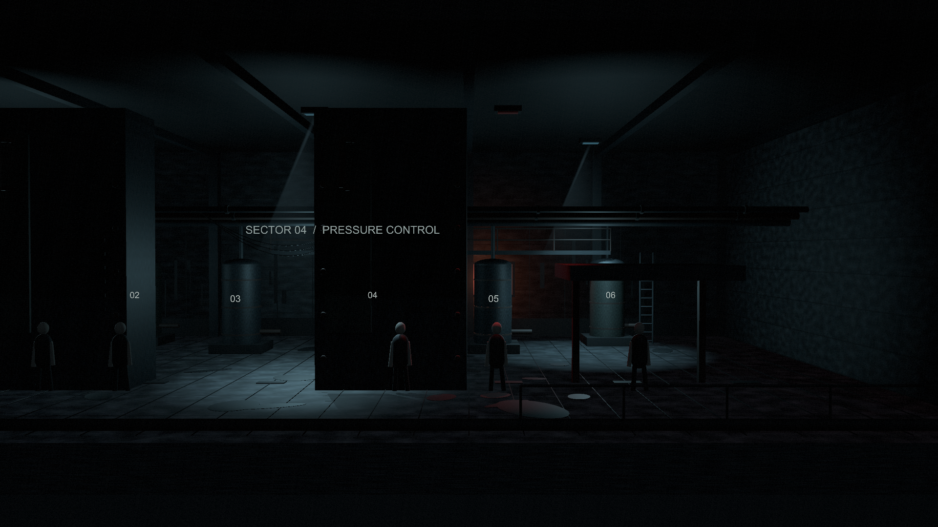
RECOIL
GSMD music and sound collaboration
A detective searching for someone uses a plastic water gun to fly and survive a forgotten industrial town overrun by Rampagers.
Origin in a dream
RECOIL began with a dream of staying airborne with a water gun. Outdoors, open space and flight offer room to breathe. Fear grows in cramped interiors, where flight can no longer guarantee the detective’s safety.
Story outline
Dun searches a strangely familiar town, rescues a lost boy from a factory and escorts him home. There, he discovers that the boy’s parents have died. The boy vanishes, and the house appears to be Dun’s own.
3D art study: factory machinery
Dreams and redemption
Current development:
2D gameplay in Unity.
Planned presentation: 2.5D,
with 3D depth and lighting.
Inspired by dreams, RECOIL explores childhood neglect: anger and fear left unexpressed recede into the unconscious, while the longing for safety and intimacy becomes a pursuit within the dream. Though the story is dark, it is ultimately about redemption.
Xiuyu Zhang
thirdadvan@gmail.com
Notes:
Sources: E2 Game Project Recoil Proposal.pdf, sections 1.2 and Narrative, and the author’s revised thematic direction supplied 12 October 2026. The first paragraph describes outdoor flight as respite and cramped interiors as a source of fear, where flight cannot ensure safety. The third paragraph presents the author’s intended fictional exploration of childhood neglect, unexpressed anger and fear, unconscious repression, and the dream pursuit of safety and intimacy. This is a creative theme, not a clinical claim. The dark narrative is framed as a story of redemption. The outline retains the boy, the parents’ deaths and the disappearance, without specifying a manner of death or presenting death as the route to redemption. This is the proposed story, not a claim of full implementation. Screenshot: actual Unity capture from Assets/Scenes/RecoilFactoryArt3D.unity. Current gameplay is 2D, with 2.5D presentation planned.

Slide 2
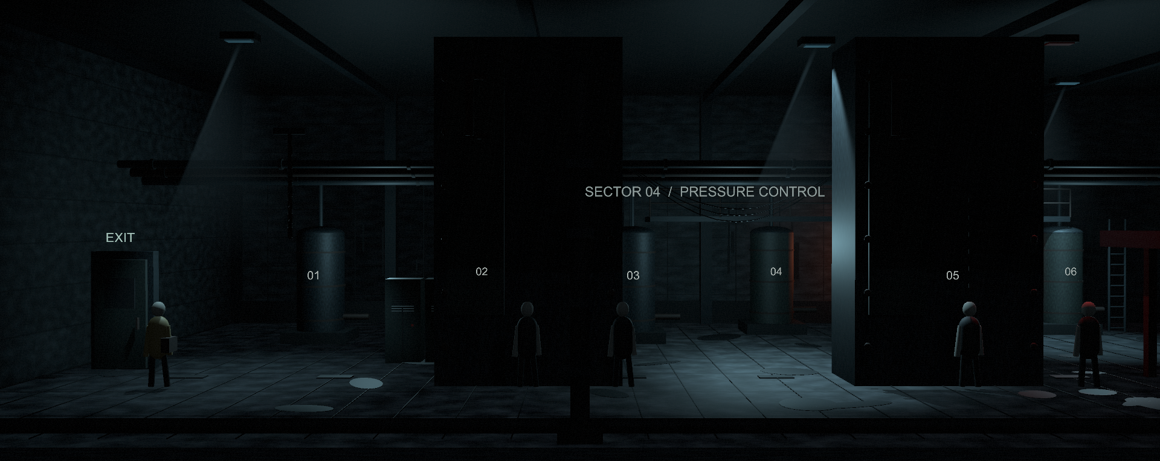
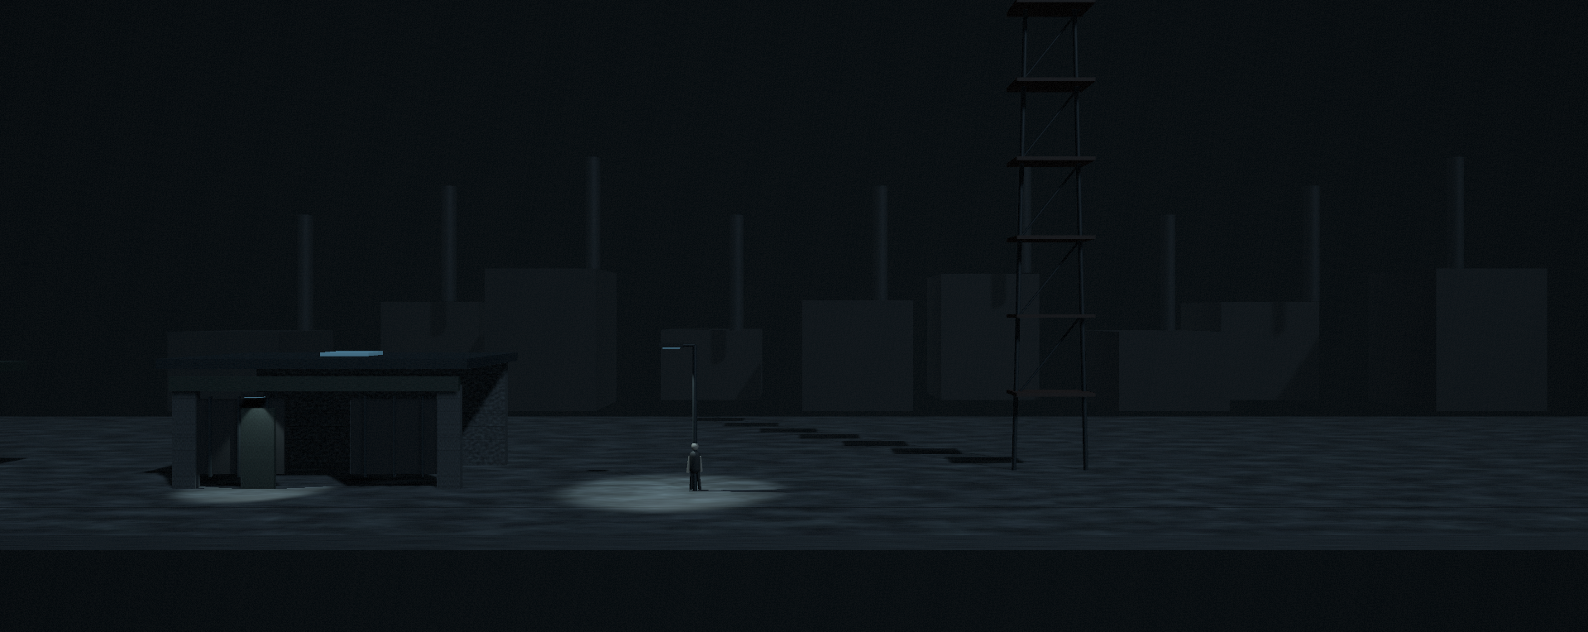
Music & sound
The mood
Dream-like familiarity and persistent unease, shaped by suppressed fear and longing. Beneath the darkness, the story moves towards redemption.
Listening references
The Empty Man
Christopher Young & Lustmord
Annihilation
Ben Salisbury & Geoff Barrow
3D art study: factory interior
INSIDE
Music and sound by Playdead’s audio team
Collaboration request
Music and sound that sustain unease and the fragile feeling of control, responding to exploration and pursuit. Sound also drives play: footsteps and flight can wake enemies. Broadcast pulses guide their movement. These cues must remain readable within the atmosphere.
3D art study: outdoor approach and alarm tower
Notes:
Music references only: The Empty Man (Christopher Young and Lustmord), https://music.apple.com/us/album/the-empty-man-original-motion-picture-soundtrack/1535564814 ; Annihilation (Ben Salisbury and Geoff Barrow), https://salisburybarrow.bandcamp.com/track/annihilation ; INSIDE, composer/audio director source https://martinstigandersen.com/inside-2/ and official artist sample https://soundcloud.com/martin-stig-andersen/shockwave-martin-stig-andersen . Reference titles on the slide are clickable listening/context links. Mood wording describes the author’s intended game experience, rather than asserting facts about these scores. No additional musical references, scene-specific commission or fixed track counts have been added. The request addresses the overall psychological mood and player experience. Sound mechanics reflect current code: water-gun shots themselves do not emit player sound waves; sustained recoil flight does, as do footsteps and landings exceeding one body height. Sleeping Rampagers take one second to wake, then inspect the latest sound source. Environmental broadcasts announce the phase in red, then directional pulses govern movement and waiting. Source code: PlayerNoiseEmitter.cs, RampagerController.cs, SoundWaveManager.cs. These gameplay cues need to be distinguishable from musical atmosphere. Indoor image: Unity camera capture from RecoilFactoryArt3D.unity, updated from saved RecoilFactoryInterior.unity, including the current ceiling height, moved maintenance platform, suspended chain and both large handhold machines. Outdoor image: Unity camera capture from RecoilOutdoorArt3D.unity. All images show editable 3D art studies, not final playable visuals. The project currently tests mechanics in 2D and plans 2.5D visual presentation.

