Slide 1
STUDENT RECORDS MANAGEMENT SYSTEM
USING DATA STRUCTURES IN C
BY K . THIRDHASRI – 24KB1A3043
T. VASUNDHARA – 24KB1A30C1

Slide 2
INTRODUCTION
This project is about student records management system
It manages adding , updating , searching , sorting and deleting student records

Slide 3
FEATURES
Add new student details.
Display all students.
Search ( linear & binary search).
Update student marks.
Delete a student details.
Sort student by marks/roll number.
Here ARRAYS , STRUCTURES and FUNCTIONS are used.

Slide 4
SETUP – HEADERS , CONSTANTS and STRUCTURE
Stdio.h: input and output operations.
String.h : for string handling
MAX : maximum number of students (100)
By using typedef keyword custom the data type ’student’
Fields : rollNo , name , marks.
Array to store students
Count of stored records

Slide 5
FUNCTIONS OVER VIEW
is duplicate()
Checks if a roll number already exists.
Helps maintain unique student records.
addstudent()
Validates roll number using is duplicate()
Uses scanf() to input name , roll number and marks.
Displays confirmation message upon successful addition.
Displaystudents()
Iterates through the array and displays:
Roll number
Name
Marks
Handles case when no records are present

Slide 6
*************
searchstudent()
Takes roll number as input
Searches sequentially through students[].
Displays student data if found.
Updatestudent()
Prompts for roll number
Asks or confirmation before updating.
Updates only marks field.
deletestudent()
Takes roll number as input.
Confirms before deletion.
Shifts elements to maintain array order.
Decreases count.

Slide 7
***
sortStudentsByMarks()
Sort student records by marks in descending order.
Uses Bubble Sort algorithm.
sortStudentsByRollNo()
Prepares array for binary search.
Maintains increasing roll number order.
binarySearchStudent()
Efficient search on sorted data.
Faster than linear search for large datasets.

Slide 8
********
Main Menu (main function)
Menu includes :
Add
Display
Search
Update
Delete
Sort
Binary search
Exit

Slide 9
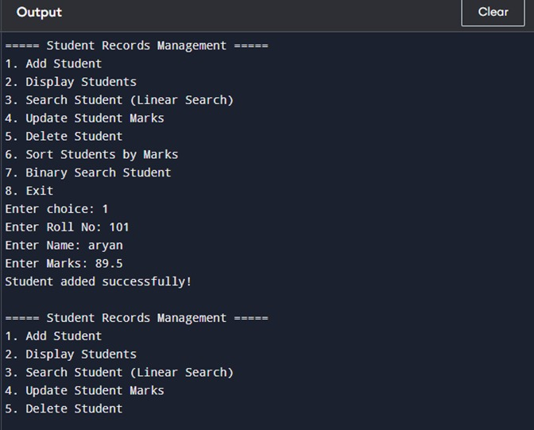
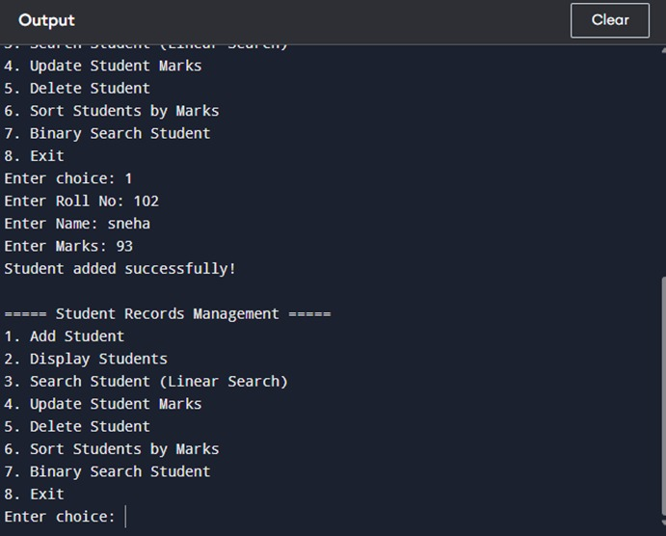
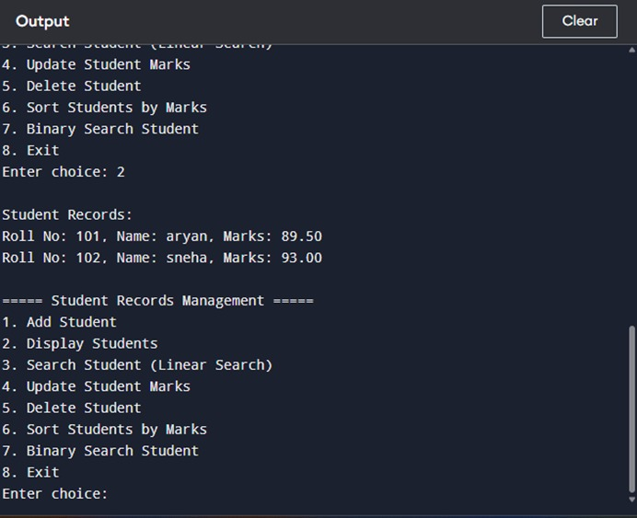
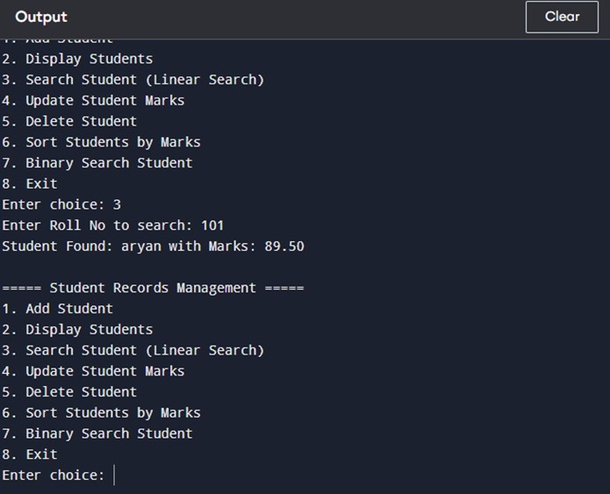

Slide 10
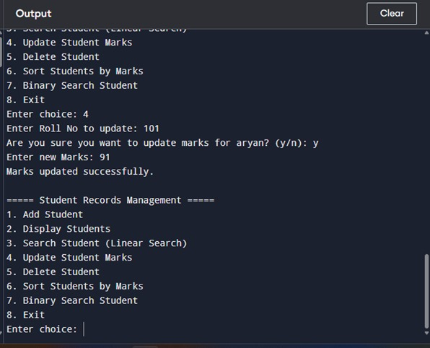
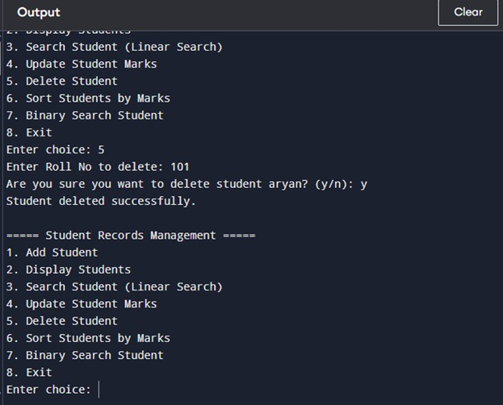
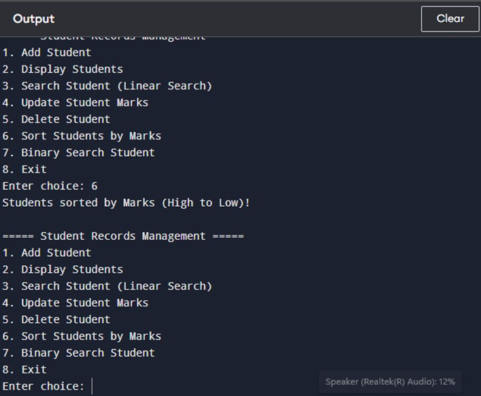
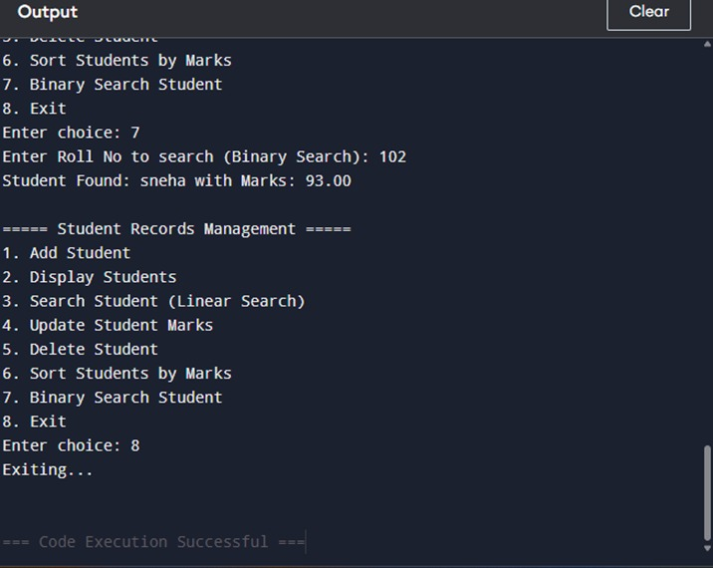

Slide 11
CONCLUSION
This project demonstrates a basic yet functional Student Records Management System using C.
It showcases the use of:
Structures for managing complex data.
Functions for modular and organized code.
Searching (Linear and Binary) and Sorting algorithms.
Ensures data integrity through checks like duplicate roll number validation.

Slide 12
FUTURE ENHANCEMENT
Provides a strong foundation for further enhancements like:
File handling for data persistence.

Slide 13


