Slide 1

INDUSTRIAL AUTOMATION WITH LINE FOLLOWER
INDUSTRIAL ROBOTICS - EMD51504

Slide 2
TEAM MEMBERS
1 | SHAIK SAMEER SALAHUDDIN | 22125004
2 | THIRISHA .R | 22125022
3 | SANDHIYA .R | 22125026
4 | HARMITHA .C.K | 22125027

Slide 4
HOW LINE FOLLOWER ROBOT WORKS?
The concept of the line follower robot is related to the transmitting and receiving of light. The white colour reflects all the light that falls on it whereas the black colour absorbs all the light.
In this line follower robot, we have used IR transmitters and receivers ( also known as photodiodes). When IR light falls on a white surface, it gets reflected back towards the IR receiver, generating some voltage changes that are analyzed by the When IR light falls on a black surface, it gets absorbed by the black surface, and no rays are reflected back thus, the IR receiver doesn’t receive any rays.
In this project, when the IR sensor senses a white surface, motor driver
gets HIGH as input, and when it senses a black line, an motor diver gets LOW as input. Based on these inputs, an motor driverprovides the proper output to control the line follower.

Slide 5


Slide 6
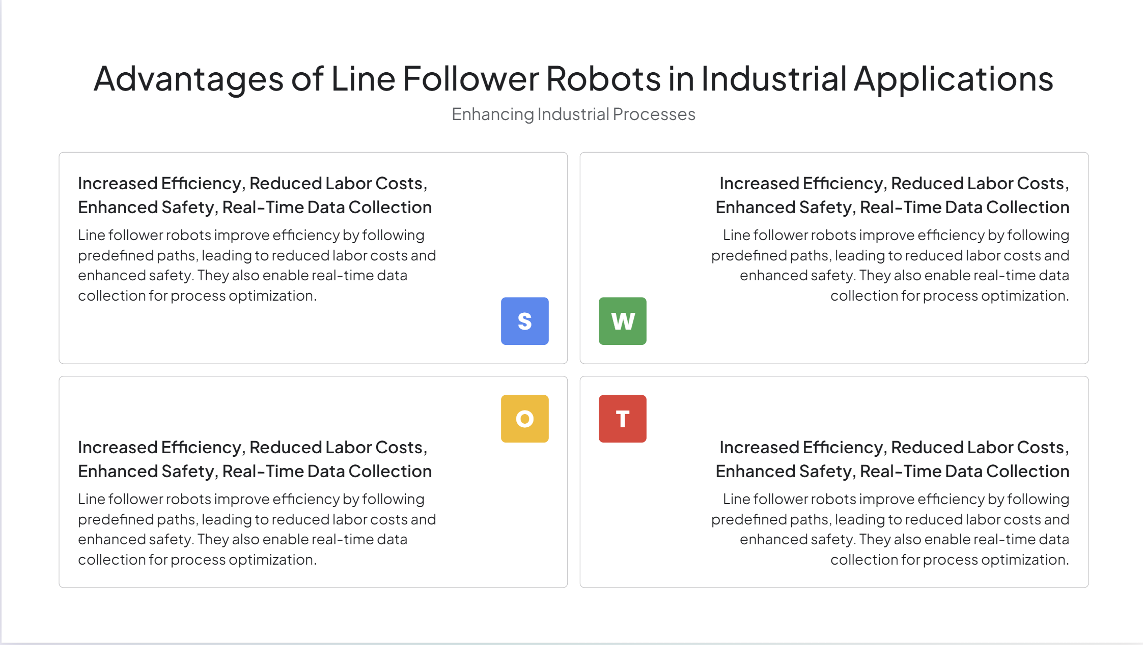

Slide 7
COMPONENTS USED :
L289N MOTOR DRIVER
2 MOTOR GEARS
2 IR SENSOR
JUMPERWIRES
BATTERY AND BATTERYHOLDER

Slide 8
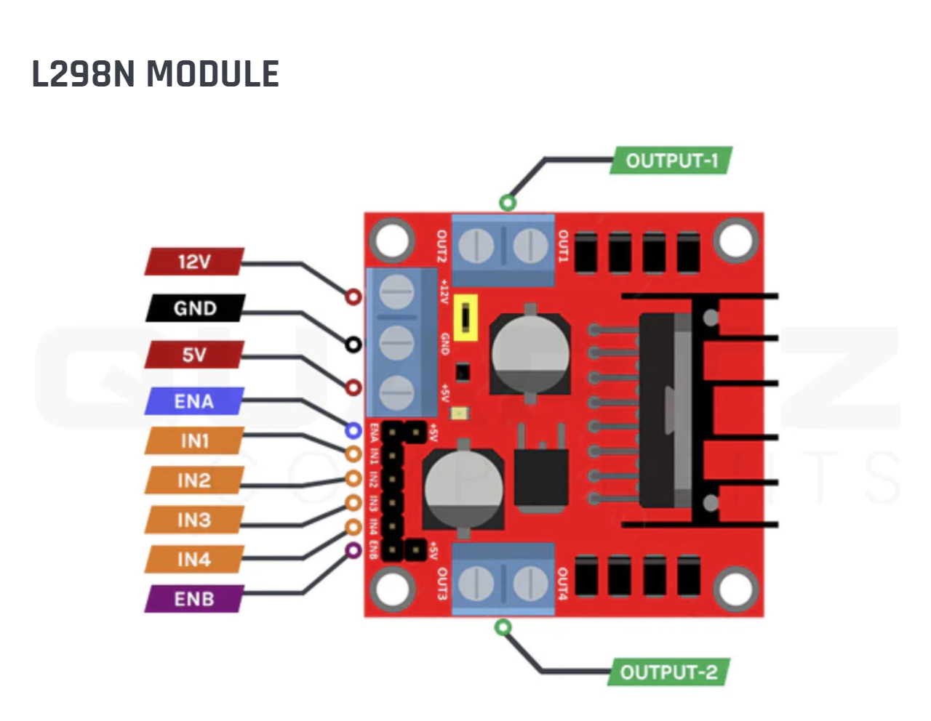
Motor controller | L298N, drives 2 DC motors
Operating Voltage | 5- 35V
Logic voltage | 4.5 – 7 V
Max current | 2A per channel
Voltage Regulator | 78M05
Module dimensions | 43 x 43 x 28 mm
Junction operating temperature | -25 to 130 º Celsius

Slide 9
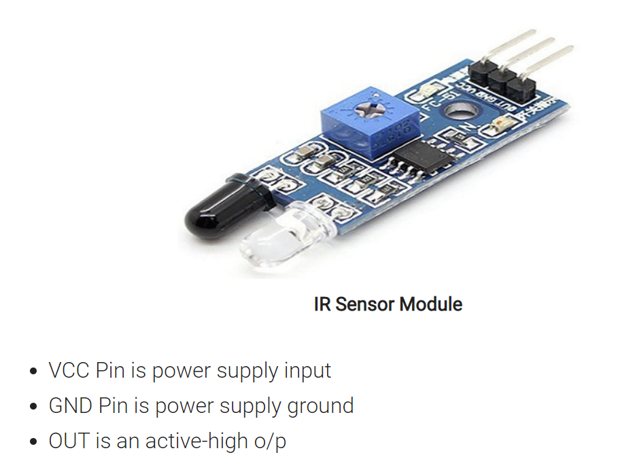
HOW IR SENSOR MODULE WORKS
When we connect the InfraRed sensor module to the 5v power supply. Infrared LED starts emitting infrared rays. These infrared rays reach to object’s surface and this radiation gets reflected back to the IR receiver. The Photodiode or IR receiver detects the infrared light and produces output accordingly.
IR sensor consists of an Infrared LED and a Photodiode. An IR LED is a special-purpose LED, that emits infrared rays ranging from 700 nm to 1 mm wavelength. Such types of rays are invisible to our eyes. In nutshell, a photodiode or IR Receiver LED detects infrared rays.

Slide 10
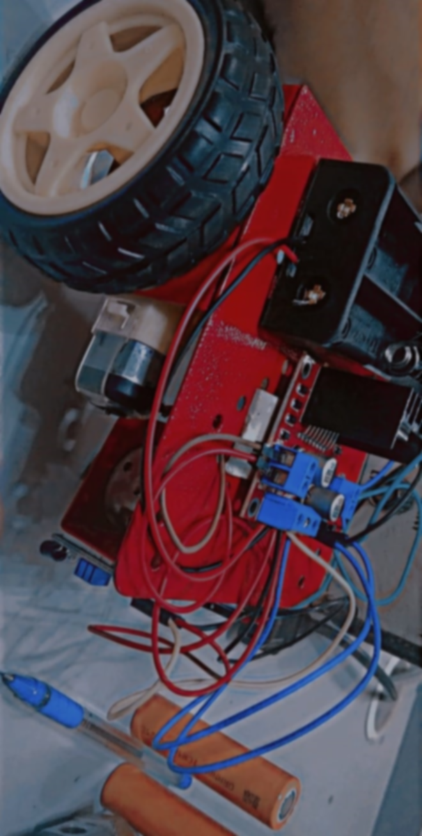
Circuit
diagram

Slide 11
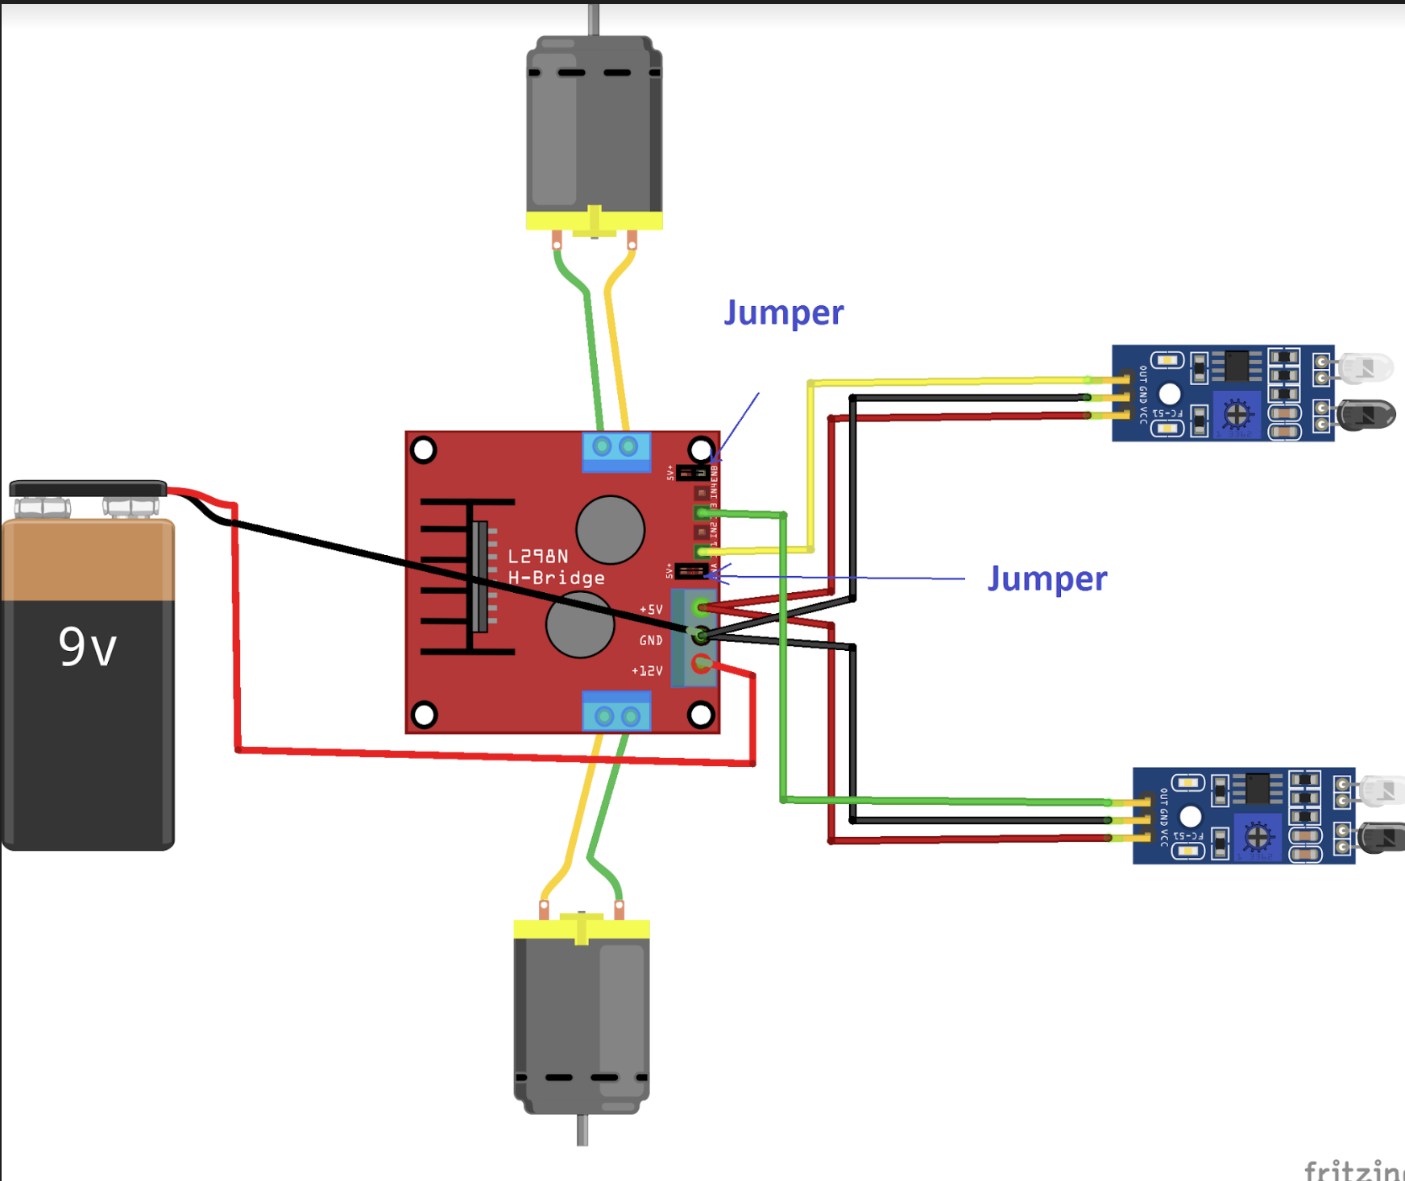

Slide 12
The spinning direction of the motor can be controlled by applying logic HIGH (5V) or logic LOW (Ground) to these inputs. The chart below shows various combinations and their outcomes.
Input1 | Input2 | Spinning Direction
Low(0) | Low(0) | Motor OFF
High(1) | Low(0) | Forward
Low(0) | High(1) | Backward
High(1) | High(1) | Motor OFF

Slide 13
USES OF LINE FOLLOWER ROBOT :
Line Follower robots although may seem simple but are one of the most practical and useful robots.
Line follower robots makes use of sensors and microcontrollers to operate.You can create different types of line followers based on the arrangement of sensors and the type of IR sensors depending on the percentage of accuracy or precision you need.
For general purpose you can write a basic alogrithm with the ir sensor/line array.
For industrial purpose you can develop/use a PID algorithm(PID).
Generally Line followers are being used in various industries
-Industrial application : The line followers can be used to carry/deliver packages in warehouses, airports,restaurants etc
-Automobile Indutries : The line follower can also be used in cars,taxis and buses to create an autonomous transport system
-Household application : It can be used for cleaning and transport of household items throughout the house
-Guidance : It can also be used as guidance for people at malls,amusement parks and also be of help to physically challenged people helping them go about their daily lives as normal people would.

Slide 14
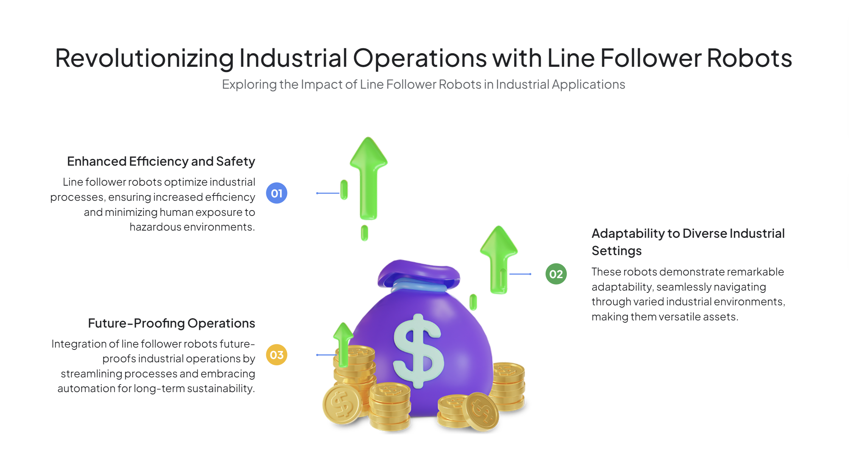

Slide 15
Harmitha c.k
SANDHIYA.R
Thirisha.r

