Slide 1
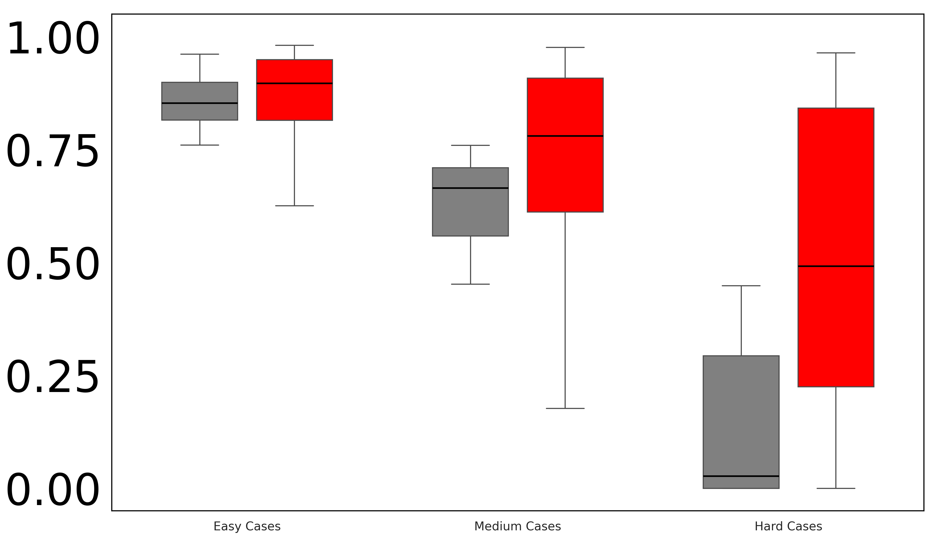
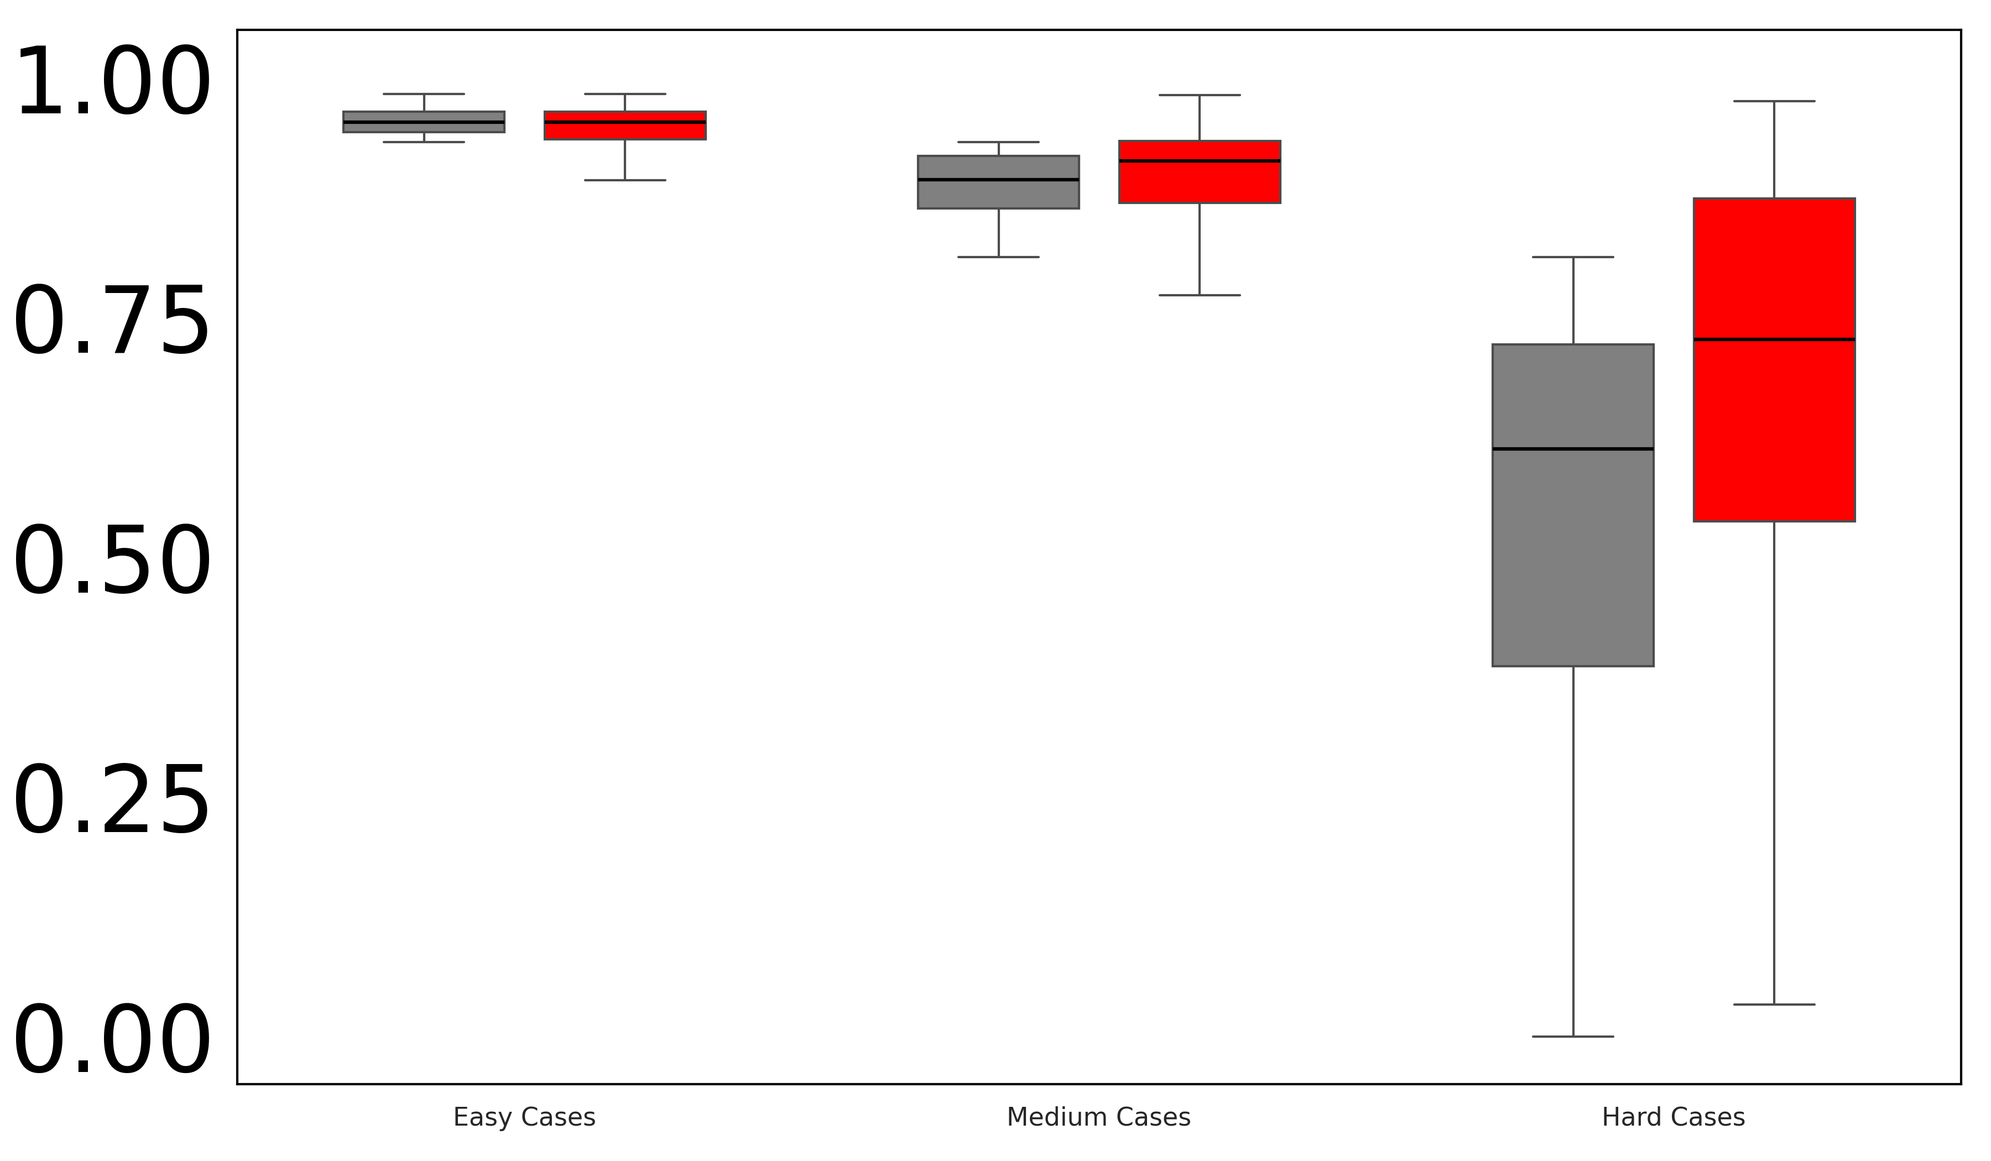
Adaptive PolyDice-1 Loss
Dice Loss
Dice Coefficient
Easy Cases
Medium Cases
Hard Cases
Easy Cases
Medium Cases
Hard Cases
CVC-ClinicDB
Kvasir-SEG

