Slide 1
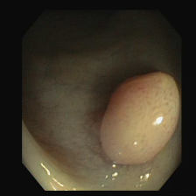


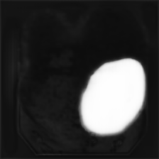
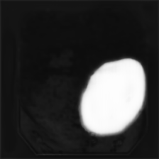
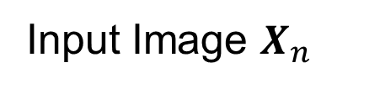

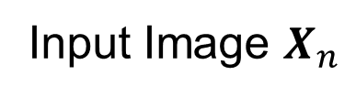
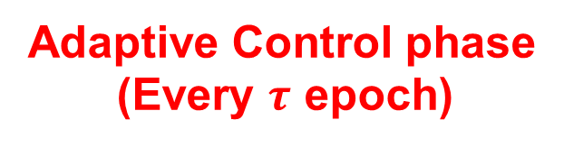
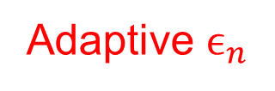
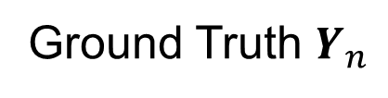
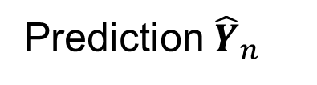

Training phase
(Every epoch)
Update weights via backprop
PolyDice-1
Loss
Input Image $X_{n}$
Prediction ${\hat{Y}}_{n}$
Adaptive $ϵ_{n}$
Ground Truth $Y_{n}$
Fix weights
Control Function
$${\hat{Y}}_{n}^{\left(1\right)}$$
・・・
Difficulty Metric
Input Image $X_{n}$
Segmentation
model
Uncertainty
Score
$${\hat{Y}}_{n}^{\left(T\right)}$$
Adaptive Control phase
(Every $τ$ epoch)
Multiple predictions
with MC Dropout

