Slide 1

Semester Project Robotic assembly of large-scale timber structures
Ibois
Genilloud Florian
01.09.2020
École Polytechnique Fédérale de Lausanne (EPFL)
Ibois
Assistant: Nicolas Rogeau
Professor: Pr. Yves Weinand
Ecole Polytechnique Fédérale de Lausanne

Slide 2
Content
Ibois
State of Art
Depth Camera
Camera + Laser
Other methods
Conclusion
Ecole Polytechnique Fédérale de Lausanne

Slide 3
State of art
Ibois
Use of a camera without autofocus (C270)
Need to find a way to improve the calibration
Must be the most precise for the insertion vector

Slide 4
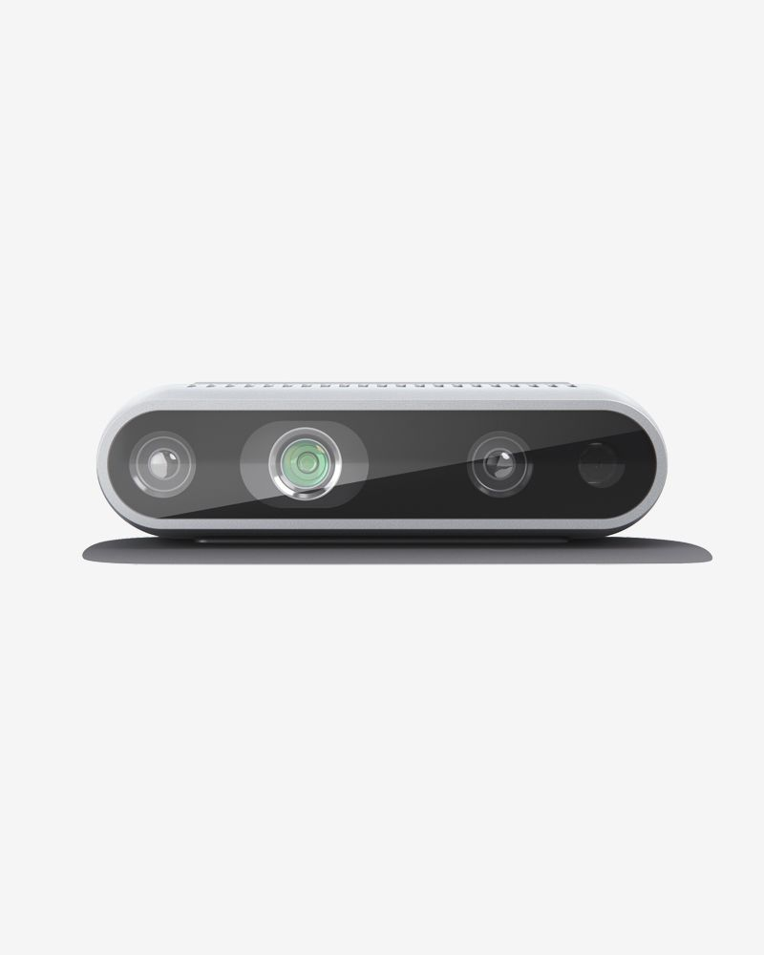
Depth Camera
Ibois
Robotic assembly of large-scale timber structures
Intel RealSense D435 RGB-D
Price: ~200CHF
Range : optimal at 50cm
Precision: 1-5mm, 1-3°
Calibration using openCV tools
Ref: Highly accessible platform technologies for vision‑guided, closed‑loop robotic assembly of unitized enclosure systems, Daniel Tish, Nathan King, Nicholas Cote
Ecole Polytechnique Fédérale de Lausanne

Slide 5
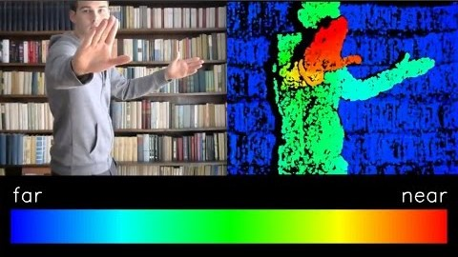
Depth Camera
Ibois
Robotic assembly of large-scale timber structures
Intel RealSense D435 RGB-D
Ecole Polytechnique Fédérale de Lausanne

Slide 6
Depth Camera
Ibois
Robotic assembly of large-scale timber structures
Intel RealSense D435 RGB-D
Ref: Highly accessible platform technologies for vision‑guided, closed‑loop robotic assembly of unitized enclosure systems, Daniel Tish, Nathan King, Nicholas Cote
Pros | Cons
Cheap | Error increase with the range
Precise enough for the task | Hard to calibrate (tool center- camera position)
Can segmentize the image | Need background on the image
Ecole Polytechnique Fédérale de Lausanne

Slide 7
Point-laser
Ibois
HTPOW KGL-850 point Laser green 50mw → 40 CHF
(-) can be used less than 5 min in a row
(-) Need to change the battery each time it’s out of energy
(+) Relatively powerful
(+) As a good linearity
https://www.laserfr.com/KGL-850-laser-vert-50mw-point.html
Laser LT 104 point laser red 50mw → 15 CHF
(+) High capacity battery
(+) Battery is rechargeable
(+) Good heat dissipation
https://www.laserpointeur.com/c-40_77_78-p-10085.html
Other ones exist

Slide 8
Point-laser for distance
Ibois
Robotic assembly of large-scale timber structures
Price : 10-40CHF
Range: 10cm-1m
Precision: ~1mm
Calibration: Use Paper, Ruler, and Pixel Ref: ferenc-nemeth/opencv-laser-rangefinder
Ecole Polytechnique Fédérale de Lausanne

Slide 9
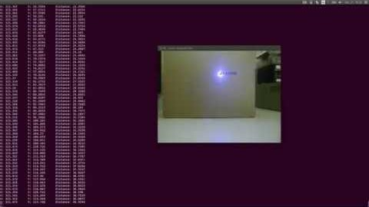
Point-laser for the distance
Ibois
https://www.youtube.com/watch?v=bvDV_c-mpdM&ab_channel=Ferenc

Slide 10
Point-laser for distance
Ibois
Robotic assembly of large-scale timber structures
Ref: https://www.instructables.com/id/Making-Rangefinder-Using-a-Laser-and-a-Camera/
Pros | Cons
Cheap | Error increase with the range
Precise enough for the task | Need to manually activate the laser when need it
Relatively easy to calibrate | The laser needs to be out of the arUco
Ecole Polytechnique Fédérale de Lausanne

Slide 11
Point-laser for orientation
Ibois
Robotic assembly of large-scale timber structures
Price : 20-80CHF
Range: 10cm-1m
Precision: ~1mm, angle not determ.
Calibration as before
Ecole Polytechnique Fédérale de Lausanne

Slide 12

How to know the orientation?
Ibois
β
a · b = ||a|| ||b|| cos(α)
angle desired(β) = 90°- α
b
Different solutions to find β :
Use Edge detection
Use arUco coordinate
α
a
Other ways to compute β ?

Slide 13
Point-laser for orientation
Ibois
Robotic assembly of large-scale timber structures
Pros | Cons
Add precision on the angle | Error increase with the range
Relatively easy to calibrate | Need to manually activate the laser when need it
Able to compare Laser and arUco precision to decide which is the best | Need to be sure that the points are well defined
Ecole Polytechnique Fédérale de Lausanne

Slide 14
Orientation without arUco
Ibois
Robotic assembly of large-scale timber structures
Change the arUco by a black line parallel with the border.
Use Gaussian filters for Edge detection
The one with the highest convolution pick gives the angle
laser to compute distance.
Ecole Polytechnique Fédérale de Lausanne

Slide 15
Other methods
Ibois
Keep the system as is
Find a way to improve the calibration
Then, if needed, add the laser
Maybe change the code for live tracking
Use some Machine learning algorithm
Use the robot and camera to get data
Work on the data to find a model which can predict the position (Bayesian Filter)
Change the camera for a better one

Slide 16
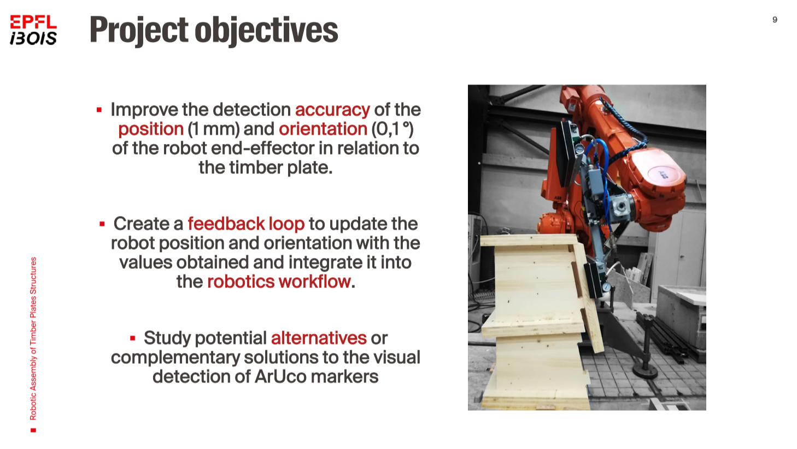
Ibois
Slide From Nicolas Rogeau

Slide 17
Questions ?
Ibois
Robotic assembly of large-scale timber structures
Thank you for you attention
Ecole Polytechnique Fédérale de Lausanne

