Slide 1

Semester Project Robotic assembly of large-scale timber structures
Ibois
Genilloud Florian
12.11.2020
École Polytechnique Fédérale de Lausanne (EPFL)
Ibois
Assistant: Nicolas Rogeau
Professor: Pr. Yves Weinand
Ecole Polytechnique Fédérale de Lausanne

Slide 2
Content
Ibois
Bluring effect
Which marker ?
Block Diagram
Organization
How to deal with uncertainty ?
Conclusion
Ecole Polytechnique Fédérale de Lausanne

Slide 3

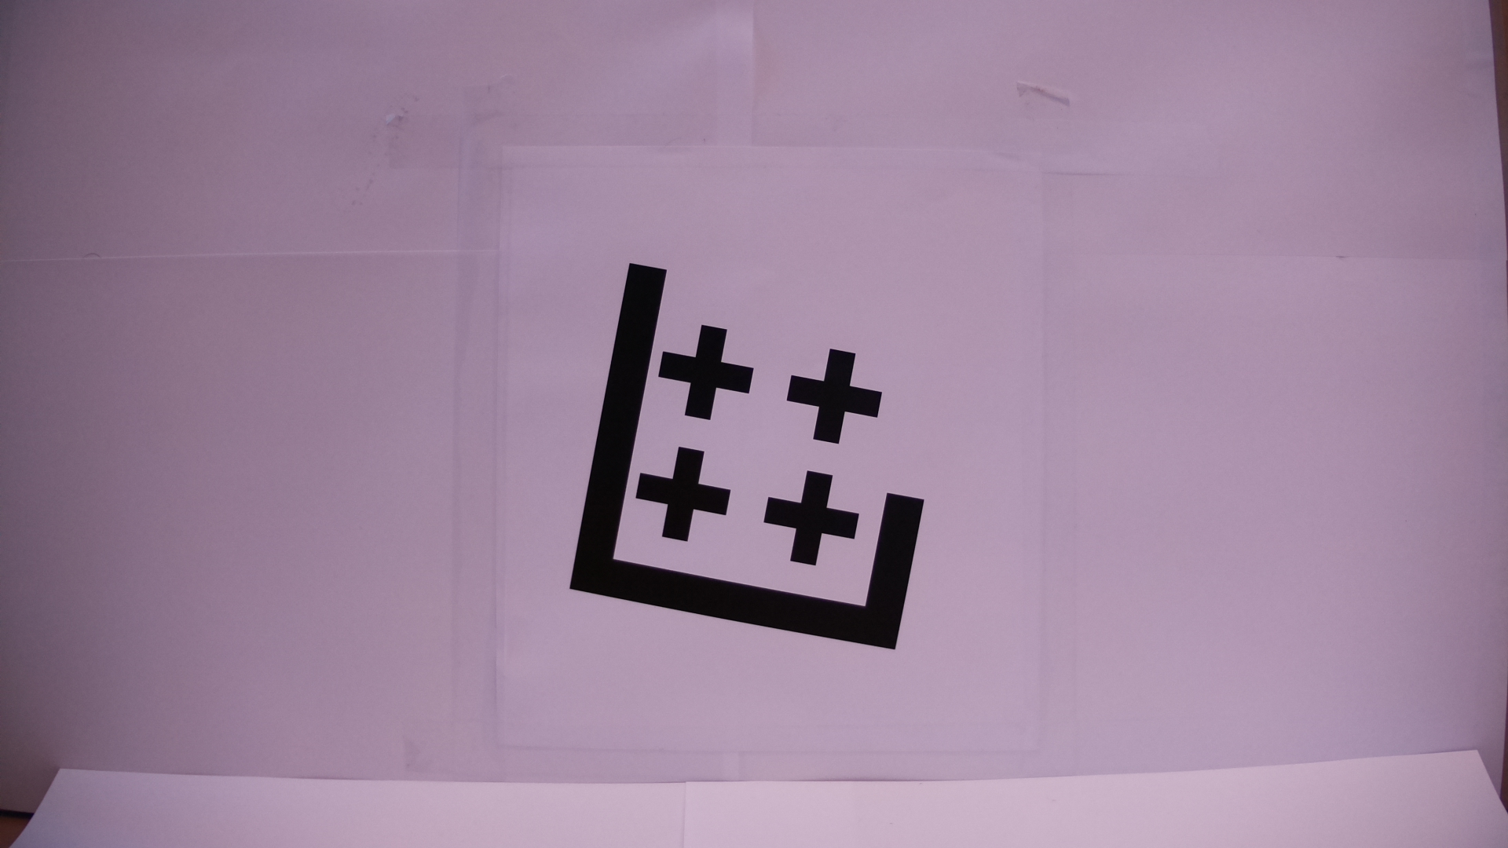
Bluring effect
Ibois
30 Centimeter
70 Centimeter
Ecole Polytechnique Fédérale de Lausanne

Slide 4


Bluring effect
Ibois
30 Centimeter , 10.51°
70 Centimeter, 10.45°
Ecole Polytechnique Fédérale de Lausanne

Slide 5
Marker’s selection
Need a shape with straight line (no circle if possible)
It’s not a problem of the edge are a bit circular
The algorithm for feature matching takes time.
Pentagon could work better than cross but need to test it with the output of the CNC

Slide 6
Block Diagram more in details

Slide 7
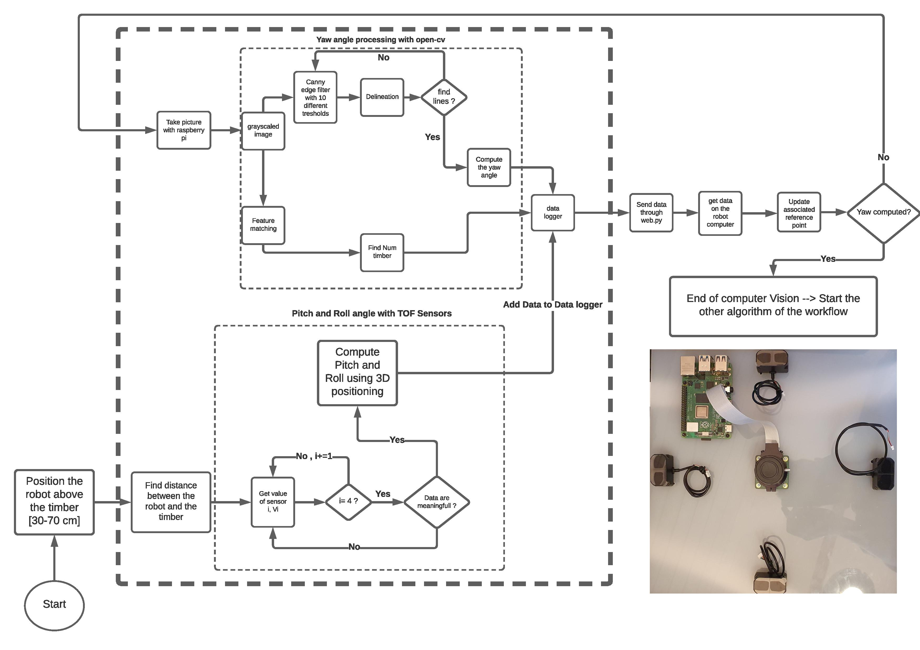

Slide 8
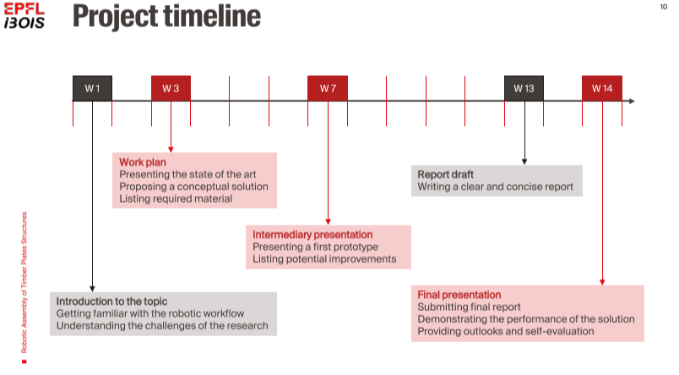
Time-line and organization
Ibois
Ref: Slide from Nicolas Rogeau
8
Ecole Polytechnique Fédérale de Lausanne

Slide 9


Implement and test the TOF Sensors and implement the algorithm for feature matching
Find a way to have the 4 values needed
Try to finish the implementation of everything and test on the robot
Final Report
Final Presentation

Slide 10
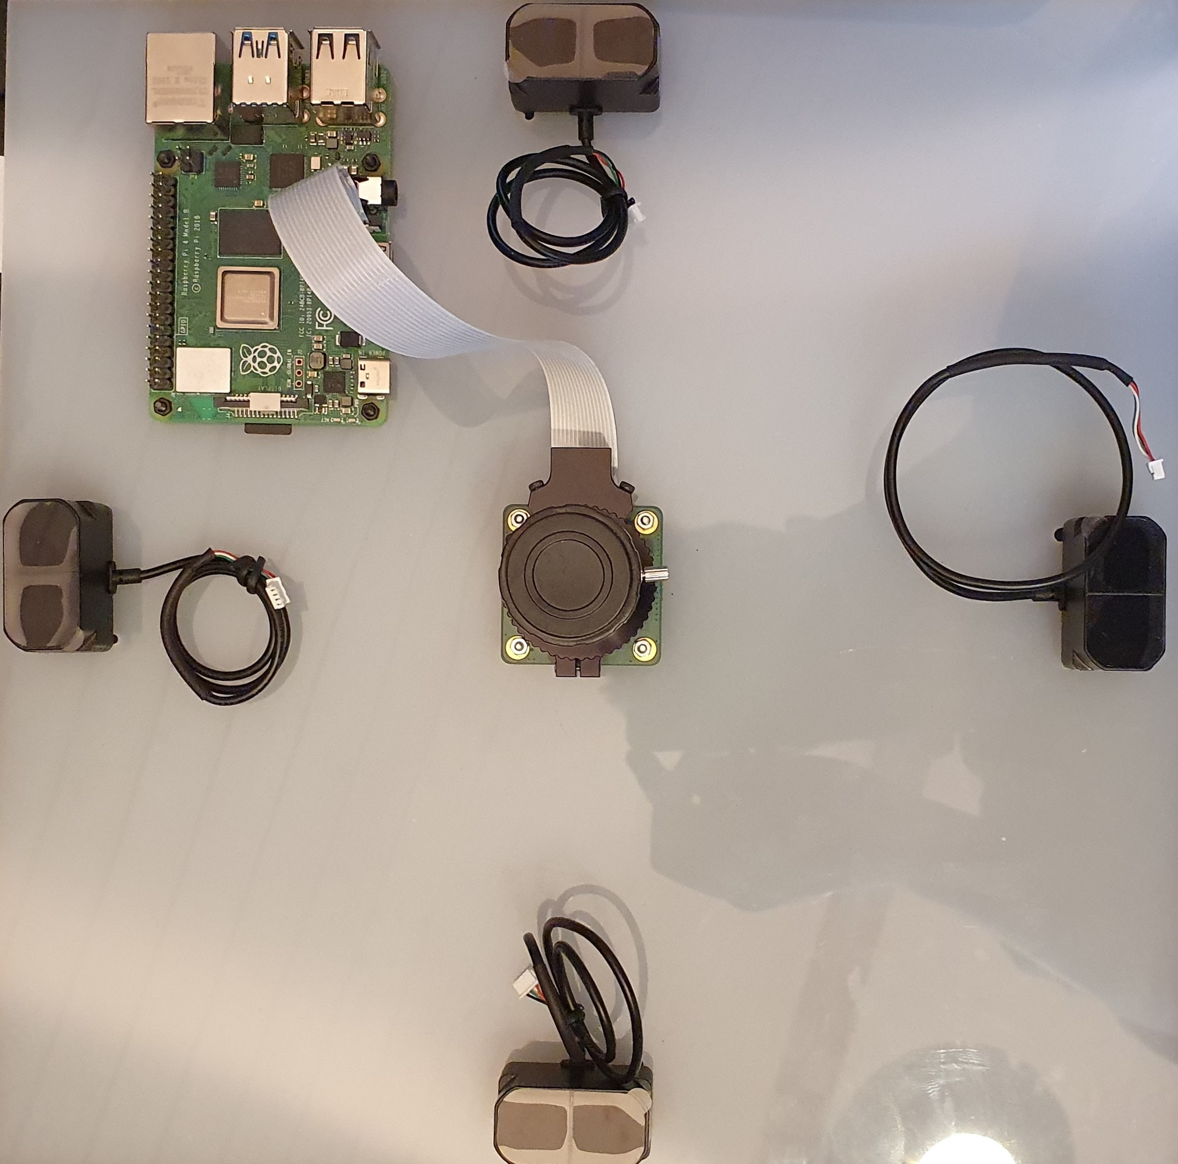
Uncertainty
I will test it today on the module directly to have real values
d

Slide 11
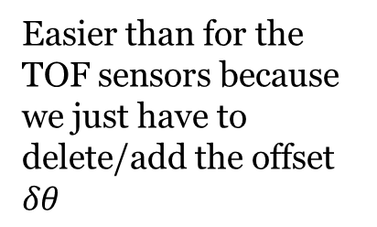
Uncertainty
Easier than for the TOF sensors because we just have to delete/add the offset $δθ$

Slide 12
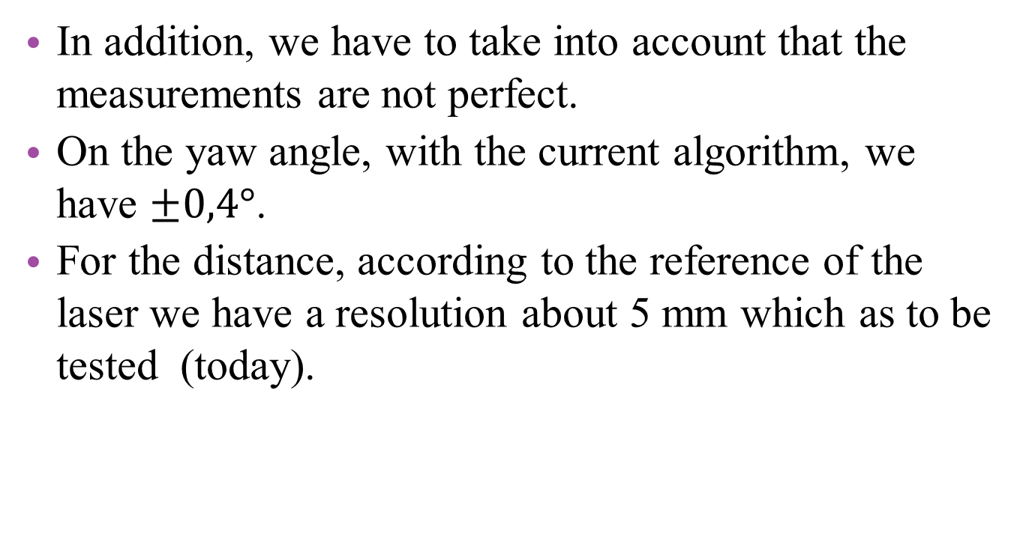
Uncertainty
\pm
\pm
In addition, we have to take into account that the measurements are not perfect.
On the yaw angle, with the current algorithm, we have $±0,4°$.
For the distance, according to the reference of the laser we have a resolution about 5 mm which as to be tested (today).

Slide 13
Questions ?
Ibois
Robotic assembly of large-scale timber structures
Thank you for you attention
Ecole Polytechnique Fédérale de Lausanne

