Slide 1
Executive Summary
Goal: Predict whether Falcon 9 first stage landings will be successful.
Data Sources: Wikipedia launch tables, SpaceX API, and historical launch records.
Key Findings: CCAFS SLC 40 is the most frequent launch site; success rates vary by orbit type and payload mass.
Final Model Accuracy: Decision Tree achieved 83.33% accuracy in predicting landing outcomes.

Slide 2
Introduction
Falcon 9 first stage landings enable cost savings by reusing rockets.
Predicting landing success informs mission planning and competitor cost estimates.
Understanding factors influencing success helps optimize launch strategy.

Slide 3
Data Collection & Wrangling
Wikipedia Scraping: Extracted Falcon 9 launch data (launch site, payload, orbit).
API Data: Retrieved detailed launch information via SpaceX API, including booster version, payload mass, landing outcome, and GPS coordinates.
Data Cleaning: Removed multi-core/multi-payload launches; converted date columns; handled missing values.
Encoding & Preparation: Converted categorical data to one-hot encoding; created Class column for landing success.

Slide 4
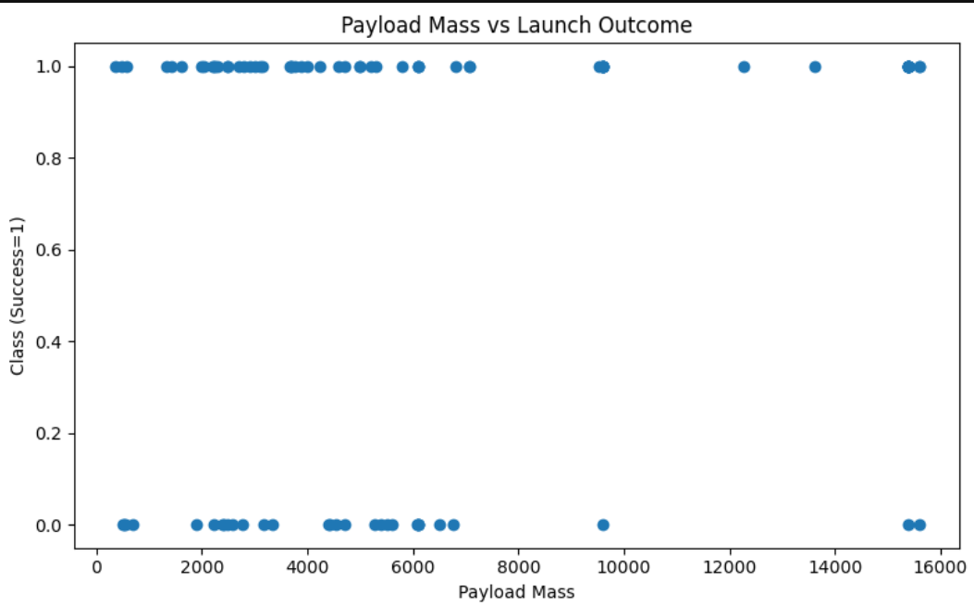
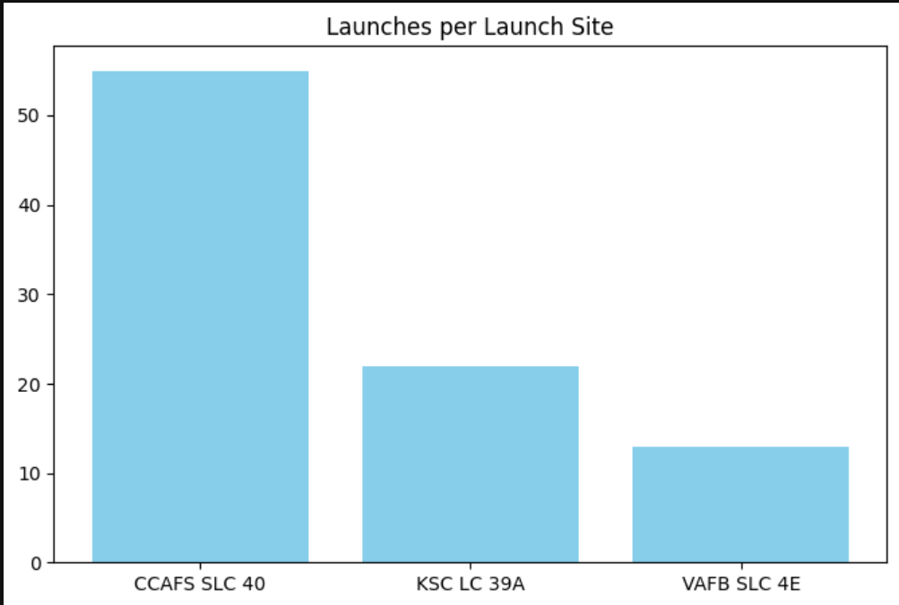
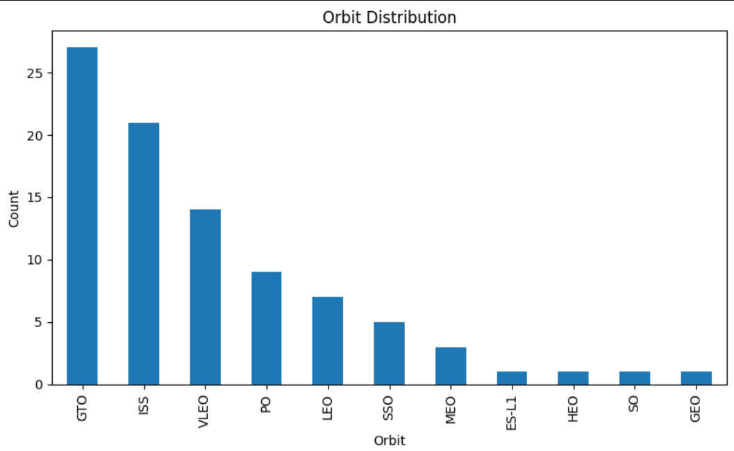
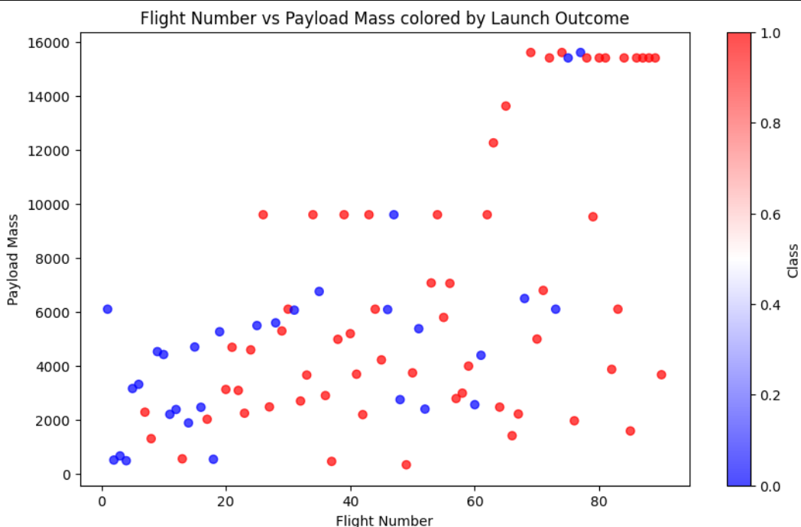
EDA Results (Visualizations)

Slide 5
EDA & Interactive Visual Analytics
Key insights from FlightNumber, PayloadMass, and Orbit analysis.
Trends in successful vs. unsuccessful landings.

Slide 6
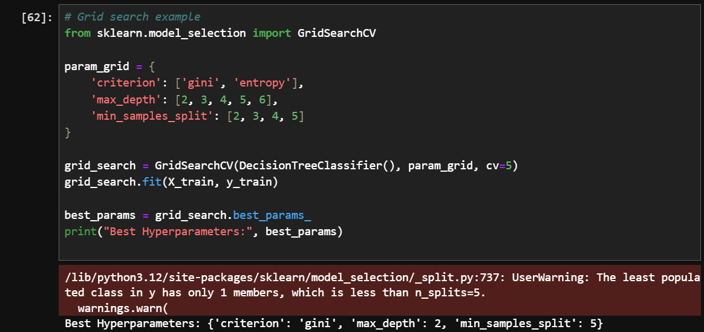
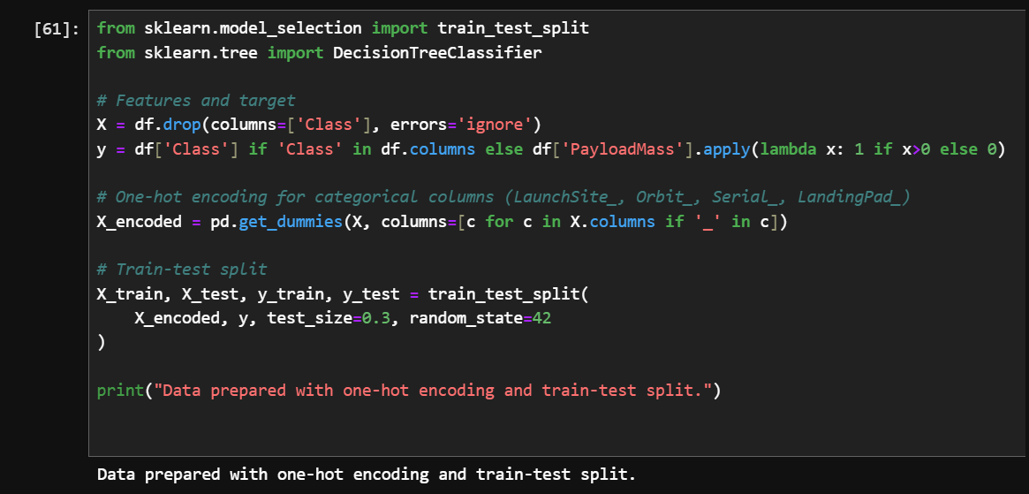
Predictive Analysis Methodology
Classification algorithms: Logistic Regression, SVM, Decision Tree, KNN.
Data split: Train/Validation/Test.
Feature scaling and encoding.
Hyperparameter tuning.

Slide 7
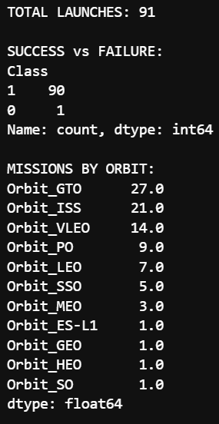
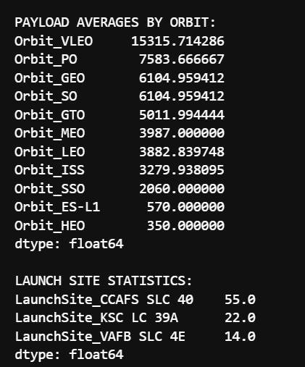
SQL Results
Total launches by launch site
Successful vs failed missions
Mission counts by orbit type
Average payload mass per orbit
Launch site statistics

Slide 8
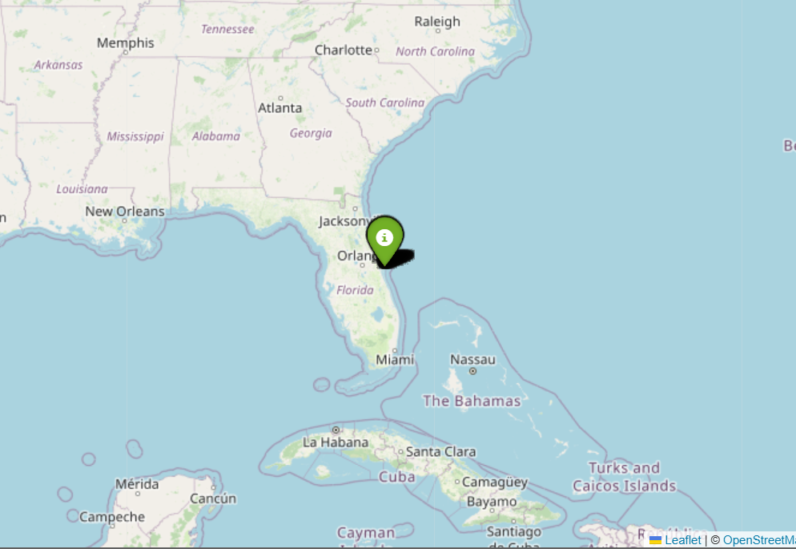
Folium Interactive Map
Visualized launch sites using Folium map.
Included markers showing longitude, latitude, and landing success outcomes.

Slide 9
Plotly Dash Dashboard
Interactive dashboard for exploring launches.
Filters for orbit, payload, and site.
http://127.0.0.1:8050/

Slide 10
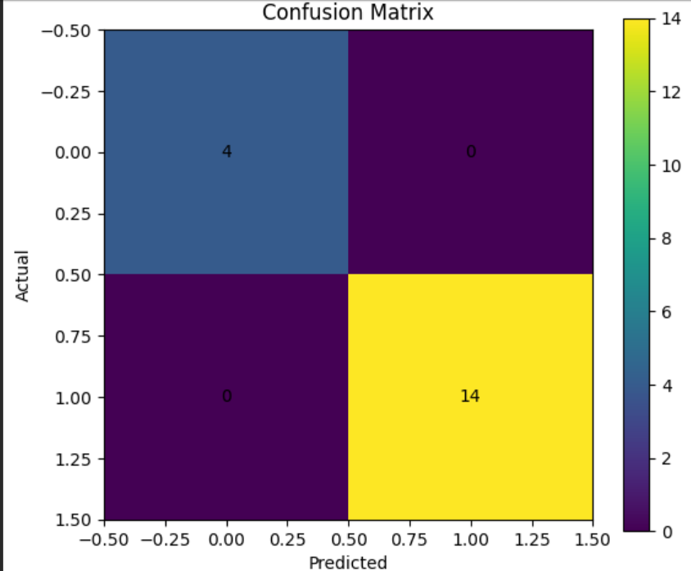
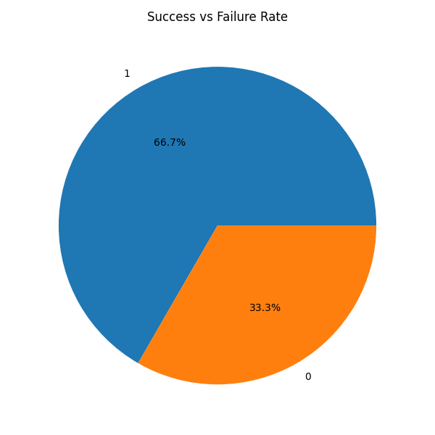
Classification Results
Accuracy of models on test set (Decision Tree, KNN, etc.).
Confusion matrix example.
Best performing model.
Insert confusion matrix or table.

Slide 11
Conclusion
Key insights: Launch site, orbit, and payload mass strongly influence landing success.
Best-performing model: Decision Tree
Future improvements: Explore ensemble models, include weather and mission-specific features, refine feature selection.

