Slide 1







TEAM CULT
INSIGHT-RAG
BY
THIRUMURUGESH J D
VARUN A

Slide 2
TEAM CULT
INSIGHT-RAG
Document Q&A Bot using RAG
An AI-powered document question answering system that retrieves relevant document context and generates answers with citations while preventing hallucinations.

Slide 3
TEAM CULT
Problem Statement
Organizations store huge amounts of documents and knowledge
Finding specific information takes significant time
Traditional search often returns irrelevant results
AI chatbots may generate incorrect or hallucinated answers

Slide 4
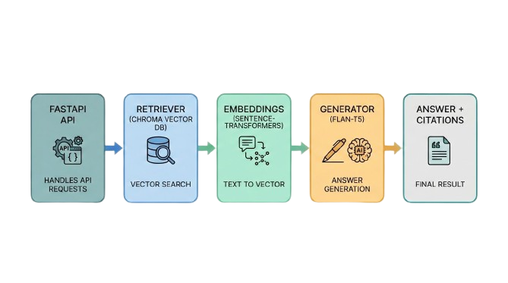
TEAM CULT
Solution Overview
User uploads documents into the system
User asks a natural language question
System finds the most relevant document sections
AI generates a grounded answer with citations

Slide 5
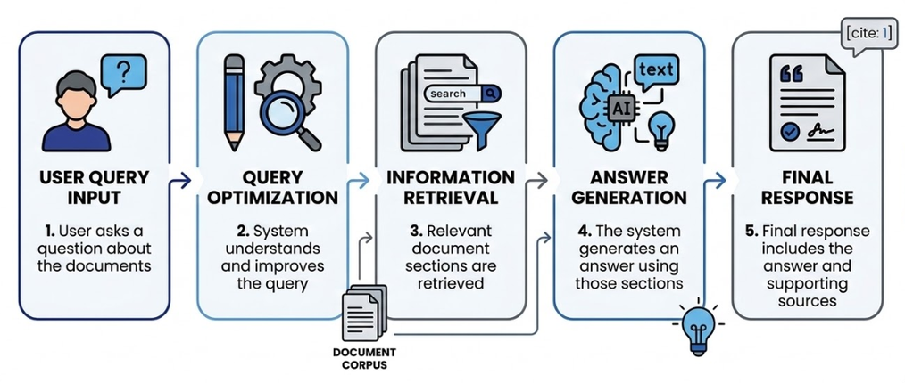
TEAM CULT
How the System Works
User asks a question about the documents
System understands and improves the query
Relevant document sections are retrieved
The system generates an answer using those sections
Final response includes the answer and supporting sources

Slide 6
TEAM CULT
Core Working of the System
Documents are analyzed and divided into searchable segments
Intelligent search finds relevant sections using multiple methods
Retrieved content is ranked and filtered for relevance
The system generates answers strictly from those sources
Social Media Marketing
Paid Advertising

Slide 7
TEAM CULT
Key Features & Innovations
Hybrid search combining semantic and keyword retrieval
Grounded answers with evidence citations
Built-in hallucination prevention mechanism
Conversation memory for follow-up questions
Confidence score for answer reliability

Slide 8
TEAM CULT
Real-World Applications
Enterprise knowledge assistants
Legal and contract analysis tools
Research and academic document search
Customer support automation
Internal company documentation search

Slide 9
TEAM CULT
Conclusion & Future Improvements
Fast and reliable document-based question answering
Reduces time spent searching through large documents
Provides transparent answers with sources
Future work: larger datasets, advanced reasoning, improved ranking

Slide 10
TEAM CULT
Thank You!!!!!!!

