Slide 1

Morphology and Word Formation in Natural Languages
Presented by : Galla Sai Siddartha (192425093)
Subject code : DSA0304
Subject : Natural Language Processing
Guide name : Dr. T. Devi, Dr. Deepa
Date : 15/07/2026

Slide 2
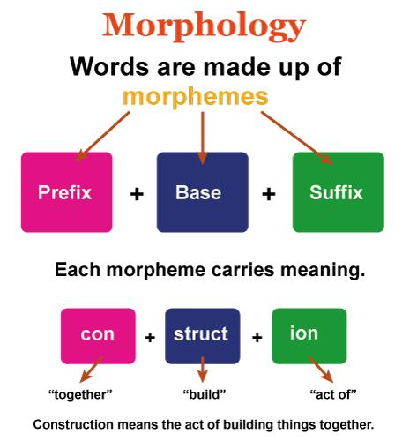
What is Morphology?
Morphology is the branch of linguistics that studies the structure and formation of words.
It focuses on how morphemes, the smallest meaningful units of language, combine to create words.
Morphology helps us understand how words change their form while preserving or modifying their meaning.
Why is Morphology Important?
Helps identify the root word and its meaning.
Improves text analysis and language understanding.
Supports NLP tasks such as stemming, lemmatization, machine translation, and spell checking.

Slide 3
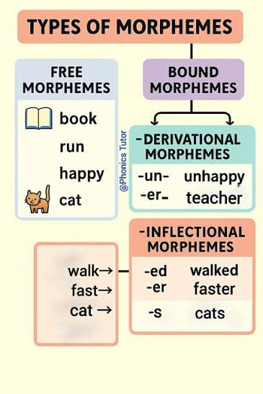
Types of Morphemes
Free Morphemes
Can stand alone as independent words.
Carry a complete meaning without needing other morphemes.
Examples: book, play, happy, child
Bound Morphemes
Cannot stand alone.
Must be attached to another morpheme to form a meaningful word.
Examples: un- (prefix), re- (prefix), ing (suffix), -ed (suffix)
Examples of Word Formation
Word Morpheme Breakdown
Playing play + ing
Unhappy un + happy
Rewritten re + write + en

Slide 4
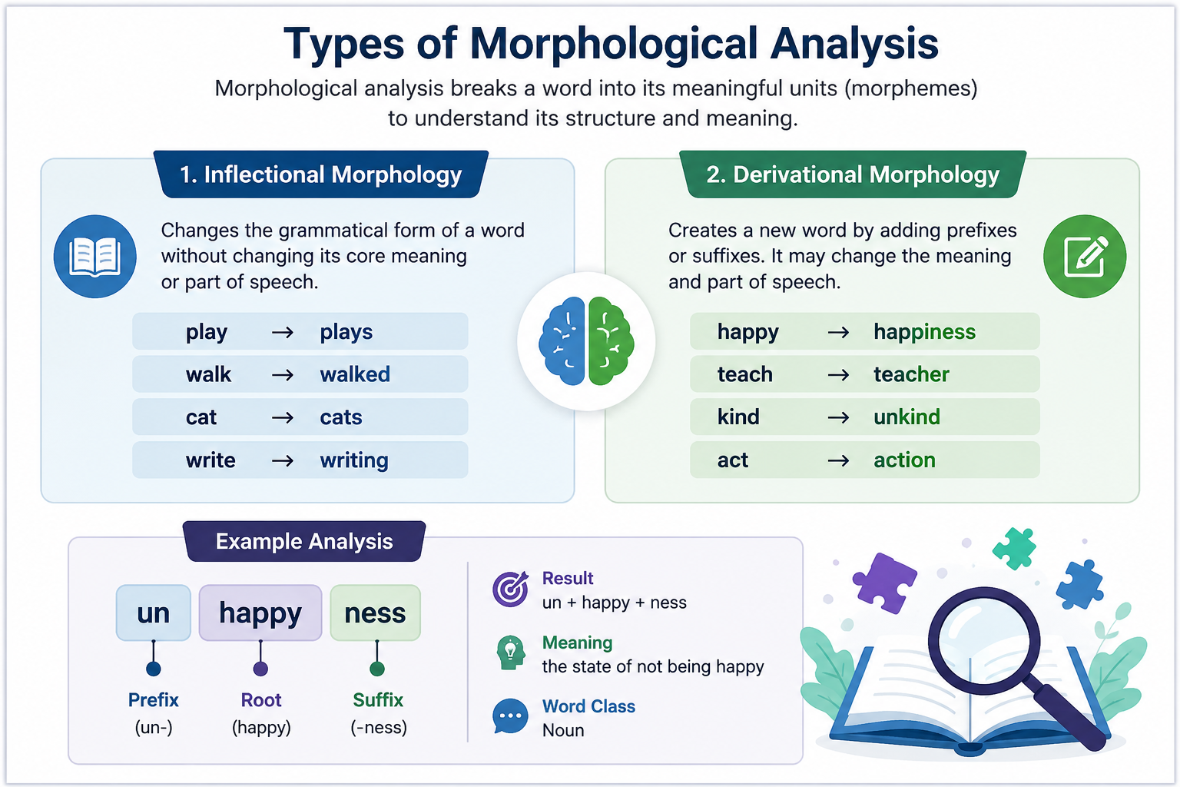
Types of Morphological Analysis
Inflectional Morphology
Changes the grammatical form of a word.
Does not change the word's core meaning or part of speech.
Examples:
play → plays
walk → walked
cat → cats
Derivational Morphology
Creates a new word by adding prefixes or suffixes.
May change the meaning and part of speech.
Examples:
happy → happiness
teach → teacher

Slide 5
Word Formation Processes
Word formation is the process of creating new words or modifying existing words by adding prefixes, suffixes, or combining words. It helps expand a language's vocabulary and improves communication.
1. Prefixation
A prefix is added to the beginning of a
word to change its meaning.
Examples:
happy → unhappy
2. Suffixation
A suffix is added to the end of a word to
change its grammatical form or meaning.
Examples:
teach → teacher
happy → happiness
3. Compounding
Two or more complete words are combined to form a new word.
Examples:
football = foot + ball
4. Blending
Parts of two words are merged to create a new word.
Examples:
smoke + fog = smog
breakfast + lunch = brunch

Slide 6



How Languages Build Words
Not all languages construct words the same way. Typological differences reveal three dominant strategies for encoding grammatical meaning.
Analytic
Agglutinative
Inflected (Fusional)
Minimal word-internal structure; meaning relies on word order. Example: English uses separate words for tense and aspect.
Affixes are strung together in sequence, each carrying one grammatical feature. Example: Finnish, Turkish.
A single affix encodes multiple grammatical categories simultaneously. Example: French verb conjugations.

Slide 7
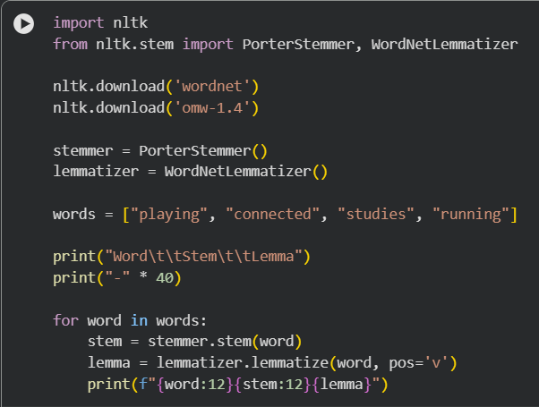
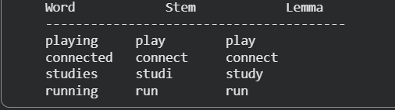
CODE & OUTPUT

Slide 8
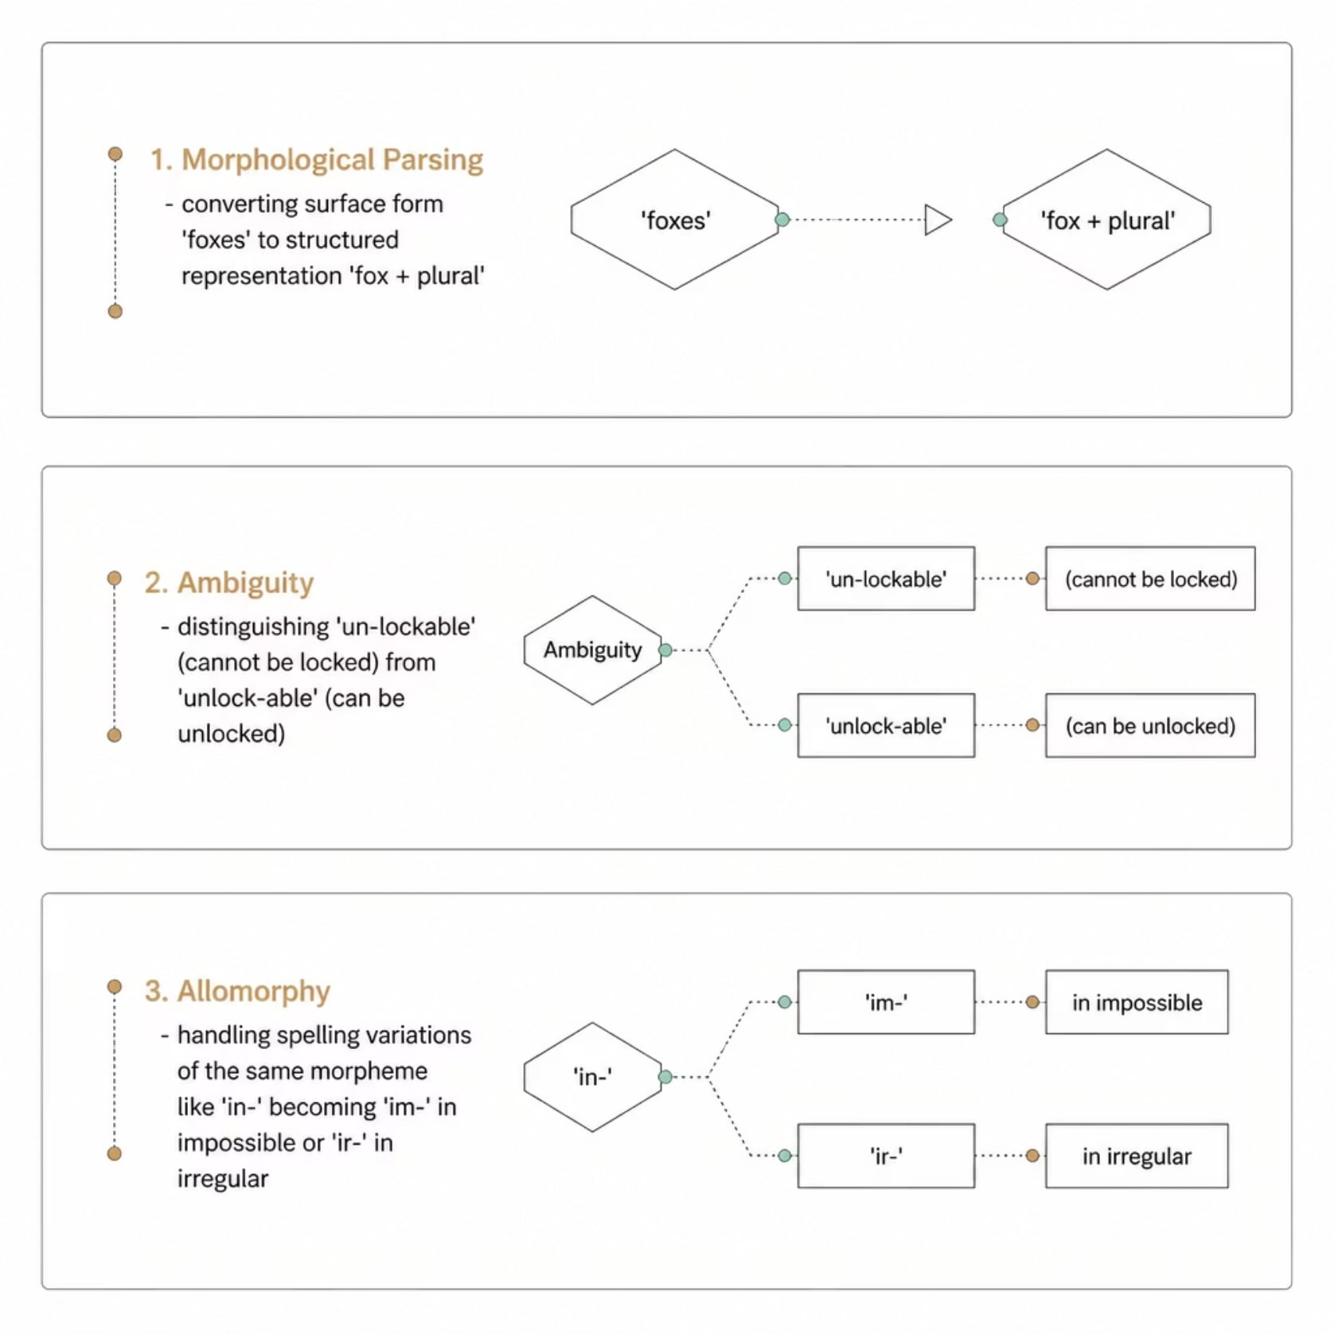
The Challenges of Automated Analysis
Automated morphological analysis must resolve three fundamental problems before any downstream NLP task can proceed reliably.
1. Parsing
Surface form → structured morpheme representation
2. Ambiguity Resolution
Selecting the correct bracketing among competing analyses
3. Allomorphy
Recognising that in-, im-, ir-, il- are the same morpheme

Slide 9

Applications of Morphology in NLP
1. Search Engines
Matches different forms of the same word.
Example: connect, connected, connecting → connect
2. Machine Translation
Identifies the root word and grammatical information.
Produces more accurate translations between languages.
3. Spell Checking & Grammar Correction
Detects spelling and grammatical errors.
Suggests the correct word form.
4. Chatbots & Virtual Assistants
Understands user queries even when words appear in different forms.
Improves the quality of responses.

Slide 10


