Slide 1
Netflix Movie
Recommendation Engine
ML
Capstone project built as a recruiter-ready ML product
Python | Pandas | Scikit-learn | Streamlit | Recommendation Systems
Personalization
Analytics
Deployment
Kummari Thirumala Raju

Slide 2
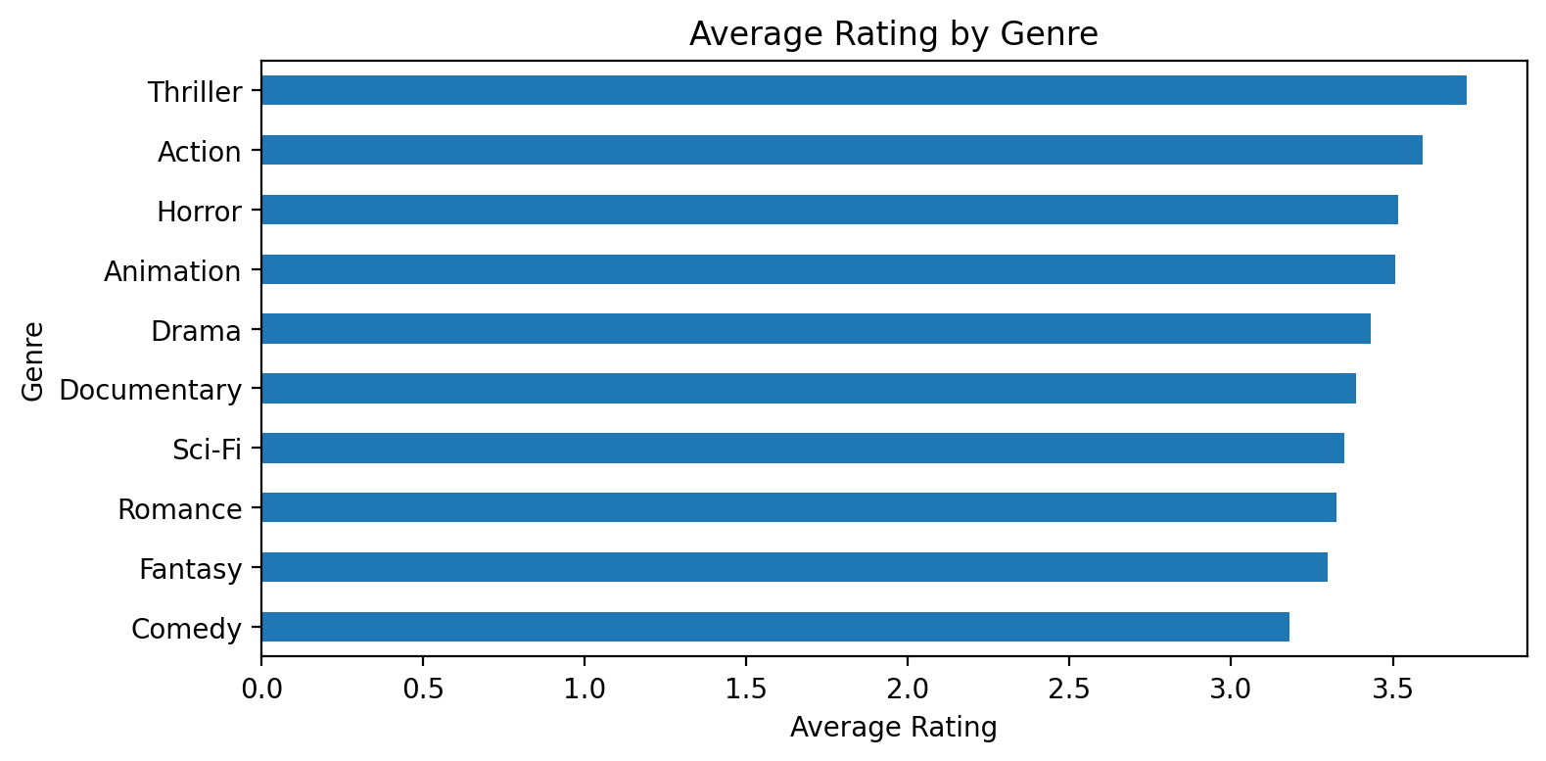
Project Snapshot
End-to-end recommendation workflow with measurable model output.
5969
100
500
10
3.44
Ratings
Users
Movies
Genres
Avg Rating
Built deliverables
EDA dashboard with genre insights
Popularity and content-based recommendations
Hybrid user recommendation logic
Model evaluation with RMSE and MAE
GitHub-ready folder structure and app

Slide 3
Problem and Objectives
Convert user activity into personalized movie discovery.
Problem
Capstone objectives
OTT users face choice overload. Recommendation engines reduce search effort and increase engagement by predicting what users are likely to watch.
Find the most popular and liked genres
Recommend the best suited movies for users
Find best and worst rated genres
Build a deployable interactive ML app
Data
EDA
Models
App
Deploy

Slide 4
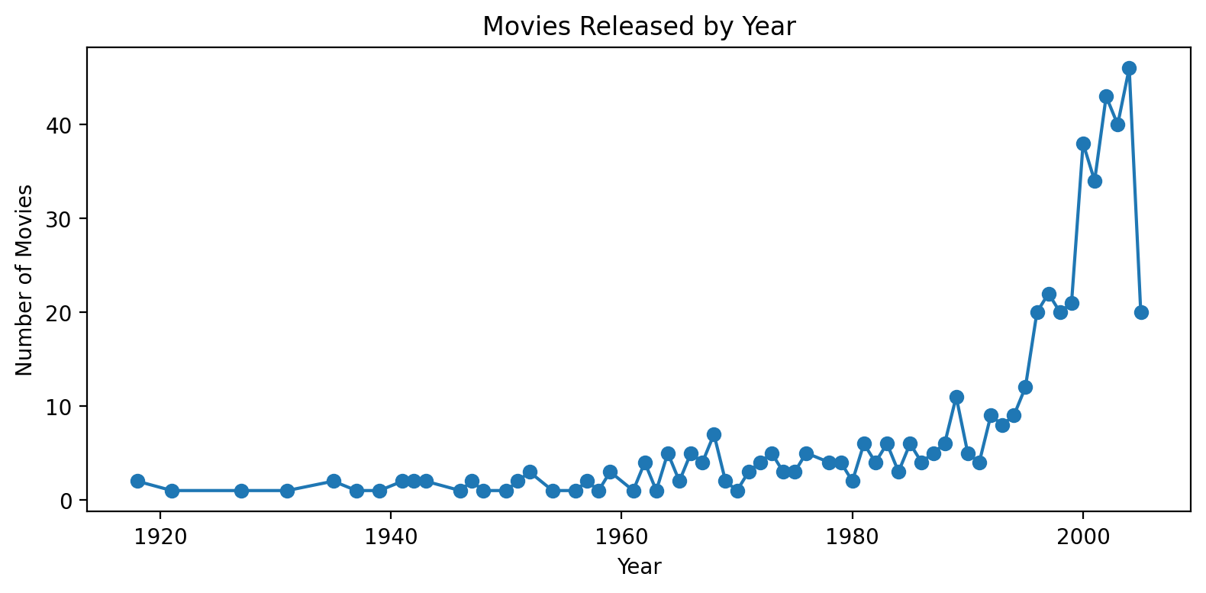
Dataset Understanding
Fields, size, quality checks and suitability for recommendations.
Column
Meaning
Data quality result
CustomerID
Unique user identifier
No missing values after check
No duplicate records after cleanup
Rating values validated from 1 to 5
Movie years: 1918 to 2005
Ready for EDA and recommendation modeling
MovieID
Unique movie identifier
Rating
User rating from 1 to 5
Title
Movie title
Genre
Movie category
Year
Movie release year

Slide 5
System Architecture
Modular pipeline from raw CSV to deployed Streamlit product.
CSV Data
Cleaning + EDA
Feature Engineering
Recommenders
Streamlit App
Artifacts saved in models folder: encoders, vectorizer, similarity matrix, movie stats, metrics and trained rating model.
Why this matters: the app loads trained assets instead of retraining every time, making it faster and deployment-ready.

Slide 6
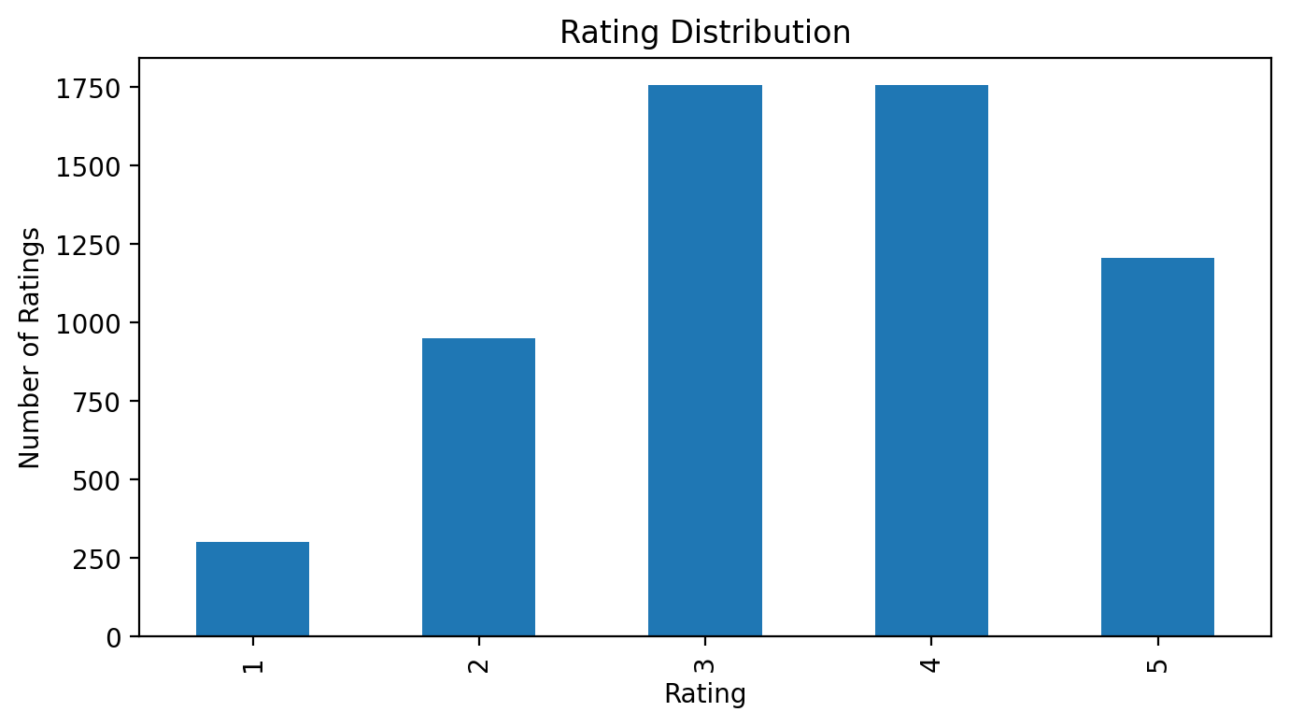
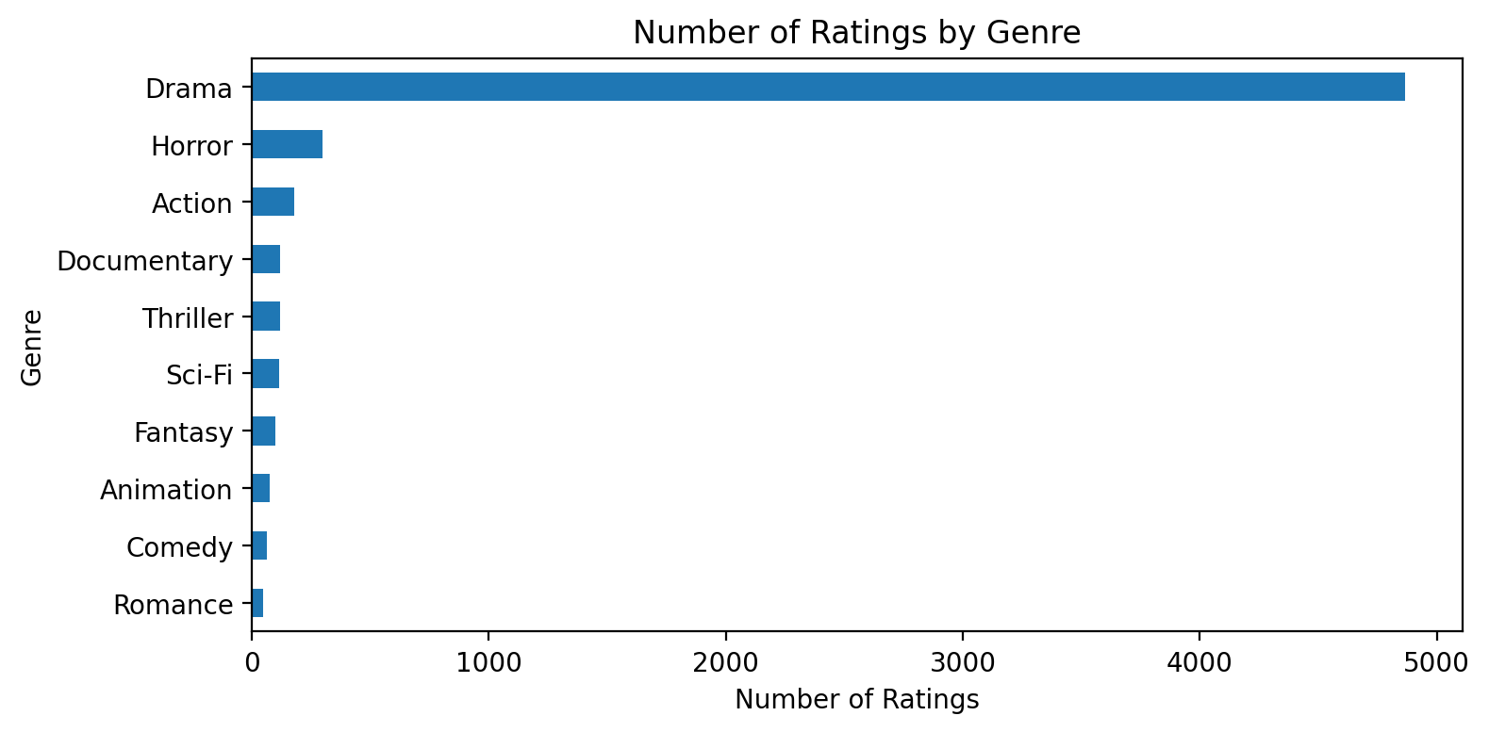
EDA Highlights
Data patterns that guide recommendations and business decisions.
Thriller
Comedy
Drama
Best-rated genre
Worst-rated genre
Most-rated genre

Slide 7
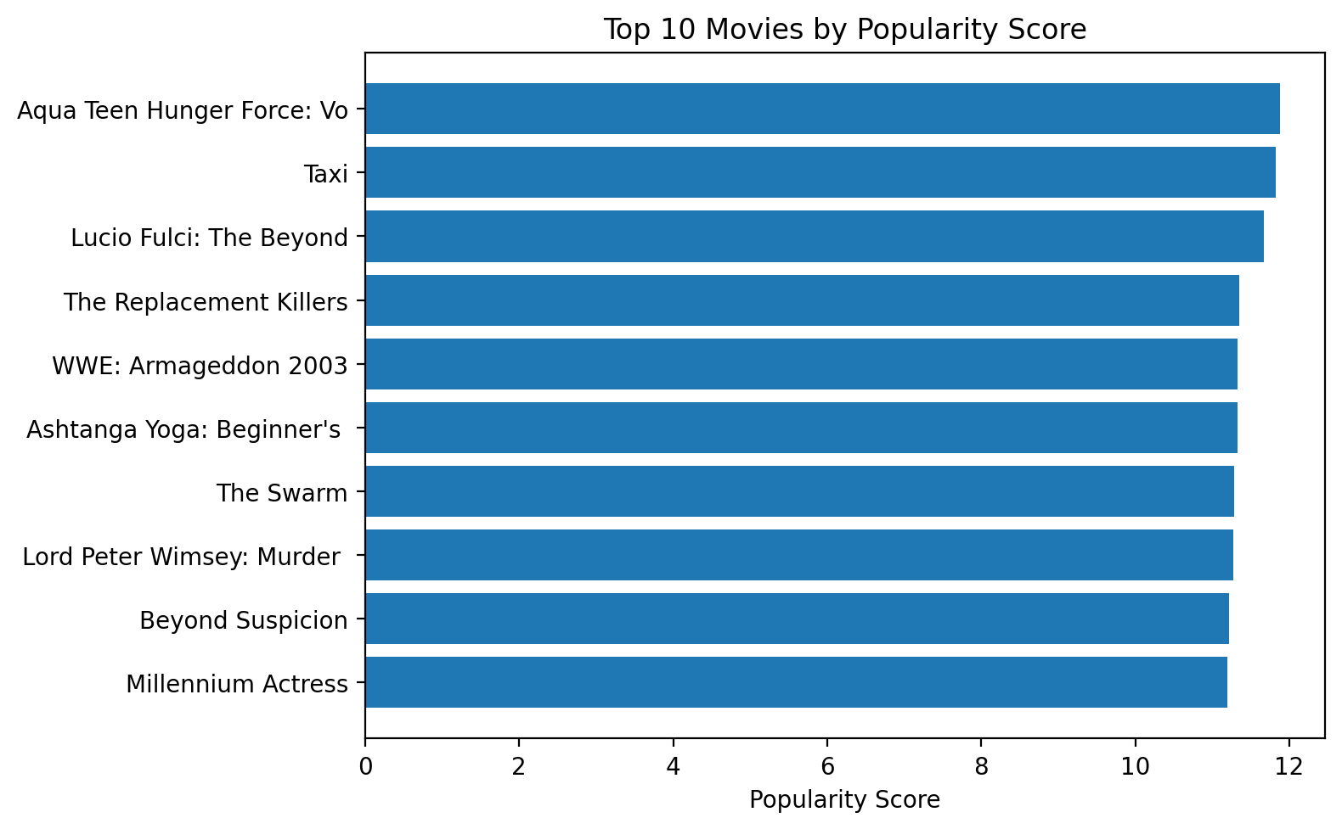
Recommendation Models
Multiple approaches handle different user situations.
Popularity-Based
Content-Based
Hybrid User-Based
Best for new users. Ranks movies using average rating and rating count.
Best for movie search. Uses TF-IDF and cosine similarity on title, genre and year.
Best for personalization. Combines movie quality, user genre preference and popularity.
Hybrid score = 45% average rating + 35% genre preference + 20% normalized popularity

Slide 8
Interactive Streamlit App
Pages designed for demos, recruiters and project review.
Home
EDA
Popular
Movie
User
Evaluate
Interactive controls
Demo story
Search/select movie title
Filter by genre
Adjust top-N recommendations
Enter customer ID
Predict rating for user-movie pair
Start with KPIs on Home
Show genre insights in EDA
Generate similar movies
Generate user recommendations
Explain RMSE/MAE in evaluation

Slide 9
Model Evaluation
Rating prediction adds measurable ML quality to the project.
1.150
0.972
RF
RMSE
MAE
Model
Random Forest Regressor predicts user ratings using encoded user ID, movie ID, genre and year.
RMSE shows how strongly large prediction mistakes affect performance.
MAE shows the average rating error in star units.
These metrics prove that the project is more than a static dashboard.
Future upgrade: add SVD matrix factorization and Precision@K/Recall@K.

Slide 10
Thank You
Questions?
Netflix Movie Recommendation Engine

