Slide 1
DIGITAL PORTFOLIO
STUDENT NAME : THIRUMALAI . A
REGISTER NO & NMID : 35524U18080 & 7A652B0A9CFF3CEA2F24F947CF8A4D21
DEPARTNMENT : BSC COMPURT SCIENCE
COLLEGE/UNIVERSITY :GOVT ARTS AND SCIENCE COLLEGE
THIRUPATTUR / THIRUVALLUVAR UNIVERSITY
Notes:
1

Slide 2

PROJECT LITTLE
BUILDING THE FEATURE

Slide 3
Problem Statement Project Overview End Uers Tools and Technologies Portfolio design and layout Feature and Functionality Result and screenshots Conculsion Github link
AGENDA

Slide 4
PROBLEM STATEMENT
1.Users face difficulties due to the absence of this feature, limiting functionality.
2.Current system does not fully meet user needs or expectations.
3. Lack of this feature reduces efficiency and user experience.
4. Competitor platforms already provide similar functionality, creating a gap.
5. Adding the feature will enhance usability, engagement, and overall satisfaction.

Slide 5
PROJECT OVERVIEW
1. Understand the problem and gather detailed user requirements. 2. Plan the scope, resources, and timeline for development. 3. Design the feature with a focus on usability and efficiency. 4. Develop and integrate the feature into the existing system. 5. Test thoroughly to ensure quality, performance, and reliability. 6. Deploy the feature, collect user feedback, and optimize further.

Slide 6
END USER
1. Understand the problem and gather detailed user requirements. 2. Plan the scope, resources, and timeline for development. 3. Design the feature with a focus on usability and efficiency. 4. Develop and integrate the feature into the existing system. 5. Test thoroughly to ensure quality, performance, and reliability. 6. Deploy the feature, collect user feedback, and optimize further.

Slide 7
TOOLS AND TECHNOLOGIES
1. Programming Languages – e.g., Python, Java, or JavaScript for development. 2. Frameworks – like React, Angular, or Django to speed up building. 3. Databases – MySQL, MongoDB, or Firebase to store and manage data. 4. Version Control – Git/GitHub for tracking code changes and collaboration. 5. Testing Tools – Selenium, JUnit, or Postman to ensure quality. 6. Deployment Platforms – AWS, Azure, or Docker for hosting and scaling.

Slide 8
PORTFOLIO DESIGN AND LAYOUT
1. Cover Page – Title of the project, your name, and a clean visual theme. 2. Introduction – Brief overview of the feature and its purpose. 3. Problem Statement – Explain the issue the feature is solving. 4. Project Overview – Steps followed: planning, design, development, testing, deployment. 5. Tools & Technologies – List of languages, frameworks, and platforms used. 6. Screenshots & Results – Visuals of the feature, outcomes, and user benefits.

Slide 9
FEATURE AND FUNCTIONALITY
1. Feature Definition – The new capability added to the system to solve a specific problem. 2. Core Functionality – How the feature works to achieve its main purpose. 3. User Interaction – Simple, intuitive design so users can easily access and use it. 4. Integration – Works smoothly with existing system modules and services. 5. Performance – Provides fast, reliable, and efficient results for the end user. 6. Scalability – Can be improved or expanded in the future based on user needs.

Slide 10
RESULT
1. Improved User Experience – Users find the system easier and more helpful. 2. Efficiency – Tasks are completed faster with less effort. 3. Problem Solved – The specific issue identified in the problem statement is addressed. 4. Higher Engagement – Users interact more with the system because of added value. 5. Competitive Advantage – The system stays ahead or on par with competitors.

Slide 11
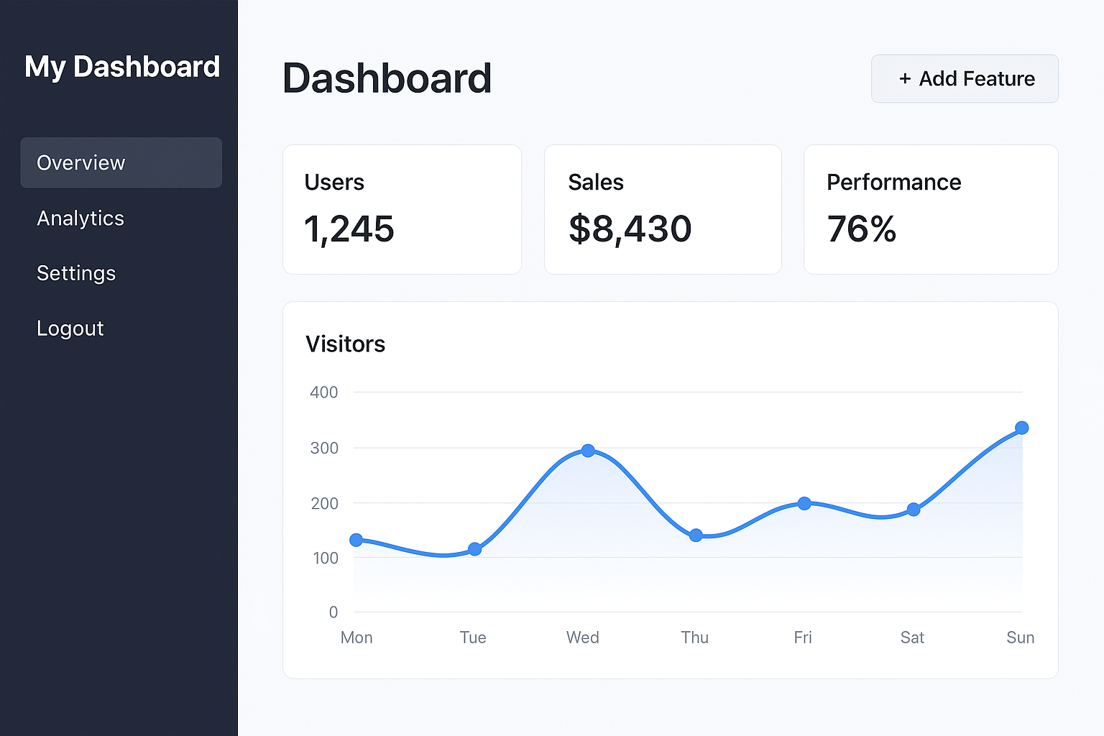
SCREENSHOT

Slide 12
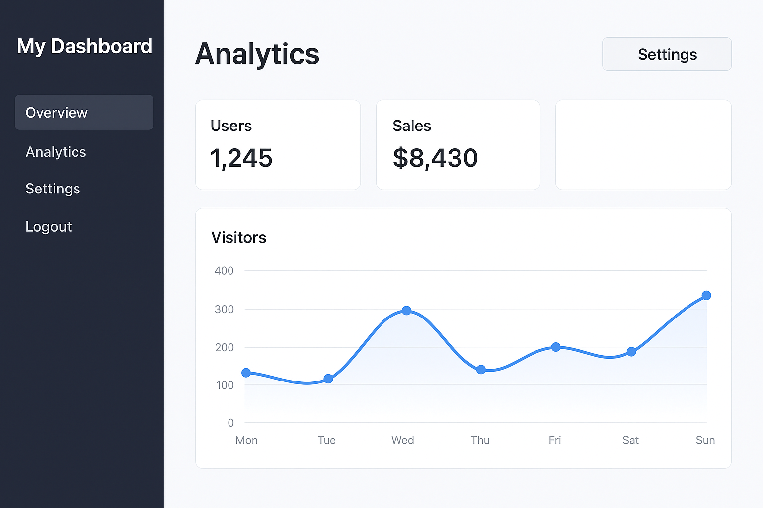
SCREENSHOT

Slide 13
CONCLUSION
1. The feature successfully addresses the identified problem. 2. It enhances overall usability and user satisfaction. 3. Integration with existing systems was achieved smoothly. 4. The feature improves efficiency and productivity. 5. User feedback confirms its usefulness and value. 6. It lays the foundation for future improvements and scalability.

Slide 14
GITHUB LINK
https://github.com/thirumalai2025nm/naan-mudalvan.git

