Slide 1
Employee Data Analysis using Excel
STUDENT NAME: AK THIRUNAVUKKARASU
REGISTER NO: B3B5AAFF256B6B6A5234A9A45AADBDEE, 312207651
DEPARTMENT: B.COM[GENERAL]
COLLEGE: PACHAIYAPPAS COLLEGE

Slide 2
PROJECT TITLE
Department-Wise Salary Analysis Based on Employee Type & FTE

Slide 3


AGENDA
Problem Statement
Project Overview
End Users
Our Solution and Proposition
Dataset Description
Modelling Approach
Results and Discussion
Conclusion
3/21/2024 Annual Review

Slide 4

PROBLEM STATEMENT
Evaluate Departmental Pay Structures: Assess whether the salary distribution within each department aligns with expected compensation levels for various roles and responsibilities.
Identify Departmental Salary Discrepancies: Determine if significant salary differences exist between departments, and analyze how these discrepancies impact overall fairness and equity.
Analyze FTE Impact: Examine how Full-Time Equivalent (FTE) status affects salary levels, ensuring that adjustments reflect the true value and workload of different employment types.

Slide 5

PROJECT OVERVIEW
This project analyzes salary data by department and employee type to identify disparities and trends. Using a pivot table, we examined average salaries and variations to highlight any inequities. Key findings reveal significant differences in salary distribution, impacting fairness and equity. Recommendations will address these issues to improve compensation practices. The goal is to provide actionable insights for better salary adjustments and budget decisions.

Slide 6

WHO ARE THE END USERS?
Senior Management: They will review the results to understand salary trends and make strategic decisions regarding compensation policies and organizational structure. They will also consider FTE data to guide workforce planning and cost management strategies.
Department Heads: They will benefit from understanding salary variations within their departments and addressing any compensation-related concerns. They will use FTE insights to manage departmental budgets and ensure that salary distributions reflect the actual contributions of their team members.
HR Managers: They will use insights to assess and adjust salary structures to ensure fair compensation practices across departments and employee types. They will also use FTE data to align salary adjustments with the actual workload of full-time and part-time employees.

Slide 7

OUR SOLUTION AND ITS VALUE PROPOSITION
Our solution provides a detailed analysis of salary distribution across departments and employee types using pivot table insights. This approach highlights disparities and trends in compensation, allowing for targeted adjustments to ensure fairness and equity. The value proposition lies in offering actionable insights for better-informed salary and budget decisions, ultimately leading to improved compensation practices and enhanced employee satisfaction.

Slide 8
Dataset Description
The dataset includes comprehensive salary information for employees across various departments and employee types within the organization. It features fields such as employee ID, department name, employee type
(e.g., full-time, part-time, contract), and salary amount. This data enables detailed analysis of salary distribution patterns, average salaries by department, and variations between different employee types, providing a basis for evaluating compensation practices and making informed decisions.

Slide 9

THE "WOW" IN OUR SOLUTION
The "wow" in our solution lies in its ability to reveal hidden salary disparities and trends with precision, enabling tailored adjustments that promote fairness and equity across the organization. By leveraging detailed pivot table analysis, our solution delivers actionable insights that drive more informed and strategic decision-making in compensation management, ultimately enhancing employee satisfaction and aligning salary practices with organizational goals.
3/21/2024 Annual Review
9

Slide 10
MODELLING
In our modeling approach, we utilized pivot tables to structure and analyze salary data by department and employee type. This method allowed us to efficiently summarize and compare salary distributions, identify patterns, and highlight disparities. The modeling process involved calculating average salaries, assessing variations, and visualizing data to uncover insights into compensation practices. This structured analysis provides a clear basis for evaluating fairness and making informed decisions on salary adjustments.
10

Slide 11
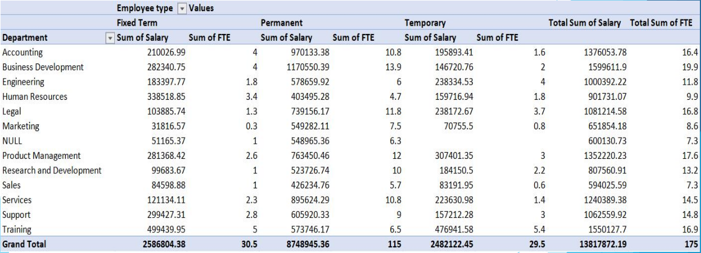
RESULTS
11

Slide 12
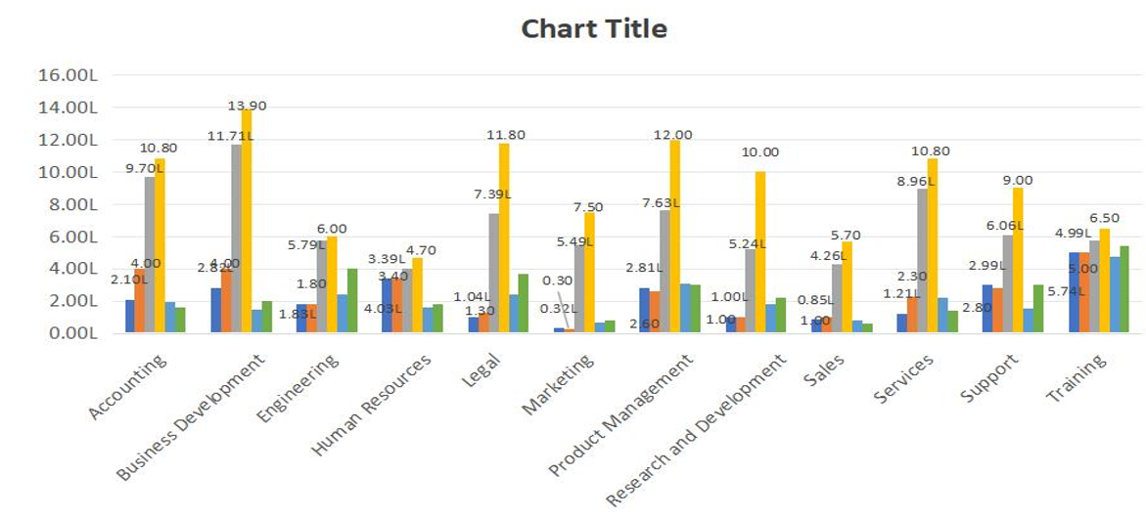
Bar Diagram

Slide 13
conclusion
In conclusion, our analysis of salary data across departments and employee types has revealed significant variations and disparities in compensation. The insights gained highlight areas where salary adjustments may be needed to ensure fairness and equity. By addressing these disparities, the organization can enhance its compensation practices, improve employee satisfaction, and align salary structures with its strategic goals. Implementing the recommendations from this analysis will support more effective budget management and foster a more equitable work environment.

