Slide 1

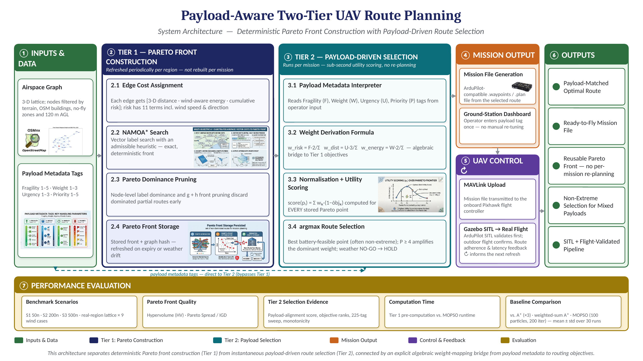
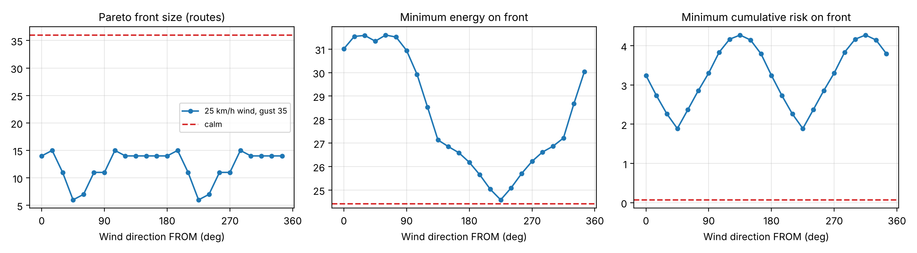
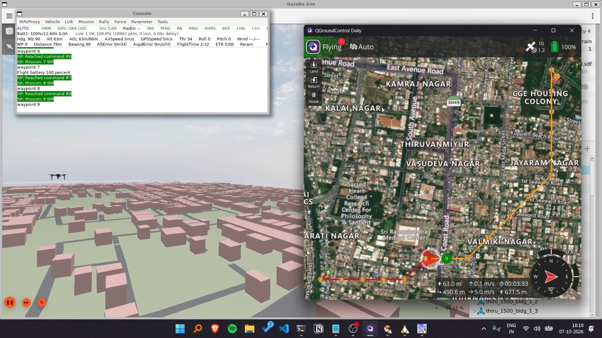
Sri Sivasubramaniya Nadar College of Engineering
Department of Computer Science and Engineering
PAYLOAD-AWARE TWO-TIER UAV ROUTE PLANNING FOR LAST-MILE DELIVERY
Thirumurugan RA, 3122235001149 Meghna Manimaran, 3122235001079 Shrika SP Thota, 3122235001125
Guide: Dr. N. Sujaudeen, Assistant Professor, Department of CSE
Problem Statement & Objectives
Methodology
Results and Analysis
Problem Statement
Existing UAV planners pick a route from the Pareto front with a payload-blind rule (entropy, crowding distance) or a weighted sum fixed before the search, so every payload change needs expert re-tuning and a fresh search. Given a stored front and payload tags (fragility F, weight class W, urgency U, priority P), select the best route with no re-tuning and no re-search, in under 1 s.
Objectives
1. Precompute an exact Pareto front (NAMOA*) over a 3-D airspace graph
2. Model terrain, buildings, no-fly zones and direction-aware wind per edge
3. Map payload tags to selection weights with an explicit formula
4. Benchmark Tier 1 against A* and MOPSO (HV, IGD, spread)
5. Show Tier 2 picks suit the payload, incl. non-extreme routes, in <1 s
6. Export the route as an ArduPilot mission; verify in Gazebo + SITL
Tier 1 vs baselines (first pass; HV higher, IGD lower is better)
Scenario | Method | Routes | Time (s) | HV | IGD
S2 (200) | NAMOA* (Tier 1) | 16 | 0.162 | 1.2065 | 0.000
S2 (200) | MOPSO | 12 | 1.505 | 1.2061 | 0.017
S2 (200) | A* energy | 1 | <0.001 | 1.083 | 0.648
S3 (500) | NAMOA* (Tier 1) | 115 | 33.761 | 1.1235 | 0.000
S3 (500) | MOPSO | 38 | 4.326 | 1.1146 | 0.043
S3 (500) | A* energy | 1 | 0.002 | 0.674 | 0.442
NAMOA* recovers the whole reference front (IGD 0) with the best HV; MOPSO finds only 12 and 38 routes and A* one. Exactness costs 33.8 s on S3, paid once per region and weather window.
Tier 2 picks on the S3 front (115 routes)
Preset (F, W, U, P) | Dist | Energy | Risk | Risk rank | Point type | Latency
Fragile medical (5,1,1,3) | 41.02 | 45.86 | 1.92 | 25 | non-extreme | 0.144 ms
Emergency medicine (1,1,3,5) | 37.11 | 44.71 | 6.56 | 94 | non-extreme | 0.140 ms
Disaster relief (1,3,1,2) | 37.52 | 44.27 | 5.63 | 88 | min-energy | 0.136 ms
Mixed cargo (3,2,2,3) | 39.90 | 45.06 | 2.74 | 32 | non-extreme | 0.136 ms
Related work and research gap
Author / Year | Proposed Method | Key Findings | Limitations
Chokkalingam & Ganesan (2026) | POPSO with Pareto-entropy archive | Well-spread fronts; better path efficiency and safety | Final pick by hand-set weighted sum; wind is speed-only; no payload
Ren et al. (2019) | CDNSGA-II over an octree city model | Spread-out, collision-free distance/safety paths | Pick by crowding distance only; no mission context or wind
Deng et al. (2026) | MS-INSGA2: adaptive operators + local search | Beat 11 algorithms on 3-D planning tasks | No payload context; wind left to future work; front rebuilt per task
Mandow & Pérez de la Cruz (2010) | NAMOA*: label-based multi-objective A* | Exact Pareto front with admissible heuristics | Says nothing about which route to fly
Tsoutsouras et al. (2020) | Mass- and speed-aware power model, multi-drop planning | Near-optimal on-board trajectories in ~320 ms | One trajectory, no front; mass is physical, not a selector
Four presets get four different routes, three non-extreme. Fragile medical flies 10.5% further than emergency medicine for 71% less risk; disaster relief takes the min-energy route.
Tier 1 (once per region and weather window): every edge gets a cost vector [distance, wind-aware energy, 11-component risk]; NAMOA* finds all non-dominated routes and stores the front with its weather snapshot and expiry.
Tier 2 (per mission, <1 s): w_risk = 2F/S, w_dist = 3U/S, w_energy = 2W/S, S = 2F + 3U + 2W (P ≥ 4 boosts the largest weight by 10%); score(p) = Σ w_k (1 − normalised objective_k); route = argmax over the battery-feasible front, else HOLD.
Output & evaluation: the route is exported as a QGC WPL 110 / .plan mission, uploaded over MAVLink and flown in ArduPilot SITL + Gazebo; Module 5 scores every run with the metrics on the left.
Wind direction sweep on S2 (25 km/h, gust 35; dashed = calm air)
Research gap
Gap 1 No payload-aware selection: fixed rule, hand-tuned sum, or none
Gap 2 No front reuse: search is re-run whenever the mission changes
Gap 3 No explicit mapping from payload description to trade-off
Gap 4 Wind direction not modelled per edge; fronts carry no weather record
Our work: Tier 1 builds an exact front once per region and weather window; Tier 2 turns payload tags into weights and picks the best route from that stored front.
Functional Modules and Dataset Description
Panels: front size, minimum energy and minimum cumulative risk as the wind turns 360°. Direction alone moves the cheapest route's energy by 27.5%; opposite winds give equal risk (same crosswind) but different energy (headwind vs tailwind), and the front shrinks from 36 routes in calm air to 6–15.
Modules
M1 Airspace Graph Builder: 3-D lattice; wind-aware energy + 11-component risk
M2 Tier 1 Pareto Engine: NAMOA* + front store with drift-based refresh
M3 Baselines: A* (distance / energy / risk), weighted-sum A*, MOPSO
M4 Tier 2 Payload Interpreter: tags → weights → argmax; battery & weather HOLD
M5 Evaluation: HV, IGD, spread, alignment score, 225-tag sweep
M6 Mission Export & Dashboard: QGC WPL 110 / .plan files, Tkinter UI
M7 Simulation: Gazebo Harmonic + ArduPilot SITL, flown-track metrics
Dataset Description
Synthetic graphs (seeded): S1 50, S2 ~200, S3 500 nodes; wind 12–28 km/h
Real-region lattice: 6 km box, 200 m spacing → 893 nodes, 6,752 directed edges
Sources: Open-Meteo weather, Copernicus DEM, OpenStreetMap (Overpass)
Payload tags: 5 × 3 × 3 × 5 = 225 combinations, 4 reference presets
Simulation bundle: 1.5 km frozen region (terrain, buildings, roads, pads)
Tier 2 mission flown in Gazebo + ArduPilot SITL
Gazebo city world from OSM buildings (left), MAVProxy console reaching each waypoint and the QGroundControl mission view (right).
Upload, read-back, AUTO, landing and disarm all succeeded: cross-track RMS 0.11–0.13 m, landing offset 0.01–0.02 m.
Evaluation Metrics
Reference front = non-dominated union of every route found by every method; objectives min–max normalised.
Metric | What it measures | Better
Hypervolume (HV) | Objective space the front dominates, up to reference point [1.1, 1.1, 1.1] | Higher
IGD | Mean distance from each reference route to the nearest found route | Lower; 0 = exact
Spread Δ | How evenly the routes cover the front out to its extremes | Lower
Alignment A | Σ w_k (1 − (rank_k − 1)/(K − 1)): rank-based fit of a pick to its weights | Higher
Latency / monotonicity | Tier 2 time per pick; raising F, U or W never raises risk, distance or energy (225 tags) | < 1 s; 0 violations
Cross-track RMS / landing offset | Flown SITL track vs planned route; touchdown distance from the pad | Lower (m)
Conclusion and future work
Conclusion: Tier 1 gives an exact front (IGD 0) once per region and weather window; Tier 2 turns payload tags into distinct, payload-appropriate routes in ~0.14 ms, and those routes fly in SITL within 0.13 m of the plan. Wind direction must be modelled per edge.
Contribution: an explicit formula from payload tags to Pareto selection weights over a reusable exact front: no expert re-tuning and no re-search per mission.
Future work: full MOPSO benchmark (100 × 200 × 30 runs, significance tests), wind in Gazebo and battery calibration; Phase II on a Pixhawk F450 with Raspberry Pi 5 running Tier 2 on board.

