Slide 1
Final Project-Based Learning Review
AI-Powered Intelligent Document Search and Analytics
Team members: M. SRIHITHA | Y. AKSHAYA | T. VARSHA
Guide: Dr. Aftab Yaseen

Slide 2
SLIDE 1 — PROBLEM STATEMENT AND MOTIVATION
Problem Statement and Motivation
Traditional document search depends on exact keywords, so it often misses context and semantic meaning. This makes it hard to find the right information quickly in large document collections.
Large collections are hard to search manually
Keyword search misses synonyms and context
Users spend too much time finding relevant content
Target users: educational institutions, research teams, organizations, and libraries.
Traditional Search
Semantic Search
Exact word matches only
Limited context understanding
Can return incomplete results
Understands intent
Finds relevant documents
Improves speed and accuracy

Slide 3


SLIDE 2 — PROPOSED SOLUTION AND OBJECTIVES
Proposed Solution and Objectives
The proposed system combines AI/NLP semantic search with document analytics in one unified platform.
Solution Overview
How It Fits Together
Semantic Search
Finds meaning, not just keywords.
Unified System
Document Analytics
One interface for search and analysis.
Extracts summaries and key insights.
Integrated Workflow
Search and analysis work together.
Semantic Search
Document Analytics
Find relevant documents.
Surface key insights quickly.
Users search first, then analyze selected documents for actionable results.
Project Objectives
01
02
Semantic retrieval
Document analytics
03
04
User-friendly interface
Scalable system

Slide 4
SLIDE 3 — SYSTEM ARCHITECTURE AND TECHNICAL COMPETENCE
System Architecture and Technical Competence
The system follows a modular pipeline: documents are ingested, preprocessed, analyzed with AI/NLP, and returned through a searchable interface. Each stage is separated to keep the architecture scalable and easy to extend.
Together, these modules support semantic retrieval, document understanding, and interactive exploration of results.

Slide 5
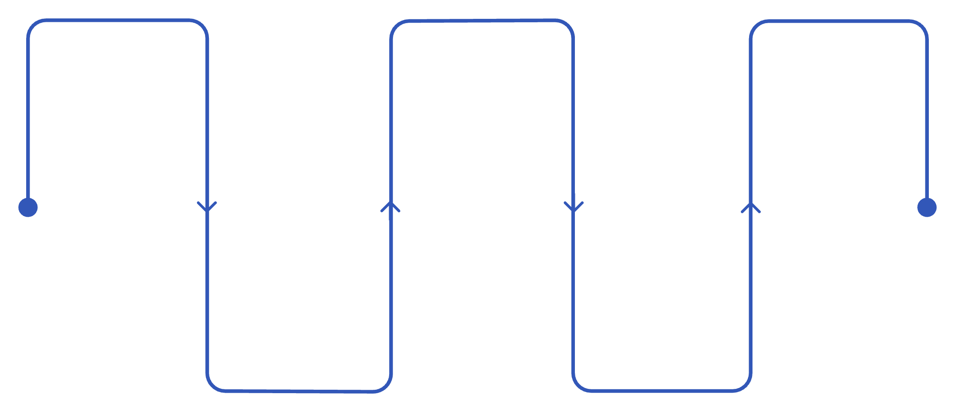

SLIDE 4 — IMPLEMENTATION AND WORKING DEMONSTRATION
Implementation and Working Demonstration
The system demonstrates end-to-end semantic document search, from upload and preprocessing to retrieval and result display.
Document Upload / Access
Semantic Search
Analytics View
Results Display
Query Input
Implemented Features
Key Contribution
1
2
AI/NLP goes beyond keyword matching. A query like "climate change impact" can surface documents about "global warming effects" through semantic relevance.
Document Ingestion and Preprocessing
Semantic Search
Completed vs. Planned
Prepares uploaded documents for search.
Finds relevant content by meaning and context.
Completed
Planned
3
4
Core semantic search, basic analytics, and UI.
Multi-language support and expanded format support.
Document Analytics
User Interface
Summaries and key insights from results.
Simple workflow for search and review.

Slide 6
SLIDE 5— ACCURACY OF RESULTS
Accuracy of Results
This slide summarizes how the system’s output accuracy was evaluated and what the early results showed. The main checks focused on whether returned documents matched the expected ground truth and whether results were relevant and consistent.
Evaluation Approach
01
02
03
Test cases performed
Procedure and methodology
Metrics used
Representative search queries were used to check expected document retrieval.
Each query was compared with the expected answer set and reviewed for relevance.
Accuracy was reviewed using precision, recall, F1-score, relevance, and response time.

Slide 7
SLIDE — TECHNICAL COMPETENCE
Technical Competence
This slide highlights the project's core technical depth: document processing, semantic retrieval, and system integration.
01
02
03
Preprocessing
Semantic Retrieval
Integration
Documents are extracted, cleaned, normalized, and prepared for search.
Embeddings and vector similarity are used to rank relevant results beyond exact keyword matching.
Upload, processing, search, and result display are connected through working APIs.
Technical Choices
Error Handling and Scalability
Vector-based retrieval improves relevance over exact string matching.
The system is designed to stay practical, maintainable, and easy to demonstrate.
Errors are handled during upload, parsing, indexing, and query execution.
Indexed storage and modular processing support growth to larger document collections.

Slide 8

SLIDE 7— INNOVATIVE AND SUSTAINABLE FEATURES
Innovative and Sustainable Features
Our project combines semantic retrieval, analytics, and a unified workflow to improve document search while remaining maintainable and ready for future expansion.
Innovation Beyond Conventional Search
Sustainability and Responsible Design
Context-aware retrieval
Maintainability
Search is based on semantic meaning, not just exact keyword matching.
Clear modular code structure makes future updates easier.
Unified workflow
Document search and analytical insights are combined in one interface.
Efficient resource usage
Better discovery
Optimized indexing and retrieval help keep processing lightweight.
Users find relevant information faster with less manual searching.
Accessibility
User-friendly design supports diverse users and easy interaction.
Comparison with Conventional Approaches
Approach | What it does | Key advantage
Traditional keyword search | Relies on exact matches only | Simple, but limited in relevance and flexibility
Proposed system | Uses semantic understanding, context awareness, and integrated analytics | Finds more relevant results and improves information discovery
Demonstrated vs. Planned Innovations
Demonstrated
Planned
Semantic search
Basic analytics
Unified interface
Multi-language support
Advanced analytics
Expanded format support
Performance optimization

Slide 9


SLIDE 8 — UTILITY TO SOCIETY
Utility to Society
The proposed system makes document search more useful by helping people find relevant information faster.
Real-World Use Cases
Expected Benefits
Educational institutions
Time savings
Students and researchers can find papers and course materials faster.
Users reach relevant information faster.
Research teams
Productivity
Scientists can discover related studies and supporting data across large collections.
Teams spend less time searching and more time using information.
Organizations
Quality
Employees can access company documents and internal knowledge more efficiently.
Search returns more relevant results.

Slide 10

SLIDE 9 — TESTING, LIMITATIONS, AND FUTURE SCOPE
Testing, Limitations, and Future Scope
This slide summarizes the validation already completed, the current constraints of the system, and a realistic roadmap for future improvements.
Testing Completed
Current Limitations
Unit tests
Integration tests
Large-scale processing
Covered preprocessing and retrieval modules.
Validated the end-to-end workflow.
Very large batches need more time and resources.
Manual and UI testing
Data quality dependence
Checked search accuracy, analytics output, and usability.
Noisy or poorly structured text reduces results.
Format and language scope
Support is limited for non-text formats and currently English only.
Future Scope
Broader document support
Better retrieval and scaling
Multi-language analytics
Add OCR and better handling for PDFs and image-based content.
Improve relevance scoring, indexing, caching, and performance.
Expand beyond English and add richer insight extraction.

Slide 11


SLIDE 10 — CONCLUSION AND FINAL OUTCOMES
Conclusion and Final Outcomes
This project delivers a practical AI/NLP workflow for semantic search and document analytics.
Key Outcomes
Strongest Contribution
Semantic search
Embeddings and vector similarity combined with analytics in one workflow.
Finds relevant information beyond keyword matching.
Practical Use Case
Document analytics
Best suited for research and academic document discovery.
Extracts useful insights from the collection.
Scalable workflow
Designed to handle growing document sets.

Slide 12
SLIDE 11 — OVERALL CONTRIBUTION SUMMARY
Key Takeaways and Next Steps
Key Takeaways
Semantic search improves document retrieval.
Search plus analytics delivers actionable insights.
The system is practical, scalable, and deployment-ready.
What Makes This Project Strong
Real Problem
Technical Breadth
Working System
Solves a genuine need.
Covers NLP, backend, frontend, and data.
End-to-end functionality is in place.
User Value
Clear benefits for users and organizations.
Next Steps
01
02
Gather Feedback
Optimize Performance
Collect input from users.
Improve speed and scale.
03
Expand Support
Add PDFs, OCR, and multilingual support.
Final Statement: "This project shows that intelligent document search is valuable and ready to grow."

