Slide 1
RECRUITING ASSISTANT FOR HR MANGERS

Slide 2
1. INTRODUCTION
1.1 OVERVIEW:
IN THIS PROJECT, WE USE CUSTOM OBJECTS, RELATIONSHIPS, PAGE LAYOUTS TO GIVE THE HR TEAM EASY ACCESS TO DATA THEY NEED ON AN EXISTING RECRUITMENT APP.
To make the existing app more efficient for the HR Team create Custom objects and Relationship to stores and access the data more efficiently

Slide 3
1.2PURPOSE
The recruitment function of HR includes analyzing the requirements of an available job, attracting suitable candidates to the position, carefully screening and selecting all applicants, hiring, and seamlessly integrating new employees and roles into the organization.

Slide 4
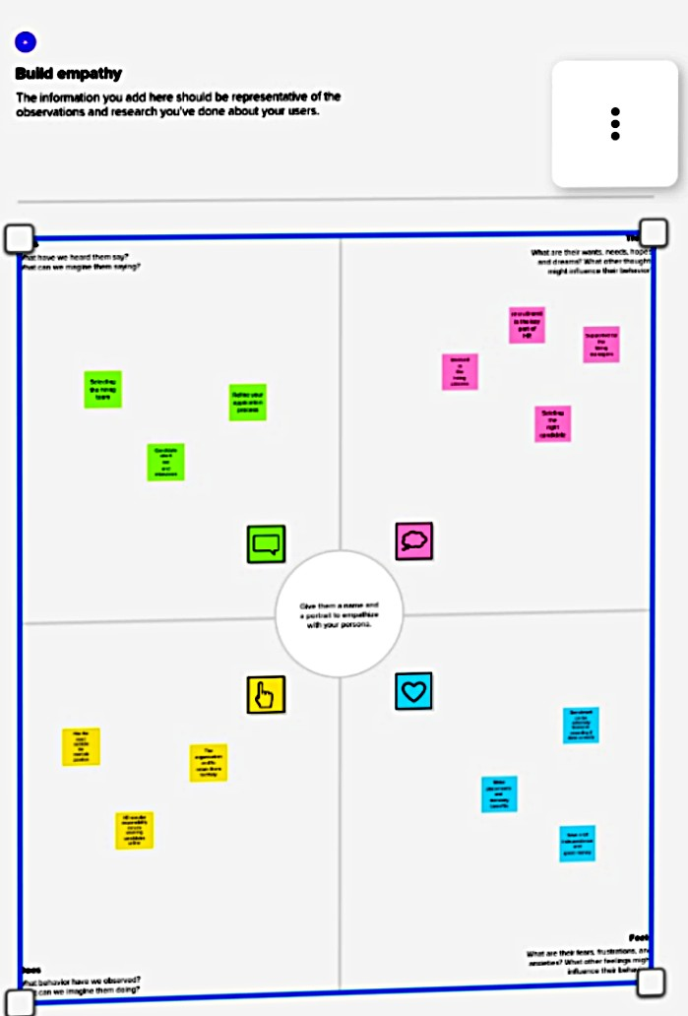
2.PROBLEM DEFINITION AND DESIGN THINKING
2.1 EMPTHY MAP

Slide 5
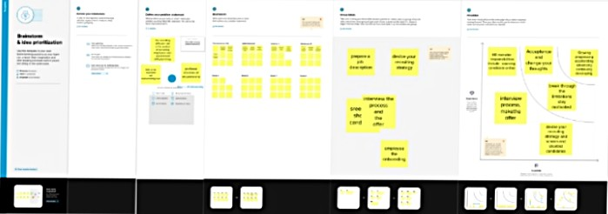
2.2 Brainstroming And ideation

Slide 6
3.RESULTS
3.1DATA MODEL
OBEJECT NAME | FIELDS IN THE OBJECT
Obj1
Obj2
Field label | Data type
Job posting site | Text
Reviews | Auto number
Field lable | Data type
Job posting site | Master detail relationship
Position | Master detail Relationship

Slide 7
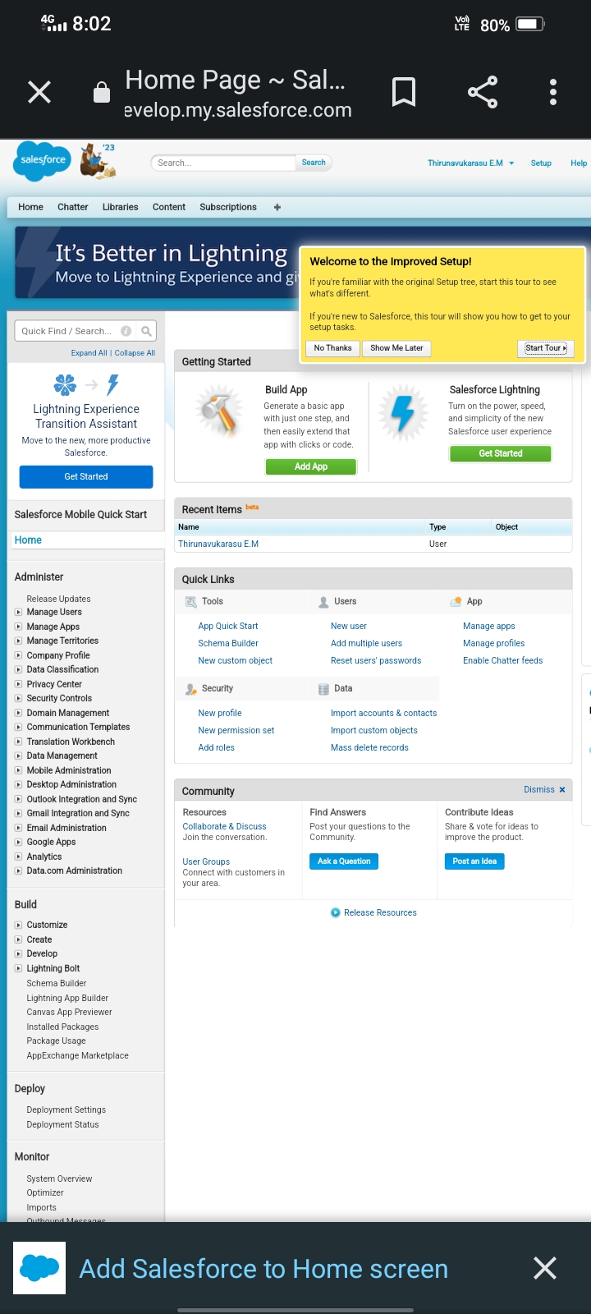
3.2.Activity AND SCREEN SHORT

Slide 8
4.TAILHEAD PROFILE URL
.TEAM LEADER- https://trailblazer.me/id/thiem5
TEAM MEMBER.1-http://trailblazer.me/id/manii23
TEAM MEMBER.2 –https://trailblazer.me/id/anbam7
TEAM MEMBER.3 –https://trailblazer.me/id/kkathir19

Slide 9
5.ADVANTAGES AND DISVANTAGES
Reduce time to hire. ... Shorten onboarding times. ... Cost less. ... Strengthen employee engagement. ... Create resentment among employees and managers. ... Leave a gap in your existing workforce. ... Limit your pool of applicants. ... Result in inflexible culture.

Slide 10
5.1 DISADVANTAGES
Creating jealousy. Hiring internally may create unnecessary jealousy among employees. ... Making a hole in the team. Promoting or hiring from within may leave a gap in a team or department. ... Limiting the application pool. ... Creating an inflexible culture. ... Encouraging unfair promotions.

Slide 11
6.APPLICATIONS
HRIS (human resources information system) is a type of business application that enables companies to store employee information, manage common HR functions, and execute critical HR activities such as processing payroll and administering benefits.
Features of HRIS applications include an employee self-service portal, payroll, workforce management, recruitment and hiring, benefits administration, and talent management. These capabilities are often delivered through individual modules that form a unified suite of HR tools

Slide 12
7.CONCLUSION
Recruitment and selection is critical to the organization just like human resources. In fact, the quality of human resources is a direct outcome of the recruitment and selection process. As such, recruitment process begins with identification of vacancies existing in the organization until the employees are finally inducted into the organization as new employees. Irrespective of the fact that the hiring decisions are made by the HR, line managers, supervisors, and subordinates contributes to the recruitment and selection process. Ideally, there are basically two sources of employment which includes both the internal and external sources. The Job search process forms an integral part of the recruitment process since it is a potential source of recruitment

Slide 13
7.FUTURE SCOPES
The future of Recruiting departments will need to upskill, track new metrics, and adopt new technologies. They will need to take on a more visible, strategic role within the business and will seriously rethink the way they see their job.

