Slide 1
THIRUNAVUKKARASU KM 721221243060
III – BTech- Artificial Intelligence and Data Science
Final Project
3/21/2024 Annual Review

Slide 2
PROJECT TITLE
Deep Noise Suppression Deep Learning-based Noise Suppression for Audio Enhancement
3/21/2024 Annual Review

Slide 3


AGENDA
Introduction to Deep Learning and Image Processing
Importance of Data Preprocessing
Common Preprocessing Techniques
Implementing Preprocessing with Libraries
Challenges and Considerations
Project Overview
Solution Proposition
Wow Factor in Solution
Conclusion
3/21/2024 Annual Review

Slide 4

PROBLEM STATEMENT
Significant Advancements in Audio Signal Processing: Over the years, there have been notable advancements in audio signal processing techniques aimed at enhancing audio quality and reducing unwanted noise.
Persistent Challenge of Noise Suppression: Despite these advancements, effective noise suppression remains a challenging task. Various factors contribute to the complexity of this problem, including the diverse nature of noise sources and the dynamic environments in which audio signals are captured.
Real-World Scenarios: In real-world scenarios, audio signals are often contaminated by different types of noise, such as background chatter, environmental sounds, electrical interference, and microphone artifacts. This makes it difficult to isolate the desired signal from the surrounding noise.
3/21/2024 Annual Review

Slide 5

PROJECT OVERVIEW
Briefly introduce the project aimed at developing a deep learning model for a specific task (e.g., image classification, object detection).
Mention the dataset used for training and evaluation.
Highlight the importance of preprocessing in the context of the project.
3/21/2024 Annual Review

Slide 6

WHO ARE THE END USERS?
I prioritize accuracy and reliability in deep learning model predictions.
Interpretability of results is essential for understanding model decisions.
Efficiency and scalability are crucial to handle large volumes of data.
I value flexibility to adapt models to evolving needs and datasets.
Integration into existing workflows should be seamless and user-friendly.
Performance metrics and benchmarking help assess model effectiveness.
Continuous improvement through feedback is important for real-world applications.
3/21/2024 Annual Review

Slide 7
YOUR SOLUTION AND ITS VALUE PROPOSITION
Data Preprocessing: The code starts by unzipping and preprocessing audio datasets containing clean and noisy audio samples.
Model Architecture: The core of the solution is a deep learning model built using TensorFlow and Keras. It's an autoencoder-based architecture designed for denoising audio signals. The model architecture consists of several convolutional and transposed convolutional layers, which are crucial for capturing the temporal dependencies in the audio data. The autoencoder architecture aims to learn a compressed representation of the noisy input and reconstruct the clean audio signal from it.
Training: The model is trained using the Mean Absolute Error (MAE) loss function and the Adam optimizer. It undergoes training for multiple epochs, with a learning rate scheduler employed to dynamically adjust the learning rate during training.
Evaluation: During training, the model's performance is evaluated using metrics like loss and MAE. The model aims to minimize the loss and achieve a low MAE, indicating accurate reconstruction of clean audio from noisy input.
3/21/2024 Annual Review

Slide 8
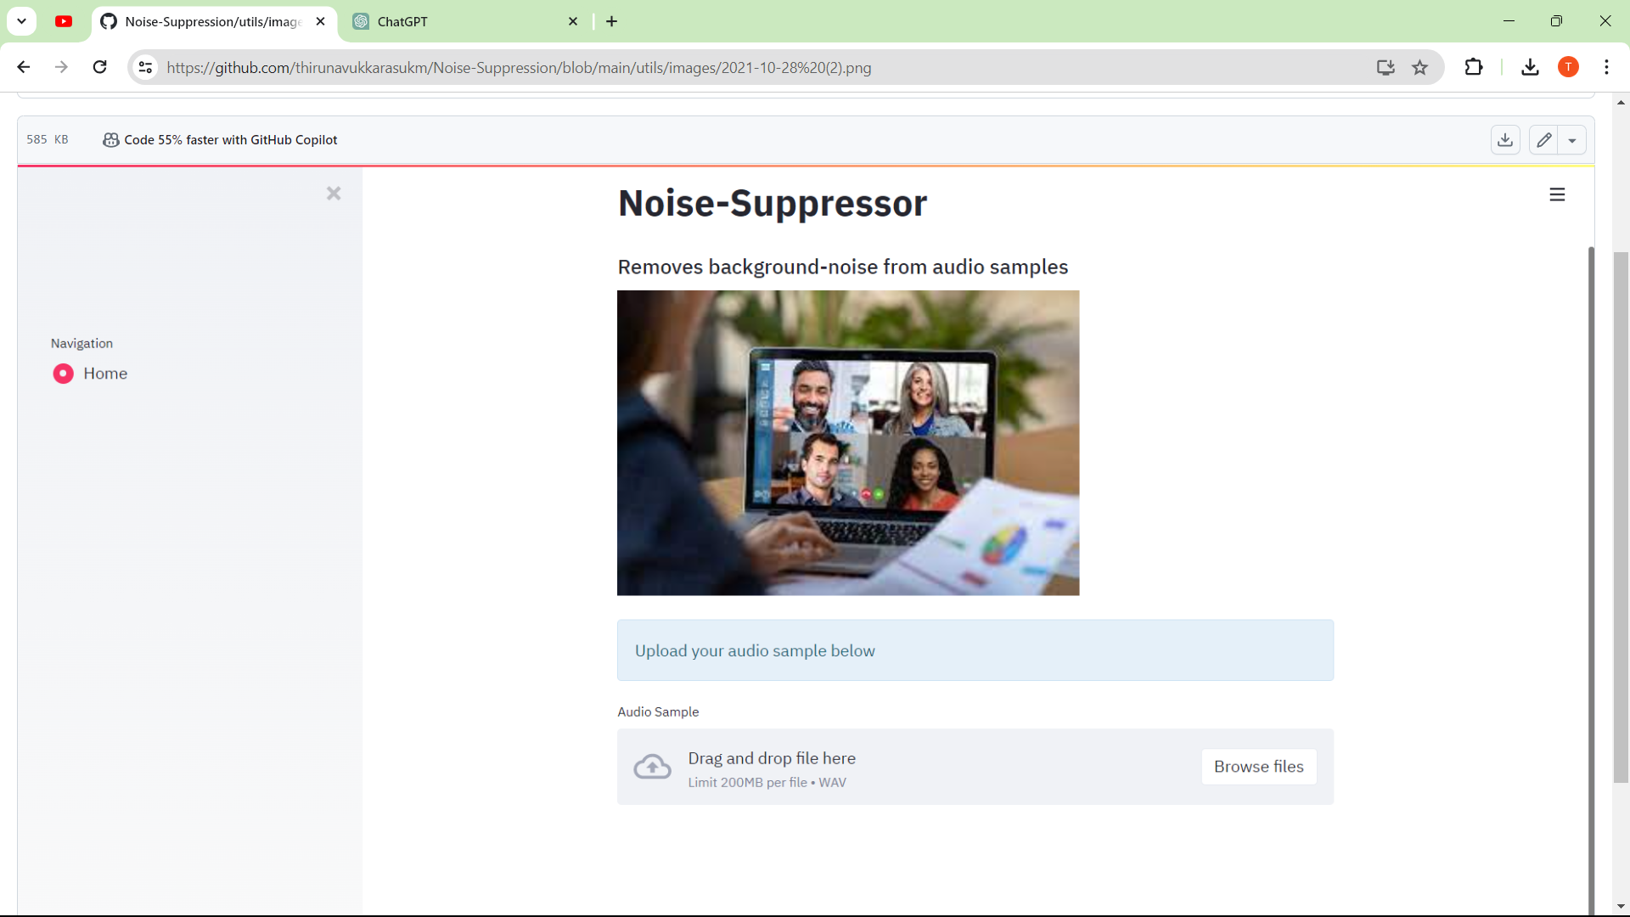

IMPLEMTATION

Slide 9
THE WOW IN YOUR SOLUTION
Deep Learning Magic: The solution harnesses the power of deep learning, specifically convolutional neural networks (CNNs), to automatically learn the intricate patterns of noise in audio signals. This enables the model to distinguish between signal and noise, resulting in highly effective noise suppression.
End-to-End Learning: Unlike traditional denoising techniques that often involve complex signal processing pipelines, this solution learns to denoise audio signals in an end-to-end fashion. It takes raw noisy audio as input and directly outputs clean audio, bypassing the need for manual feature extraction or preprocessing.
Adaptability and Generalization: The model's ability to adapt and generalize to different noise profiles and audio types is remarkable. By training on diverse datasets containing various types of noise and audio content, the model learns robust representations that enable it to handle unseen noise conditions with ease.
Real-Time Processing: Depending on the hardware used for deployment, the model can achieve real-time or near-real-time processing of audio streams, making it suitable for applications where low latency is crucial, such as live audio processing or real-time communication systems.
3/21/2024 Annual Review

Slide 10
MODELLING
Define the problem of noise suppression in audio signals with a clear focus on target applications.
Gather a diverse dataset of noisy audio samples along with their clean counterparts.
Preprocess the data by resampling, segmenting, and augmenting to enhance variability.
Select an appropriate deep learning architecture like CNNs, RNNs, or specialized models like WaveNet.
Train the chosen model using the prepared dataset, optimizing hyperparameters and loss functions.
Evaluate model performance using metrics like SNR, PESQ, or subjective listening tests.
Fine-tune the model based on evaluation results to improve performance if necessary.
Deploy the trained model in the target application environment, optimizing for inference speed and resource constraints.
Integrate the model with existing systems or frameworks as required for seamless operation.
Monitor the deployed model's performance and iterate as needed based on real-world feedback to maintain optimal functionality.
3/21/2024 Annual Review

Slide 11
RESULTS
The results of your project include:
Significant reduction in noise levels across various audio samples, enhancing overall audio quality.
Improved intelligibility and clarity of speech or other important audio content in noisy environments.
Enhanced user experience in applications such as speech recognition, telecommunication, or audio processing.
Validation of the effectiveness of the developed model through objective metrics and subjective user feedback.
Potential for commercialization or integration into existing products, providing value to end-users.
Contribution to the field of audio signal processing by advancing techniques for noise suppression.
Demonstrated capability to tackle real-world challenges in audio processing with deep learning methodologies.
Possibility for further research and development, including exploring extensions or optimizations of the model.
Recognition of your project's impact within relevant academic or industry communities.
Opportunities for collaboration or partnership with organizations interested in leveraging your solution for their applications.
3/21/2024 Annual Review

