Slide 1
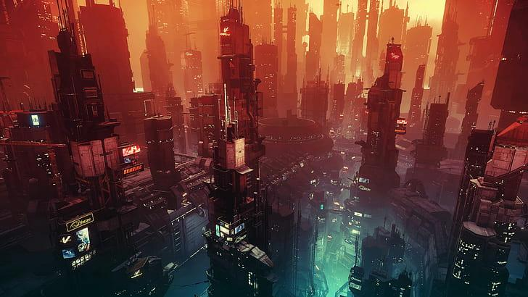
DIGITAL PURSUIT A CYBER BATTLE
DIGITAL PURSUIT
A
CYBER BATTLE

Slide 2

SCENE
SCENE-1
BEING HACKED

Slide 3
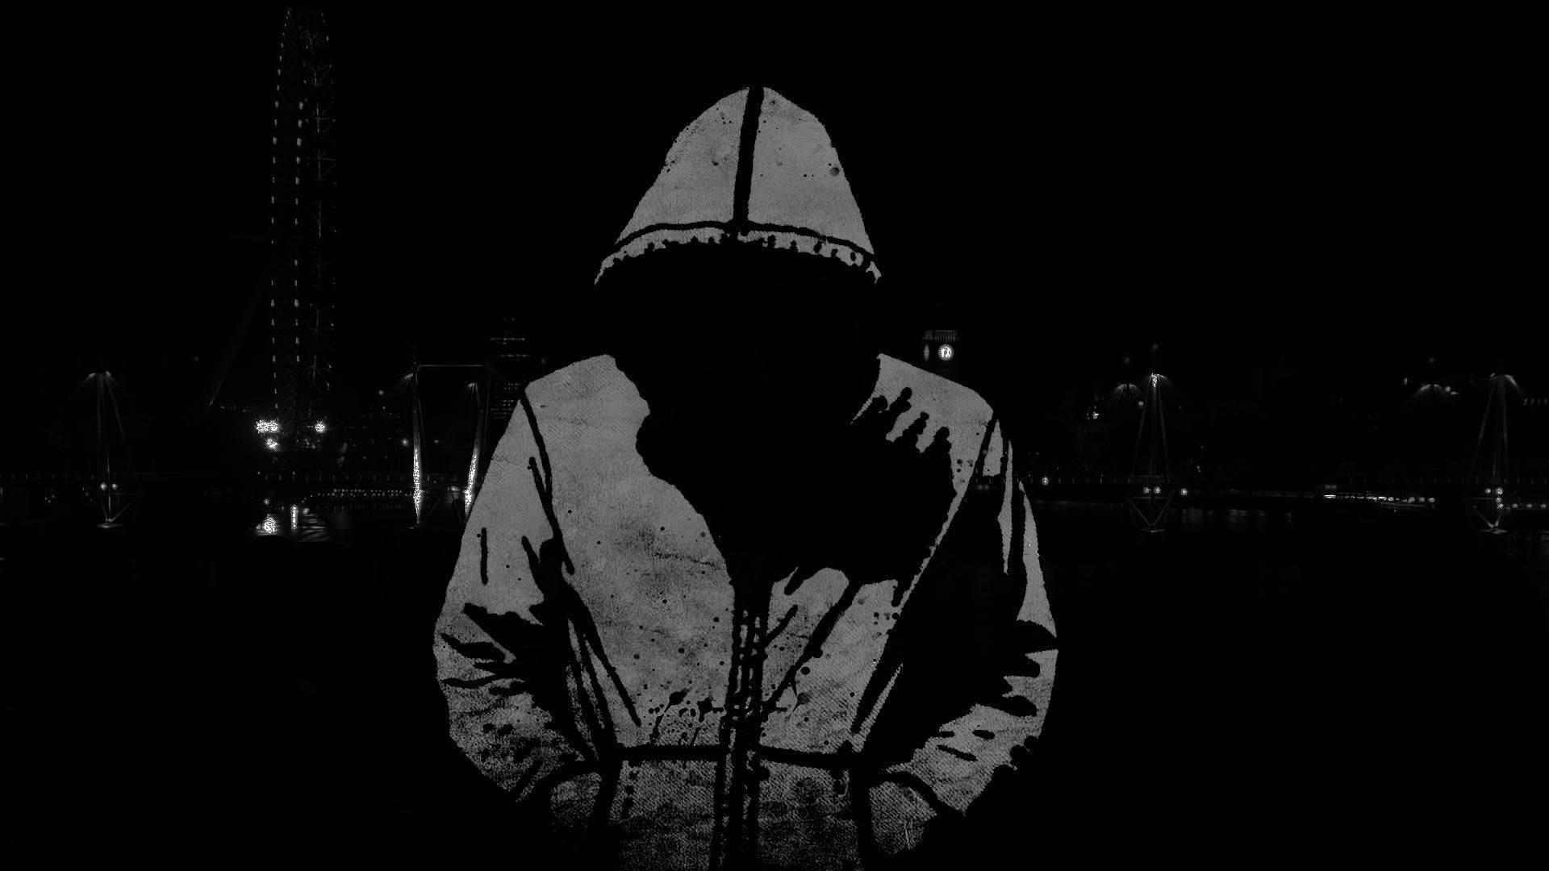

Slide 4
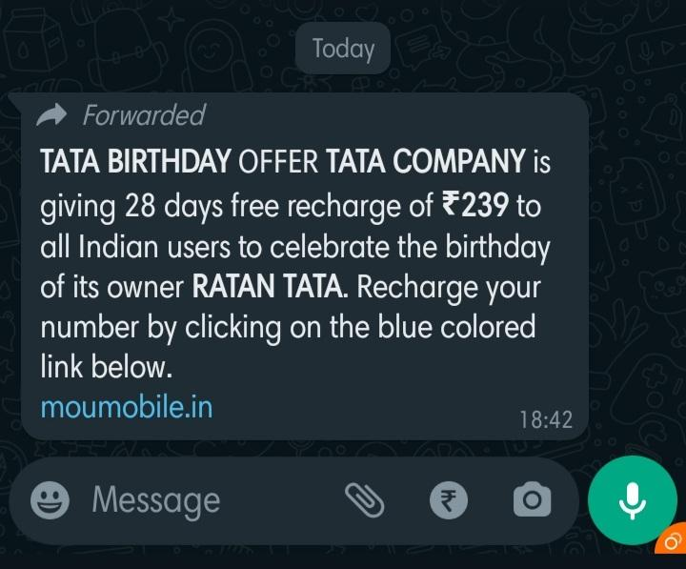

This Photo by Unknown Author is licensed under CC BY-SA

Slide 5
hey 119.2.168.1.1
I’m coming

Slide 6
SCENE-2
TO THE RESCUE

Slide 7

ANTONY ENTERS IN THE MOTIVE OF STEALING DATA

Slide 8

ROLEX COMES TO THE RESCUE

Slide 9

ROLEX FIGHTS AGAINST ANTONY,
BUT ANTONY IS POWERFUL

Slide 10

ANTONY STEALS THE DATA

Slide 11

BE SAFE..
BE SAFE..

Slide 12

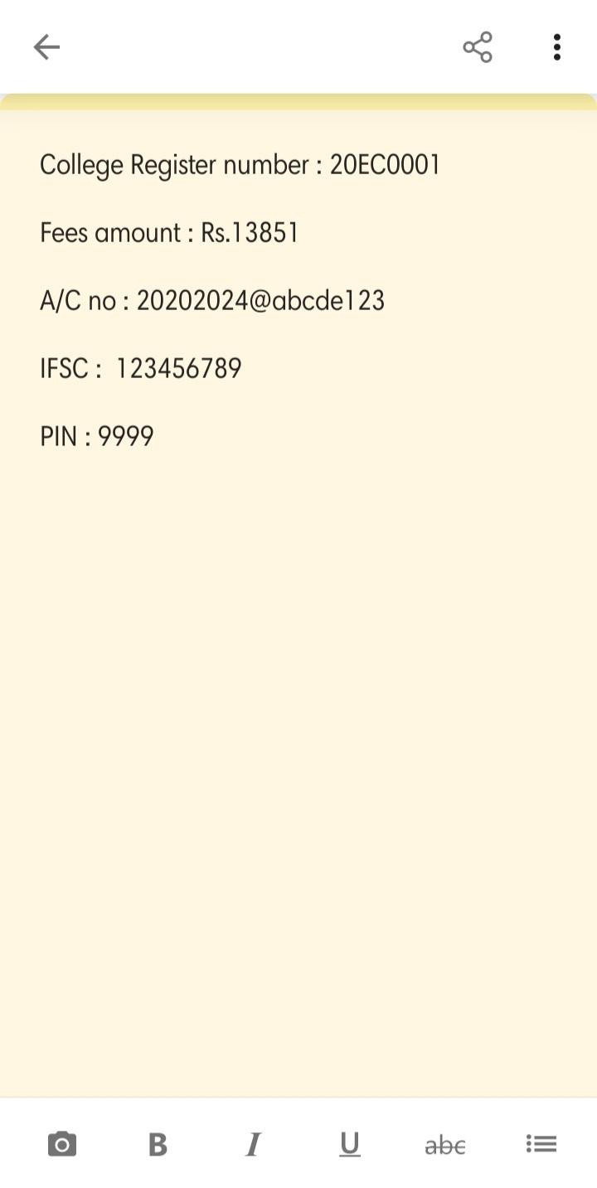

Slide 13

DILLI STARTS TO MALFUNCTION

Slide 14
SCENE-3
WHO IS LEO?

Slide 15

PARTHIBAN FINDS SOMETHING SUSPICIOUS ON DILLI

Slide 16

TEENA COMES TO THE RESCUE

Slide 17
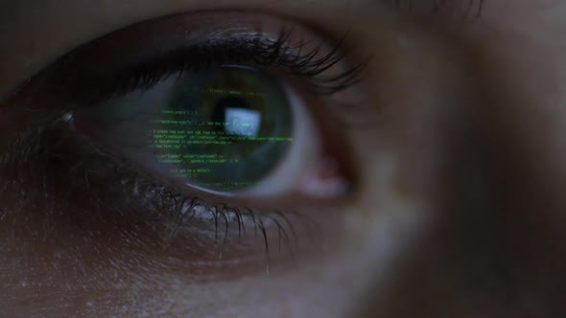
TEENA INVESTIGATES THE SCENE

Slide 18
TEENA INVESTIGATES TO ROLEX

Slide 19
TEENA INVESTIGATES TO ELISA

Slide 20
TEENA FINDS OUT LEO HAS SENT ANTONY

Slide 21
SCENE-4
THE CONCLUSION

Slide 22

TEENA TRIES TO FIND OUT LEO

Slide 23
CHINTU…. I GOT YOU
192.168.1.1
TRIES TO FIND OUT LEO BY HIS LOCATION

Slide 24


Slide 25


Slide 26

hey 119.2.168.1.1
I’m coming
LEO IS REACHABLE BY NO ONE

Slide 27

PREVENTION IS BETTER THAN CURE

Slide 28

THANK YOU……

