Slide 1

PUDUCHERRY TECHNOLOGICAL UNIVERSITY
Department of Electronics and Communication Engineering
REAL TIME MISSING OBJECT DETECTOR
(MINI PROJECT)
Guided By:
Dr.Gnanou Florence Sudha
Professor
Department of ECE,PTU
Presented by:
Murali.M 19EC2001
Thirumurugan.S 20EC1082
Anuragaa.S 20EC1083
Parimala Devi.T 20EC2004

Slide 2

Reaching out to find lost things

Slide 3
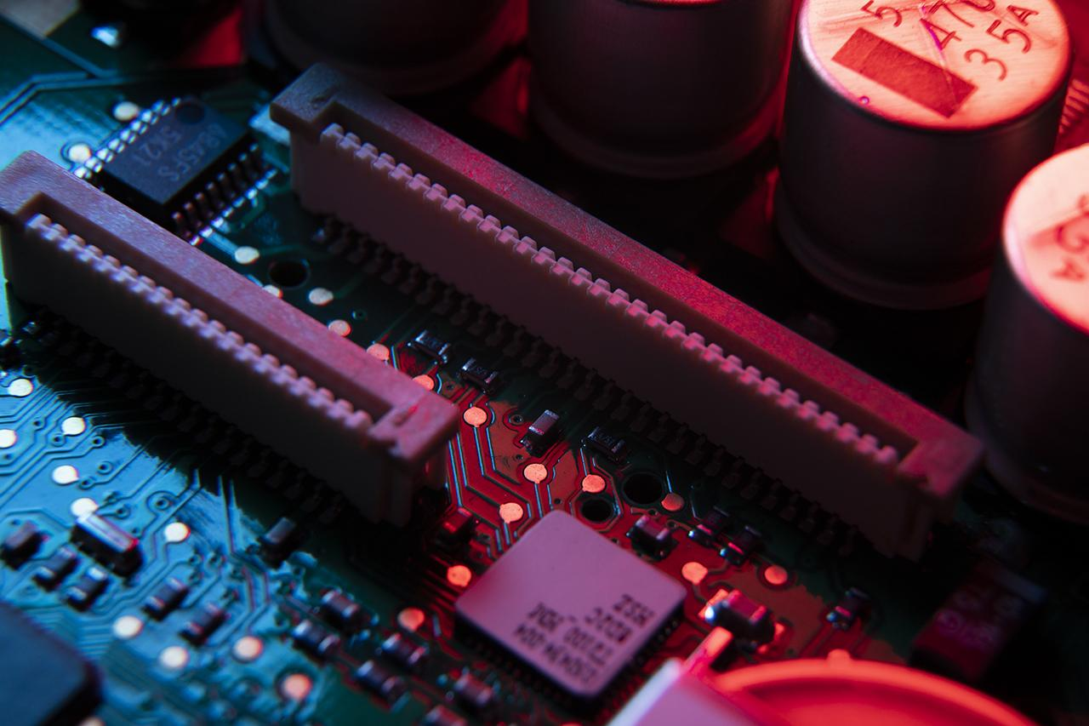
Agenda
Motivation
Objective
Existing system
Proposed solution
Abstract
Components required
Block diagram
Connections
Working
Source code
Sample inputs and outputs
Advantages
Conclusion
References

Slide 4
Motivation
Some objects play a vital role in day to day life.
There is no use for the object when it is not used in the correct time.
Bike keys,Medicines bag are very important and has to be used on time

Slide 5
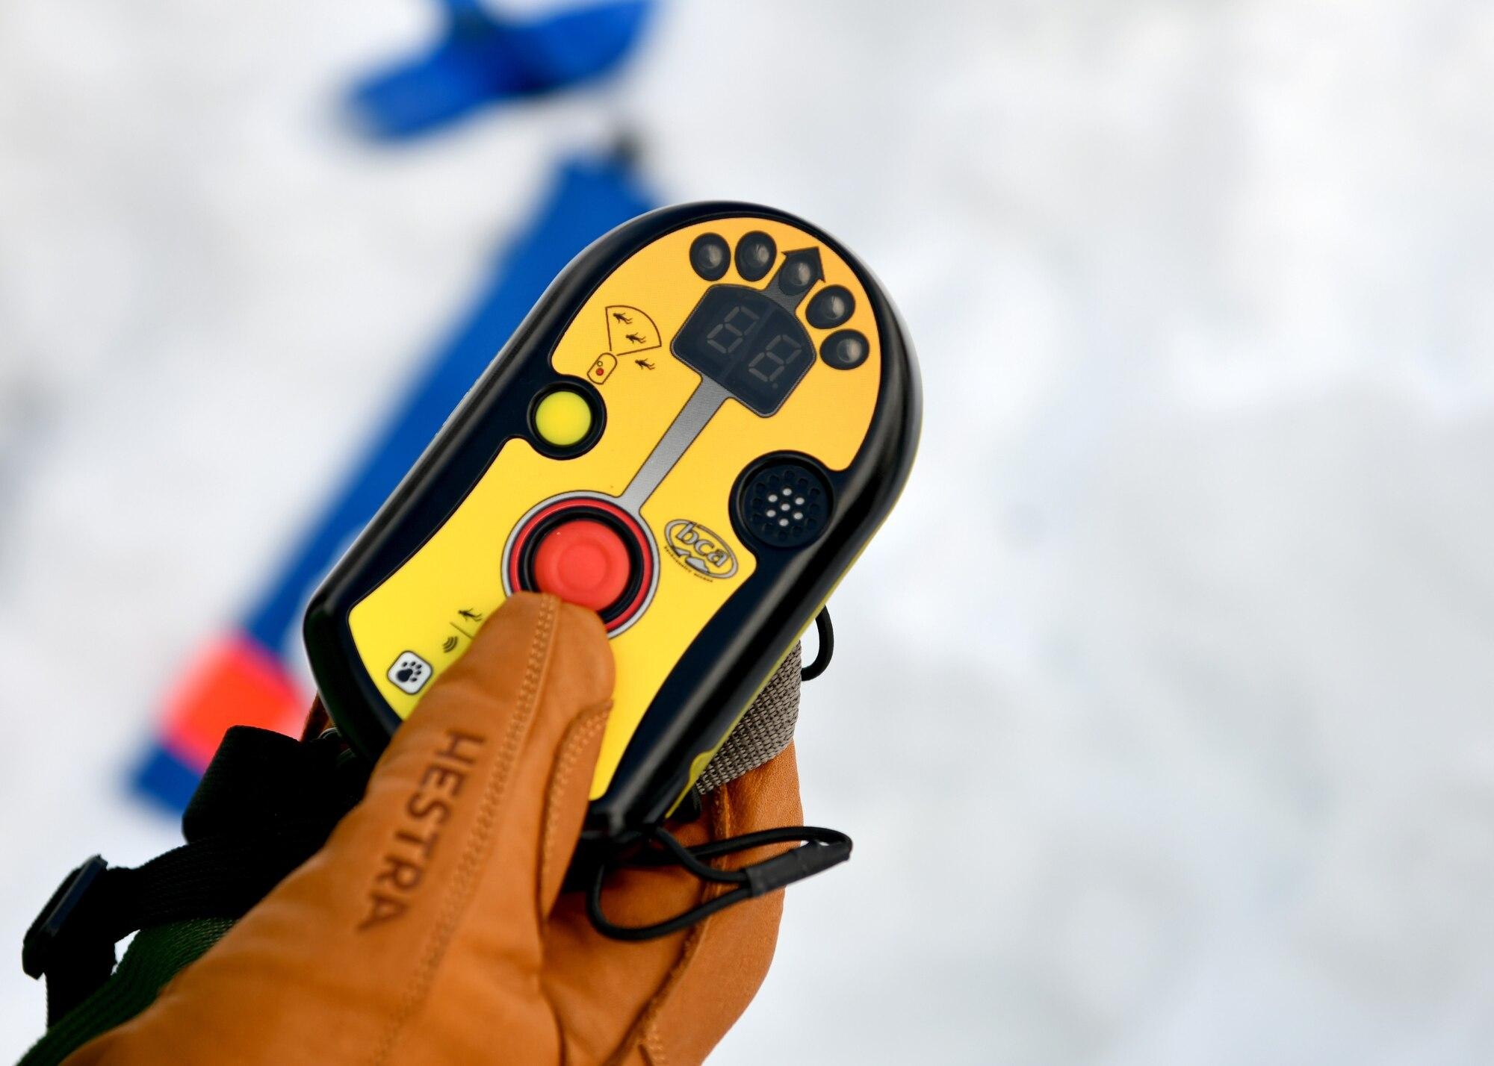
Objective
To develop a Real time object detection mechanism using Embedded electronics.
To identify a misplaced object using a Transceiver mechanism.

Slide 6

Existing system
Existing system uses GPS and GSM technology to locate objects
GPS technology is preferable in detecting object which are at outdoor locations ,But it is not suitable for indoor positioning

Slide 7
Proposed solution
GPS technology is preferred only in outdoor positioning
RF technology is the most suitable technology for Indoor positioning and it provides maximum accuracy with less number of equipments

Slide 8
Abstract
The main objective of this project is to identify a misplaced object using a transceiver mechanism. RF technology is most widely used technology and it is most suitable technology for indoor positioning because other tracking systems such as GPS cannot be used for indoor positioning. In this project,We propose to implement a system which detects the objects in home such as keys, mobiles, wallets, medicine box,etc. This system consists of RF transceiver of two modules (Finder module, Object module). RF transceiver of object module is attached to the objects. Finder module is a common device for all object modules. When the finder module is activated,It transmits a RF signal and the nearby object module will respond to the signal. From the response obtained from the object module, We can find and locate the missing object .

Slide 9
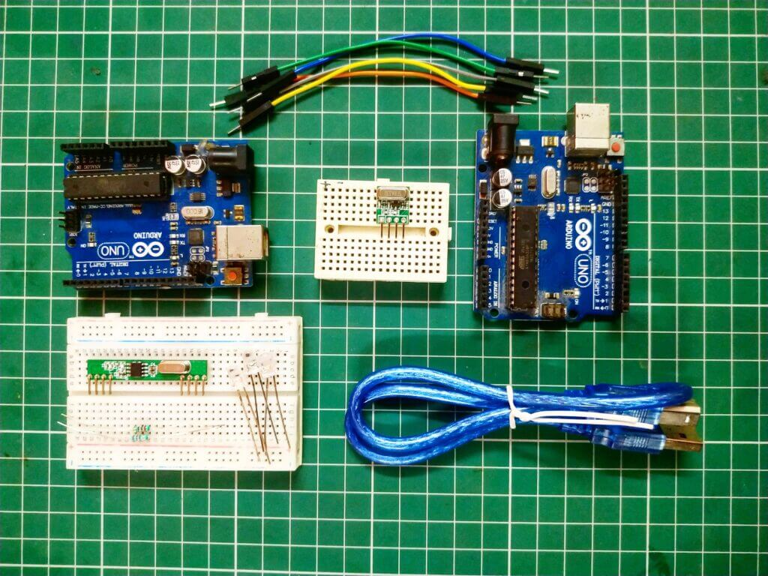
Components required
Arduino NANO microcontroller
Wireless RF transceiver
5v Power supply
Programming kit and IDE
LEDs
Buzzers
Connecting wires

Slide 10

Block Diagram
OBJECT MODULE 1
FINDER MODULE
RF Receiver
µc
µc
RF Transmitter
Power
supply
Power
supply
OBJECT MODULE 2
RF Receiver
µc
Power
supply

Slide 11
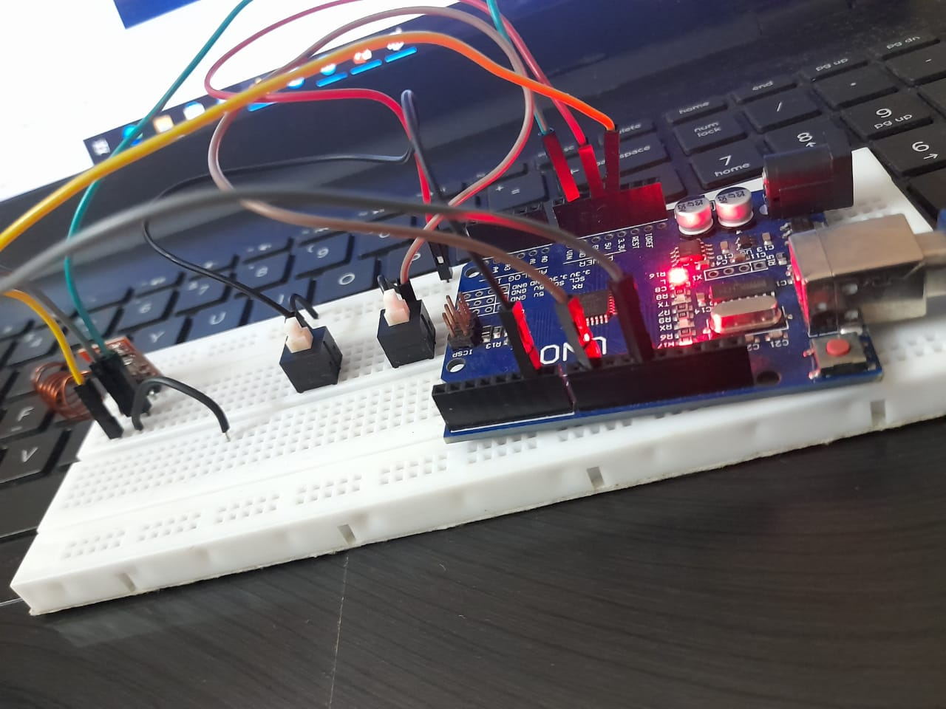
Connections
FINDER MODULE
2 switches connected to data pins D6 and D9 of Arduino UNO
433 MHz RF transmitter connected to data pin D12
A spring wire antenna connected to Antenna pin of RF Transmitter

Slide 12
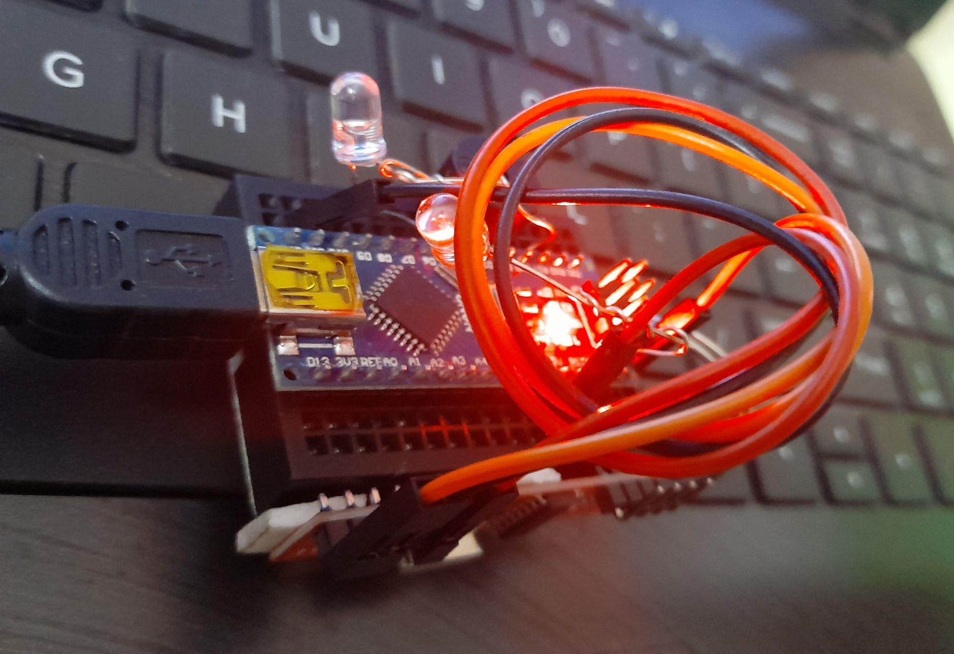
Connections
OBJECT MODULE 1
3 LEDs connected to data pins D2,D3 and D5 of Arduino NANO
433 MHz RF receiver connected to data pin D11
A buzzer connected to data pin D7

Slide 13
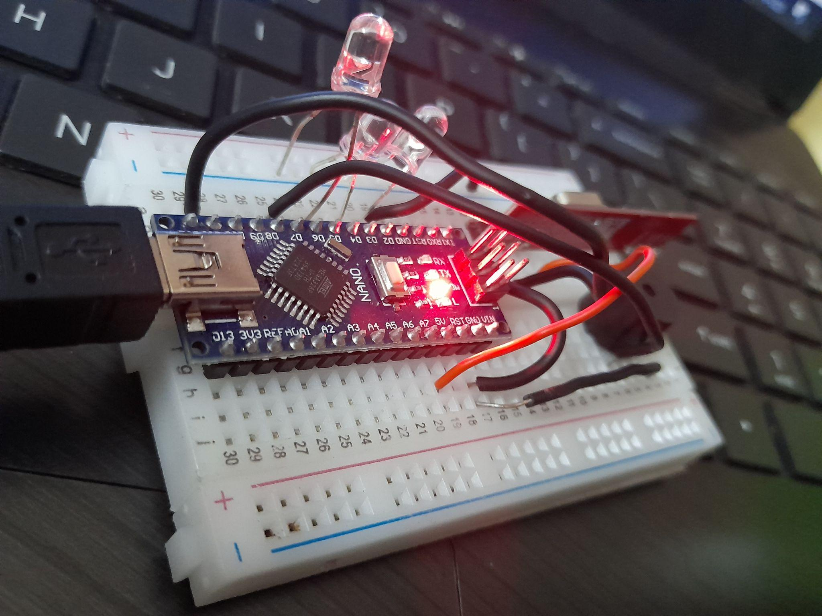
Connections
OBJECT MODULE 2
2 LEDs connected to data pins D7 and D8 of Arduino NANO
433 MHz RF receiver connected to data pin D11
A buzzer connected to data pin D4

Slide 14
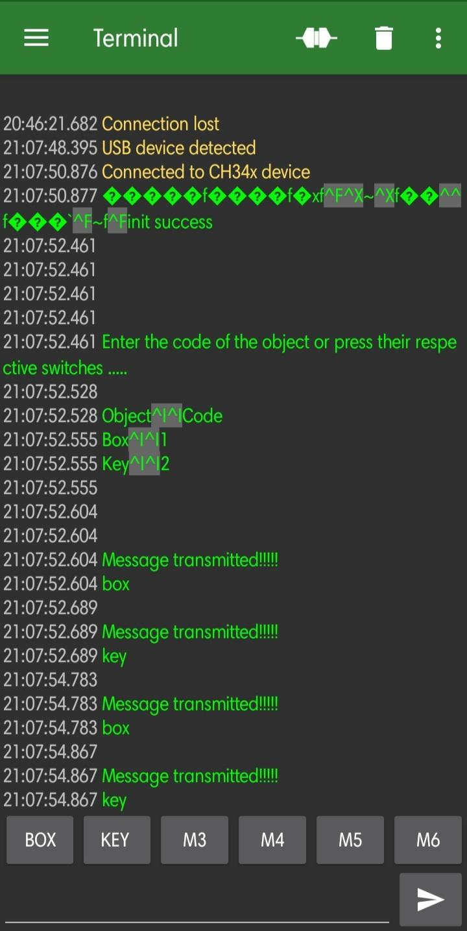
Connections
The finder module has been connected to a mobile device using a USB serial terminal mobile application.
This mobile application is used to communicate with the Arduino microcontroller and serially transmit data.

Slide 15
Working
The finder module has two switches, each of which corresponding to a single object module.
The data is sent by the transmitter module from the transmitter end(Finder module), and it is received by the receiver module at the receiver side(Object module).
The object module checks to see if the corresponding data has been received. If the data is correct, the buzzer beeps and the LED turns on, indicating that the object has been detected.
The finder module has a maximum range of 100 metres. It can detect objects on two floors in a house or office.

Slide 16
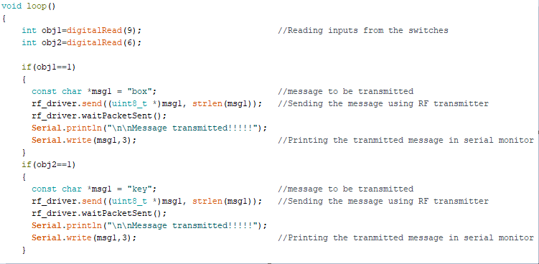
Source Code FINDER

Slide 17
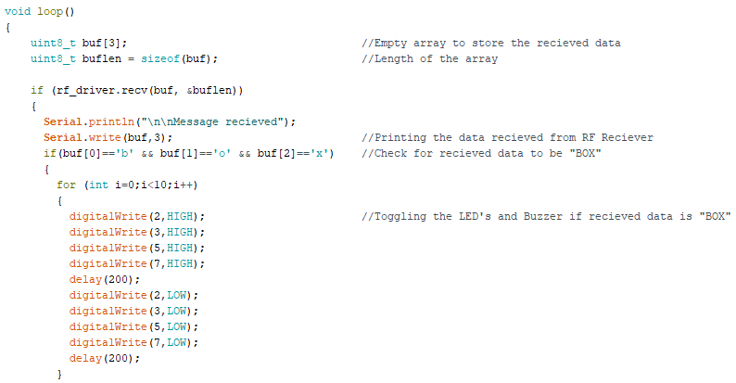
Source Code OBJECT MODULE 1

Slide 18
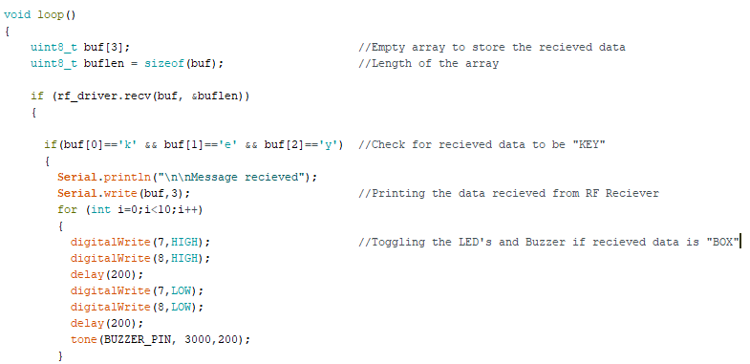
Source code OBJECT MODULE 2

Slide 19
Sample Inputs and Outputs
Using Switches,
Switch 1 | Switch 2 | Result
ON | OFF | Object module-1 beeps and gets detected
OFF | ON | Object module-2 beeps and gets detected
ON | ON | Both the Object modules beeps and gets detected

Slide 20
Sample Inputs and Outputs
Using Serial USB terminal,
BUTTON | Result
KEY | Object module-1 beeps and gets detected
BOX | Object module-2 beeps and gets detected

Slide 21
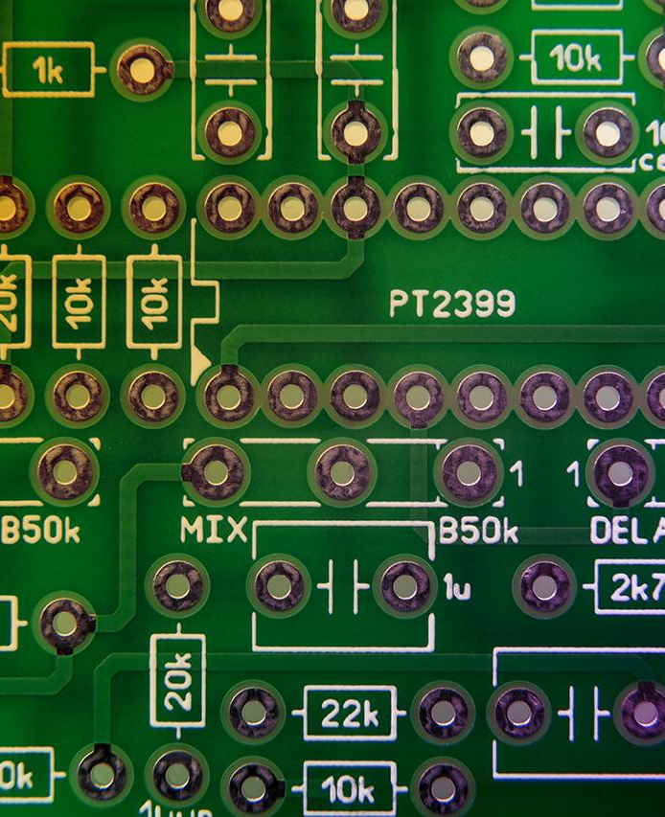
Advantages
Real-time detection of misplaced objects
Saves time and easy to search for the lost items.
Helping users to easily retrieve the item.
This technology can be integrated into various settings,including home,offices and public spaces,etc.,that is compatible for sustain in the future.

Slide 22
Conclusion
In this project,we are using wireless communication to detect misplaced objects in real-time scenario.
This approach offer the advantage of quick and accurate detection and making it particularly valuable in scenarios where locating misplaced items is crucial.

Slide 23
References
1.QingboJi,ChaongDai,ChangboHou and Xun Li, “Real-time embedded object detection and tracking system in ZyncSoc”,inEURASIP Journal on Image and Video Processing,2021,Harbin Engineering University.
2. Mohammed Ali Safvati-Ali Soleymani,”RFID-based Object Detection System in IoT”,in 4th International Conference on Applied Research in ComputerEngineering and Signal Processing,10 November 2016,Iranian University,Tehran, page 2.
3.Lun-Chi Chen, Ruey-Kai Sheu, Hui-ChiehLu, Win-TsungLo, Yen-Ping Chu, “Object Finding System Based on RFID Technology”Conference Paper in Lecture Notes in Computer Science , January 2006, page 10.

Slide 24

THANK YOU

