Slide 1
Comparison of KNN and SVM algorithms for classification of handwritten digits
Team members:
Thiruvengadam Kalai Kannan
Sai Kumar Dosapati

Slide 2
PROBLEM DESCRIPTION
In this project, we classified the handwritten digits using the k – nearest neighbors (KNN) algorithm and Support Vector Machine (SVM) algorithm and compared their performance (accuracy, precision, recall).

Slide 3
MOTIVATION
We found this project interesting because, it is difficult even for some humans to decipher some handwriting.
So, making a machine to learn and understand human handwriting is quite a challenge.
We want to work on this challenging project.

Slide 4
MNIST DATASET
We used the MNIST dataset for this project.
The MNIST (Mixed National Institute of Standards and Technology) database is a large database containing images of handwritten digits commonly used in the field of image processing and machine learning.
This is a modified version of the original NIST dataset in which the training data was taken from American Census Bureau employees and the testing data was taken from American high school students.
This made it too hard to classify them correctly. The database contains 60,000 training images and 10,000 testing images.
Half of the training set and half of the test set were taken from NIST's training dataset, while the other half of the training set and the other half of the test set were taken from NIST's testing dataset.

Slide 5
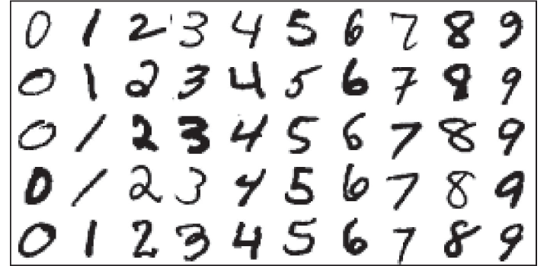
Mnist pics

Slide 6
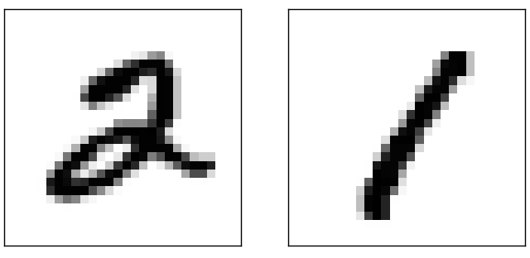
Closer look

Slide 7
Processing on data
Reshape : Changing each array of 28*28 pixels to an array of 784 columns.
Normalize : The pixel values usually are between 0 and 255. Normalizing it to be between 0 and 1 by dividing each pixel value by 255.

Slide 8
KNN ALGORITHM
The k-Nearest Neighbors algorithm (or k-NN for short) is a non - parametric method used for classification and regression.
The input consists of the k closest training examples in the feature space.
The output is a class label, classified by a majority vote of its neighbors, with the object being assigned to the class most common among its k nearest neighbors (k is a positive integer, typically small).
If k = 1, then the object is simply assigned to the class of that single nearest neighbor.
If k is large, we can assign weight to the contributions of the neighbors, so that the nearer neighbors contribute more to the average than the more distant ones.

Slide 9
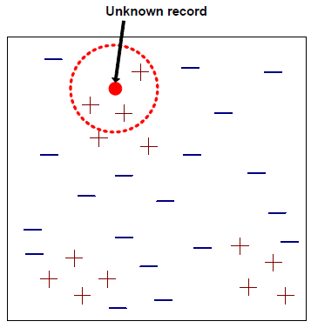
Predetermine k
Calculate Euclidean distance between the new test point and every training point.
Sort the distances in ascending order and take the first k of them(k neighbors).
Identify the class labels of the k neighbors.
Whichever class the majority of the k neighbors belong to is assigned to the test point.

Slide 10
Challenges of KNN
KNN classifier is a lazy learner
It doesn’t build a model
Computationally expensive
60000 * 10000 distance calculations
Choosing k value was tricky
We tried k values of 1,3,5,100,200 etc
Euclidean distance – curse of dimensionality

Slide 11
KNN CODE
count_classlabel=zeros(10,1);
k=3;
for i=1:10000
for j=1:60000
test_point=timg(i,:);
train_point=img(j,:);
euclid_dist= sqrt(sum((test_point - train_point) .^ 2));
dis(j,:)=[j euclid_dist];
end
sorted_dist=sortrows(dis,2);
count_classlabel=zeros(10,1);
for j=1:k
classlabel(j)=labels(sorted_dist(j,1));
if(classlabel(j)==0)
count_classlabel(1,1)=count_classlabel(1,1) + 1;
elseif(classlabel(j)==1)
count_classlabel(2,1)=count_classlabel(2,1) + 1;
elseif(classlabel(j)==2)
count_classlabel(3,1)=count_classlabel(3,1) + 1;

Slide 12
elseif(classlabel(j)==3)
count_classlabel(4,1)=count_classlabel(4,1) + 1;
elseif(classlabel(j)==4)
count_classlabel(5,1)=count_classlabel(5,1) + 1;
elseif(classlabel(j)==5)
count_classlabel(6,1)=count_classlabel(6,1) + 1;
elseif(classlabel(j)==6)
count_classlabel(7,1)=count_classlabel(7,1) + 1;
elseif(classlabel(j)==7)
count_classlabel(8,1)=count_classlabel(8,1) + 1;
elseif(classlabel(j)==8)
count_classlabel(9,1)=count_classlabel(9,1) + 1;
elseif(classlabel(j)==9)
count_classlabel(10,1)=count_classlabel(10,1) + 1;
end
end
[val ind]=max(count_classlabel);
predictlabel(i)=ind-1;
end

Slide 13
PERFORMANCE
Accuracy- is the fraction of correct classification
Precision- is the fraction of retrieved instances that are relevant
Recall- is the fraction of relevant instances that are retrieved
For k=3 :
Accuracy = 97.05 %
Precision = 88.15 %
Recall = 88.92%

Slide 14
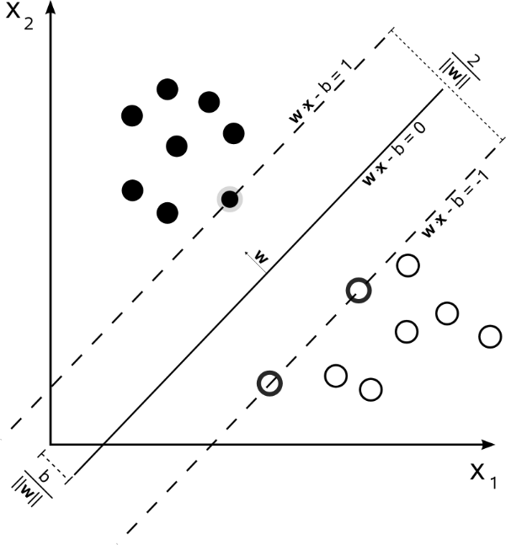
SVM ALGORITHM
Support vector machines (SVMs) are supervised learning models with associated learning algorithms that analyze data and recognize patterns, used for classification and regression analysis.
It is a binary linear classifier i.e it classifies all the data into two classes.
SVM can be used to classify data into multiple classes by data sampling. By sampling we reduce a single multiclass problem into multiple binary classification problems.

Slide 15
CODE for data sampling
idx0=[];idx1=[];idx2=[];idx3=[];idx4=[];idx5=[];idx6=[];idx7=[];idx8=[];idx9=[];
for i =1:length(labels)
if (labels(i)==0)
idx0=[idx0 i];
elseif (labels(i)==1)
idx1=[idx1 i];
. . .
end
end
totidx=[1:60000];
possample0=datasample(idx0,100,'replace',false);
negidx0=setdiff(totidx,idx0);
negsample0=datasample(negidx0,100,'replace',false);
. . .
traindata0=[img(possample0,:);img(negsample0,:)];
trainlabel0(1:100)=1;
trainlabel0(101:200)=-1;
. . .

Slide 16
While classifying class 0/1/…/9, change the class label that is 0/1/…./9 to 1(positive) and the rest to -1(negative) for both train and test data.
SMO:
CALCULATING KERNEL FOR EACH CLASS LABEL ( 0 AND THE REST , 1 AND THE REST . . . )
var=0.8;
for i=1:200
for j=1:200
diff=traindata0(i,:)-testdata0(j,:);
squared_diff=dot(diff,diff);
kernel0(i,j)=exp(squared_diff*(-1)/(2*var*var));
end
end

Slide 17
Computational complexity of SVM
784 features are present i.e 784 legrange multipliers are needed resulting in many number of kkt conditions. Hence we go for optimization. Using SMO.
Data is not linearly separable and hence we use Gaussian Kernel to change its dimensions.
Data is so huge to calculate kernel values for 60,000*10,000.
  Kernel(i,j) = (|Xi-Xj|^2)/(2*var^2)
We choose 100 positive and 100 negative examples from both train and test data. That is we have 200 train data and 200 test data for each class.
VARIANCE- 0.8 (BEST), 0.3,0.5
ITERATIONS- 1000,400(BEST),600

Slide 18
PERFORMANCE
The amount of train data, variance and the iterations over which the lagrange multipliers get updated has an effect on the accuracy.
Kernel 200*400, 400*600 – similar accuracy.
With varied variance values, accuracy varied. We tried for var=0.3, 0.5 and 0.8.
With different variance values, we got better accuracy for different values of iterations.
As the data is huge, we had to restrict the train data and accuracy can be improved by taking more train data.
The best accuracy we were able to reach was 75.2% by taking var=0.8 and iterations as 400.

Slide 19
COMPARISON OF ALGORITHMS
SVM – Because of its computational complexity, it is difficult to classify all the training data.
As we can’t use more train data, accuracy is less.
KNN – It has better accuracy which is 97.5 where as SVM has 75.20% .
More importantly, KNN is less expensive than SVM.
We can conclude KNN is better than SVM.

Slide 20
REFERENCES
http://yann.lecun.com/exdb/mnist/
http://ufldl.stanford.edu/wiki/index.php/Using_the_MNIST_Dataset
http://www-users.cs.umn.edu/~kumar/dmbook/index.php#item4
https://en.wikipedia.org/wiki/MNIST_database
https://en.wikipedia.org/wiki/K-nearest_neighbors_algorithm
https://en.wikipedia.org/wiki/Support_vector_machine

Slide 21
THANK YOU!!!

