Slide 1

Design and Analysis of Algorithms
CS345
Assignment 4
Transitive Closure in O$(n^{ω})$ time

Slide 2




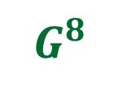
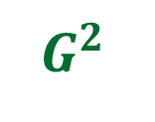

Recall Lecture $19$
Theorem:
We can compute transitive closure of graph $G$ in O$(n^{ω} log n)$ time.
$$G$$
Assignment 4:
Design an algorithm to compute transitive closure of graph $G$ in O$(n^{ω})$ time.
$\log{n}$ Matrix Multiplications ☺
$G^{2}$
$G^{4}$
$G^{8}$
…
$$G^{n−1}$$

Slide 3
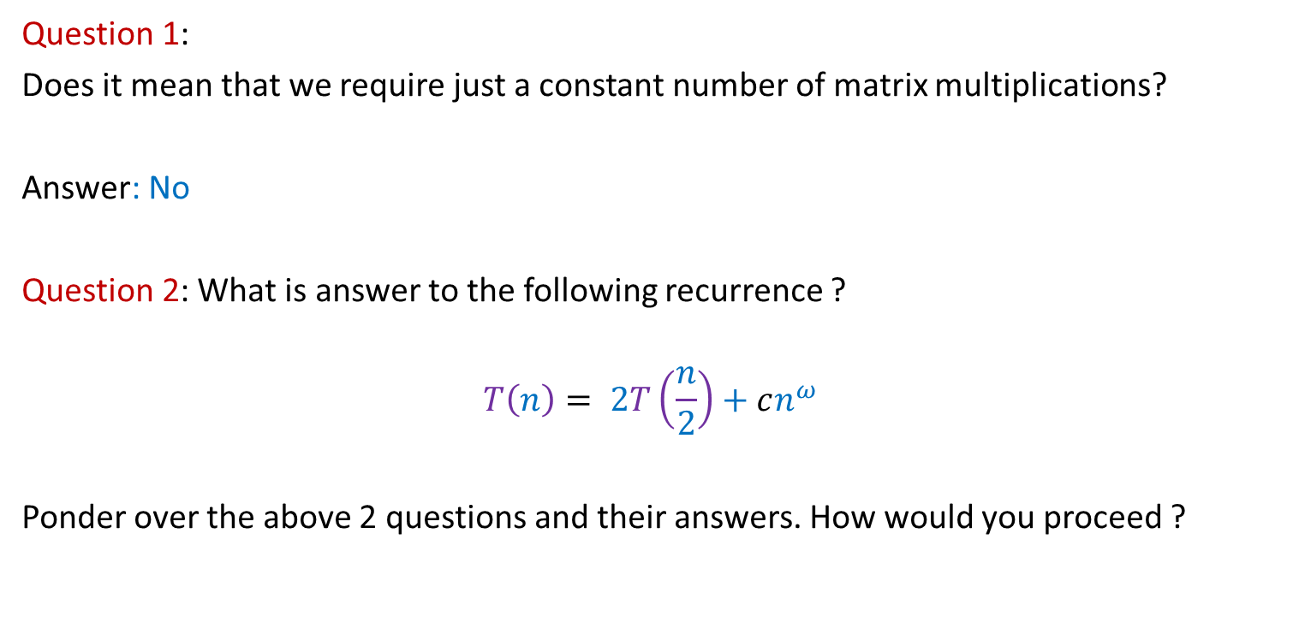
First let us understand what the problem means
Question 1:
Does it mean that we require just a constant number of matrix multiplications?
Answer: No
Question 2: What is answer to the following recurrence ?
$$T\left(n\right)= 2T\left(\frac{n}{2}\right)+cn^{ω}$$
Ponder over the above 2 questions and their answers. How would you proceed ?

Slide 4
Question: Can you work with simpler graph?
Recall some tool we developed in the course itself.

Slide 5
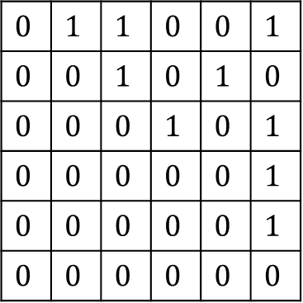
Make use of the SCC graph
Idea: It suffices to compute transitive closure of the SCC graph.
Question: How does its Adjacency Matrix look like ?
Answer: Nothing special ☹
Question: What if you relabel the vertices according to topological ordering?
Answer: Upper Triangular Matrix
0
$$0$$ | $$1$$ | $$1$$ | $$0$$ | $$0$$ | $$1$$
$$0$$ | $$0$$ | $$1$$ | $$0$$ | $$1$$ | $$0$$
$$0$$ | $$0$$ | $$0$$ | $$1$$ | $$0$$ | $$1$$
$$0$$ | $$0$$ | $$0$$ | $$0$$ | $$0$$ | $$1$$
$$0$$ | $$0$$ | $$0$$ | $$0$$ | $$0$$ | $$1$$
$$0$$ | $$0$$ | $$0$$ | $$0$$ | $$0$$ | $$0$$

Slide 6
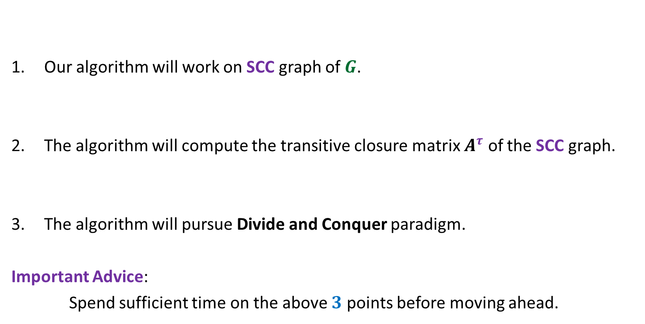
High level overview of the Algorithm
Our algorithm will work on SCC graph of $G$.
The algorithm will compute the transitive closure matrix $A^{τ}$ of the SCC graph.
The algorithm will pursue Divide and Conquer paradigm.
Important Advice:
Spend sufficient time on the above $3$ points before moving ahead.

Slide 7

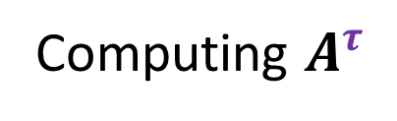


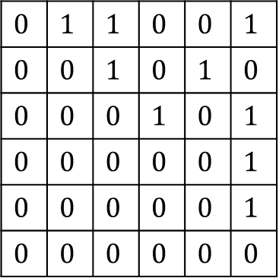


Computing $A^{τ}$
$$1$$ |  | $$…$$ |  |  | $$n$$
$$1$$
$$:$$
$$n$$
0
$$0$$ | $$1$$ | $$1$$ | $$0$$ | $$0$$ | $$1$$
$$0$$ | $$0$$ | $$1$$ | $$0$$ | $$1$$ | $$0$$
$$0$$ | $$0$$ | $$0$$ | $$1$$ | $$0$$ | $$1$$
$$0$$ | $$0$$ | $$0$$ | $$0$$ | $$0$$ | $$1$$
$$0$$ | $$0$$ | $$0$$ | $$0$$ | $$0$$ | $$1$$
$$0$$ | $$0$$ | $$0$$ | $$0$$ | $$0$$ | $$0$$
$$A$$
$$1 … \frac{n}{2} \frac{n}{2}+1 n$$
SCC($G$)

Slide 8



Divide Part
Computing $A^{τ}$
$$1$$ |  | $$…$$ |  |  | $$n$$
$$1$$
$$:$$
$$n$$
0
$$0$$ | $$1$$ | $$1$$ | $$0$$ | $$0$$ | $$1$$
$$0$$ | $$0$$ | $$1$$ | $$0$$ | $$1$$ | $$0$$
$$0$$ | $$0$$ | $$0$$ | $$1$$ | $$0$$ | $$1$$
$$0$$ | $$0$$ | $$0$$ | $$0$$ | $$0$$ | $$1$$
$$0$$ | $$0$$ | $$0$$ | $$0$$ | $$0$$ | $$1$$
$$0$$ | $$0$$ | $$0$$ | $$0$$ | $$0$$ | $$0$$
$$C$$
$$B$$
0
$$D$$
$$A$$
$$1 … \frac{n}{2} \frac{n}{2}+1 n$$

Slide 9



Divide Part
Computing $A^{τ}$
$$1$$ |  | $$…$$ |  |  | $$n$$
Compute$B^{τ}$
$$1$$
$$:$$
$$n$$
0
$$0$$ | $$1$$ | $$1$$ | $$0$$ | $$0$$ | $$1$$
$$0$$ | $$0$$ | $$1$$ | $$0$$ | $$1$$ | $$0$$
$$0$$ | $$0$$ | $$0$$ | $$1$$ | $$0$$ | $$1$$
$$0$$ | $$0$$ | $$0$$ | $$0$$ | $$0$$ | $$1$$
$$0$$ | $$0$$ | $$0$$ | $$0$$ | $$0$$ | $$1$$
$$0$$ | $$0$$ | $$0$$ | $$0$$ | $$0$$ | $$0$$
$$C$$
$$B$$
0
$$D$$
$$A$$
$$1 … \frac{n}{2} \frac{n}{2}+1 n$$
$$i$$
$$j$$
How will you compute transitive closure of such pairs of vertices ? Spend sufficient time…

Slide 10



Divide Part
Computing $A^{τ}$
$$1$$ |  | $$…$$ |  |  | $$n$$
Compute$B^{τ}$
$$1$$
$$:$$
$$n$$
0
$$0$$ | $$1$$ | $$1$$ | $$0$$ | $$0$$ | $$1$$
$$0$$ | $$0$$ | $$1$$ | $$0$$ | $$1$$ | $$0$$
$$0$$ | $$0$$ | $$0$$ | $$1$$ | $$0$$ | $$1$$
$$0$$ | $$0$$ | $$0$$ | $$0$$ | $$0$$ | $$1$$
$$0$$ | $$0$$ | $$0$$ | $$0$$ | $$0$$ | $$1$$
$$0$$ | $$0$$ | $$0$$ | $$0$$ | $$0$$ | $$0$$
$$C$$
Compute$D^{τ}$
$$B$$
0
$$D$$
$$A$$
$$1 … \frac{n}{2} \frac{n}{2}+1 n$$
$$i$$
$$j$$
How will you compute transitive closure of such pair of vertices ? Spend sufficient time…

Slide 11

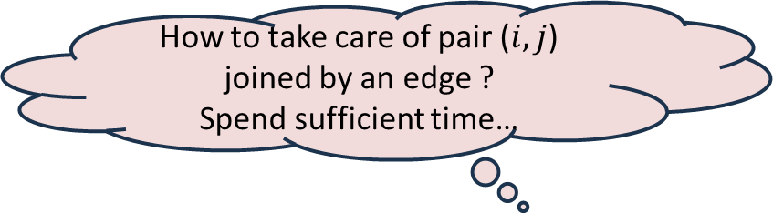





Conquer Part
Computing $A^{τ}$
$$j$$
$$1$$ |  | $$…$$ |  |  | $$n$$
Compute$B^{τ}$
$$1$$
$$:$$
$$n$$
0
$C$
$$0$$ | $$1$$ | $$1$$ | $$0$$ | $$0$$ | $$1$$
$$0$$ | $$0$$ | $$1$$ | $$0$$ | $$1$$ | $$0$$
$$0$$ | $$0$$ | $$0$$ | $$1$$ | $$0$$ | $$1$$
$$0$$ | $$0$$ | $$0$$ | $$0$$ | $$0$$ | $$1$$
$$0$$ | $$0$$ | $$0$$ | $$0$$ | $$0$$ | $$1$$
$$0$$ | $$0$$ | $$0$$ | $$0$$ | $$0$$ | $$0$$
$$C$$
Compute$D^{τ}$
$$i$$
$$B$$
0
How to take care of pair ($i,j$) joined by an edge ?
Spend sufficient time…
$$i$$
$$D$$
$$A$$
$$1 … \frac{n}{2} \frac{n}{2}+1 n$$
$$i$$
$$j$$
$$i→j$$

Slide 12




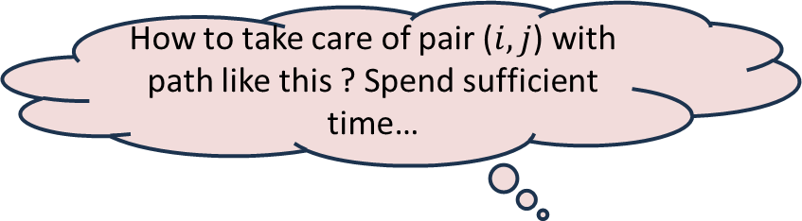



Conquer Part
Computing $A^{τ}$
$$k$$
$$j$$
$$1$$ |  | $$…$$ |  |  | $$n$$
Compute$B^{τ}$
$$1$$
$$:$$
$$n$$
0
$C$
$$0$$ | $$1$$ | $$1$$ | $$0$$ | $$0$$ | $$1$$
$$0$$ | $$0$$ | $$1$$ | $$0$$ | $$1$$ | $$0$$
$$0$$ | $$0$$ | $$0$$ | $$1$$ | $$0$$ | $$1$$
$$0$$ | $$0$$ | $$0$$ | $$0$$ | $$0$$ | $$1$$
$$0$$ | $$0$$ | $$0$$ | $$0$$ | $$0$$ | $$1$$
$$0$$ | $$0$$ | $$0$$ | $$0$$ | $$0$$ | $$0$$
$$i$$
$$C$$
Compute$D^{τ}$
$$B$$
$$B^{τ}C$$
$$k$$
0
How to take care of pair ($i,j$) with path like this ? Spend sufficient time…
$$D$$
$$A$$
$$1 … \frac{n}{2} \frac{n}{2}+1 n$$
$$i$$
$$k$$
$$j$$
$i$ $⇝$ $k$
$$→j$$

Slide 13


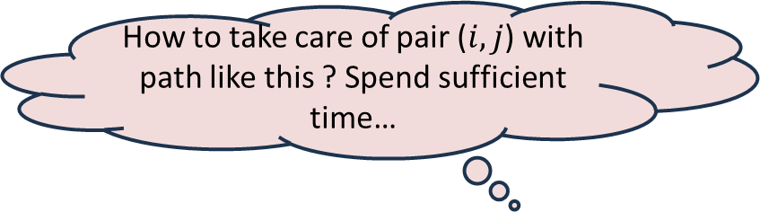





Conquer Part
Computing $A^{τ}$
$$k$$
$$j$$
$$1$$ |  | $$…$$ |  |  | $$n$$
Compute$B^{τ}$
$$1$$
$$:$$
$$n$$
0
$C$
$$0$$ | $$1$$ | $$1$$ | $$0$$ | $$0$$ | $$1$$
$$0$$ | $$0$$ | $$1$$ | $$0$$ | $$1$$ | $$0$$
$$0$$ | $$0$$ | $$0$$ | $$1$$ | $$0$$ | $$1$$
$$0$$ | $$0$$ | $$0$$ | $$0$$ | $$0$$ | $$1$$
$$0$$ | $$0$$ | $$0$$ | $$0$$ | $$0$$ | $$1$$
$$0$$ | $$0$$ | $$0$$ | $$0$$ | $$0$$ | $$0$$
$$i$$
$$C$$
Compute$D^{τ}$
$$B$$
$$B^{τ}C$$
$CD^{τ}$
0
$$k$$
How to take care of pair ($i,j$) with path like this ? Spend sufficient time…
$$D$$
$$A$$
$$1 … \frac{n}{2} \frac{n}{2}+1 n$$
$$i$$
$$k$$
$$j$$
$$i→k$$
$⇝$ $j$

Slide 14








Conquer Part
Computing $A^{τ}$
$$1$$ |  | $$…$$ |  |  | $$n$$
Compute$B^{τ}$
$$1$$
$$:$$
$$n$$
0
$C$
$$0$$ | $$1$$ | $$1$$ | $$0$$ | $$0$$ | $$1$$
$$0$$ | $$0$$ | $$1$$ | $$0$$ | $$1$$ | $$0$$
$$0$$ | $$0$$ | $$0$$ | $$1$$ | $$0$$ | $$1$$
$$0$$ | $$0$$ | $$0$$ | $$0$$ | $$0$$ | $$1$$
$$0$$ | $$0$$ | $$0$$ | $$0$$ | $$0$$ | $$1$$
$$0$$ | $$0$$ | $$0$$ | $$0$$ | $$0$$ | $$0$$
$$C$$
Compute$D^{τ}$
$$B$$
$B^{τ}C$
$CD^{τ}$
0
$$D$$
How to take care of pair ($i,j$) with path like this ? Spend sufficient time…
$$A$$
$$1 … \frac{n}{2} \frac{n}{2}+1 n$$
$$i$$
$$p$$
$$k$$
$$j$$
$i$ $⇝$ $p$
$⇝$ $j$
$$→k$$
Advice: Ponder over it before moving ahead.

Slide 15

Conquer Part
Computing $A^{τ}$
$$1$$ |  | $$…$$ |  |  | $$n$$
Compute$B^{τ}$
$$1$$
$$:$$
$$n$$
0
$C$
$$0$$ | $$1$$ | $$1$$ | $$0$$ | $$0$$ | $$1$$
$$0$$ | $$0$$ | $$1$$ | $$0$$ | $$1$$ | $$0$$
$$0$$ | $$0$$ | $$0$$ | $$1$$ | $$0$$ | $$1$$
$$0$$ | $$0$$ | $$0$$ | $$0$$ | $$0$$ | $$1$$
$$0$$ | $$0$$ | $$0$$ | $$0$$ | $$0$$ | $$1$$
$$0$$ | $$0$$ | $$0$$ | $$0$$ | $$0$$ | $$0$$
$$C$$
Compute$D^{τ}$
$$B$$
$B^{τ}C$
$CD^{τ}$
0
$B^{τ}CD^{τ}$
$$D$$
$$A$$
$$1 … \frac{n}{2} \frac{n}{2}+1 n$$
$$i$$
$$p$$
$$k$$
$$j$$
$i$ $⇝$ $p$
$⇝$ $j$
$$→k$$
Advice: Spend sufficient time to find the time for the conquer part.

Slide 16












Computing $A^{τ}$
$$1$$ |  | $$…$$ |  |  | $$n$$
Compute$B^{τ}$
$$+$$
$B^{τ}C$
$$+$$
$$1$$
$$:$$
$$n$$
0
$C$
$$+$$
$CD^{τ}$
$B^{τ}CD^{τ}$
$$0$$ | $$1$$ | $$1$$ | $$0$$ | $$0$$ | $$1$$
$$0$$ | $$0$$ | $$1$$ | $$0$$ | $$1$$ | $$0$$
$$0$$ | $$0$$ | $$0$$ | $$1$$ | $$0$$ | $$1$$
$$0$$ | $$0$$ | $$0$$ | $$0$$ | $$0$$ | $$1$$
$$0$$ | $$0$$ | $$0$$ | $$0$$ | $$0$$ | $$1$$
$$0$$ | $$0$$ | $$0$$ | $$0$$ | $$0$$ | $$0$$
$$C$$
Compute$D^{τ}$
$$B$$
${(I+B}^{τ})C$
$$+$$
$(I+ B^{τ})CD^{τ}$
0
$$D$$
$(I+ B^{τ})C(I+D^{τ})$
Compute$(I+ B^{τ})C(I+D^{τ})$
$$A$$
$$1 … \frac{n}{2} \frac{n}{2}+1 n$$
$$i$$
$$j$$

Slide 17





Computing $A^{τ}$
$$1$$ |  | $$…$$ |  |  | $$n$$
Compute$B^{τ}$
$$+$$
$B^{τ}C$
$$+$$
$$1$$
$$:$$
$$n$$
0
$C$
$$+$$
$CD^{τ}$
$B^{τ}CD^{τ}$
$$0$$ | $$1$$ | $$1$$ | $$0$$ | $$0$$ | $$1$$
$$0$$ | $$0$$ | $$1$$ | $$0$$ | $$1$$ | $$0$$
$$0$$ | $$0$$ | $$0$$ | $$1$$ | $$0$$ | $$1$$
$$0$$ | $$0$$ | $$0$$ | $$0$$ | $$0$$ | $$1$$
$$0$$ | $$0$$ | $$0$$ | $$0$$ | $$0$$ | $$1$$
$$0$$ | $$0$$ | $$0$$ | $$0$$ | $$0$$ | $$0$$
$$C$$
Compute$D^{τ}$
$$B$$
${(I+B}^{τ})C$
$$+$$
$(I+ B^{τ})CD^{τ}$
0
$$D$$
$(I+ B^{τ})C(I+D^{τ})$
Compute$(I+ B^{τ})C(I+D^{τ})$
$$A$$
$$1 … \frac{n}{2} \frac{n}{2}+1 n$$
What is the time complexity of the algorithm ?
$$i$$
$$j$$
$$2 T\left(\frac{n}{2}\right)+c_{1}n^{ω}+c_{2}n^{2}$$
$$≤$$
${+ (c}_{1}+c_{2})n^{ω}$
$$T(n) =$$
$$=O(n^{ω})$$

Slide 18

Theorem 1:
We can compute transitive closure of graph $G$ in O$(n^{ω})$ time.

Slide 19
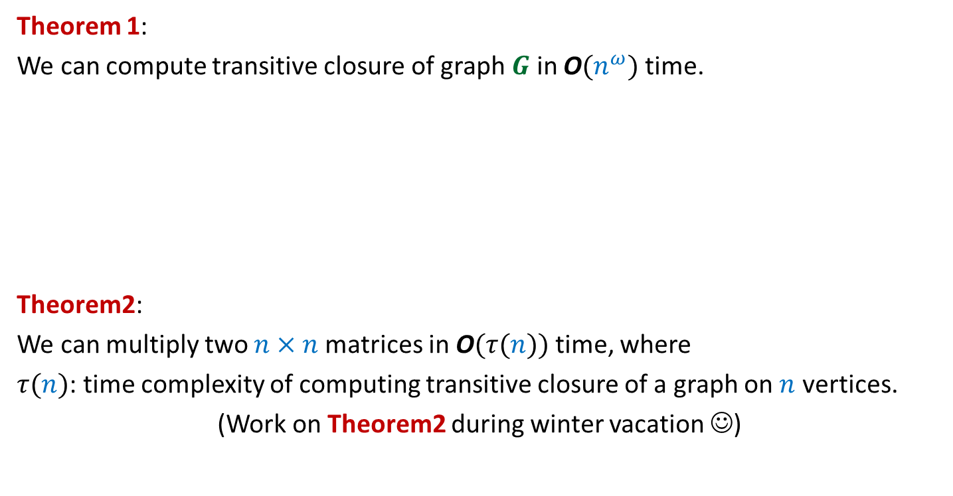
Theorem 1:
We can compute transitive closure of graph $G$ in O$(n^{ω})$ time.
Theorem2:
We can multiply two $n×n$matrices in O$(τ(n))$ time, where
$τ(n)$: time complexity of computing transitive closure of a graph on $n$ vertices.
(Work on Theorem2 during winter vacation ☺)
Same time complexity

