Slide 1


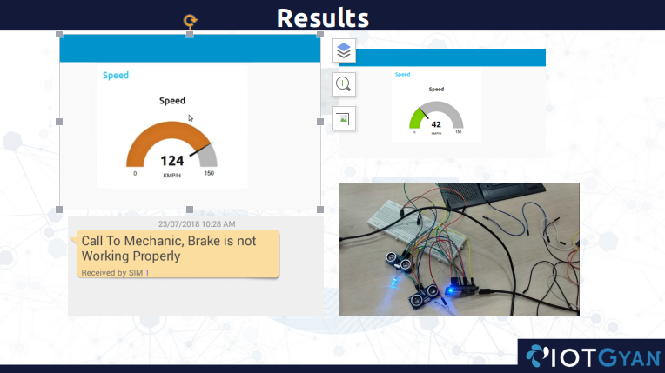
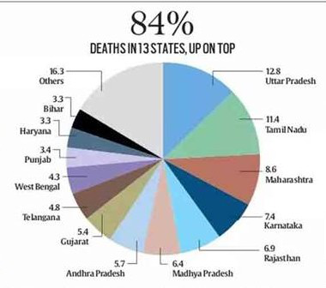
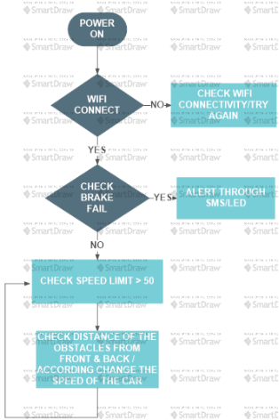
Smart Car Accident Prevention
(S.C.A.P)
if(distFromFront < very_near){
spd -= 12;
Serial.println("The Vehicle Ahead You is too closer, Stopping your vehicle and dropping Speed down to " + String(spd) );
}
else if (distFromFront<= near) {
if (distFromBack <= near) {
spd -= 10;
Serial.println("The Vehicle ahead You and behind You are approaching near, So decreasing speed down to " +String(spd));}}
Team: Dcoders (Raghav, Shubham, Ankush, Deepak, Gaurav)

