Slide 1

NODEZILLA
Mapping the world’s population using blockchain

Slide 2
Problem Statement
Find a connection between every individual part of the world’s population.
If we have the root node, we should be able to find a connection between this node and any other node. (Here, nodes refer to people)

Slide 3




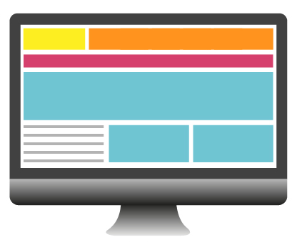
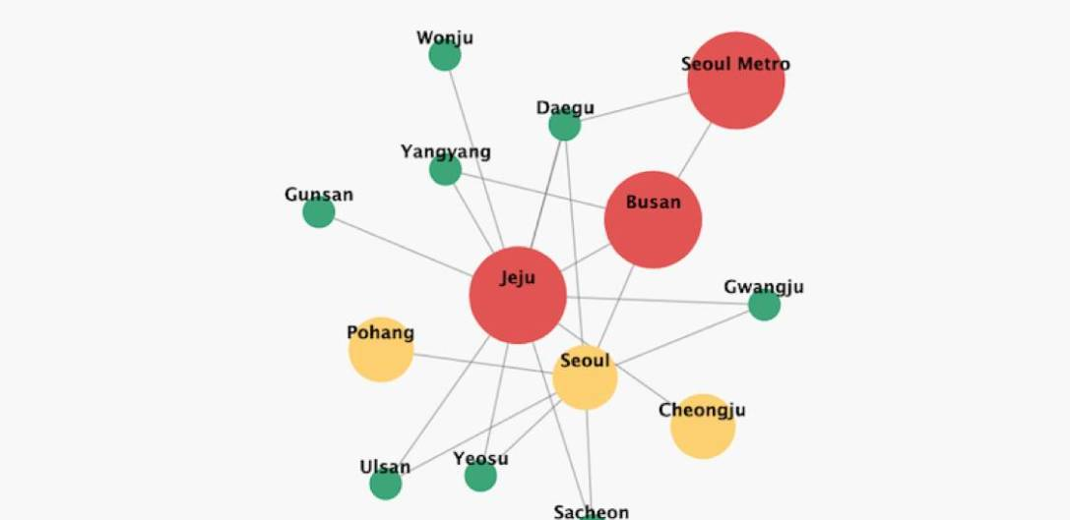
Proposed Solution
CENTRAL AUTHORITY
Birth Certificate or
relationship certificate
CENTRAL
AUTHORITY
A/C address and
Identity proof
0x12bdc43
Parents’ details

