Slide 1
Server Side Development
Node JS

Slide 2
Node JS Introduction
Node.js is an open source server environment
Node.js is free
Node.js runs on various platforms (Windows, Linux, Unix, Mac OS X, etc.)
Node.js uses JavaScript on the server
Node.js runs single-threaded, non-blocking, asynchronously programming, which is very memory efficient.

Slide 3
What Can Node.js Do?
Node.js can generate dynamic page content
Node.js can create, open, read, write, delete, and close files on the server
Node.js can collect form data
Node.js can add, delete, modify data in your database

Slide 4
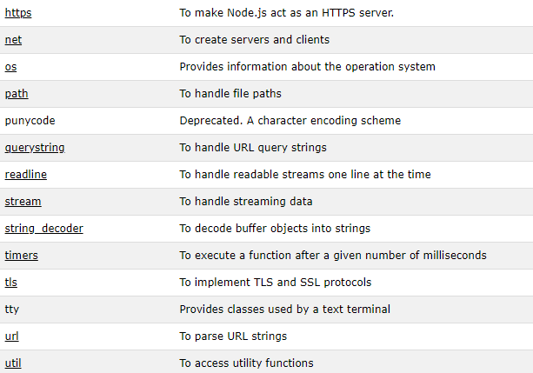
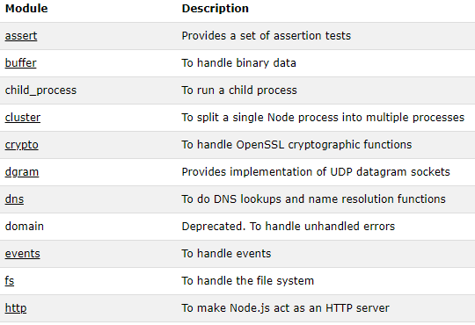
Node.js Built-in Modules
Node.js has a set of built-in modules which you can use without any further installation.

Slide 5
Modules
modules are JavaScript libraries.
A set of functions you want to include in your application.
To include a module, use the require() function with the name of the module
var http = require('http');
http.createServer(function (req, res) {
res.writeHead(200, {'Content-Type': 'text/html'});
res.end('Hello World!');
}).listen(8080);

Slide 6
Self defined Modules
You can create your own modules, and easily include them in your applications.
The following example creates a module that returns a date and time object
exports.myDateTime = function () {
return Date();
};

Slide 7
HTTP Module & Web Server
Node.js has a built-in module called HTTP, which allows Node.js to transfer data over the Hyper Text Transfer Protocol (HTTP).
The HTTP module can create an HTTP server that listens to server ports and gives a response back to the client.
The function passed into the http.createServer() method, will be executed when someone tries to access the computer on port 8080.
var http = require('http');
//create a server object:
http.createServer(function (req, res) {
res.write('Hello World!'); //write a response to the client
res.end(); //end the response
}).listen(8080); //the server object listens on port 8080

Slide 8
HTTP Header
If the response from the HTTP server is supposed to be displayed as HTML, you should include an HTTP header with the correct content type
var http = require('http');
http.createServer(function (req, res) {
res.writeHead(200, {'Content-Type': 'text/html'});
res.write('Hello World!');
res.end();
}).listen(8080);
The first argument of the res.writeHead() method is the status code, 200 means that all is OK, the second argument is an object containing the response headers

Slide 9
Read the Query String
The function passed into the http.createServer() has a req argument that represents the request from the client, as an object (http.IncomingMessage object).
This object has a property called "url" which holds the part of the url that comes after the domain name.
There are built-in modules to easily split the query string into readable parts, such as the URL module.
var http = require('http');
var url = require('url');
http.createServer(function (req, res) {
res.writeHead(200, {'Content-Type': 'text/html'});
var q = url.parse(req.url, true).query;
var txt = q.year + " " + q.month;
res.end(txt);
}).listen(8080);

Slide 10
Node.js File System Module
The Node.js file system module allows you to work with the file system on your computer.
To include the File System module, use the require() method.
var fs = require('fs');
Common use for the File System module:
Read files
Create files
Update files
Delete files
Rename files

Slide 11
Read Files
The fs.readFile() method is used to read files on your computer.
Assume we have the following HTML file (located in the same folder as Node.js)
var http = require('http');
var fs = require('fs');
http.createServer(function (req, res) {
fs.readFile('demofile1.html', function(err, data) {
res.writeHead(200, {'Content-Type': 'text/html'});
res.write(data);
res.end();
});
}).listen(8080);

Slide 12
Create Files
The File System module has methods for creating new files:
fs.appendFile()
fs.open()
fs.writeFile()
The fs.appendFile() method appends specified content to a file. If the file does not exist, the file will be created
fs.appendFile('mynewfile1.txt', 'Hello content!', function (err) {
if (err) throw err;
console.log('Saved!');
});

Slide 13
The fs.open() method takes a "flag" as the second argument, if the flag is "w" for "writing", the specified file is opened for writing. If the file does not exist, an empty file is created.
The fs.writeFile() method replaces the specified file and content if it exists. If the file does not exist, a new file, containing the specified content, will be created
The fs.appendFile() method appends the specified content at the end of the specified file
To delete a file with the File System module, use the fs.unlink() method.
To rename a file with the File System module, use the fs.rename() method.

