Slide 1
A Project on Development of a Web Application That Represents a Typical IT Firm
By Group No. 10 Group Members
FATEMA AKTER ID: 191410030 Semester: Fall 2022 BSc. in CSE | with | SHOWKAT ALI ID: 191410062 Semester: Fall 2022 BSc. in CSE
Course Information:
Course Code: CSE 424 Course Title: Software Engineering Laboratory Section : 01
Course Teacher
TASNIAH MUHIUDDIN Designation : Lecturer Department: Computer Science and Engineering Eastern University, Bangladesh
Dated : 08/11/2022

Slide 2
Contents
SL. No | Title | Slide No.
1. | Introduction | 1
2. | Features | 2
3. | Tools/ Experiments Setup | 3
4. | Advantages | 4
5. | Entity Relationship Diagram (ERD) | 5
6. | Use Case Diagram | 6
i

Slide 3
Introduction
It is a web based software application. The software should represent a demo IT Firm. We intentionally entitled the company as "Filensys Technologies". The entire software is divided into two sub-spaces. Where one sub-space is for general public to represent the company in the form of definite and well decorated web pages. Another sub-space is for internal users of the company to enable them having specific level of access controls based on their duties and responsibilities. The internal user groups we are considering to provide special layers of access controls based on their duty and responsibilities are- Administration, Accounts, and Employees respectively.
There is a future plan about this software is to integrate general public to be registered users with enabled some services including work order, observing project producing status, payment online, support ticket, and chat bot.
1

Slide 4
Features
Modules:
Administrative System Module;
Employee System Module;
Accounting System Module;
Project Management Module;
Public Interface Module;
Different Backend and Frontend Site
Single Page Application
100% Optimized for Responsive Web Design
Clean and Elegant Design
2

Slide 5
Tools/ Experiments Setup
Frontend
NodeJS LTS v16.18.0
npm v8.19.2
npx v8.19.2
create-next-app v12.3.1
Backend
PHP v8.1.10
Laravel v9.x
Composer v2.4.3
Postman v9.4
Database
MariaDB v10.4.24
phpMyAdmin v5.2.0
Oracle SQL Developer Data Modeler v22.2.0
Others
GitHub
VS Code v1.72
Google Chrome v107.0
Win10 x64 Desktop PC - 2PCs
3

Slide 6
Advantages
We are living in the era of digitally globalized village. So every organisation should have a website for sharing information about the organisation all over the world. When it is about an IT company, the company needs a website to let the world know about them. A web application of this type we are about to produce here, is especially useful for-
Get new clients.
Clients engagement.
Client satisfaction.
Internal management.
Transparent financial system.
Increase efficiency of employee.
Grow business area, and much more...
4

Slide 7
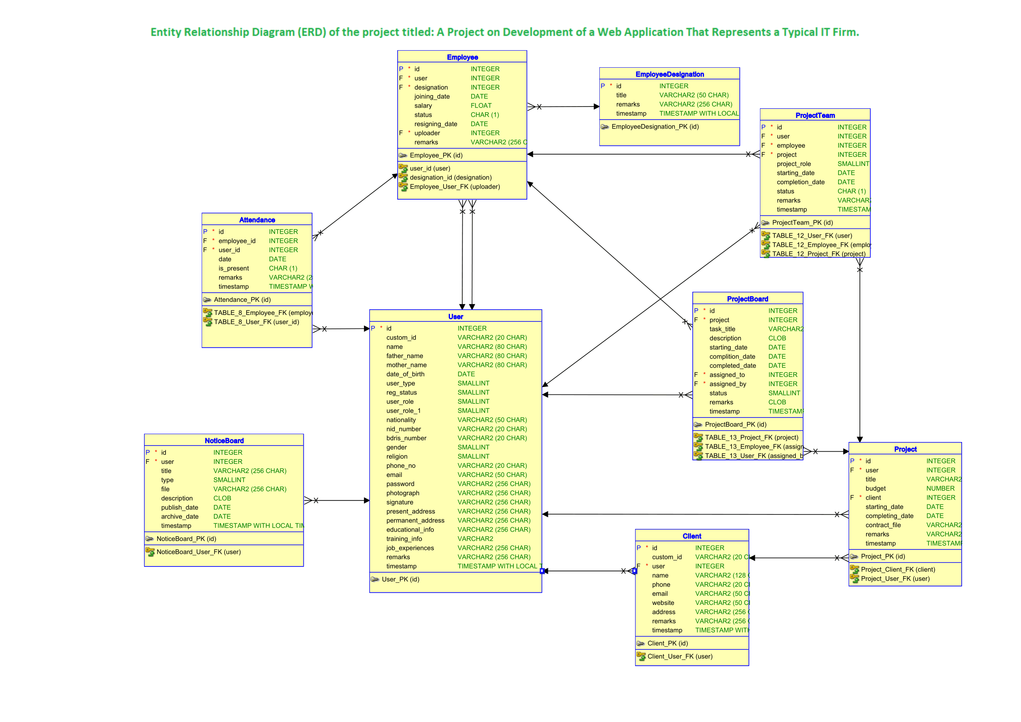
Entity Relationship Diagram (ERD)
5

Slide 8
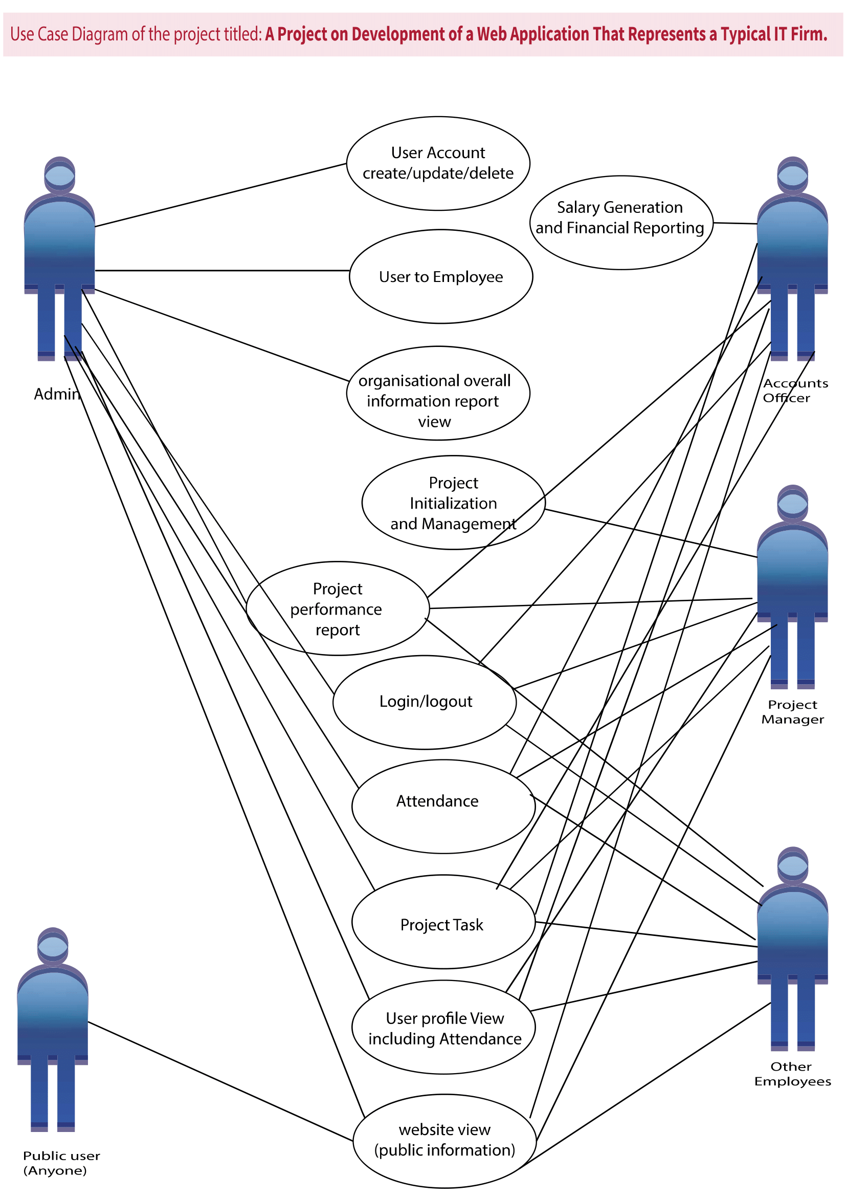
Use Case Diagram
6

Slide 9
Thank You

