Slide 1
key1
key2
key3
key4
Query
Attention
Value
value1
value2
value3
value4

Slide 2
Linear
Concat
Attention
Scaled Dot-Product
Attention
Linear
Linear
Linear

Slide 3
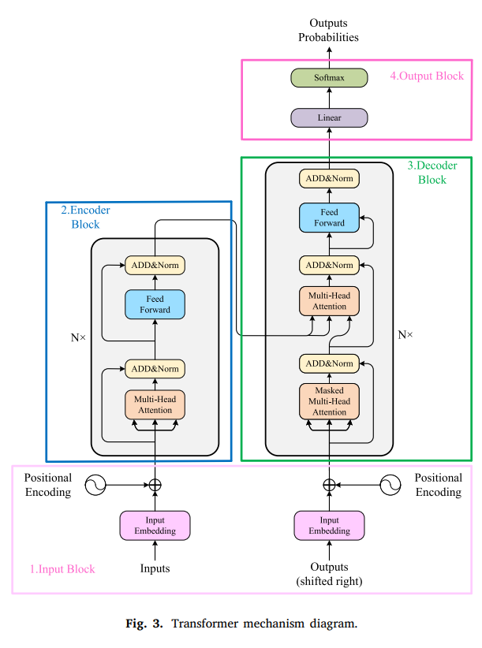
Softmax
Linear
ADD&Norm
Feed
Forward
ADD&Norm
ADD&Norm
Feed
Forward
Multi-Head
Attention
ADD&Norm
ADD&Norm
Multi-Head
Attention
Multi-Head
Attention
+
+
Input
Embedding
Input
Embedding

Slide 4




