Slide 1
Project
Windows Explorer

Slide 2
Rasel Ahammed
Submitted By :::

Slide 3
About This Project
Using this project a computer can browse.
All drives can be accessed.
All folders and subfolder can browse.

Slide 4
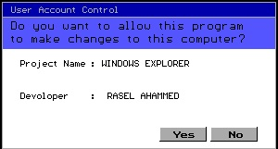
Permission Box
When the project will be executed a permission box will appear requiring permission contain two button.
Yes
No
It press “Yes” the project will open.
If “No” the project will close.

Slide 5
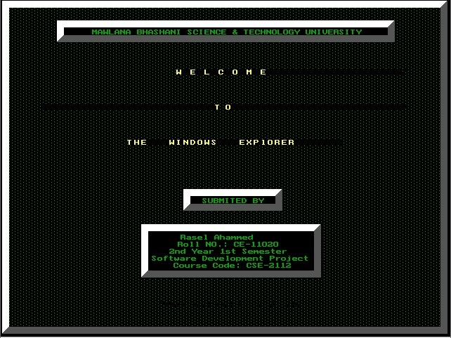
Welcome Screen
After press “Yes” a welcome screen will be shown.
Welcome screen show the developer information.
Press Any key to go to main window.

Slide 6
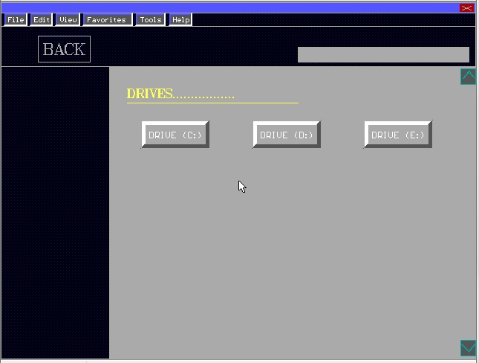
User Interface

Slide 7
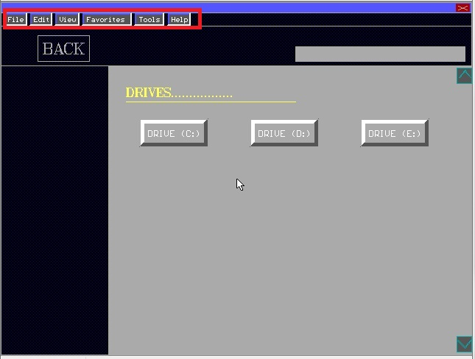
Menu Bar
Menu bar contains some menu items.
Each menu bar has specific action.
Those are- File, Edit, View, Favorites, Tools, Help

Slide 8
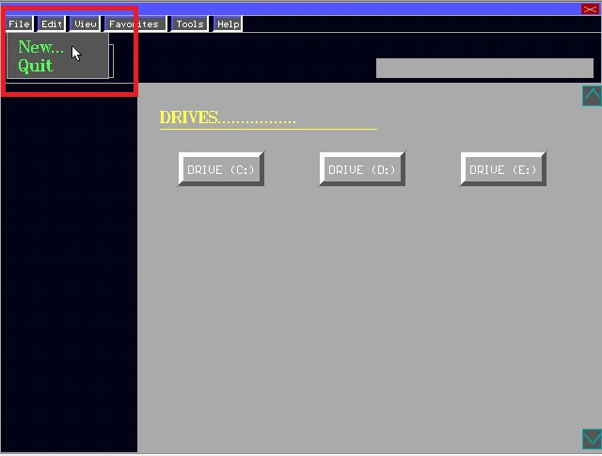
File Pop Up Menu
At File Pop Up Menu there are two options-
New
Quit
“New” is for creating new folder
And “Quit” is for exit from the browser.

Slide 9
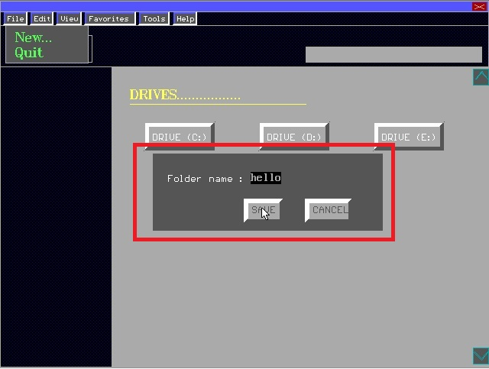
“New” and “Quit” Options
1. If click on the “New” option a small window will appear which will contain two button named as “SAVE” and “CANCEL”.
It will require desire folder name.
After typing folder name press “ENTER” and then “SAVE” or “CANCEL”.
It will create the folder in the current directory.
2.If click on the “Quit” option the browser will be exit.

Slide 10
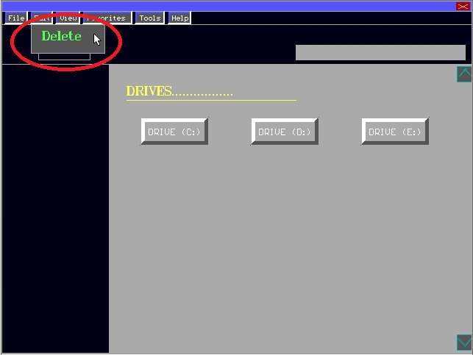
“Edit” option
“Edit” only contain “Delete” option.
Using “Delete” option a specific folder can be delete from the current directory.

Slide 11
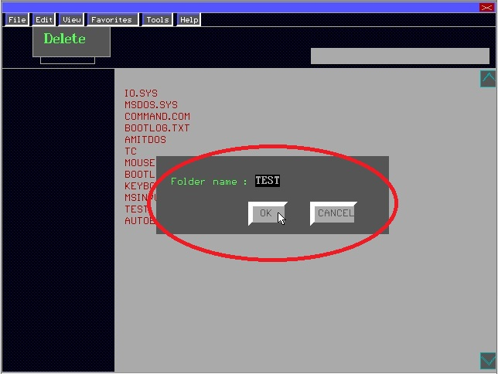
“Delete” Option
After click on the “Delete” option a window will appear requiring the folder name which will be deleted from the current directory.
Confirm will be done after pressing the “OK” button and “CANCEL” will prevent from deleting the folder.

Slide 12
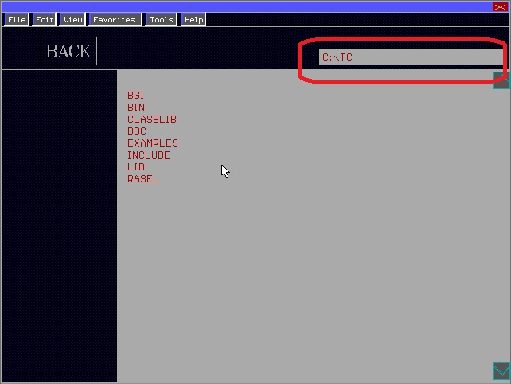
Address Bar
Address Bar will show the current position while browsing.

Slide 13
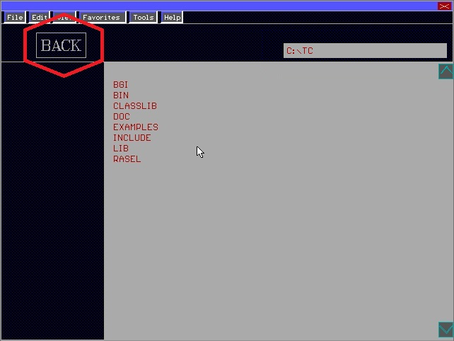
“BACK” button
Back button is used to go back while browsing. It is helpful while browsing.

Slide 14
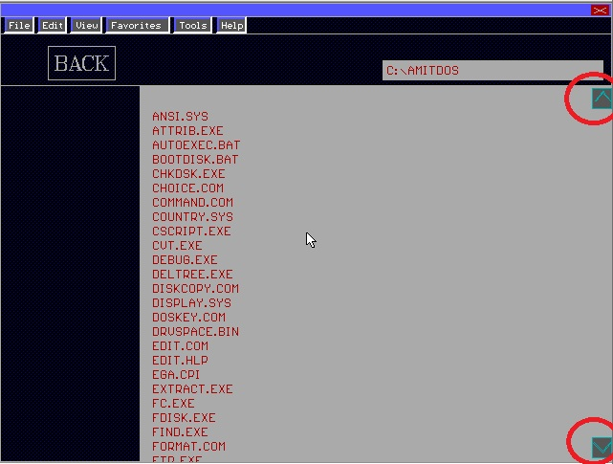
Scroll Bar
It has opportunity to scroll up and down using scroll bar showing in the
Figure.

Slide 15
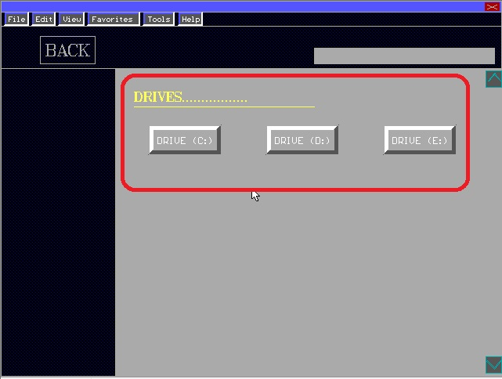
Drives
In the main window there all drive showing on your machine.
Clicking on these drive anyone can browse.

Slide 16
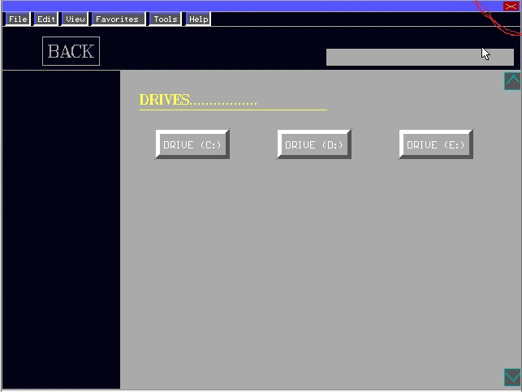
“Exit” Button
In the upper – right corner there is a “EXIT” button.
It will close the entire UI.

Slide 17
RASEL AHAMMED ID: CE - 11020 SESSION: 2010-2011 Email:raselcse20@gmail.com
ABOUT ME

Slide 18
END

