Slide 1
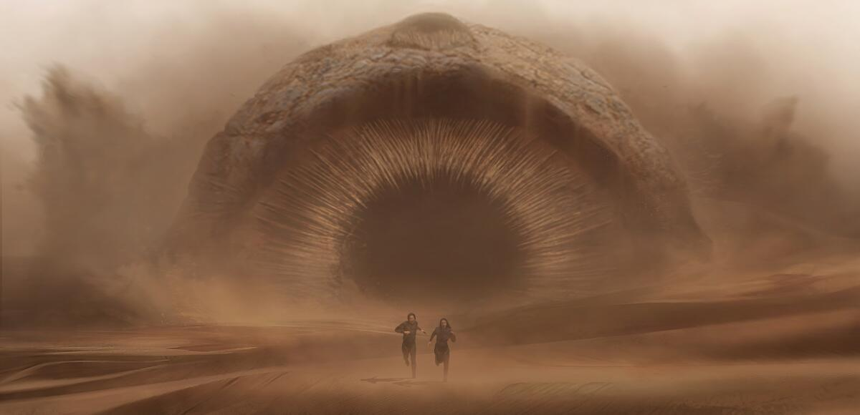
DUNE
251372382

Slide 2
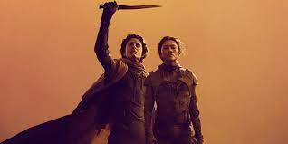
DUNE
251372382
A choice between the love of his life and the fate of the universe

