Slide 1
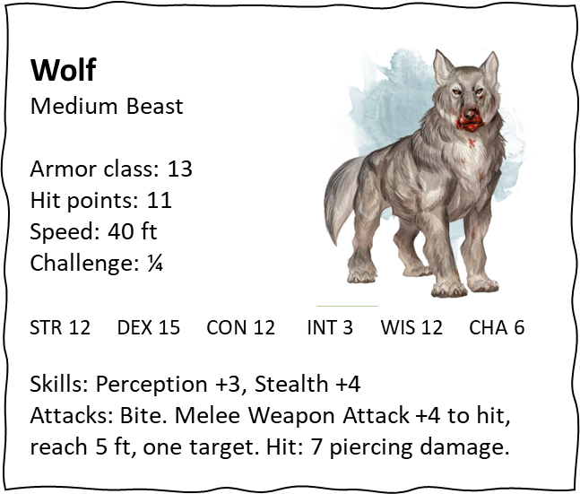
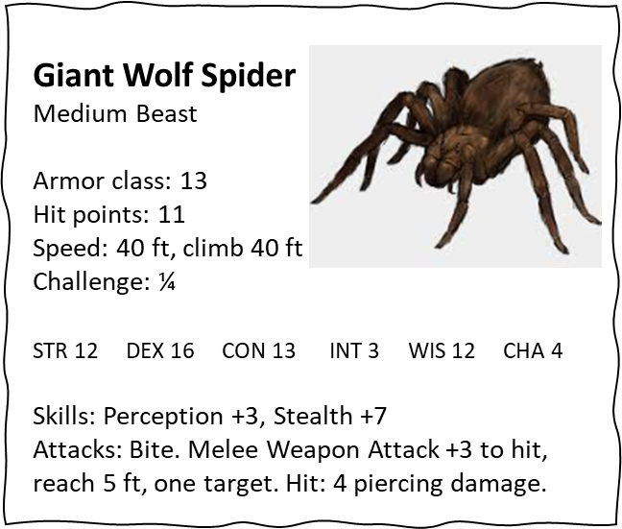
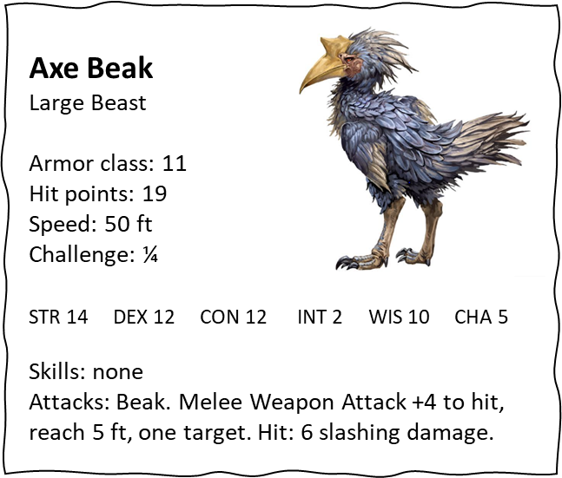

Slide 2
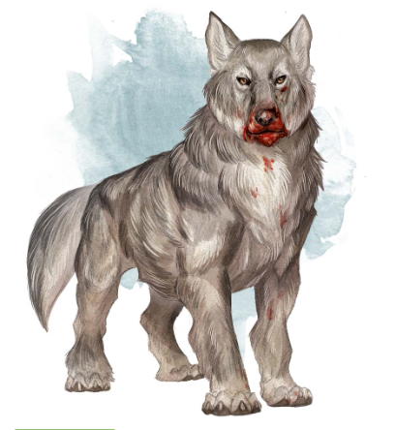
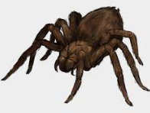
Wolf
Medium Beast
Armor class: 13
Hit points: 11
Speed: 40 ft
Challenge: ¼
Giant Wolf Spider
Medium Beast
Armor class: 13
Hit points: 11
Speed: 40 ft, climb 40 ft
Challenge: ¼
STR 12 DEX 15 CON 12 INT 3 WIS 12 CHA 6
Skills: Perception +3, Stealth +4
Attacks: Bite. Melee Weapon Attack +4 to hit, reach 5 ft, one target. Hit: 7 piercing damage.
STR 12 DEX 16 CON 13 INT 3 WIS 12 CHA 4
Skills: Perception +3, Stealth +7
Attacks: Bite. Melee Weapon Attack +3 to hit, reach 5 ft, one target. Hit: 4 piercing damage.

Slide 3
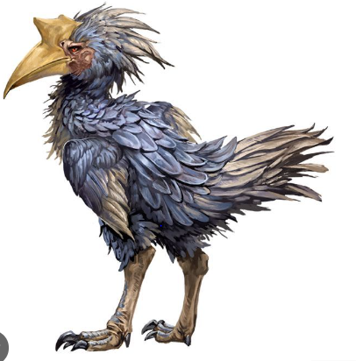
Axe Beak
Large Beast
Armor class: 11
Hit points: 19
Speed: 50 ft
Challenge: ¼
STR 14 DEX 12 CON 12 INT 2 WIS 10 CHA 5
Skills: none
Attacks: Beak. Melee Weapon Attack +4 to hit, reach 5 ft, one target. Hit: 6 slashing damage.

