Slide 1
Ad-hoc Sensor Network
over Mobile Devices
-Thisara Rupasinghe-

Slide 2
Ad-hoc Sensor Network
Nodes included with different type of sensors, connected to each other to collect information.
Problems with Sensor Networks?
Defficulty to deploy nodes on ground
Cost of nodes
Power constraints
Node tracking issues
Networking complexity
Nodes security concerns

Slide 3
Proposed Solution
Use mobile devices as sensor node & construct a network.
Todays mobile devices equipped with different kind of sensors.
Most mobile device are idel for about 70% of the time.
Naturally deployed across the globe.
No power constraints.
Avoid initial cost and effort.

Slide 4
Requirements
Magnetometer, the most common sensor on mobile devices.
Use GPS service to get location data.
Individual can specify the data requirement.
Mobile application will work on that requirement to record data.
Run as background service to record data.
User ranking scheme according to users contribution to system.

Slide 5
Application Details
Mobile App implemented on Android 2.2
  Able grab large user segment because of popularity
  No need of specific hardware.
  Free and open source platform.
Work with android 2.1 Eclair and upwards
Client server based architeture.
User needs live data connection.
Any mobile device with android can user this system.

Slide 6
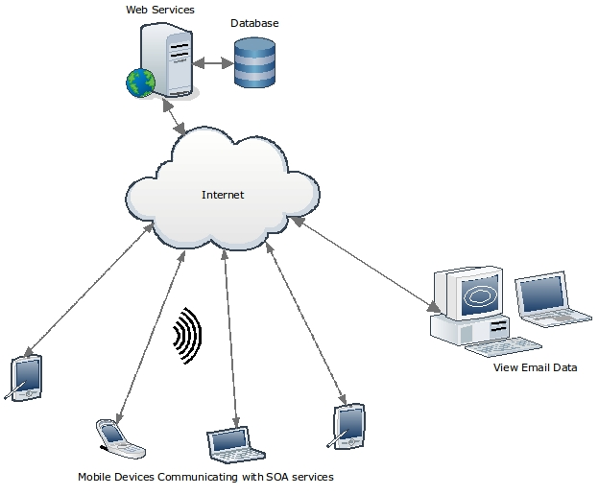
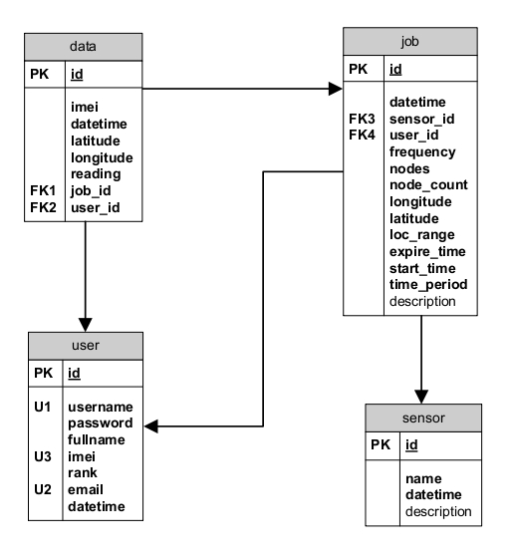
System Architecture

Slide 7
Evaluation
Test cases were developed based on requirements and varified against the implemented system.
App was distributed among selected 15 individuals to run it on their devices.
There feedbacks were collected using questionnaire.
That help to improve the system a lot.
Also identified some important enhancements & expansion as future work.

Slide 8
Conclusion
Any similar system?
Why this is imortant?
Currently this app work only for Magnetometer.
But with minimum change to the system this can be extended to work with other sensor.
This is not a replacement for the traditional sensor networks but alternative.
handy tool for researches/ students who use sensor networks with low budget.
Shared as Google Project.

Slide 9
  Thank You

