Slide 1
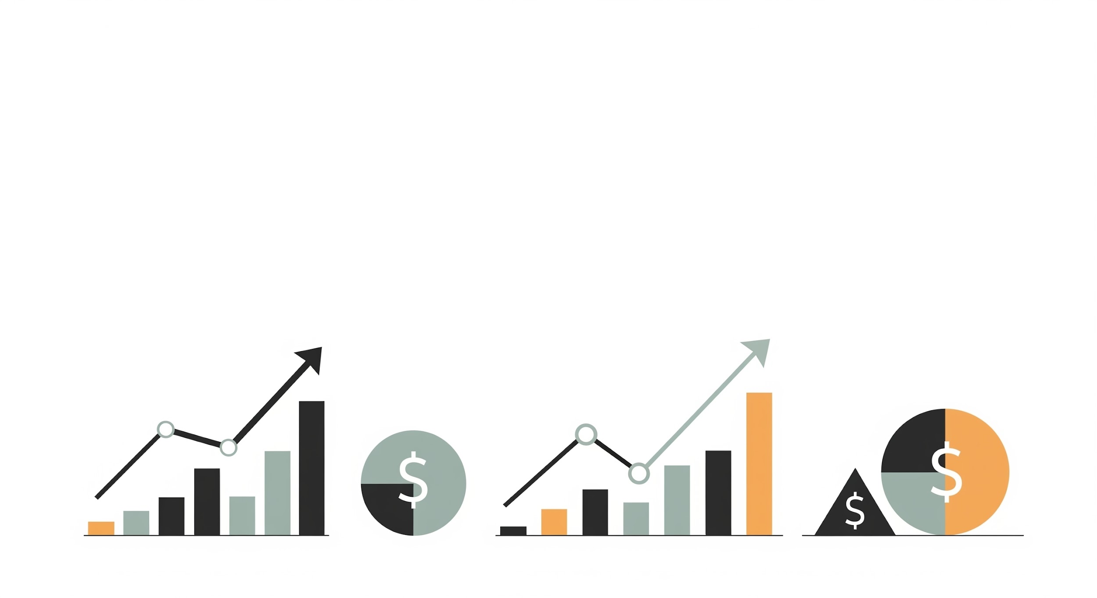
A Case Study in Time-Series Forecasting: Sector Rotation
by Young Han
Notes:
Hello everyone,
My name is young and today I will be talking about my work on building sector rotation strategy

Slide 2
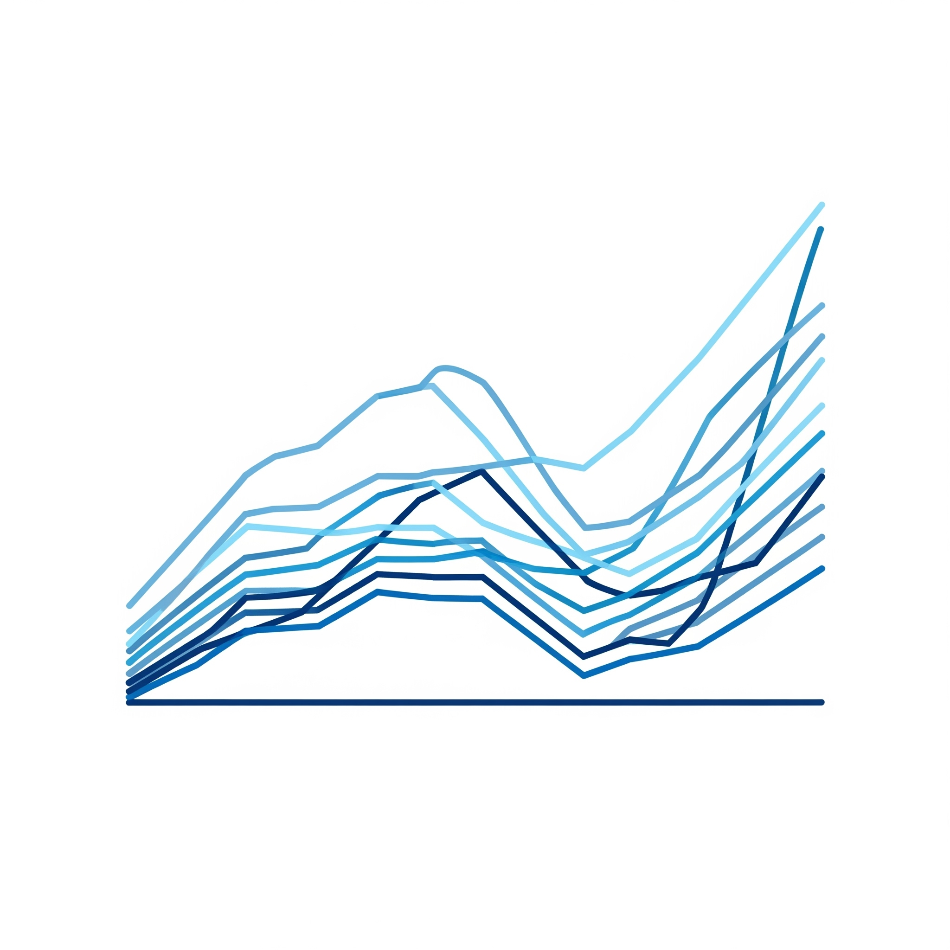
Project Overview
Objective:
To develop and validate a quantitative model (sector rotator) that ranks the 11 US sector ETFs based on predicted next-month performance
The ultimate aim is to test if this active strategy can outperform a passive SPY benchmark
Why it matters:
Provides a data-driven investigation into a popular active investment strategy for investors
Highlights the challenges of beating the market
Notes:
Sector rotation is very popular strategy among retail investors, traders and even large firms.
You can think of the stock market as being made up of 11 major baskets, called sectors. You have technology sector, energy sector, and healthcare sector.
The idea behind the sector rotation is simple: not all of these sectors perform well at the same time.
So the goal is to actively invest in the sectors that are expected to be the strongest in the near future, and move out of the ones that are expected to be the weakest.
My project uses machine learning to ask the question of can we produce a reliable model that predicts which sectors will be better than the others
First, predict next month performance of each sector ETFs.
Then, rank their relative strength comparing each other.
Finally, backtest the strategy to see if it outperforms passive SPY benchmark

Slide 3

Dataset
Source:
Daily price data from Yahoo Finance
Macroeconomic data from FRED
Scope:
15 years of data, 3900 observations, covering 11 sector ETFs, benchmarks, and economic indicators
Preprocessing step:
Addressing missing data for newer ETFs by creating a continuous price history
Notes:
These are simple dataset intro.
Data are extracted from yahoo finance and federal reserve economic data, fred
Whole data spans from jan 2010 to july 2025

Slide 4
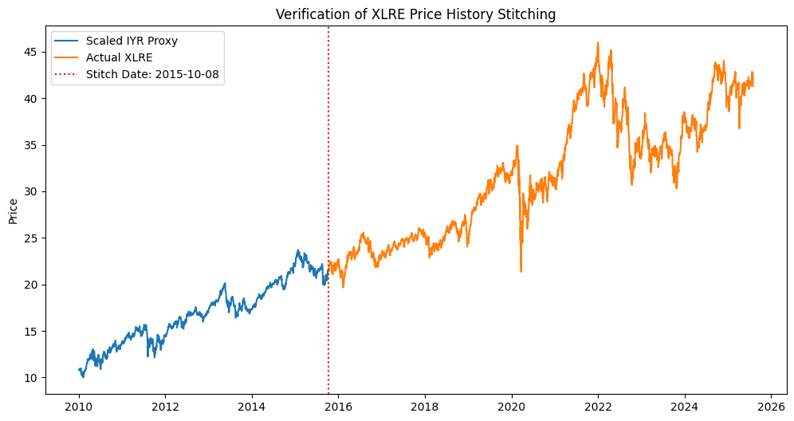
The Data & The First Hurdle
Like many real-world dataset, part of the data was incomplete
(XLRE, XLC)
Solved this problem by finding highly correlated ‘proxy’ datasets and using them to backfill the missing history
Notes:
When I first download the data, 2 ETFs were much younger than the others.
I found highly correlated proxy ETF for each and backfilled missing data with the proper scaling for continuous price history

Slide 5
Feature & Target Engineering
How the Model sees the Market
Input features: What just happened?
Feature categories:
Momentum: “How has the price changed over the last n month?”
Volatility: “How bumpy was the ride recently?”
Macro context: “What was the overall market environment like?”
Target variable: What happened next?
Step 1: Predict Absolute Performance
The actual performance over the next 21 trading days (absolute return)
Step 2: Rank for Relative Strength
Individual predictions are ranked against each other to identify the top 3 expected performers
Final rankings is the signal used for the portfolio strategy
Notes:
I tried to simplify number and the kind of features as much as possible.
Mainly there are 3 different feature categories: momentum, volatility, and macroeconomic.
Momentum tells you the price change over time
Volatility tells you the variation of the price
Macro data tells you the overall market situation
My main target variable for machine learning was the actual performance over the next 21 trading days
Using the target variable, I ranked top 3 performers for each month
And the final rankings are used to build portfolio strategy

Slide 6
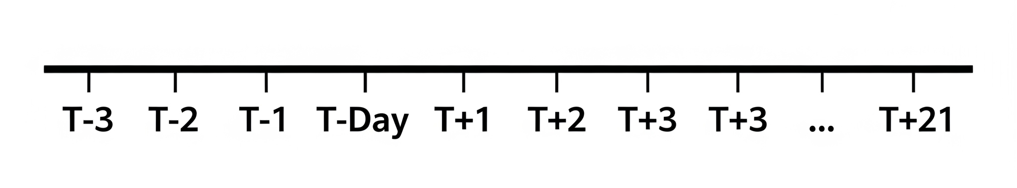
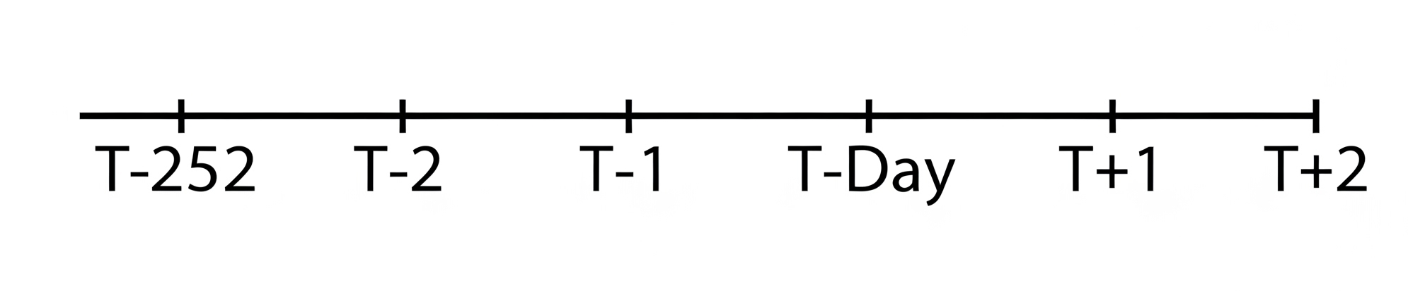
Final Data Preparation
Data Cleaning
The forward and backward looking features naturally create NA values at the start and end of the dataset
Incomplete rows were removed for the model training
21 rows with missing values (target variable) created due to forward-looking calculation
252 rows with missing values (feature variables) created due to backward-looking calculation
The final analytical window for the project:
From January 2011 to June 2025
Notes:
This is final data prep and cleaning
Backward looking: to create features like a 1 year return for any given day, we need to look back at the price from one year ago. For the first year of data, that history doesn’t exist. This creates NA values at the beginning of dataset
Forward looking: to create 21 day forward return target, we need to see 21 days into the future. For the last 21 days of dataset, that future isn’t available. This creates NA values at the end of dataset
The final analytical window was from jan 2011 to june 2025

Slide 7
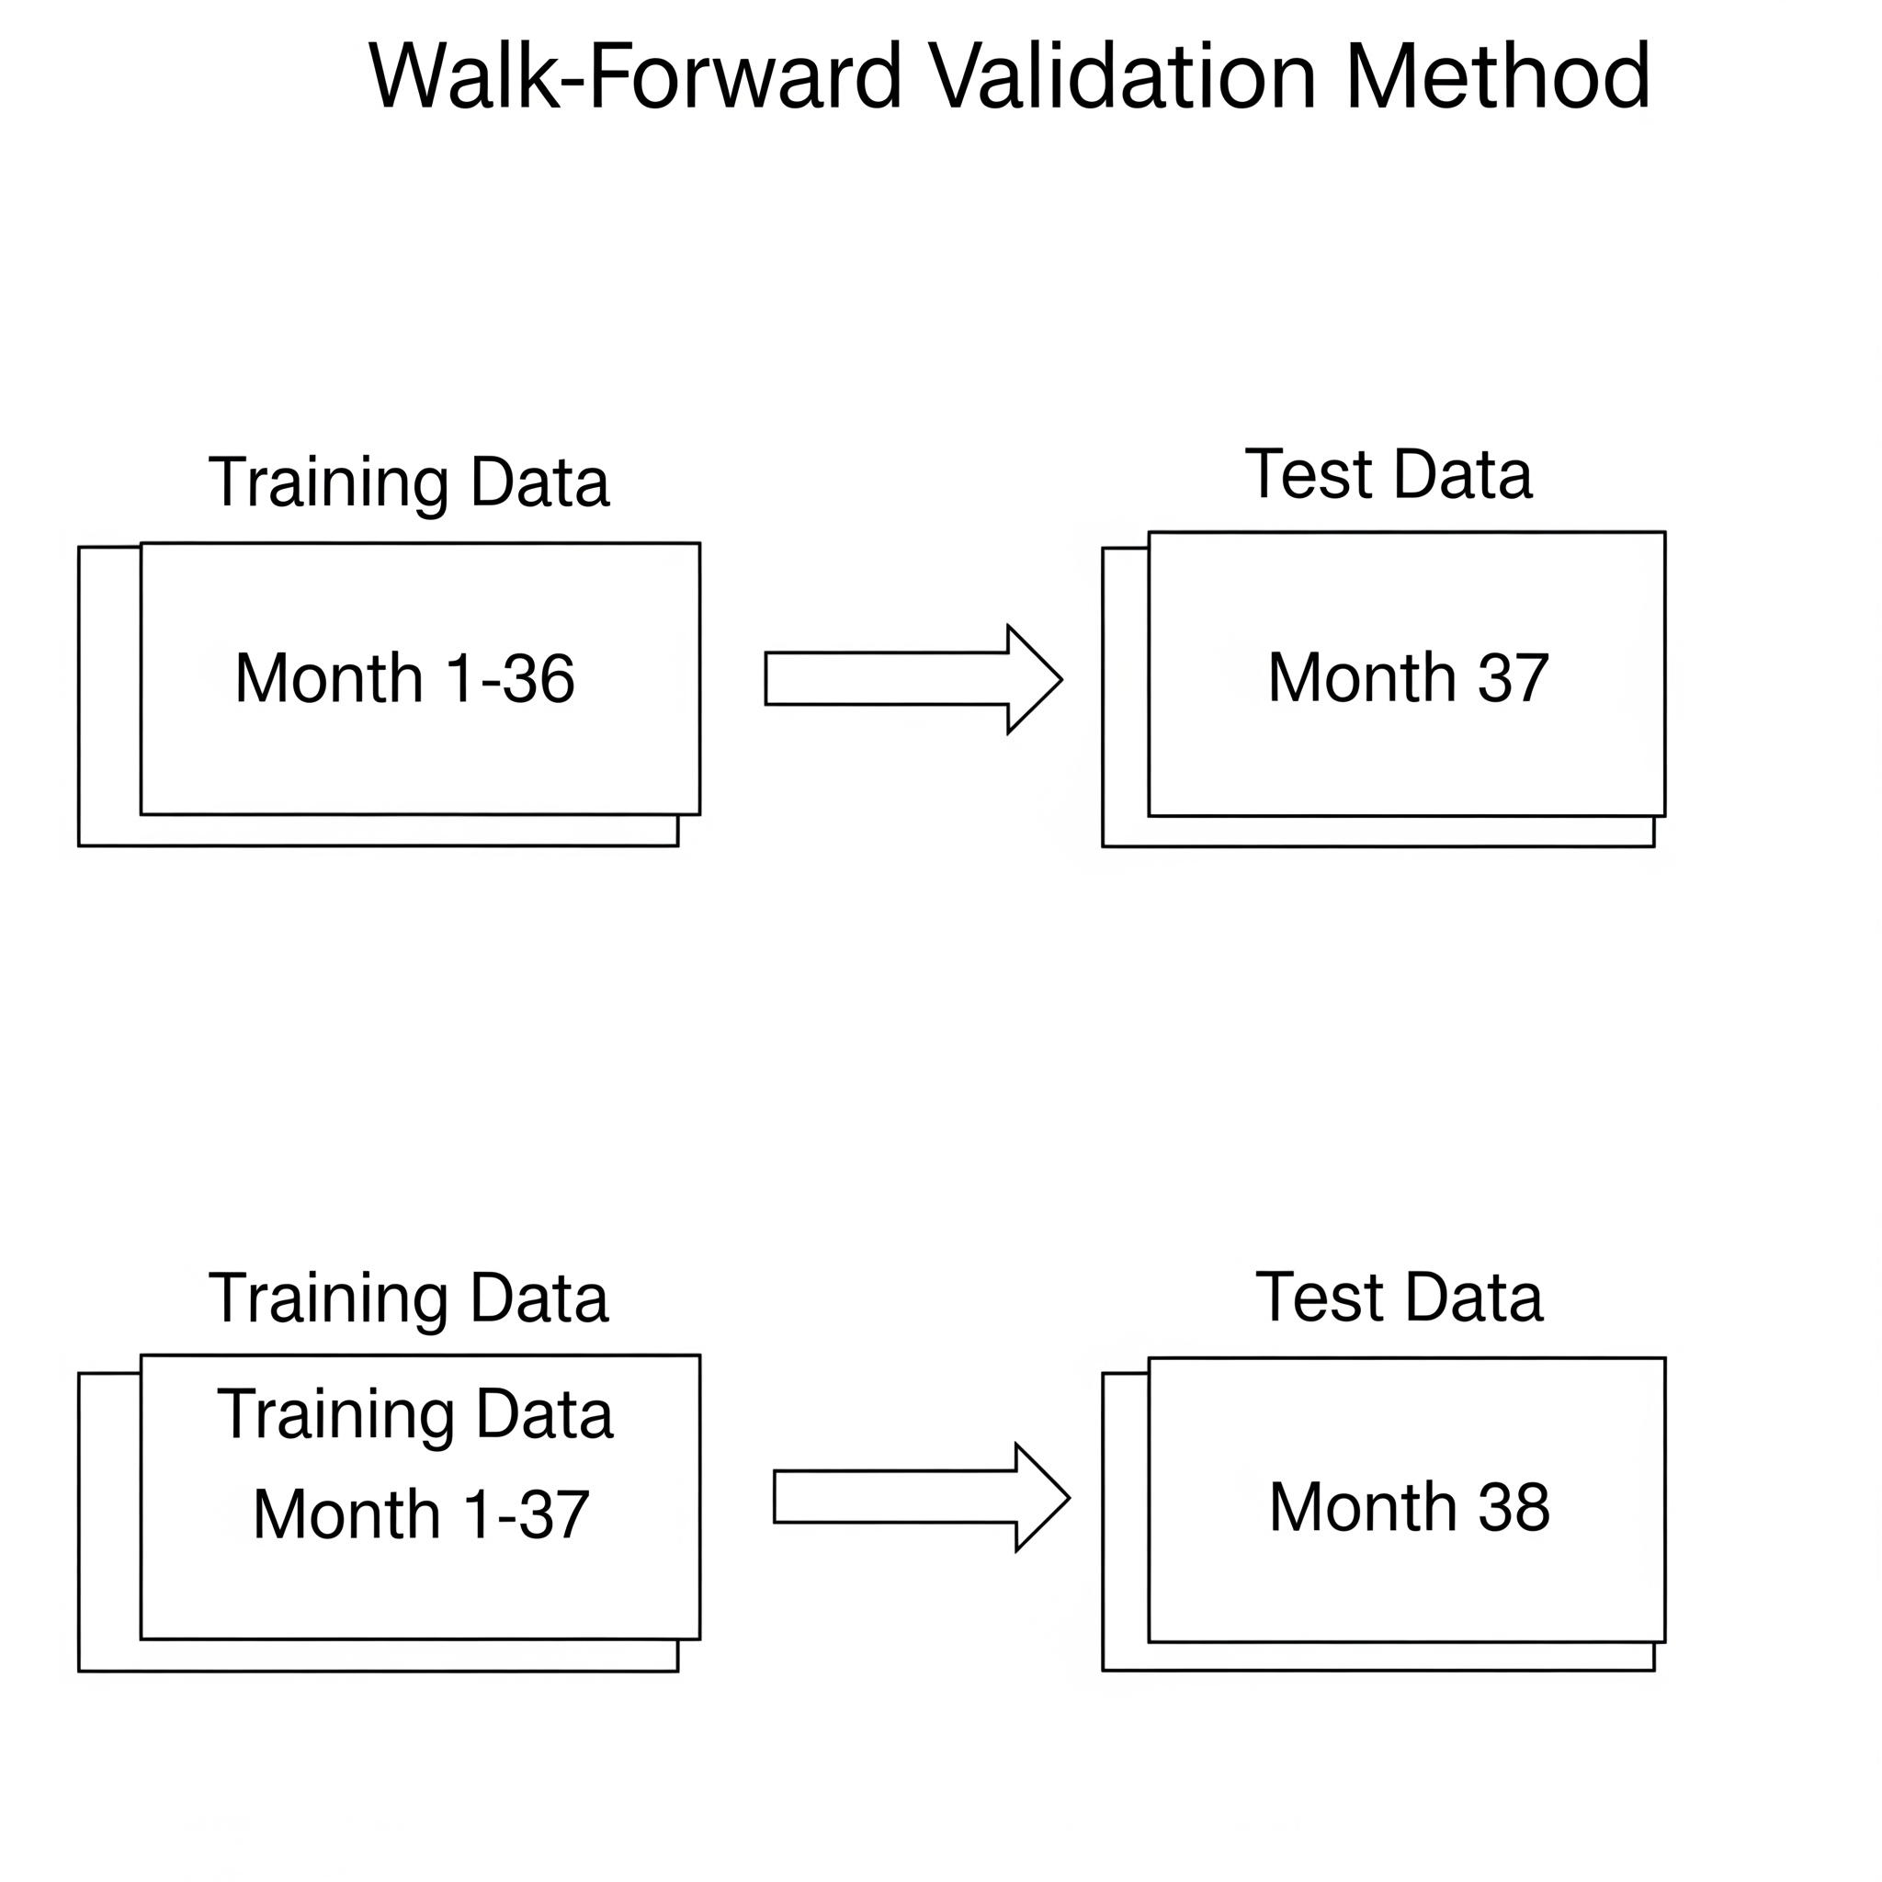
Method
T-2 Timeline
Walk-Forward Validation
To prevent look-ahead bias, predictions were made on the second to the last business day of the month (T-2).
Example: for predicting September 2025
Prediction on August 27, 2025 (T-2)
Execution on August 29, 2025 (T-Day)
For time-series, a standard train-test split lets the model see the future
The method used: Walk-Forward Validation
Training begins with the first 36 months and goes all the way until current month
Notes:
Before training the model, this is the final stop where I setup the trading strategy and the training validation
T-day, target day or trading day, is the last business day of month and rotation executed on this day.
T-2, target day minus 2 days, is where the prediction is made for the next month.
Reason: to prevent leakage
Validation method used: walk forward validation
Month 1-36 is initial training and it is used to predict month 37 performance.
Next window, month 1-37 used to predict month 38 performance. And it goes on up to current month.
The actual prediction begins on 37th month. So the prediction range was from feb 2014 to june 2025
At the end, in this project, I ended up with 133 monthly predictions.

Slide 8
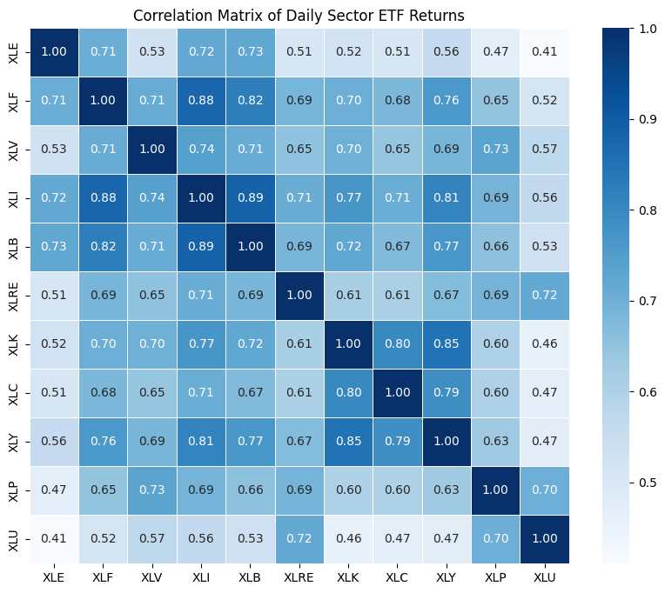
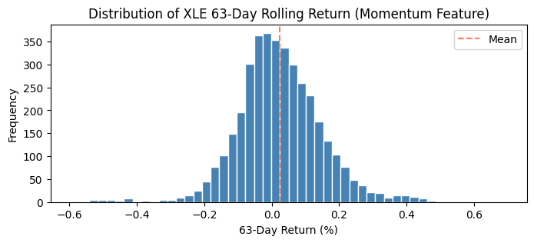
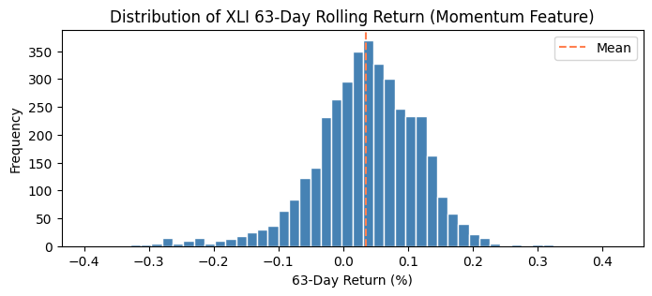
Core Challenge
All sectors tend to move together, exhibiting high multicollinearity
Notes:
Heatmap shows that all 11 sector ETFs are moderately to highly correlated. This makes it difficult for a model to distinguish individual outperformers from the general market noise
The feature distributions reveal that sectors have vastly different characteristics. For example, the low correlation energy sector is far more volatile and prone to extreme swings than the high correlation industrial sector
The model must find a signal strong enough to overcome the high correlation

Slide 9
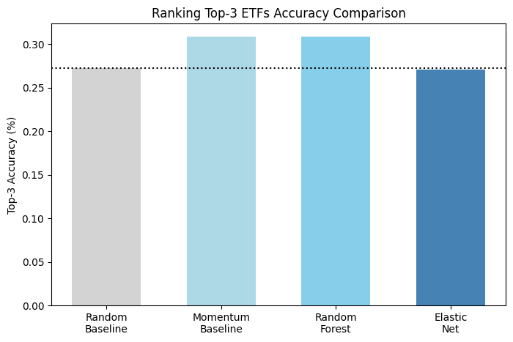
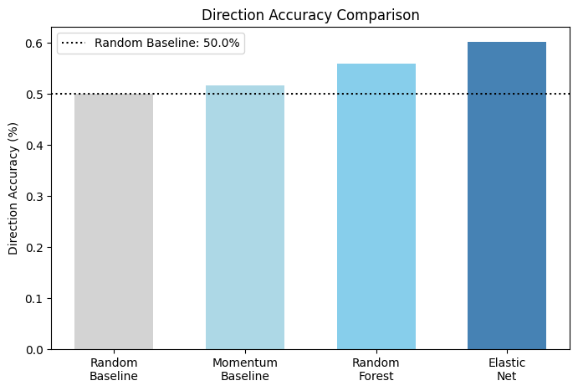
Results: The Models Failed
The models failed at their primary goal
A suspicious result with direction accuracy
Notes:
Both the random forest and elastic net models failed to beat the simple momentum baseline at predicting the top 3 ETFs.
Top 3 Random baseline: 3/11,
Direction random baseline: 1/2
The simpler elastic net model achieved the highest direction accuracy (60.1%). This seems too good to be true and requires investigation

Slide 10
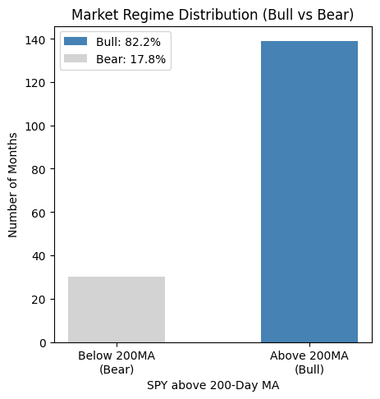
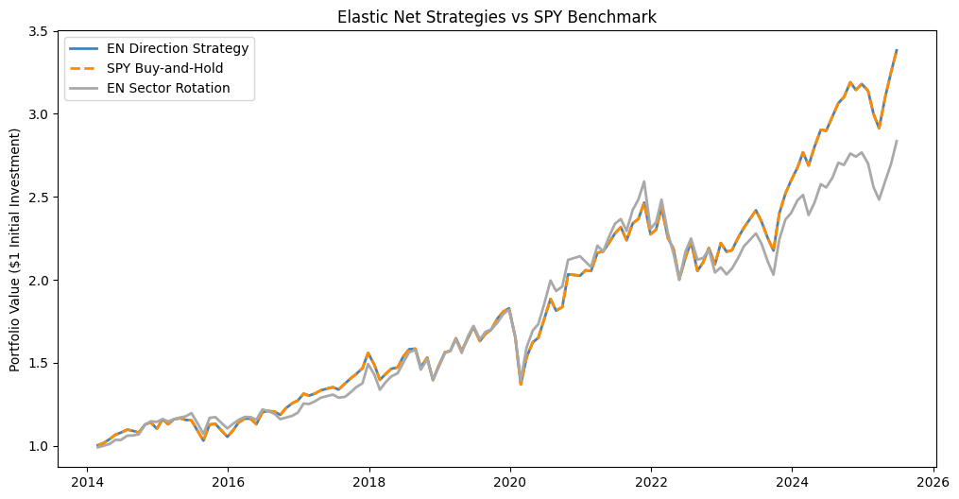
The “Lazy” Model
Elastic Net Strategies vs
SPY Benchmark (Buy and Hold Strategy)
The model was trained on a dataset where the market was in a “Bull” regime 82.2% of the time
Notes:
The model learned market regime bias. It ignored the input features and adopted a simple strategy: always predict positive returns
As a result, the model’s market-timing strategy was virtually identical to a simple buy and hold spy strategy. It provided no real value at all.

Slide 11
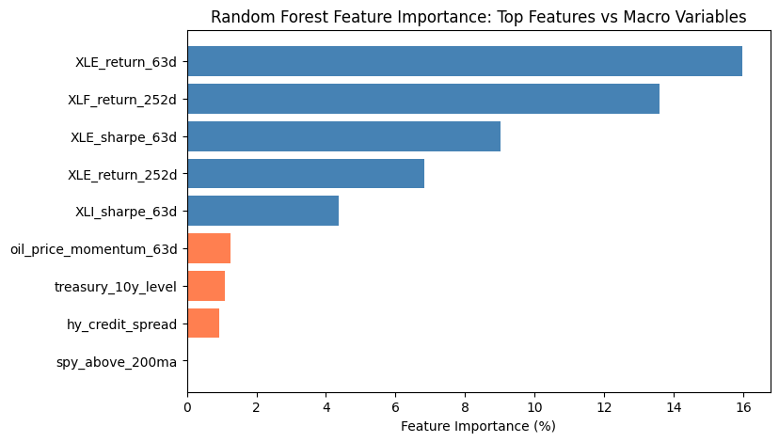
The “Obsessed” Model
Random Forest model found strong signals - almost exclusively in the energy sector
3 of the top 5 features are related to XLE (energy sector)
Macroeconomic features show little to no importance
Notes:
Feature importance
Mean decrease in impurity from scilit learn
Rf is made of hundreds of individual decision trees
Each tree learns by asking a series of questions to split the data. At each split the tree chooses the feature that creates the purest possible groups
Every time a feature is used to make a split, it reduces the model’s overall uncertainty. Powerful features reduce impurity more than weak ones
The model calculator the total amount of impurity each feature reduced in a single tree
Feature importance is the average of that features contribution across all trees in the forest
Splits involving the xle return 63d feature were responsible for 16% of the total reduction in impurity (model error) across the entire forest
Measure of how decisive or influential it was when it was used
The xle return 63d feature alone is more influential than all four macroeconomic features combined
The model is not a balanced sector rotator; it’s an obsessed model that bases its decisions for all 11 sectors on the behavior of one, xle
For this project, i wanted to more evenly distributed feature importance since the goal was to build a diversified rotation strategy. I wanted to mix of every sector related features.

Slide 12
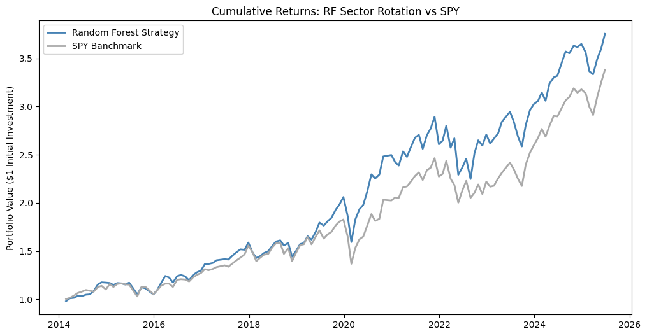
The Verdict: Simulating the Outcome
The Random Forest strategy appeared to slightly outperform the SPY benchmark
The result came from a flawed XLE-obsessed model
The model failed to produce a viable, real-world investment strategy
Notes:
At first glance, rf strategy appears to slightly outperform the spy benchmark
However, this small edge is misleading, as it comes from a flawed xle obsessed model
Conservative transaction costs for this strategy would be around .15% per year
As the backtest shows, over the entire 10-year period, the Random Forest strategy turned a $1 investment into $3.70, slightly better than the $3.40 from the SPY benchmark.
Rf cagr: around 12.15% per year, benchmark cagr: around 11.19%
This tiny edge is not compelling enough to adopt the strategy, it comes from a flawed, unreliable model
"This is like a student who gets an 'A' on a history test, but we find out they did it by only studying the chapter on World War II. They got lucky because the test happened to be 90% about that one topic.
"My model is that lucky student. It produced a good result on this specific historical 'test', but its underlying logic is not sound, robust, or diversified. Because it's a fragile 'one-trick pony', we cannot trust it to work in the future, especially if the market environment changes. Therefore, despite the positive backtest, it must be classified as a bad model."

Slide 13
Conclusion
The linear model became “lazy,” simply following the market’s 82% bull market regime while ignoring features
The random forest model became “obsessed,” overly relying on highly volatile patterns of the energy sector (XLE) while ignoring other sectors
This project demonstrated how easily models can be misled by environmental biases and feature characteristics
Future work:
Engineer more sophisticated features
Develop a strategy focused on a smaller, less correlated portfolio of sectors
Build a dedicated model for the energy sector (XLE) to leverage its strong patterns
Reference list
Dataset: Yahoo Finance, FRED
Libraries: scikit_learn, pandas, numpy, seaborn, matplotlib

Slide 14

Thank you!

