Slide 1
Digital Portfolio
STUDENT NAME: THISHANTH.V REGISTER NO AND NMID: asunm130123G206
DEPARTMENT: BSC COMPUTER SCIENCE
COLLEGE:AGURCHAND MANMULL JAIN COLLEGE

Slide 2

AGENDA
Problem Statement
Project Overview
End Users
Tools and Technologies
Portfolio design and Layout
Features and Functionality
Results and Screenshots
Conclusion
Github Link

Slide 3
PROJECT TITLE
STUDENT PORTFOLIO

Slide 4
PROBLEM STATEMENT
Students often lack a centralized and professional platform to showcase their academic achievements, skills, and projects. Traditional resumes fail to capture the full scope of their capabilities, and institutions struggle to track student progress effectively. A digital Student Portfolio System is needed to help students organize and present their accomplishments in a structured, accessible, and impactful way.
A portfolio provides a broader view of a student’s capabilities by showcasing:
Academic achievements
Projects and research work
Certifications and skills
Internships and extracurricular activities
Reflections and learning outcomes

Slide 5
PROJECT OVERVIEW
Purpose
The purpose of this project is to develop a centralized, user-friendly system that enables students to create personalized digital portfolios. It aims to enhance self-presentation, support academic tracking, and improve opportunities for higher education and employment.
Key Objectives
To allow students to document and display academic and personal achievements.
To support multimedia uploads (documents, images, videos, etc.) for project and skill showcase.
To provide institutions with tools to monitor student progress and development.
To improve students' digital presence and career readiness.

Slide 6

WHO ARE THE END USERS?
1. RECRUITERS/EMPLOYES :
Review skills and project work during hiring process
Evaluate both technical and design knowledge
2. PEERS AND MENTORS :
Provide feedback
Collaborate on open-source or academic projects
3.ACADAMIC INSTRUCTORS :
Assess practical implementation of skills
Validate course outcomes
4. PERSONAL USE:
Track career progress
Keep all achievements and work in one place

Slide 7
TOOLS AND TECHNIQUES
TECHNOLOGIES :
Frontend Languages: HTML5, CSS3
Programming Languages: Java, Python (used in projects)
Design: CSS Flexbox & Grid for layout, Google Fonts for typography
DEVELOPMENT TOOLS :
VS Code: Main code editor
Git & GitHub: Version control and collaboration
GitHub Pages: For free and reliable website hosting

Slide 8
POTFOLIO DESIGN AND LAYOUT
DESIGN:
Minimalistic UI: Focus on readability and user experience
Consistent Layout: Uniform margins, font sizes, and color schemes
Sectional Division: Each section is clearly marked (About, Skills, Projects)
COLOR SCHEME & FONTS:
Primary Color: Light blue – indicates trust and calmness
Secondary Color: White – clean background for readability
Typography: Clean sans-serif fonts for modern appearance
RESPONSIVENESS:
Designed to adapt to different screen sizes (mobile, tablet, desktop)
8

Slide 9
FEATURES AND FUNCTIONALITY
CORE FEATURES:
About Me Section: Personal introduction and motivation
Skills Section: Represented as interactive tags (Java, Python, CSS)
Projects Section: Project titles and descriptions displayed neatly
Navigation: Smooth scroll and clear flow of content
EXTRA FUNCTIONALITIES:
Mobile Friendly: Works on smartphones and tablets
Fast Loading: No backend or heavy libraries
Version Controlled: Easy to update and maintain via GitHub

Slide 10
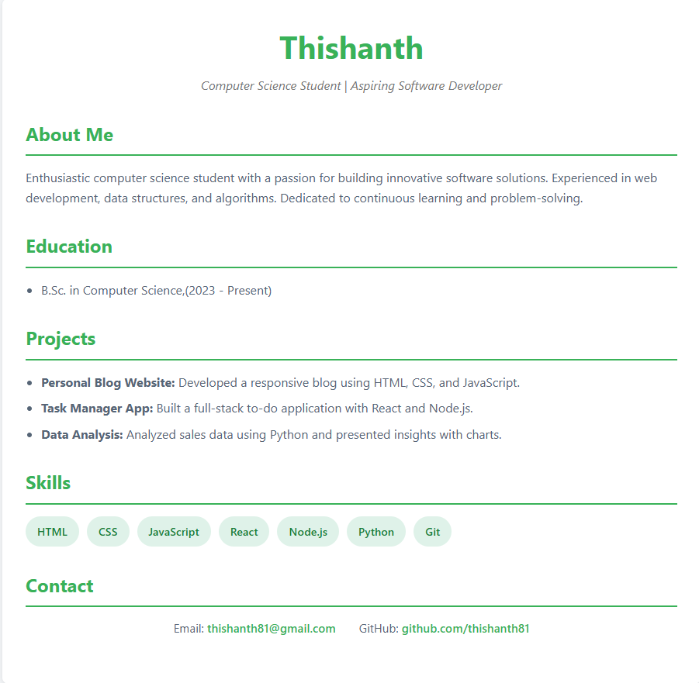
RESULTS AND SCREENSHOTS
3/21/2024 Annual Review
10

Slide 11
CONCLUSION
IMPACT :
A personal portfolio helps in standing out from the crowd in technical interviews
Reflects professionalism, consistency, and strong communication
FUTURE SCOPE :
Add blog section to document learning
Integrate contact form or links to LinkedIn/GitHub
Include more projects with live demos and GitHub links
11

