Slide 1


Fake News Detector

Slide 2
Agenda
01.
Introduction
02.
Domain
03.
Dataset
04.
Course of action

Slide 3

Problem Statement: In today's digital age, misinformation spreads rapidly, leading to confusion and mistrust among people.
Objective: Our goal is to develop a system that automatically identifies fake news articles, helping to combat the spread of misinformation.
Approach: Using machine learning and natural language processing techniques, we analyze textual content to detect patterns indicative of fake news.
Expected Outcome: We aim to create a reliable and scalable solution that promotes information integrity and trustworthiness in the digital realm.
Impact: By detecting and debunking fake news, we contribute to fostering social harmony, protecting public health, and upholding democratic processes.
Introduction

Slide 4

Domain
The domain for the project is Natural Language Processing (NLP), and the project utilizes the Python programming language along with the following libraries:
1. Streamlit:
2. NumPy:
3. pandas
4. re:
5. nltk:
6. scikit-learn (sklearn)

Slide 5
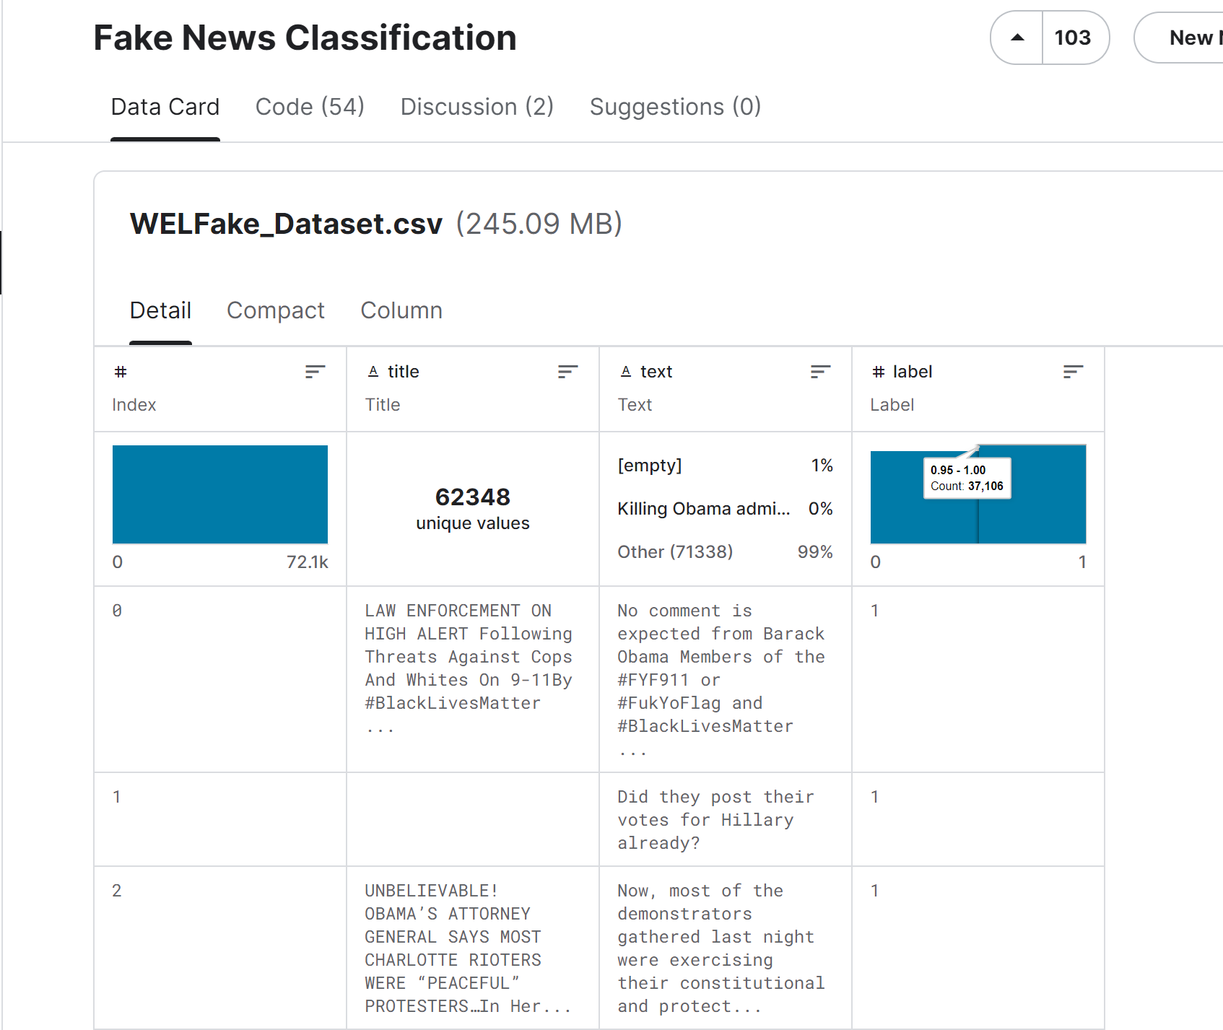
Dataset Name: Scam Detection Fake News Labelled Dataset - our primary source of information.
Source: Acquired from Kaggle, a rich resource for diverse datasets.
Size: With 62,348 unique rows, our dataset comprises a mix of real and fake articles.
Characteristics: Focused on textual content including titles and article text, with additional metadata like publication dates or authors.
What to Watch For: We'll keep an eye out for any imbalance between real and fake news and verify the accuracy of labels for robust analysis.
Dataset

Slide 6
Feature Engineering:
- Convert text to TF-IDF representation for numerical analysis.
- Transform preprocessed text into TF-IDF features.
Model Training:
- Split data for training and testing.
- Train Logistic Regression model for fake news classification.
Model Evaluation:
- Assess model accuracy by testing predictions on a separate dataset.
Web Application Development:
- Develop an interactive web app using Streamlit.
- Enable users to input news articles for classification.
User Interface: - Display clear prediction results for user-entered articles.
Course of action
Data Loading and Preprocessing:
- Load dataset from 'train.csv' using pandas.
- Fill missing values and create a unified 'content' column for analysis.
Text Preprocessing:
- Clean text by removing non-alphabetic characters, converting to lowercase, and tokenizing.
- Apply stemming and remove stopwords to refine text data.

Slide 7

Thank
You
TEAM MEMBERS
ASWANTH E K
DEVANANDA E
GURUPRIYAN D A
MARIYA VENUS
MOHAMMED RIZVAN​
Introduce your solution, provide a brief overview of
your product or service, and explain how exactly it helps customers solve the problem.

Slide 8



