Slide 1




Slide 2

PRESENTATION FRAME
The executive question
COST PRESSURE
PRICING LEVERAGE
63%
5–6×
Serialization looks like syntax, but in AI systems it becomes unit economics: every repeated key, delimiter, newline, tag, and repair loop becomes billed context.
CSV used 62.9% fewer tokens than pretty JSON in the flat TOON benchmark.
Output tokens cost five to six times input on representative flagship models.
BENCHMARK SCOPE
CORE WARNING
12
Shape
Figure 2 uses a complete 12-format, internally consistent benchmark setup.
The right format depends on data shape, usage context, and validation requirements.
Decision target: minimize total billed tokens without sacrificing comprehension accuracy, parseability, or operating discipline.
EMBLEM-NLP | Prompt Ecology, Reverse Engineering —Embodied Agencies.
02
Notes:
The executive decision is not “CSV versus JSON” in the abstract. It is whether a format lowers total operating cost once accuracy, parsing, retries, latency, and provider pricing are included. The report gives us three anchor numbers: a 62.9 percent token reduction for CSV versus pretty JSON in one flat benchmark, output multipliers as high as five to six times input, and a complete 12-format accuracy-versus-token comparison from one consistent benchmark.

Slide 3
EVIDENCE BASE
Three evidence classes, one guardrail
The report separates token-efficiency measurement, comprehension accuracy, and provider pricing so the deck does not mix incompatible benchmarks.
01
02
03
TOON token efficiency
ImprovingAgents
Provider pricing
100 uniform employee records, measured with GPT-5 o200k_base tokenizer.
1,000 records, 1,000 randomized retrieval questions, GPT-4.1-nano, 12 paired format results.
Official list prices verified June 16, 2026, expressed per million tokens.
Guardrail: do not combine token counts and accuracy from different datasets, tokenizer families, or serialization settings in the same scatter plot.
EMBLEM-NLP | Prompt Ecology, Reverse Engineering —Embodied Agencies.
03
Notes:
This slide is the audit discipline. The report uses three evidence classes: the TOON flat-data token benchmark, the ImprovingAgents comprehension benchmark, and official provider pricing. The important guardrail is comparability. We only plot paired token and accuracy values from the same benchmark run. That prevents a misleading chart where cheap token counts from one setup are visually compared against accuracy numbers from another.

Slide 4
EXECUTIVE SUMMARY
Bottom line for production teams
01
Flat, high-volume input
Use CSV or TSV as the cost floor. Evaluate TOON when uniform arrays justify schema-once encoding.
02
Nested or heterogeneous input
Use compact JSON as the safest efficiency baseline; TOON can lose on mixed or deeply nested structures.
03
Structured output
Use JSON Schema or strict tool calling when validation matters.
04
Benchmark discipline
Measure target model, tokenizer/count endpoint, serializer configuration, parse failures, retries, and total billed tokens.
EMBLEM-NLP | Prompt Ecology, Reverse Engineering —Embodied Agencies.
04
Notes:
Here is the operating takeaway. For flat, high-volume inputs, CSV or TSV is the cost floor, and TOON is worth benchmarking when the records are large and uniform. For nested or mixed data, compact JSON is the baseline, not pretty JSON. For output, do not optimize notation until the structured-output baseline is stable. And for every benchmark, preserve the tokenizer, count endpoint, serializer version, payload hash, model, price date, parse-failure rate, and retry cost.

Slide 5
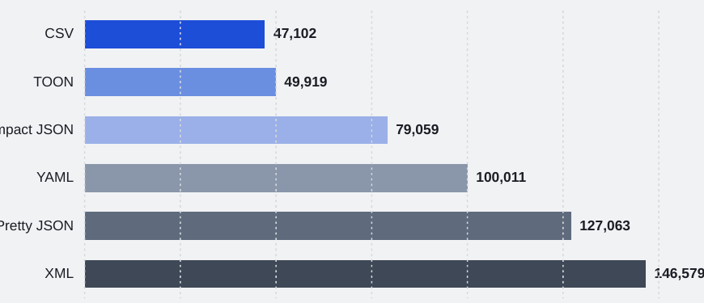
TOKEN COST
Input cost floor: CSV leads flat tables
Key reading
CSV is the least-expensive representation in this flat-data case.
TOON is 6.0% larger than CSV, but 36.9% smaller than compact JSON.
XML is the most expensive because tag names repeat in opening and closing tags.
Production implication: first remove removable whitespace and repeated fields before considering a new serialization grammar.
EMBLEM-NLP | Prompt Ecology, Reverse Engineering —Embodied Agencies.
05
Notes:
This is the simplest cost story. In the TOON flat-track benchmark, CSV is the lowest token representation. TOON is only six percent larger than CSV and much smaller than compact or pretty JSON. This supports the production rule: for flat uniform tables, use CSV or TSV unless the structure demands more. Also note that XML is expensive here because every field name is duplicated in opening and closing tags.

Slide 6
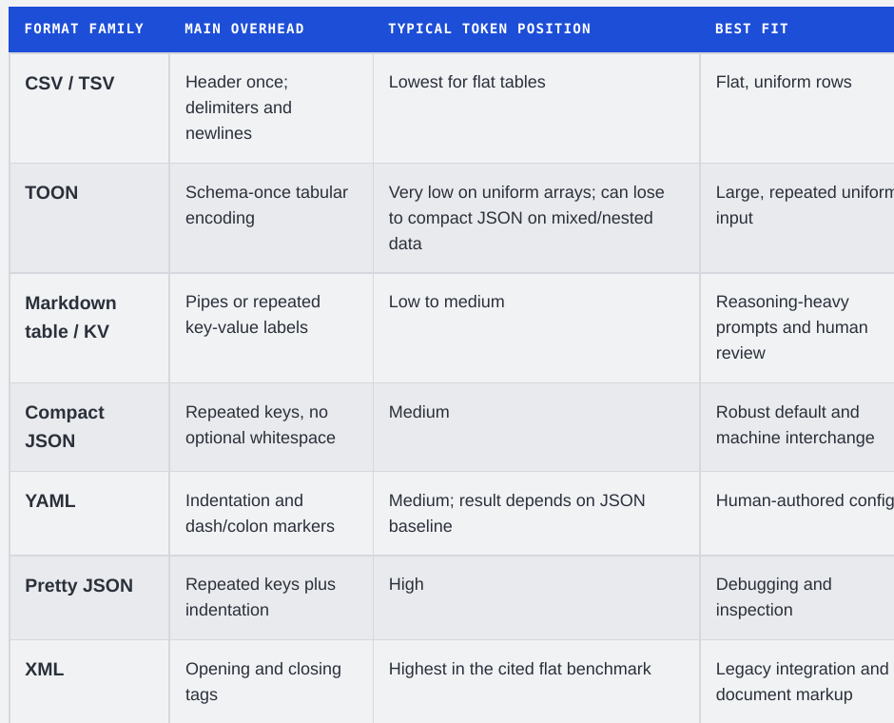
FORMAT SELECTION
Shape drives the format choice
The mistake to avoid
A format can be excellent for uniform arrays and still be weaker for mixed structures. The report notes TOON can become 14.7% larger than compact JSON across a mixed-structure track.
DEFAULT
EXCEPTION
Compact JSON
CSV / TOON
Best baseline for nested, heterogeneous, API-facing data.
Strongest only when the data shape is flat or uniform enough.
EMBLEM-NLP | Prompt Ecology, Reverse Engineering —Embodied Agencies.
06
Notes:
The decision variable is data shape. CSV and TSV win on flat, uniform rows. TOON can be highly efficient when a repeated object array lets the schema appear once. But compact JSON remains the robust default for mixed, nested, and API-facing data. This is why the report warns against blanket claims like “TOON is always cheaper” or “YAML is more token efficient than JSON.”

Slide 7
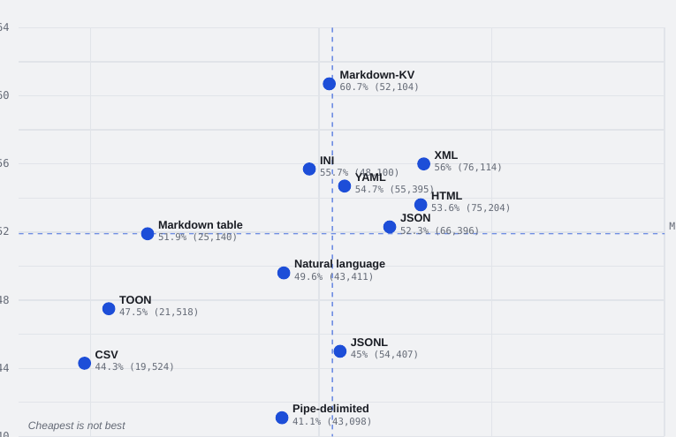
ACCURACY TRADE-OFF
Cheapest is not always best
What changes the decision
Markdown-KV leads accuracy at 60.7%, but uses 52,104 tokens.
CSV is cheapest at 19,524 tokens, but scored 44.3%.
Markdown table is the strongest compact compromise in this benchmark.
This is not a universal ranking; it is one model, one synthetic dataset, and one retrieval task.
EMBLEM-NLP | Prompt Ecology, Reverse Engineering —Embodied Agencies.
07
Notes:
The scatter plot is the key nuance. The cheapest representation is not automatically the best representation. Markdown-KV scored highest on the ImprovingAgents benchmark but was more token-heavy than CSV. CSV was cheapest but scored much lower. The important conclusion is not that Markdown-KV is always best; it is that format familiarity and explicit structure can affect retrieval accuracy enough to offset raw compression.

Slide 8
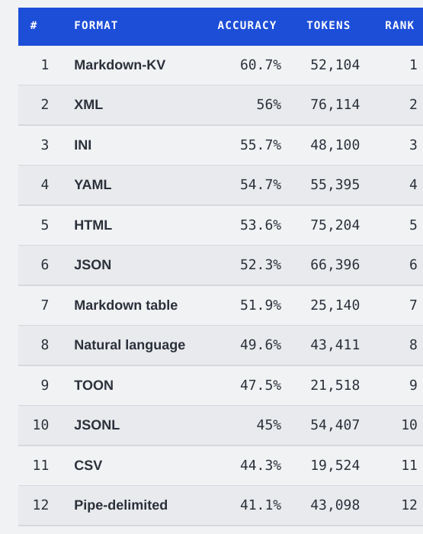
BENCHMARK TABLE
Complete 12-format result set
Interpretation
The 12-format table completes the corrected publication scope: TOON is included alongside every format from the ImprovingAgents run.
Accuracy winner: Markdown-KV at 60.7%.
Cheapest format: CSV at 19,524 tokens.
Compact compromise: Markdown table at 51.9% and 25,140 tokens.
TOON reached 47.5% at 21,518 tokens, with no statistically significant difference from CSV in that benchmark.
EMBLEM-NLP | Prompt Ecology, Reverse Engineering —Embodied Agencies.
08
Notes:
This table is what turns the report from a narrative into an operational reference. It includes all twelve paired token-and-accuracy values from the same ImprovingAgents setup. For executives, the sentence to remember is: the benchmark demonstrates a real cost-accuracy trade-off, not a universal format ranking. For engineering, it tells us which candidates deserve production-specific replication.

Slide 9
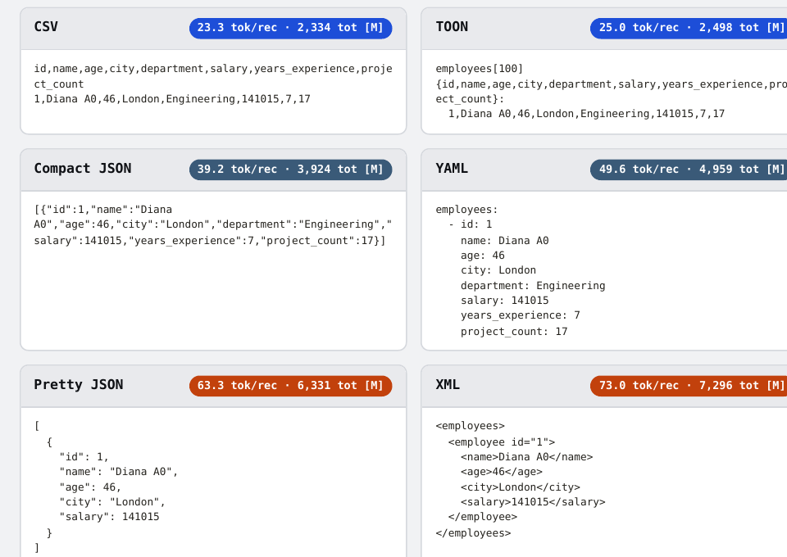
CONCRETE EXAMPLE
Same record, every format
Why the count changes
CSV pays for the header once, then compact row values.
Compact JSON repeats keys on every object.
Pretty JSON adds removable whitespace.
XML repeats semantic labels twice: opening and closing tags.
This is the intuition behind the aggregate chart.
EMBLEM-NLP | Prompt Ecology, Reverse Engineering —Embodied Agencies.
09
Notes:
This slide makes the token math intuitive. The same employee record is encoded six ways. CSV has a one-time header and a short row. Compact JSON repeats field keys. Pretty JSON adds whitespace. XML is most verbose because tags appear before and after values. When this repeats across hundreds or thousands of records, the small syntactic differences become material cost.

Slide 10
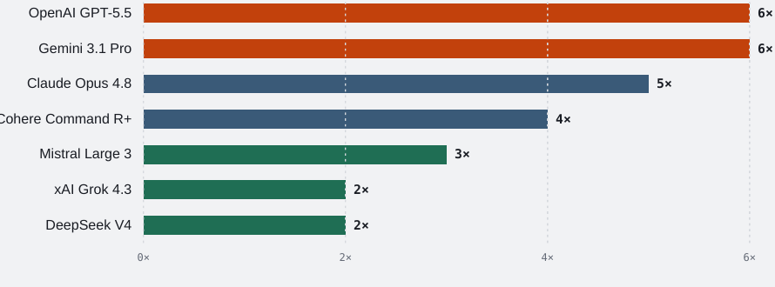
PRICING LEVERAGE
Output tokens dominate savings math
Production reading
OpenAI GPT-5.5 and Gemini 3.1 Pro price output at 6× input.
Claude Opus 4.8 is 5× input.
Grok 4.3 and DeepSeek V4 sit at 2×, so equal token cuts save less.
Optimization priority: compress high-volume input first, but stabilize structured output before chasing novel output formats.
EMBLEM-NLP | Prompt Ecology, Reverse Engineering —Embodied Agencies.
10
Notes:
Provider pricing changes where optimization matters most. On models where output is priced five or six times input, output token reductions appear valuable. But output is also where parse failures and repair loops are most expensive. So the sequencing matters: optimize high-volume input first, then stabilize JSON Schema or strict tool-calling output, and only after that evaluate output notation changes.

Slide 11
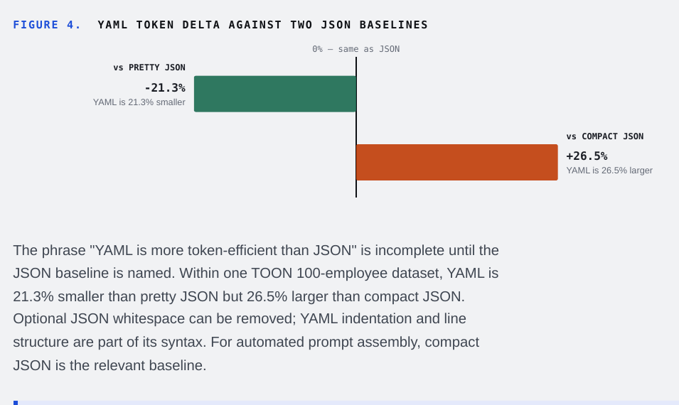
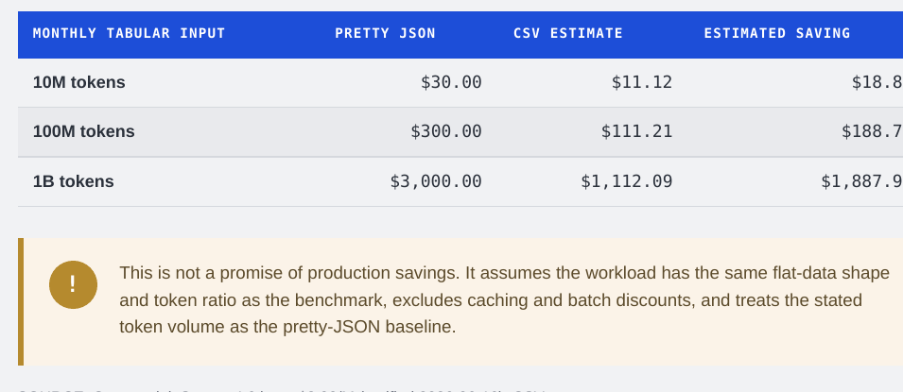
BASELINE DISCIPLINE
Name the baseline before claiming savings
YAML is 21.3% smaller than pretty JSON but 26.5% larger than compact JSON in the same TOON 100-employee dataset. For automated prompt assembly, compact JSON is the relevant baseline.
EMBLEM-NLP | Prompt Ecology, Reverse Engineering —Embodied Agencies.
11
Notes:
This is the baseline trap. “YAML is more efficient than JSON” sounds plausible only until the JSON baseline is named. YAML is smaller than pretty JSON, but larger than compact JSON in the report’s dataset. In production we should minify JSON before evaluating a migration, otherwise we are mostly benchmarking removable whitespace rather than the serialization grammar.

Slide 12
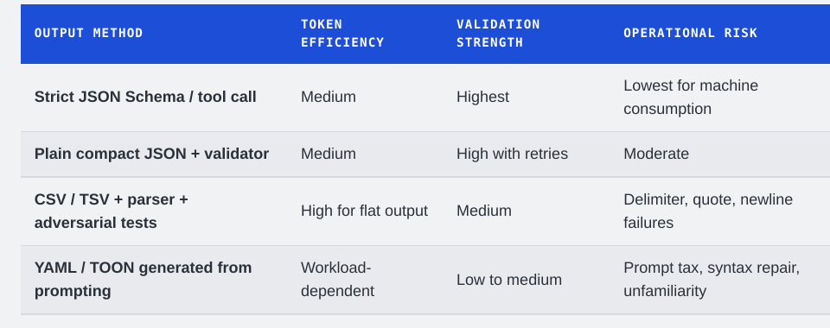
STRUCTURED OUTPUT
Savings only count if the system can trust the result
Token reduction is economically useful only if the downstream system can parse the result and avoid repair loops.
Output rule
Use provider-native JSON Schema or strict tool/function calling for machine-consumed outputs.
Plain compact JSON plus validator is acceptable with retries.
Generated CSV, YAML, or TOON requires custom escaping, validation, and repair logic.
EMBLEM-NLP | Prompt Ecology, Reverse Engineering —Embodied Agencies.
12
Notes:
Reliability is the non-negotiable output gate. Modern provider APIs increasingly support constrained JSON generation, which makes JSON the dominant machine-consumed target. CSV, TSV, YAML, and TOON can be useful as inputs, but when the model generates them, delimiter errors, escaping failures, syntax repair, and prompt tax can erase savings. So the recommendation is strict structured output first.

Slide 13
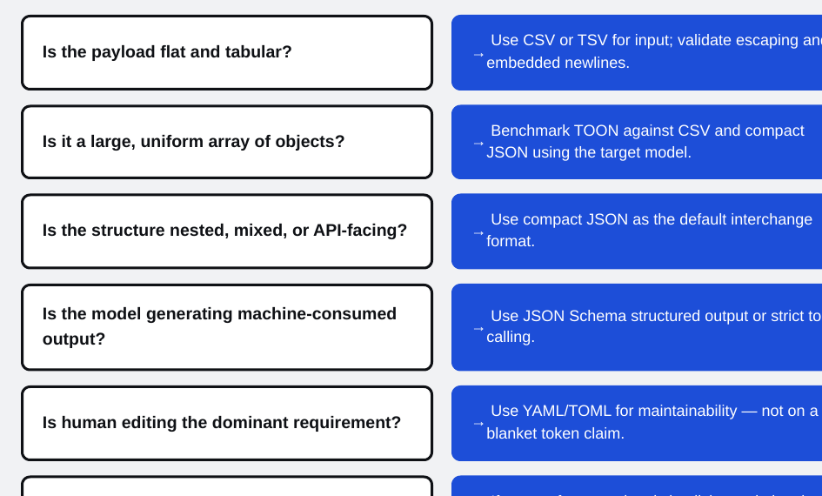
DECISION FLOW
A practical selection logic
Use this order
Flat and tabular → CSV or TSV.
Large uniform array → benchmark TOON against CSV and compact JSON.
Nested or mixed → compact JSON.
Machine output → JSON Schema or strict tool call.
Human-authored config → YAML/TOML for maintainability, not blanket token savings.
EMBLEM-NLP | Prompt Ecology, Reverse Engineering —Embodied Agencies.
13
Notes:
This is the operational flow. Start with the payload shape: flat and tabular goes to CSV or TSV; large uniform arrays justify a TOON benchmark; mixed or API-facing data defaults to compact JSON. If the model is generating output for another system, use JSON Schema or strict tool calling. Use YAML or TOML when human maintainability is the dominant requirement, not because of a generic token-efficiency claim.

Slide 14

RECOMMENDATIONS
Implementation next steps
01
Adopt compact JSON as the machine-interchange default.
02
Use CSV/TSV for validated flat-table inputs.
03
Benchmark TOON only for large uniform object arrays.
04
Lock structured-output baselines with JSON Schema or strict tool calls.
05
Record serializer version, tokenizer/count endpoint, payload hash, model, price date, parse failures, retries, latency, and total billed tokens.
Repository
Close: optimize notation only after data selection, benchmark discipline, and output reliability are already controlled.
github.com/emblem-nlp
EMBLEM-NLP | Prompt Ecology, Reverse Engineering —Embodied Agencies.
14
Notes:
Close with the operating plan. We should formalize compact JSON as the default interchange layer, use CSV or TSV for validated flat input, and benchmark TOON only in its strongest zone: large uniform arrays. For output, we standardize on provider-native structured output. Every benchmark should be reproducible and include cost, accuracy, parse failures, retries, latency, and total billed tokens. The strategic point is that notation optimization is valuable, but only after data selection and reliability are under control.

