Slide 1
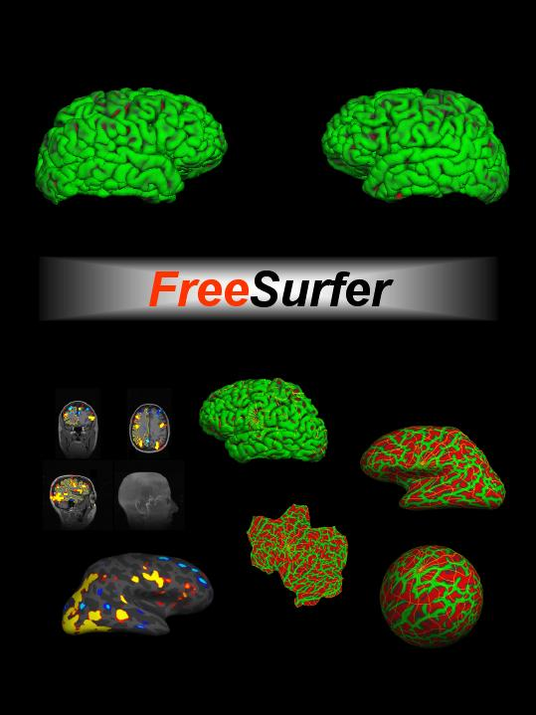


Surface-based Group Analysis in FreeSurfer

Slide 2
Outline
Processing Stages
Command-line Stream
  Assemble Data
  Design/Contrast (GLM Theory)
  Analyze
  Visualize
Interactive/Automated GUI (QDEC)
Correction for multiple comparisons

Slide 3
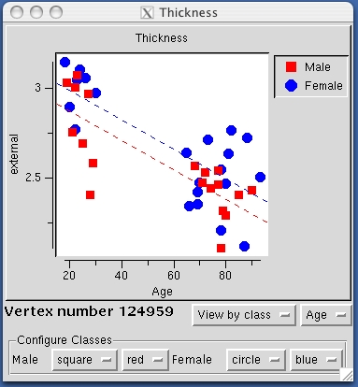
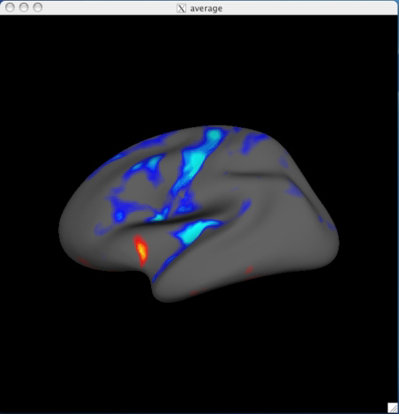
Surface-based Study (Thickness)

Slide 4
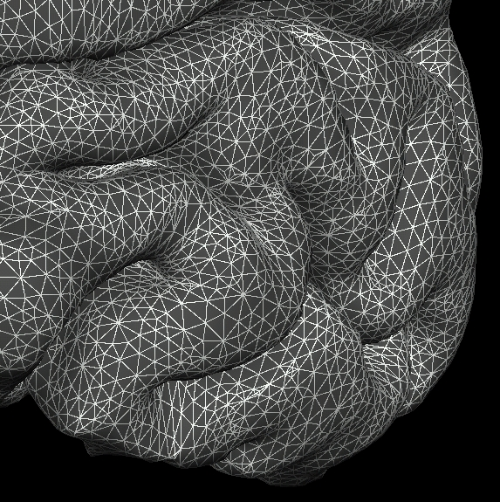
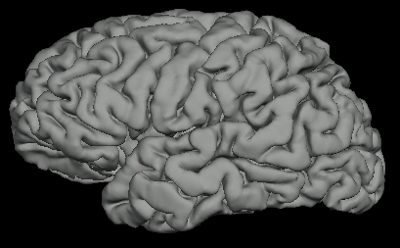
Surface-based Measures
Morphometric (eg, thickness)
Functional
PET
MEG/EEG
Diffusion (?) sampled just under the surface

Slide 5
Processing Stages
Specify Subjects and Surface measures
Assemble Data:
  Resample into Common Space
  Smooth
  Concatenate into one file
Model and Contrasts (GLM)
Fit Model (Estimate)
Correct for multiple comparisons
Visualize

Slide 6
Intersubject Registration

Slide 7
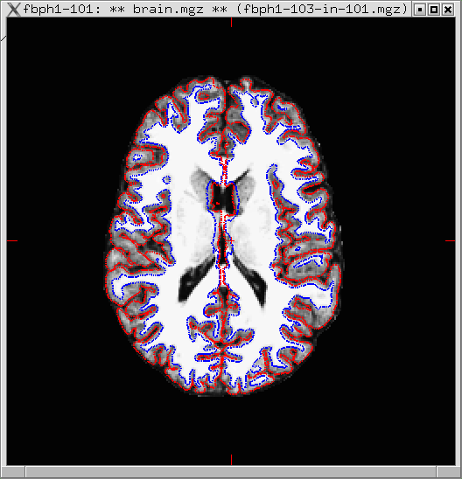
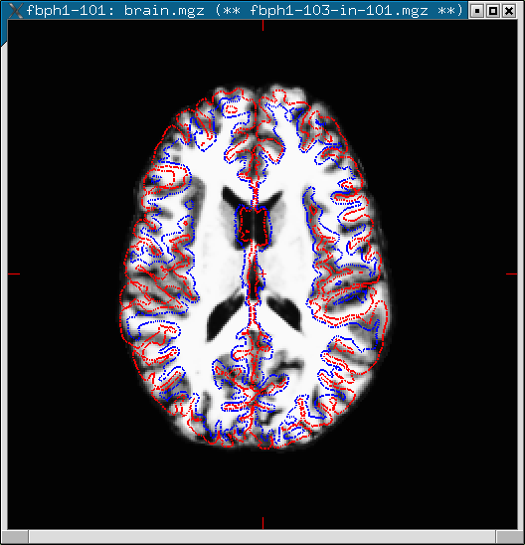
Volumetric Interesubject Registration (Affine)
3D Coordinate System
  XYZ, RAS
  MR Intensity
Affine/Linear
  Translate
  Rotate
  Stretch
  Shear
  (12 DOF)
Match Intensity, Voxel-by-Voxel
Problems
Can use nonlinear volumetric (cf CVS)

Slide 8
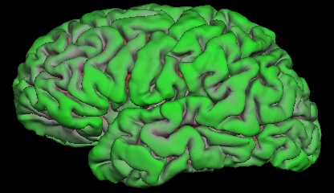
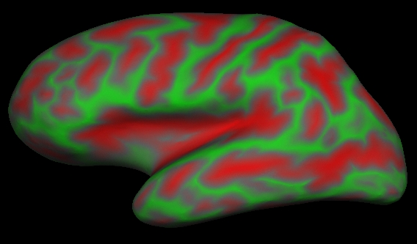
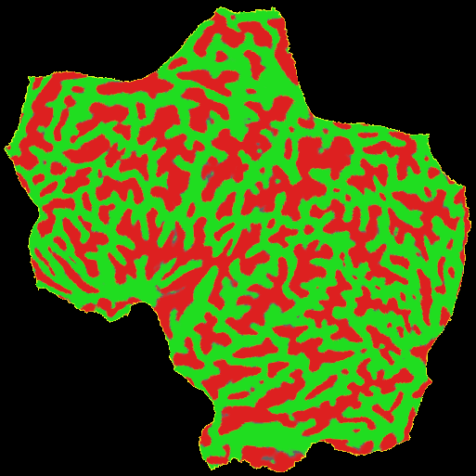
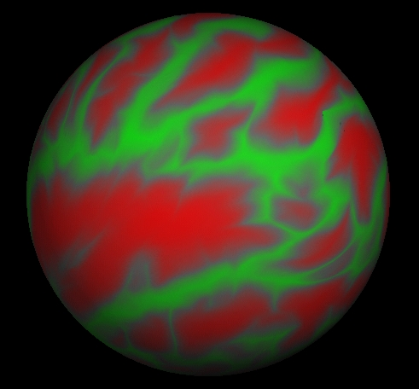
Surface-based Intersubject Registration
Curvature
SULCUS (+)
GYRUS (-)
pial
inflated
Sheet: 2D Coordinate System (X,Y)
Sphere: 2D Coordinate System (θ,φ)
Continuous, no cuts
central
anterior
posterior
sylvian
superior temporal
calcarine

Slide 9
Surface-based Intersubject Registration
Subject 1
Subject 2
Curvature “Intensity”
SULCUS (+)
GYRUS (-)
Codes folding pattern
Translate, Rotate, Stretch, Shear (12 DOF)
Match Curvature, Vertex-by-Vertex
Nonlinear Stretching (“Morphing”) allowed (area regularization)
Actually done on sphere
“Spherical Morph”

Slide 10
Surface-based Intersubject Registration
  Gray Matter-to-Gray Matter (it’s all gray matter!)
  Gyrus-to-Gyrus and Sulcus-to-Sulcus
  Some minor folding patterns won’t line up
  Fully automated, no landmarking needed
  Atlas registration is probabilistic, most variable regions get less weight.
  Done in recon-all

Slide 11
Spatial Smoothing
Why should you smooth?
Might Improve CNR
Improve intersubject registration (functional)
How much smoothing?
Blob-size
Typically 10-20 mm FWHM
Surface smoothing more forgiving than volume-based

Slide 12
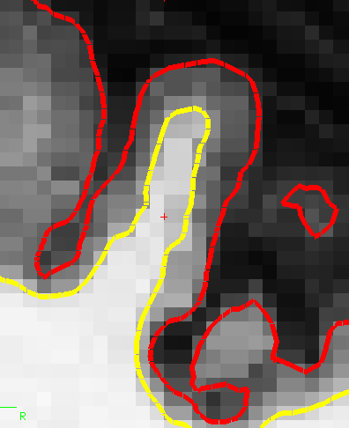
Volume-based Smoothing
14mm FWHM
  Smoothing is averaging of nearby voxels
7mm FWHM

Slide 13
Volume-based Smoothing
14mm FWHM
  5 mm apart in 3D
  25 mm apart on surface!
  Kernel much larger
  Averaging with other tissue types (WM, CSF)
  Averaging with other functional areas

Slide 14
Surface-based Smoothing
  Smoothing is averaging of nearby vertices
Sheet: 2D Coordinate System (X,Y)
Sphere: 2D Coordinate System (θ,φ)
central
anterior
posterior
sylvian
superior temporal
calcarine

Slide 15
The General Linear Model (GLM)

Slide 16
GLM Theory
Is Thickness correlated with Age?
Thickness
Dependent
Variable,
Measurement
Subject 1
y1
Subject 2
HRF Amplitude
IQ, Height, Weight
y2
Age
x1
x2
Independent Variable
Of course, you’d
need more then two
subjects …

Slide 17
Linear Model
Thickness
Intercept: b
System of Linear Equations
y1 = 1*b + x1*m
y2 = 1*b + x2*m
Slope: m
y1
y2
Matrix Formulation
Age
b
m
y1
y2
1 x1
1 x2
x1
x2
=
*
Intercept = Offset
X = Design Matrix
β = Regression Coefficients
= Parameter estimates
= “betas”
= Intercepts and Slopes
= beta.mgh (mri_glmfit)
Y = X*β
β=
b
m
mri_glmfit output: beta.mgh

Slide 18
Hypotheses and Contrasts
Is Thickness correlated with Age?
Does m = 0?
Null Hypothesis: H0: m=0
y1
y2
1 x1
1 x2
b
m
=
*
m= [0 1]*
b
m
Thickness
Intercept: b
β=
b
m
?
Slope: m
γ = C*β = 0
y1
C=[0 1]: Contrast Matrix
y2
Age
mri_glmfit output: gamma.mgh
x1
x2

Slide 19
More than Two Data Points
Thickness
Intercept: b
y1
y2
y3
y4
1 x1
1 x2
1 x3
1 x4
b
m
=
*
Slope: m
Age
Y = X*β
y1 = 1*b + x1*m
y2 = 1*b + x2*m
y3 = 1*b + x3*m
y4 = 1*b + x4*m
Model Error
Noise
Uncertainty
rvar.mgh
Notes:
No matter how many data points you have, there is still only one slope and one intercept.

Slide 20
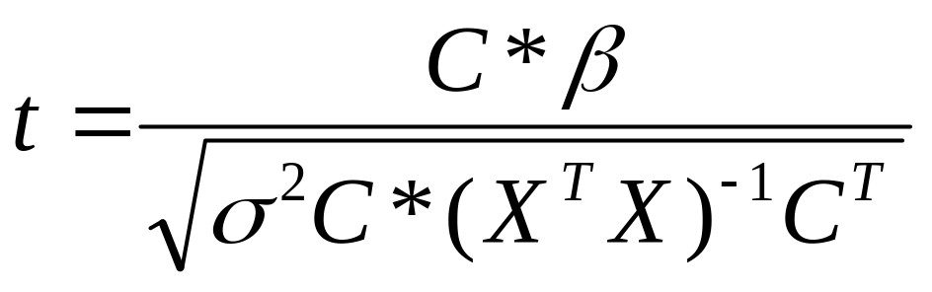
t-Test and p-values
Y = X*β
γ = C*β
p-value/significance
value between 0 and 1
closer to 0 means more significant
FreeSurfer stores p-values as –log10(p):
0.1=10⁻¹→sig=1, 0.01=10⁻²→sig=2
sig.mgh files
Signed by sign of γ
p-value is for an unsigned test

Slide 21
Two Groups
Do groups differ in Intercept?
Do groups differ in Slope?
Thickness
Intercept: b1
Is average slope different than 0?
…
Slope: m1
Slope: m2
Age
Intercept: b2

Slide 22
Two Groups
Thickness
Intercept: b1
y11
y12
y21
y22
1 0 x11 0
1 0 x12 0
0 1 0 x21
0 1 0 x22
*
b1
b2
m1
m2
Slope: m1
=
Slope: m2
Age
Y = X*β
Intercept: b2
y11 = 1*b1 + 0*b2 + x11*m1 + 0*m2
y12 = 1*b1 + 0*b2 + x12*m1 + 0*m2
y21 = 0*b1 + 1*b2 + 0*m1 + x21*m2
y22 = 0*b1 + 1*b2 + 0*m1 + x22*m2

Slide 23
Two Groups
y11
y12
y21
y22
1 0 x11 0
1 0 x12 0
0 1 0 x21
0 1 0 x22
*
b1
b2
m1
m2
Do groups differ in Intercept?
Does b1=b2?
Does b1-b2 = 0?
C = [+1 -1 0 0], γ = C*β
=
Do groups differ in Slope?
Does m1=m2?
Does m1-m2=0?
C = [0 0 +1 -1], γ = C*β
b1
b2
m1
m2
Y = X*β
β =
Thickness
Intercept: b1
Slope: m1
Is average slope different than 0?
Does (m1+m2)/2 = 0?
C = [0 0 0.5 0.5], γ = C*β
Slope: m2
Age
Intercept: b2

Slide 24
Surface-based Group Analysis in FreeSurfer
Create your own design matrix and contrast matrices
Create an FSGD File
  FreeSurfer creates design matrix
  You still have to specify contrasts
QDEC
  Limited to 2 discrete variables, 2 levels max
  Limited to 2 continuous variables

Slide 25
Command-line Processing Stages
Assemble Data (mris_preproc)
  Resample into Common Space
  Smooth
  Concatenate into one file
Model and Contrasts (GLM) (FSGD)
Fit Model (Estimate) (mri_glmfit)
Correct for multiple comparisons
Visualize (tksurfer)
}
recon-all -qcache

Slide 26
Specifying Subjects
Subject ID
$SUBJECTS_DIR
bert
fred
jenny
margaret …
Notes:
Set SUBJECTS_DIR, issue a command (mksubjdirs) to create directory structure. Convert (using mri_convert) data to COR format and store in mri/RRR, run recon-all. Typically, we acquire 3 high-quality T1 volumes to use as input to reconstruction (128-slice sagital, 1 mm in-plane resolution).

Slide 27
FreeSurfer Directory Tree
Subject ID
bert
bem stats morph mri rgb scripts surf tiff label
orig T1 brain wm aseg
lh.aparc_annnot
rh.aparc_annnot
lh.white
rh.white
lh.thickness
rh.thickness
lh.sphere.reg
rh.sphere.reg
SUBJECTS_DIR environment variable
Notes:
Set SUBJECTS_DIR, issue a command (mksubjdirs) to create directory structure. Convert (using mri_convert) data to COR format and store in mri/RRR, run recon-all. Typically, we acquire 3 high-quality T1 volumes to use as input to reconstruction (128-slice sagital, 1 mm in-plane resolution).

Slide 28
Example: Thickness Study
$SUBJECTS_DIR/bert/surf/lh.thickness
$SUBJECTS_DIR/fred/surf/lh.thickness
$SUBJECTS_DIR/jenny/surf/lh.thickness
$SUBJECTS_DIR/margaret/surf/lh.thickness
…

Slide 29
FreeSurfer Group Descriptor (FSGD) File
Simple text file
List of all subjects in the study
Accompanying demographics
Automatic design matrix creation
You must still specify the contrast matrices
Integrated with tksurfer
Note: Can specify design matrix explicitly with --design

Slide 30
FSGD Format
GroupDescriptorFile 1
Class Male
Class Female
Variables Age Weight IQ
Input bert Male 10 100 1000
Input fred Male 15 150 1500
Input jenny Female 20 200 2000
Input margaret Female 25 250 2500
One Discrete Factor (Gender) with Two Levels (M&F)
Three Continuous Variables: Age, Weight, IQ
Class = Group
Note: Can specify design matrix explicitly with --design

Slide 31
FSGDF → X (Automatic)
Female Group
Male Age
Male Group
Female Age
1 0 10 0 100 0 1000 0
1 0 15 0 150 0 1500 0
0 1 0 20 0 200 0 2000
0 1 0 25 0 250 0 2500
X =
Age
Weight
IQ
C = [-1 1 0 0 0 0 0 0]
}
Tests for the difference in intercept/offset between groups
C = [ 0 0 -1 1 0 0 0 0]
}
Tests for the difference in age slope between groups
DODS – Different Offset, Different Slope

Slide 32
Factors, Levels, Groups
Each Group/Class:
  Has its own Intercept
  Has its own Slope (for each continuous variable)
NRegressors = NClasses*(NVariables+1)

Slide 33
Factors, Levels, Groups, Classes
Continuous Variables/Factors: Age, IQ, Volume, etc
Discrete Variables/Factors: Gender, Handedness, Diagnosis
Levels of Discrete :
Handedness: Left and Right
Gender: Male and Female
Diagnosis: Normal, MCI, AD
Group or Class: Specification of All Discrete Factors:
Left-handed Male MCI
Right-handed Female Normal

Slide 34
Assemble Data: mris_preproc
mris_preproc --help
--fsgd FSGDFile : Specify subjects thru FSGD File
--hemi lh : Process left hemisphere
--meas thickness : $SUBJECTS_DIR/subjectid/surf/hemi.thickness
--target fsaverage : common space is subject fsaverage
--o lh.thickness.mgh : output “volume-encoded surface file”
Lots of other options!
lh.thickness.mgh – file with thickness maps for all subjects → Input to Smoother or GLM

Slide 35
Surface Smoothing
mri_surf2surf --help
Loads lh.thickness.mgh
2D surface-based smoothing
Specify FWHM (eg, fwhm = 10 mm)
Saves lh.thickness.sm10.mgh
Can be slow (~10-60min)
recon-all -qcache

Slide 36
mri_glmfit
Reads in FSGD File and constructs X
Reads in your contrasts (C1, C2, etc)
Loads data (lh.thickness.sm10.mgh)
Fits GLM (ie, computes β)
Computes contrasts (γ=C*β)
t or F ratios, significances
Significance -log10(p) (.01 → 2, .001 → 3)

Slide 37
mri_glmfit
mri_glmfit
--y lh.thickness.sm10.mgh
--fsgd gender_age.txt
--C age.mat –C gender.mat
--surf fsaverage lh
--cortex
--glmdir lh.gender_age.glmdir
Creates: lh.gender_age.glmdir/
beta.mgh – parameter estimates
rvar.mgh – residual error variance
etc …
age/
sig.mgh – -log10(p), uncorrected
gamma.mgh, F.mgh
gender/
sig.mgh – -log10(p)
gamma.mgh, F.mgh
mri_glmfit --help

Slide 38
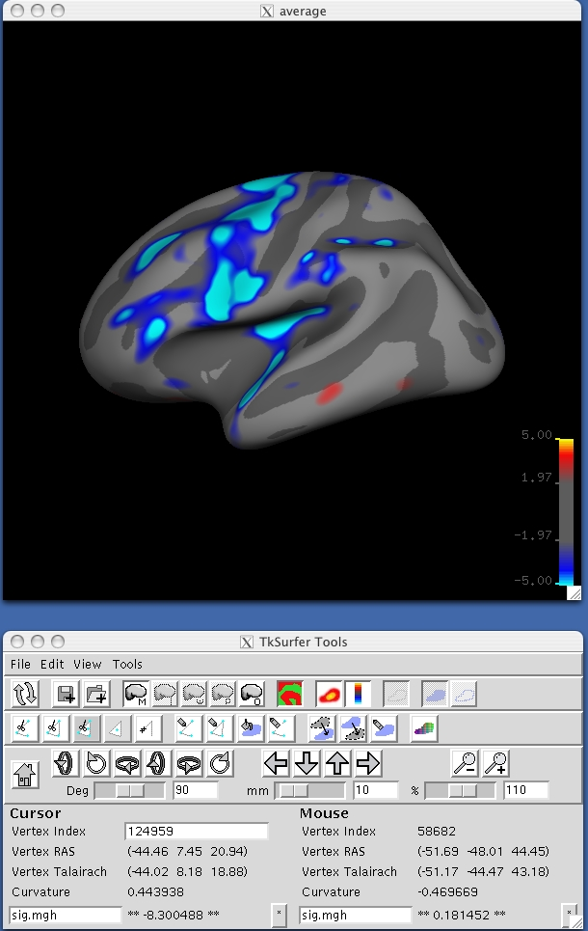
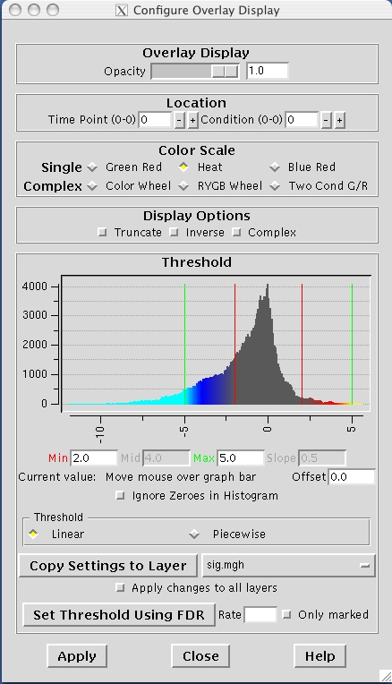
Visualization with tksurfer
Saturation:
-log10(p),
Eg, 5=.00001
Threshold:
-log10(p),
Eg, 2=.01
False
Dicovery
Rate
Eg, .01
View->Configure->Overlay
File->LoadOverlay

Slide 39
Visualization with tksurfer
File->
Load Group Descriptor File …

Slide 40
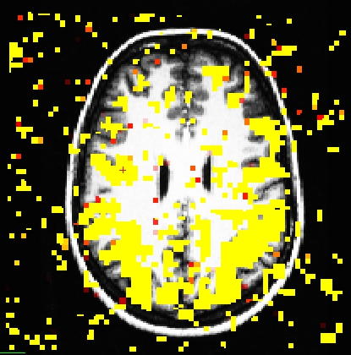
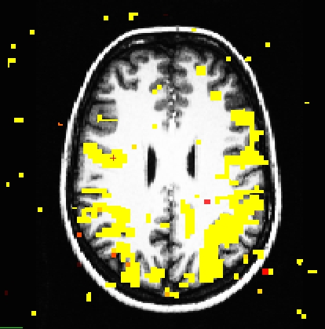
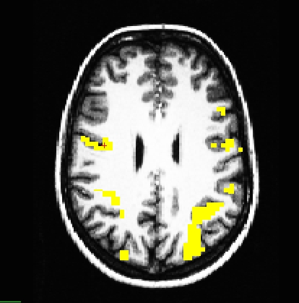
Problem of Multiple Comparisons
p < 0.10
p < 0.01
p < 10⁻⁷

Slide 41
Correction for Multiple Comparisons
Cluster-based
  Monte Carlo simulation
  Permutation Tests
  Surface Gaussian Random Fields (GRF)
    There but not fully tested
False Discovery Rate (FDR) – built into tksurfer and QDEC. (Genovese, et al, NI 2002)

Slide 42
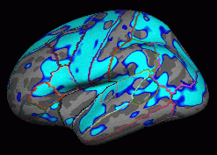
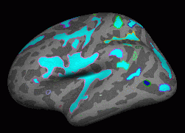
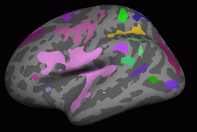
Clustering
Choose a vertex-wise threshold
  Eg, 2 (p<.01), or 3 (p<.001)
  Sign (pos, neg, abs)
A cluster is a group of connected (neighboring) vertices above threshold
Cluster has a size (area in mm²)
p<.01 (-log10(p)=2)
Negative
p<.0001 (-log10(p)=4)
Negative

Slide 43
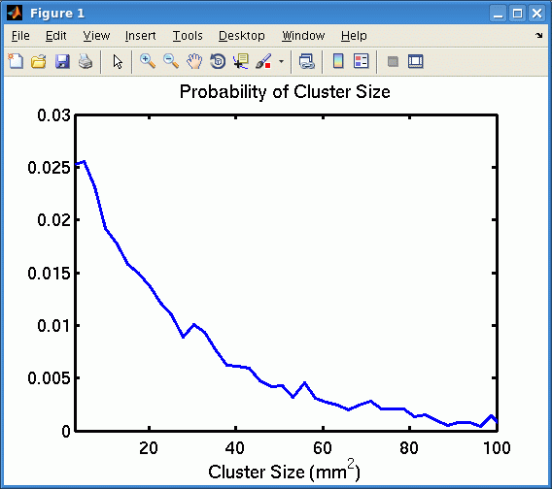
Cluster-based Correction for Multiple Comparisons
Simulate data under Null Hypothesis:
  Synthesize Gaussian noise and then smooth (Monte Carlo)
  Permute rows of design matrix (Permutation, orthog)
Analyze, threshold, cluster, max cluster size
Repeat 10,000 times
Analyze real data, get cluster sizes
P(cluster) = #MaxClusterSize > ClusterSize/10000
mri_glmfit-sim

Slide 44
QDEC – An Interactive Statistical Engine GUI
Query – Select subjects based on Match Criteria
Design – Specify discrete and continuous factors
Estimate – Fit Model
Contrast – Automatically Generate Contrast Matrices
Interactive – Makes easy things easy (that used to be hard)
…a work in progress
No Query yet
Two Discrete Factors (Two Levels)
Two Continuous Factors
Surface only

Slide 45
QDEC – Spreadsheet
qdec.table.dat – spreadsheet with subject information – spreadsheet can be huge!
fsid gender age diagnosis Left-Cerebral-White-Matter-Vol
011121_vc8048 Female 70 Demented 202291
021121_62313-2 Female 71 Demented 210188
010607_vc7017 Female 73 Nondemented 170653
021121_vc10557 Male 75 Demented 142029
020718_62545 Male 76 Demented 186087
020322_vc8817 Male 77 Nondemented 149810
gender.levels
diagnosis.levels
Discrete Factors need a
factorname.level file
Female
Male
Demented
Nondemented

Slide 46
Tutorial
Command-line Stream
  Create an FSGD File for a thickness study
  Age and Gender
  Run
    mris_preproc
    mri_surf2surf
    mri_glmfit
    mri_glmfit-sim
    tksurfer
QDEC – same data set

Slide 48
Another FSGD Example
Two Discrete Factors
  Gender: Two Levels (M&F)
  Handedness: Two Levels (L&R)
One Continuous Variable: Age
GroupDescriptorFile 1
Class MaleRight
Class MaleLeft
Class FemaleRight
Class FemaleLeft
Variables Age
Input bert MaleLeft 10
Input fred MaleRight 15
Input jenny FemaleRight 20
Input margaret FemaleLeft 25
Class = Group

Slide 49
Interaction Contrast
Two Discrete Factors (no continuous, for now)
  Gender: Two Levels (M&F)
  Handedness: Two Levels (L&R)
Four Regressors (Offsets)
  MR (β₁), ML (β₂), FR (β₃), FL (β₄)
β₄
β₂
Δ₂
L
β₃
β₁
Δ₁
R
GroupDescriptorFile 1
Class MaleRight
Class MaleLeft
Class FemaleRight
Class FemaleLeft
Input bert MaleLeft
Input fred MaleRight
Input jenny FemaleRight
Input margaret FemaleLeft
M
F
?
γ = Δ₁ −Δ₂=0
γ = (β₃-β₁)- (β₄-β₂)
= −β₁+β₂+ β₃-β₄
C = [-1 +1 +1 -1]

Slide 50
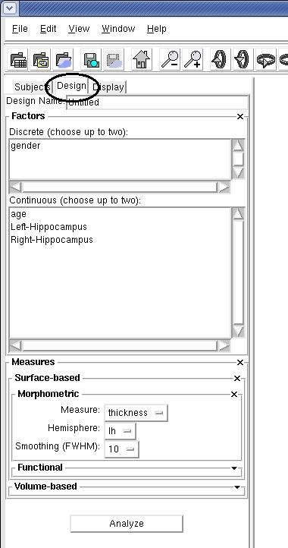
QDEC GUI
Load QDEC Table File
  List of Subjects
  List of Factors (Discrete and Cont)
Choose Factors
Choose Input (cached):
  Hemisphere
  Measure (eg, thickness)
  Smoothing Level
“Analyze”
  Builds Design Matrix
  Builds Contrast Matrices
  Constructs Human-Readable Questions
  Analyzes
  Displays Results

Slide 51
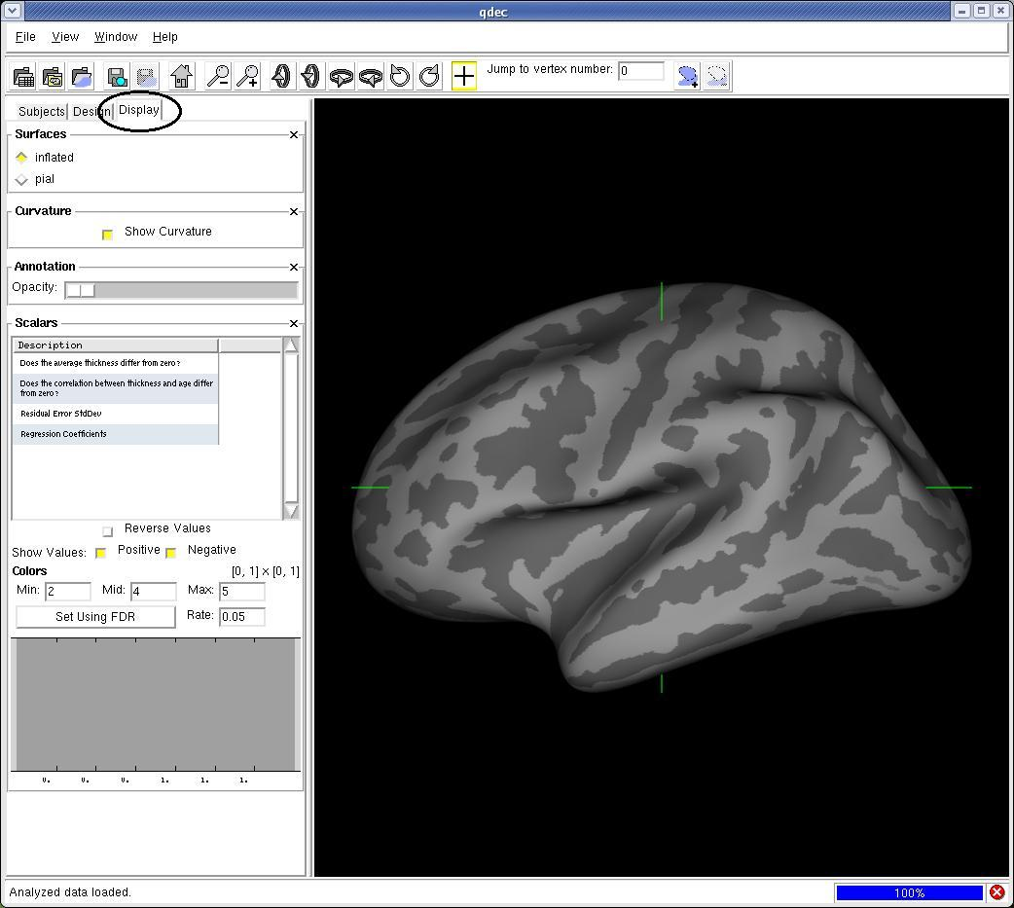
Notes:
.

Slide 52
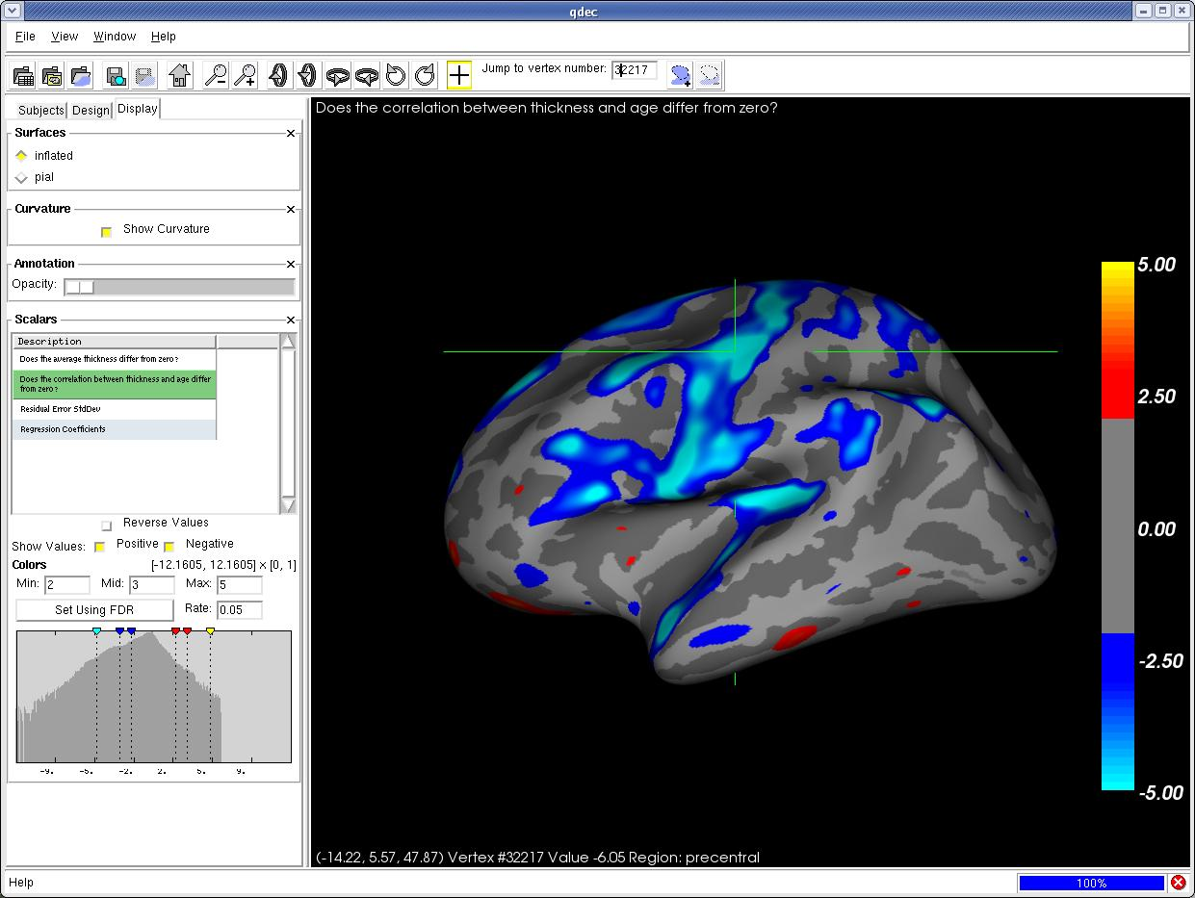

Slide 53
FSGDF →X
Input:
y
X
C
DOSS – Different Offset, Same Slope
Female Class
Age for Males and Females
Male Class
1 0 10 100 1000
1 0 15 150 1500
0 1 20 200 2000
0 1 25 250 2500
X =
C = [-1 1 0 0 0]
→ Same test, different vector
#Regressors = Nv+Nc = 3+2=5 → Fewer regressors than DODS
DOF = #Rows - #Regressors
Notes:
.

