Slide 1
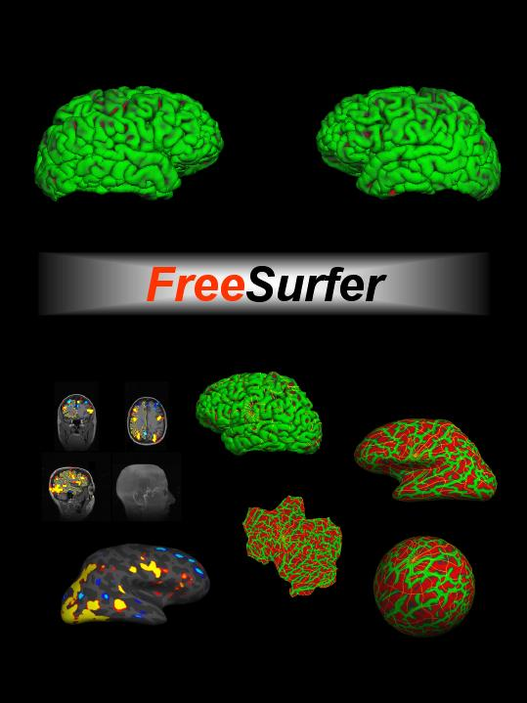





Introduction to FreeSurfer

Slide 2
Overview
Format: who, what, where, how, why, when
Processing stream run-through
Primary themes based on history:
  Cortical surfaces
  Subcortical segmentations
Home page walk-through
Warning! FreeSurfer has a steep learning curve!

Slide 3
What is FreeSurfer?
A suite of software tools for the analysis of neuroimaging data
Full characterizes anatomy
  Cortex – thickness, folding patterns, ROIs
  Subcortical – structure boundaries
Surface-based inter-subject registration
Multi-modal integration
  fMRI (task, rest, retinotopy)
  DTI tractography
  PET, MEG, EEG

Slide 4
Why is FreeSurfer special?
There are other cortical and subcortical tools:
  BrainVoyager, Caret, BrainVisa, SPM, FSL (of late)
Each has varying degrees of segmentation accuracy w/ varying levels of user intervention
FreeSurfer is highly specialized in it’s:
  cortical surface representation from the grey matter segmentation
  surface-based group registration capabilities
  accuracy of subcortical structure measurements

Slide 5
Why FreeSurfer?
Anatomical analysis is not like functional analysis – it is completely stereotyped.
Registration to a template (e.g. MNI/Talairach) doesn’t account for individual anatomy.
Even if you don’t care about the anatomy, anatomical models allow functional analysis not otherwise possible.

Slide 6
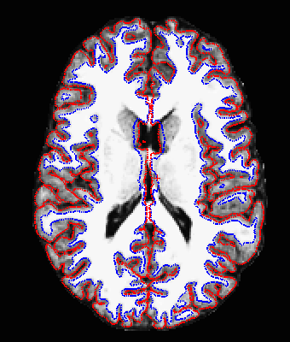
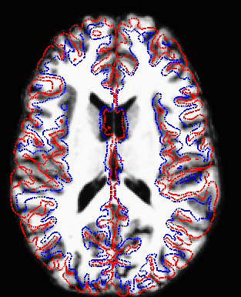
Problems with Affine (12 DOF) Registration
Subject 2 aligned with Subject 1
(Subject 1’s Surface)
Subject 1

Slide 7
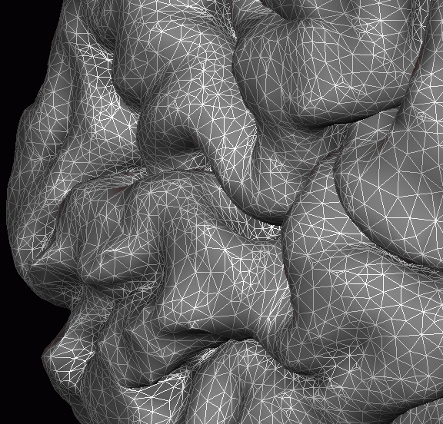
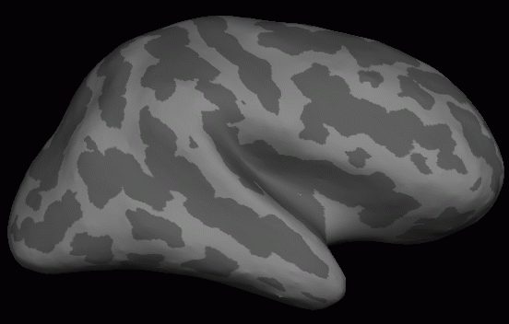
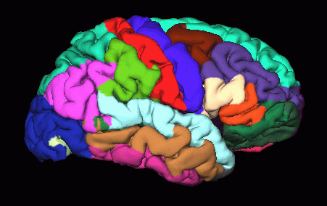
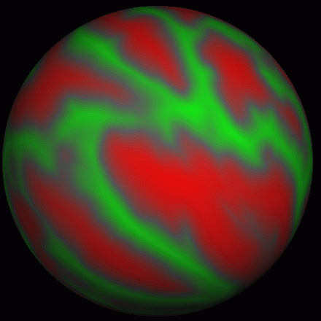
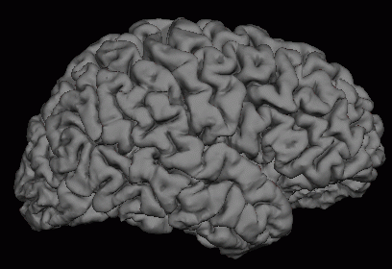
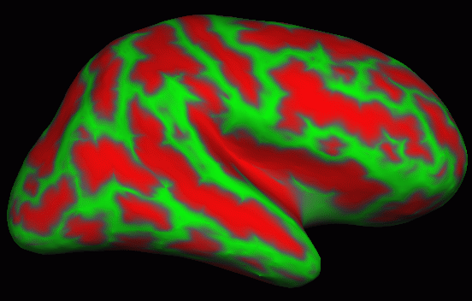
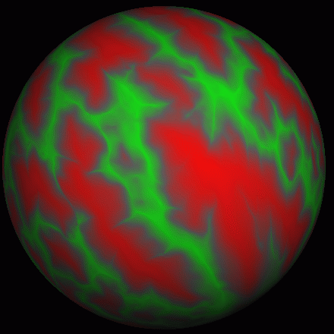
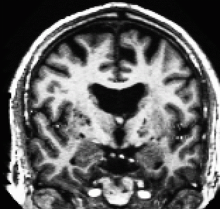
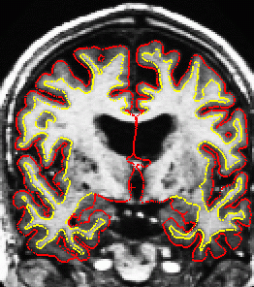
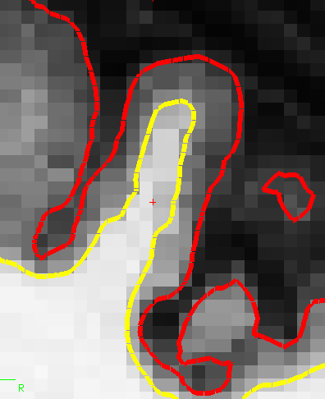
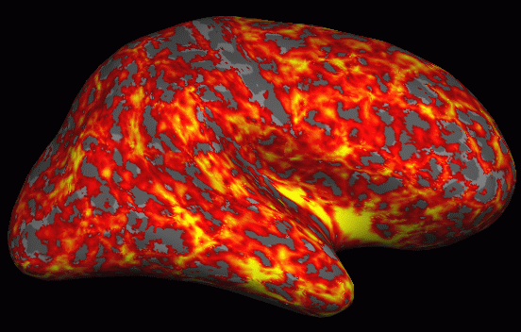
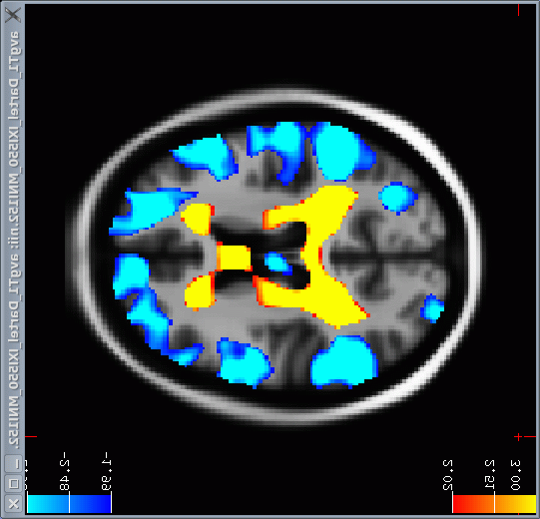
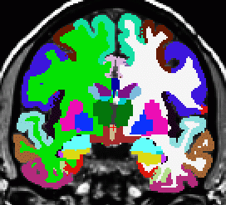
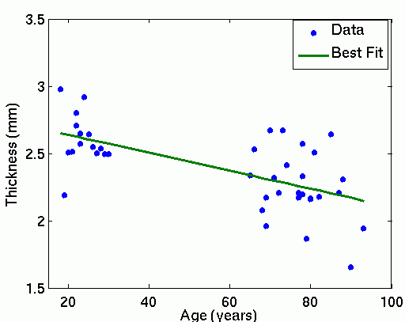
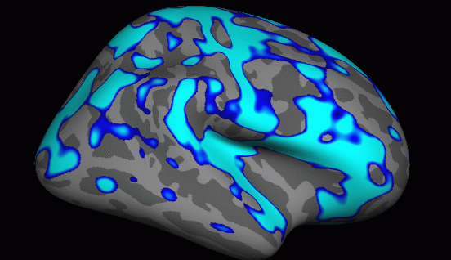
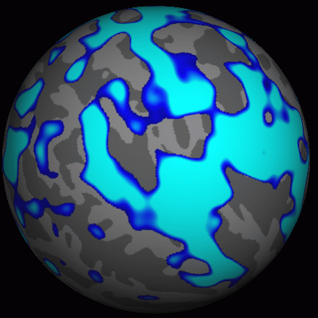
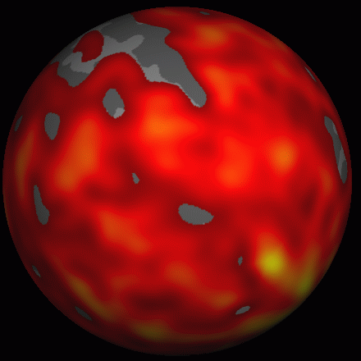
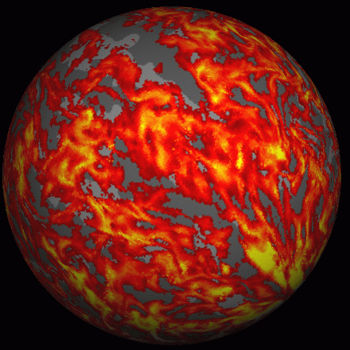
FreeSurfer Analysis Pipeline Overview
Surface Mesh
Inflation
Surface ROI
Group
Template
D
E
J
Curvature
Sphere
C
F
I
Individual T1
Spatial
Normalization
A
A
Surface
Extraction
B
Thickness
Deformation
Field
G
H
2mm
4mm
Apply
Deformation
Volume ROI
O
Statistical Map
Statistical Map
N
M
Group
Analysis
L
K
Smooth
p<.01
p<.01
Thickness
(Group Space)
Other Subjects

Slide 8
History
Improved localization of cortical activity by combining EEG and MEG with MRI cortical surface reconstruction: A linear approach, Dale, A.M., and Sereno, M.I. (1993). Journal of Cognitive Neuroscience 5:162-176.
Constrain the inverse solution by creation of a surface model

Slide 9
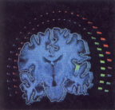
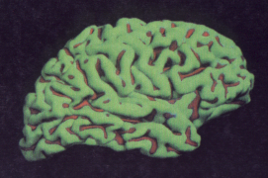
Dale and Sereno, 1993
Electric and magnetic dipole locations (left) constrained by surface model created by shrink-wrapping grey matter (right).

Slide 10
History (cont.)
Cortical Surface-Based Analysis I: Segmentation and Surface Reconstruction, Dale, A.M., Fischl, B., Sereno, M.I., (1999). NeuroImage 9(2):179-194
Cortical Surface-Based Analysis II: Inflation, Flattening, and a Surface-Based Coordinate System, Fischl, B., Sereno, M.I., Dale, A.M., (1999). NeuroImage, 9(2):195-207.
Automated Manifold Surgery: Constructing Geometrically Accurate and Topologically Correct Models of the Human Cerebral Cortex, Fischl, B., Liu, A. and Dale, A.M., (2001). IEEE Transactions on Medical Imaging, 20(1):70-80.

Slide 11
Cortical Surface-based Analysis
Prior surface models used pial surface representation for visualization and secondary analysis
This set of papers outlined the method of white surface creation followed by grey matter surface creation based on intensity gradient and smoothness constraints
Allowed accurate morphometry and inter-subject registration based on folding patterns

Slide 12
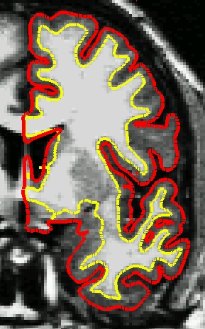
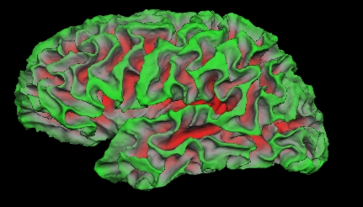
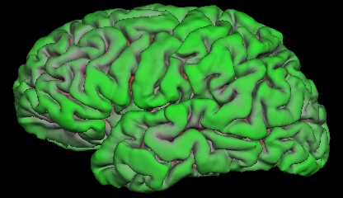
Surfaces: White and Pial

Slide 13
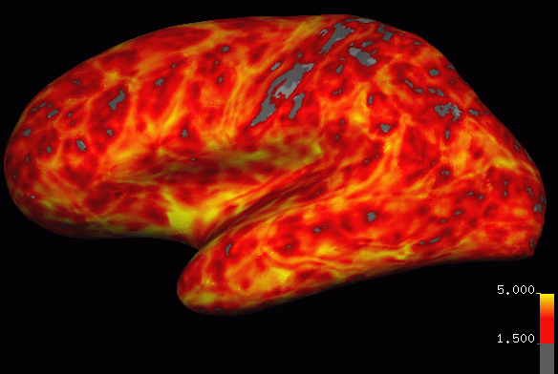
Cortical Thickness
pial surface
Distance between white and pial surfaces along normal vector.
1-5mm

Slide 14
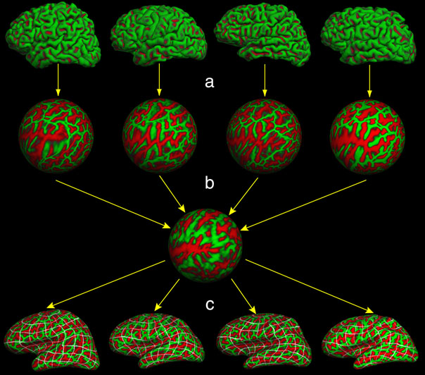
A Surface-Based Coordinate System

Slide 15
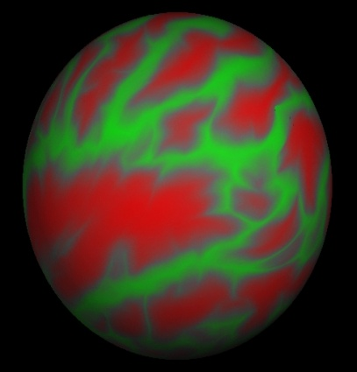
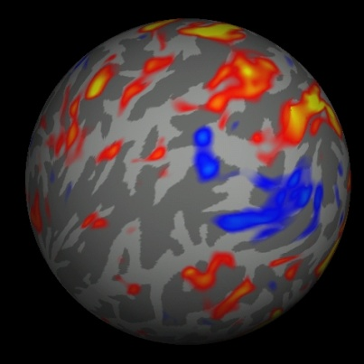
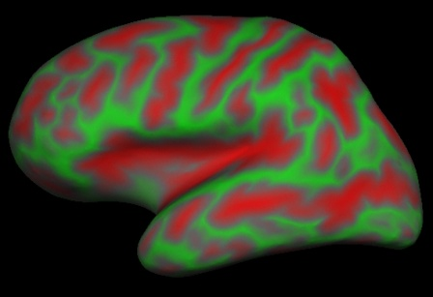
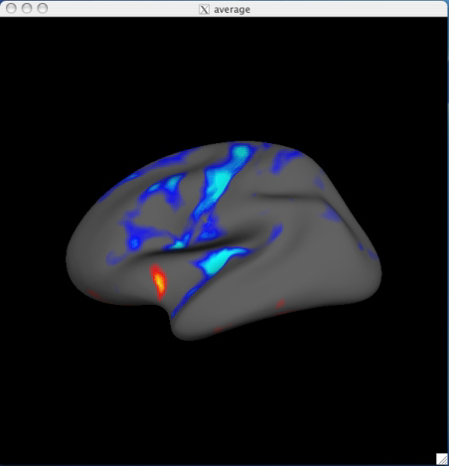
Inter-Subject Averaging
Spherical
Spherical
Native
GLM
Subject 1
Demographics
Surface-to-
Surface
Subject 2
Surface-to-
Surface
mri_glmfit
cf. Talairach

Slide 16
History (cont.)
Whole Brain Segmentation: Automated Labeling of Neuroanatomical Structures in the Human Brain, Fischl, B., D.H. Salat, E. Busa, M. Albert, M. Dieterich, C. Haselgrove, A. van der Kouwe, R. Killiany, D. Kennedy, S. Klaveness, A. Montillo, N. Makris, B. Rosen, and A.M. Dale, (2002). Neuron, 33:341-355.
Automatically Parcellating the Human Cerebral Cortex, Fischl, B., A. van der Kouwe, C. Destrieux, E. Halgren, F. Segonne, D. Salat, E. Busa, L. Seidman, J. Goldstein, D. Kennedy, V. Caviness, N. Makris, B. Rosen, and A.M. Dale, (2004). Cerebral Cortex, 14:11-22.
An automated labeling system for subdividing the human cerebral cortex on MRI scans into gyral based regions of interest, Desikan, R.S., F. Segonne, B. Fischl, B.T. Quinn, B.C. Dickerson, D. Blacker, R.L. Buckner, A.M. Dale, R.P. Maguire, B.T. Hyman, M.S. Albert, and R.J. Killiany, (2006). NeuroImage 31(3):968-80.

Slide 17
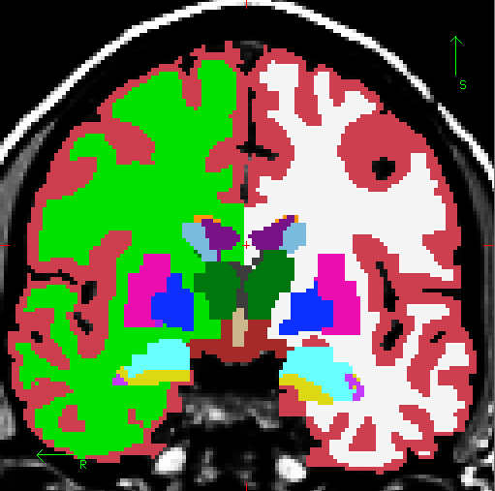
Volumetric Segmentation (aseg)
Cortex
Lateral Ventricle
White Matter
Thalamus
Caudate
Putamen
Pallidum
Amygdala
Hippocampus
Not Shown:
Nucleus Accumbens
Cerebellum

Slide 18
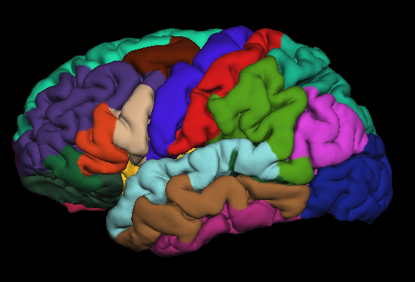
Surface Segmentation (aparc)
Precentral Gyrus
Postcentral Gyrus
Superior Temporal Gyrus
Based on individual’s folding pattern

Slide 19
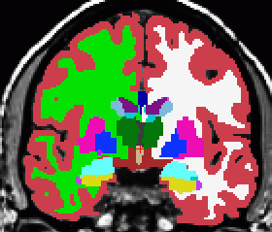
Combined Segmentation
aparc
aparc+aseg
aseg

Slide 20
Today
Longitudinal processing
Segmentation of white matter fascicles using diffusion MRI
Combined volume and surface registration
Segmentation of hippocampal subfields
Estimation of architectonic boundaries from in-vivo and ex-vivo data

Slide 21
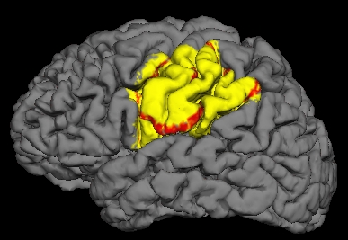
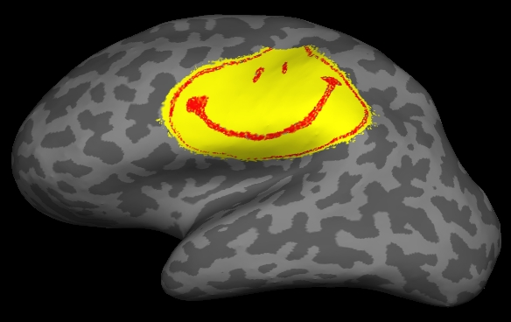
Summary
Why Surface-based Analysis?
  Function has surface-based organization
  Visualization: inflation/flattening
  Cortical morphometric measures
  Inter-subject registration
Automatically generated ROI tuned to each subject individually
Use FreeSurfer
Be Happy

Slide 22
Who
Massachusetts General Hospital + MIT + Harvard, Martinos Center for Biomedical Imaging
Boston community: Boston University, Tufts, Northeastern, Brandeis, Brigham and Womens, Childrens, McClean, Veterans Administration
Bruce Fischl, P.I.

Slide 23
Home page walk-through
http://surfer.nmr.mgh.harvard.edu/fswiki/
  Mailing list (provide a useful bug report please!)
  Wiki, and wiki account
  Download and install
  License
  Tutorials
  Acknowledgements
  Papers

