Slide 1

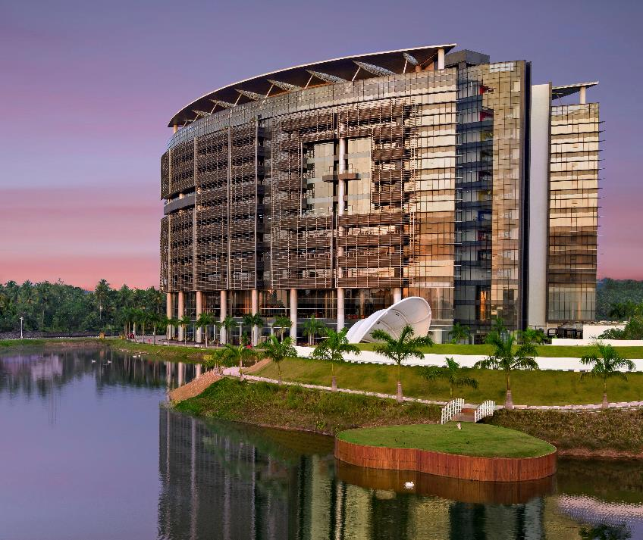
DATA STRUCTURES AND ALGORITHMS
BATCH 3

Slide 5
THANK YOU
BATCH 3

