Slide 1
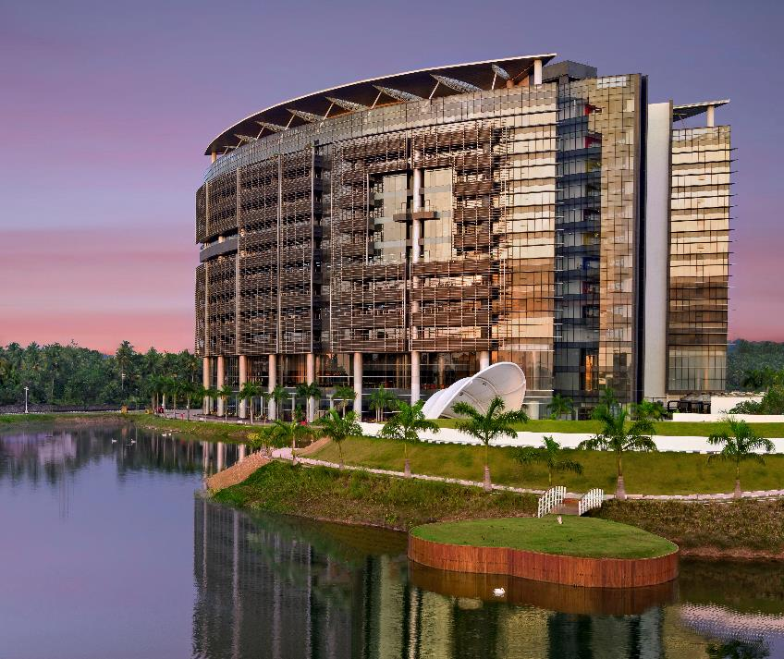
JSON Server
Akhil Murali(UST, IN)
Meghana Bareddy(UST, IN)
Batch 3, Training Room 4
UST Trivandrum Campus, Kerala, India
ust.com

Slide 2







[REST]
Front End
Back End
Front End

Slide 3

Front End

Slide 4
JSON Server
Fake REST API
Quick back-end for prototyping
JSON Format

Slide 5


Front End

Slide 6
JSON Server (Installation)
Install Node (nodejs.org/en)
npm install -g json-server (github.com/typicode/json-server)
json-server –v
Create a demo database db.json
json-server --watch db.json

Slide 7
Demo

