Slide 1

Online Training Presentation
VLSI SoC Design Using Verilog HDL
Amish Verma (Roll No. - 2000910310033)
Mentor – Mr. Sampath Kumar V.

Slide 2
PRESENTATION OUTLINE
Certificate
Objective
What is VLSI?
VLSI Design Flow
Verilog Overview and Basic Terminology
Behavioural and Structural Modelling
RTL Synthesis and RTL Simulation Flows
Basic Structure of Verilog HDL Model
Verilog HDL Model Demonstration
Conclusion

Slide 3
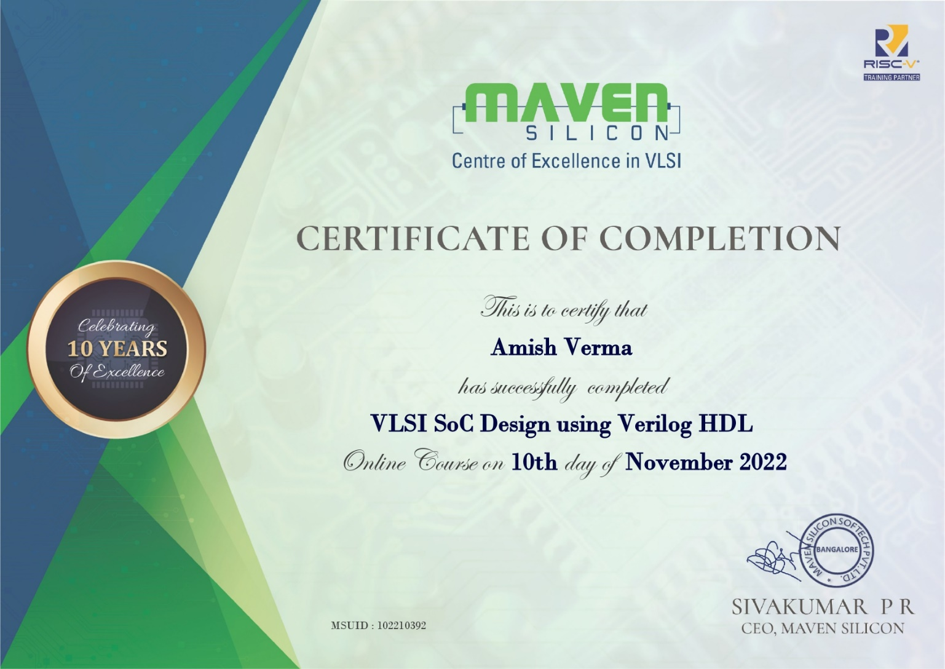
CERTIFICATE

Slide 4
OBJECTIVE OF THE TRAINING
Learning about VLSI technology and VLSI Design Flow
Using Verilog HDL
Using EDA tools like Intel’s Quartus Prime and ModelSim
Writing code for various combinational and sequential circuits using Verilog HDL, simulating them in ModelSim and synthesising them using Quartus Prime

Slide 5
WHAT IS VLSI?
VLSI stands for Very Large Scale Integration
It is a process of creating integrated circuits (ICs) with millions of transistors
Microprocessors and memory chips are some examples of VLSI devices
Apple’s new SoC (System on a Chip) M1 Ultra consists of 114 billion transistors, the most ever in a personal computer chip
It can be said that VLSI technology is a backbone of our digital economy
Before the introduction of VLSI technology, most ICs had a limited set of functions they could perform
An electronic circuit might consist of a CPU, ROM, RAM and other logic separately
VLSI enables IC designers to add all of these into one chip

Slide 6
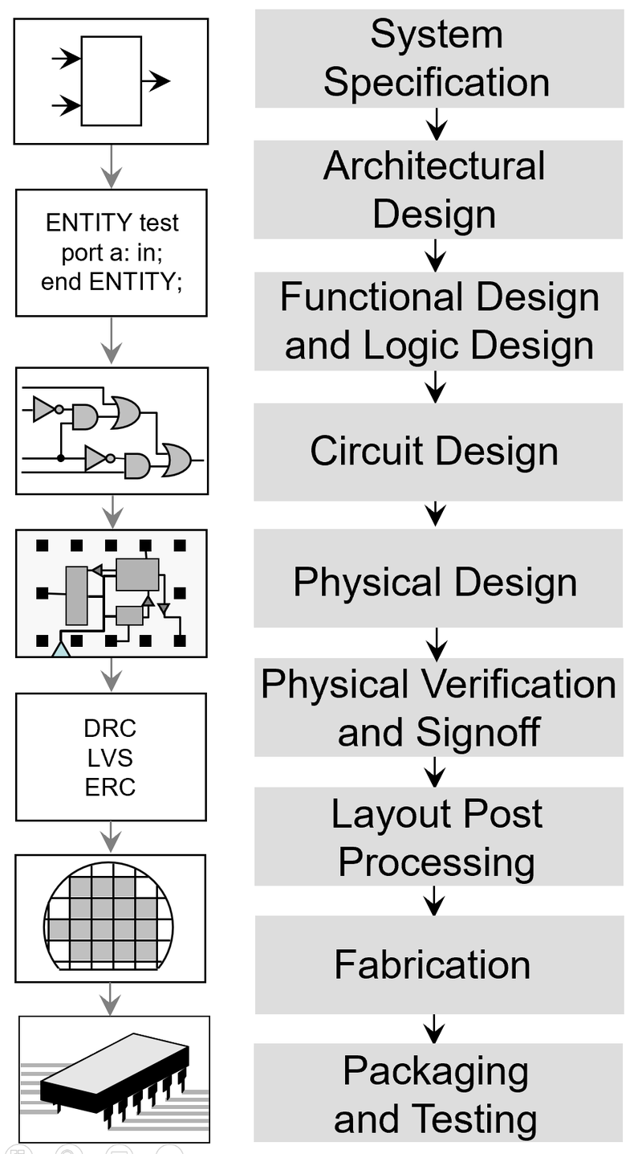
VLSI DESIGN FLOW
VLSI Design Flow is given on the right
Refers to a systematic flow of steps taken to produce an IC with desired specifications
During the functional design and logic design process, hardware description languages are used in EDA tools to programmatically generate the desired systems
EDA (Electronic Design Automation) tools like Quartus Prime and ModelSim ease the process of development of ICs
Image Source: https://en.wikipedia.org/wiki/Integrated_circuit_design#Design_flow

Slide 7
VERILOG OVERVIEW & BASIC TERMINOLOGY
Verilog is an IEEE industry standard Hardware Description Language (HDL) – used to describe a digital system
Used in both hardware simulation & synthesis
Introduced by Gateway Design Automation in 1984
HDL – A text based programming language that is used to model a piece of hardware
Behavioural Modelling – A component is described by its input/output response
Structural Modelling – A component is described by interconnecting low-level components/primitives
Register Transfer Level (RTL) – A type of behavioural modelling for the purpose of synthesis, defines input/output relationships in terms of data-flow operations inside the hardware model
Synthesis – Translating HDL to a circuit and then optimizing the represented circuit
RTL Synthesis – Translating a RTL model of hardware into an optimized technology specific gate level implementation

Slide 8
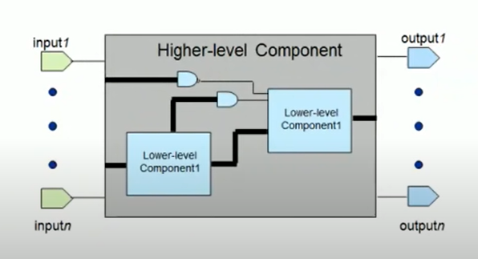
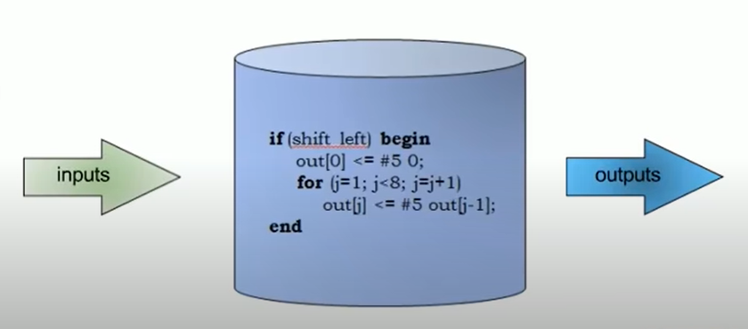
BEHAVIOURAL AND STRUCTURAL MODELLING
Behavioural Modelling
Structural Modelling
Only the functionality of the circuit, no structure
Synthesis tool creates correct logic
Functionality and structure of the circuit
Call out the specific hardware
Image Source: https://www.youtube.com/watch?v=PJGvZSlsLKs&t=86s

Slide 9
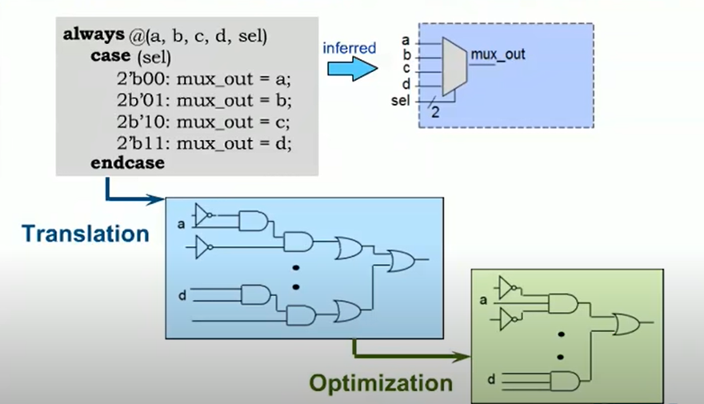
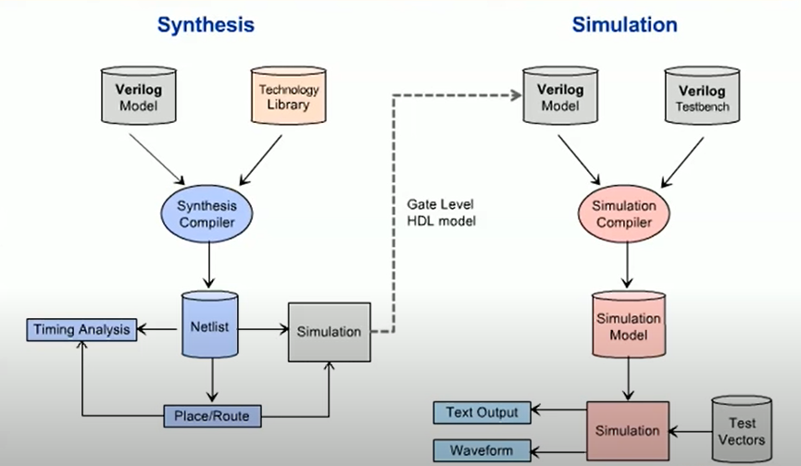
RTL SYNTHESIS & RTL SIMULATION FLOWS
Image Source: https://www.youtube.com/watch?v=PJGvZSlsLKs&t=86s

Slide 10
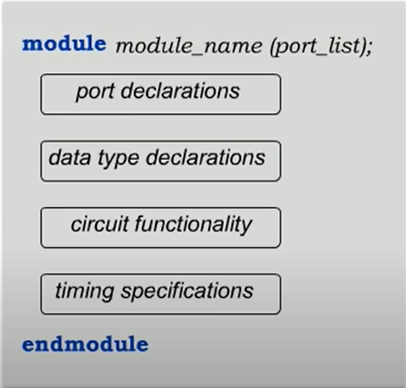
BASIC STRUCTURE OF VERILOG HDL MODEL
Begins with keyword module and ends with keyword endmodule
Case –sensitive
All keywords are lowercase
Whitespace is used for readability
Semicolon is the statement terminator
// : Single line comment
/* */ : Multi-line comment
Timing specification is for simulation
Image Source: https://www.youtube.com/watch?v=PJGvZSlsLKs&t=86s

Slide 11
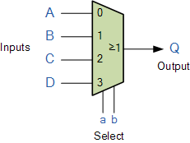
VERILOG HDL MODEL DEMONSTRATION
module mux4_1(a, sel, y);
input [3:0] a;
input [1:0] sel;
output reg y;
always@(*)
begin
case(sel)
2'd0:y=a[0];
2'd1:y=a[1];
2'd2:y=a[2];
2'd3:y=a[3];
endcase
end
endmodule
PORT DECLARATIONS
CIRCUIT FUNCTIONALITY

Slide 12
CONCLUSION
Gained a better understanding of VLSI technology, it’s importance and VLSI design flow
Learnt to model and simulate circuits using Verilog HDL
Used EDA tools – Quartus Prime, ModelSim
Implemented circuits like logic gates, half adder, full adder and multiplexer
Will use the knowledge gained in this training to model more circuits in the future
It was a great opportunity to learn about the fascinating technology that is VLSI

Slide 13
THANK YOU!

