Slide 1
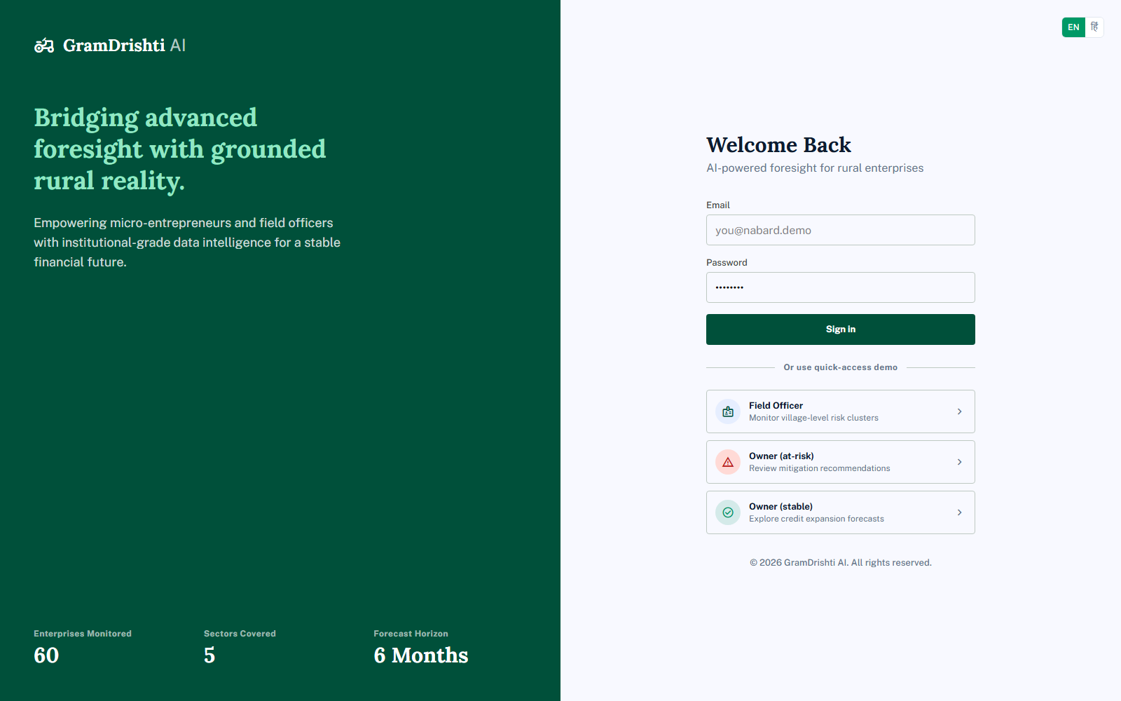
NABARD HACKATHON
GramDrishti AI
AI-powered foresight for rural enterprises
TEAM
LoneWolf
Anubhav Harsh Sinha
Predicting cash-flow risk before it becomes a default

Slide 2
THE PROBLEM → THE SOLUTION
Four real problems. Four specific answers.
PROBLEM
SOLUTION
Risk scores are a black box — no idea why, or what to do
SHAP-explained drivers + a concrete, sector-specific recommendation
A field officer can't manually track hundreds of enterprises
Portfolio dashboard: risk distribution, district/sector/climate breakdown, prioritized list
Risk is discovered only after a loan default
6-month AI forecast + risk score, recalculated live on every transaction
Built for cities, not villages — no offline support, no Hindi, no climate awareness
Offline-first, bilingual, real rainfall/flood/drought data feeding the risk model

Slide 3
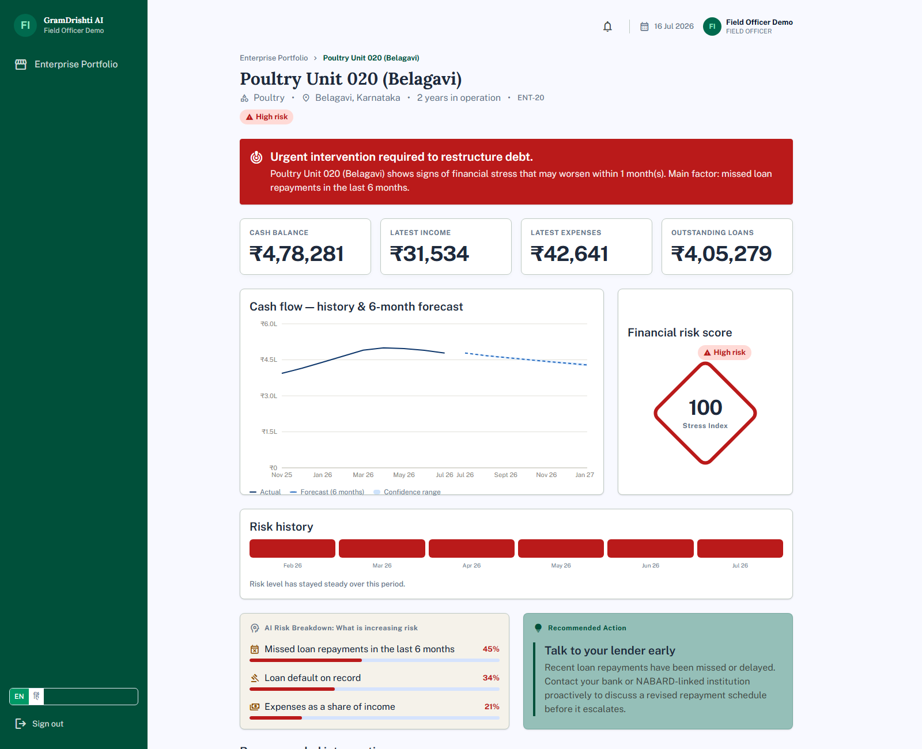
SOLVING PROBLEM 1 · THE BLACK BOX
A risk score you can act on
• LightGBM forecasting + SHAP-based explainability — every score comes with its real drivers
• “Missed loan repayments — 45%, Loan default on record — 34%, Expenses as share of income — 21%”
• Paired with a concrete recommendation (“Talk to your lender early”) — not a diagnosis without a next step

Slide 4
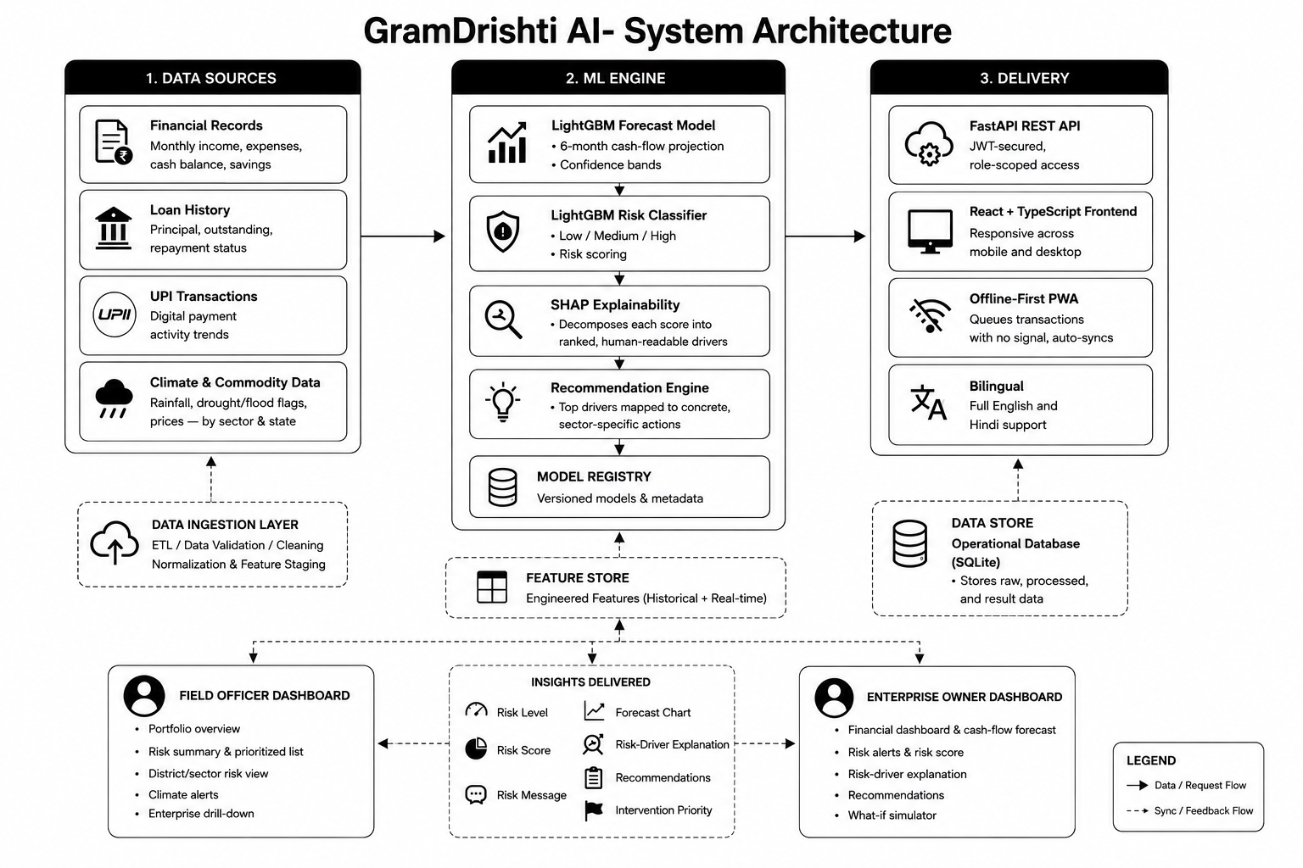
ARCHITECTURE & HOW IT WORKS

Slide 5
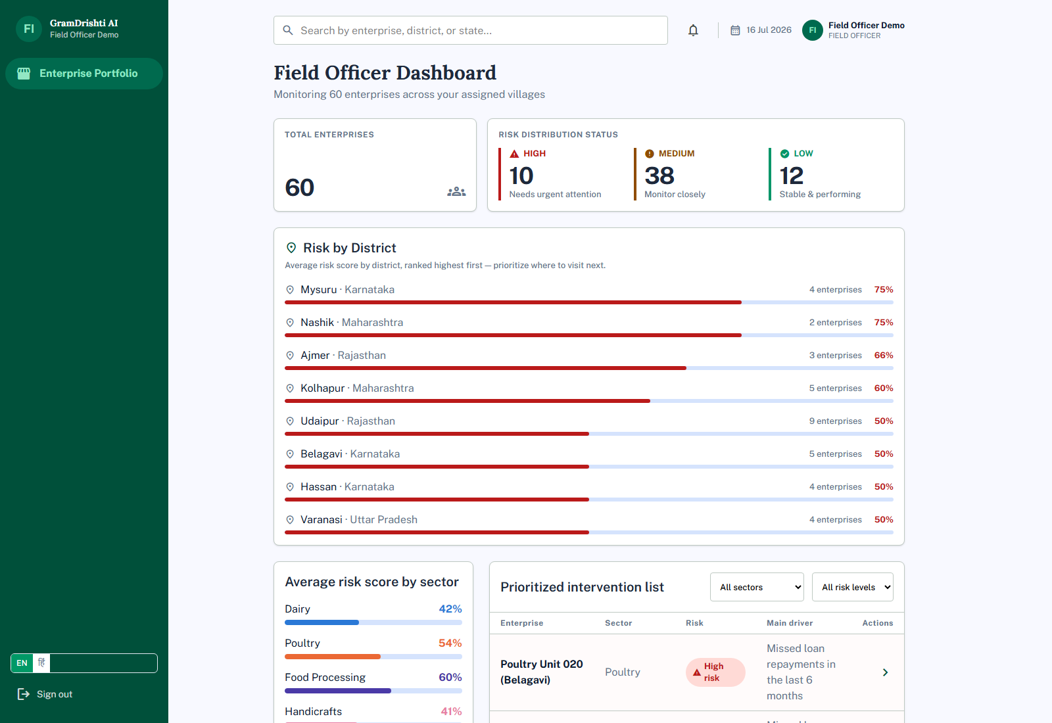
SOLVING PROBLEM 2 · FIELD OFFICER VIEW
Manage risk across the entire portfolio
• See all 60 enterprises at a glance — total count and a live high/medium/low risk breakdown
• Risk by District and Average Risk by Sector — know exactly where to prioritize a visit
• Prioritized intervention list, filterable by sector and risk level, with the AI-driven main factor for each
• Real climate risk flags (flood/drought) surfaced automatically for affected enterprises

Slide 6
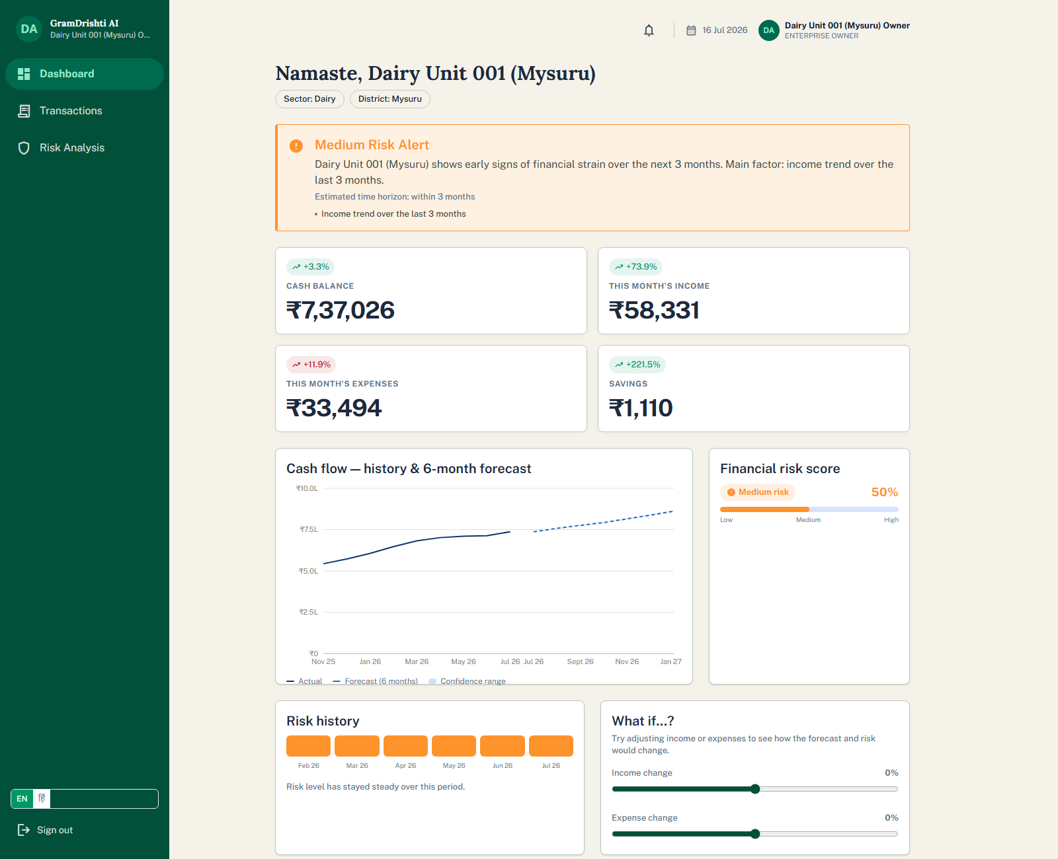
SOLVING PROBLEM 3 · ENTERPRISE OWNER VIEW
A personal financial co-pilot
• Real KPI cards with month-over-month trend deltas — cash balance, income, expenses, savings
• 6-month cash-flow forecast with a confidence band, plus a live financial risk score
• Risk history timeline shows whether things are improving or worsening over time
• Recommendations and transaction entry, right on the same screen

Slide 7
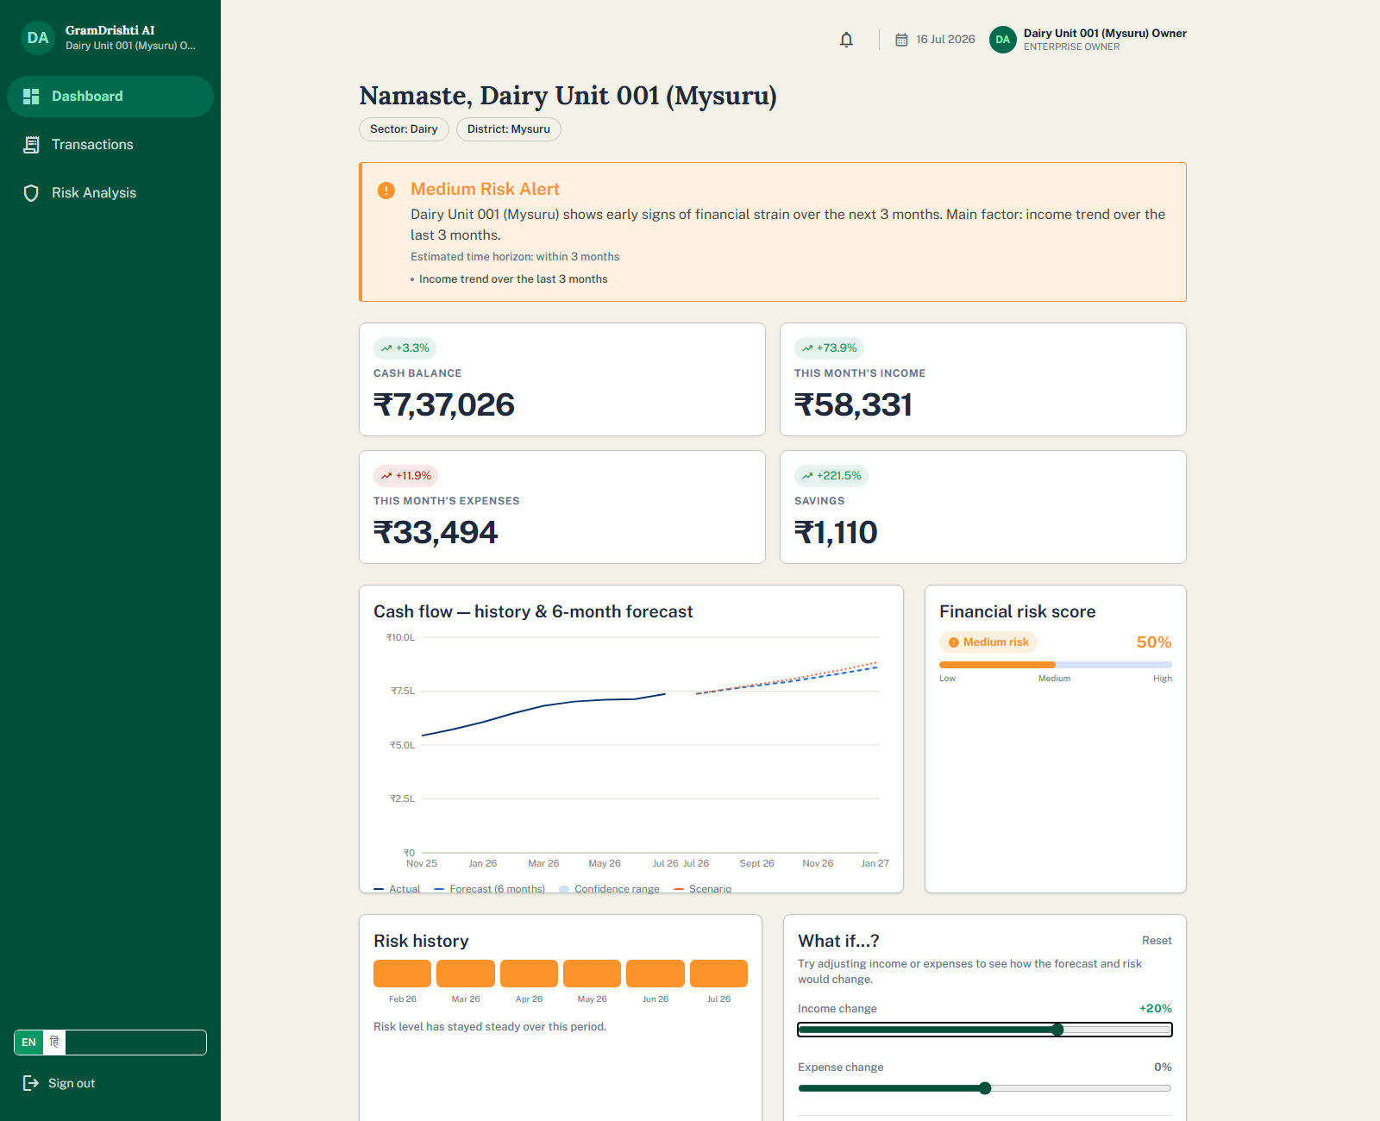
EXTENDING PROBLEM 3 · FROM FORECAST TO PLAN
Planning, not just reporting
• Entrepreneurs drag income/expense sliders and watch the 6-month forecast and risk level update live
• Turns a static report into a self-service planning tool — “what if my income drops 20%?” answered in real time

Slide 8
SOLVING PROBLEM 4 · BUILT FOR REAL RURAL CONDITIONS
• Offline-first: transactions queue with no signal and auto-sync when reconnected
• Fully bilingual — English and Hindi
• Real rainfall/flood/drought data tied to sector and state, feeding directly into risk scoring
Earlier warning → fewer defaults → a stronger rural credit ecosystem.
GramDrishti AI — AI-powered foresight for rural enterprises.

Slide 9
NABARD HACKATHON
Thank You
GramDrishti AI — AI-powered foresight for rural enterprises
ENTERPRISES MONITORED
SECTORS COVERED
FORECAST HORIZON
60
5
6 Months
TEAM
LoneWolf
Anubhav Harsh Sinha
Submitted for the NABARD Hackathon

Slide 10
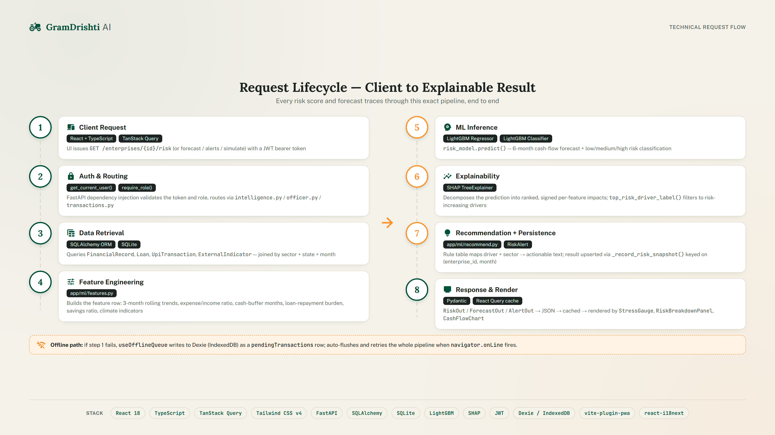
APPENDIX · TECHNICAL DEEP DIVE

