Slide 1
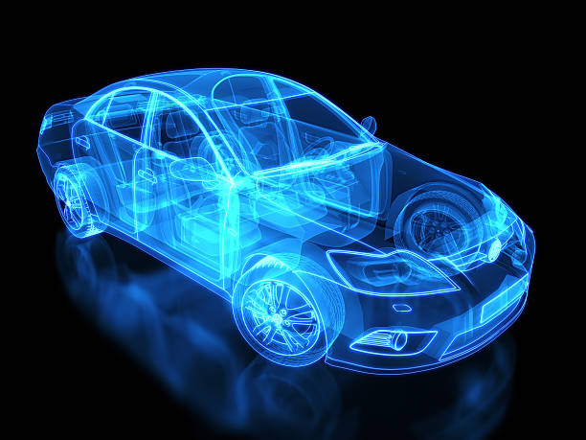
Automotive Cybersecurity
AUTOMOTIVE CYBERSECURITY

Slide 2
FLOW OF PRESENTATION
INTRODUCTION
UNDERSTANDING THE PROBLEM
PRINCIPLES OF CYBERSECURITY CONCEPTS
HOW THE INDUSTRY PROTECT CARS
CHALLENGES & FUTURE TRENDS
SL PRODUCTS

Slide 3
1. INTRODUCTION

Slide 4

Modern cars have internet, Wi-Fi, Bluetooth, and cloud access.
Each connection increases potential attack surfaces.
Cyberattacks can cause accidents, data theft, and control loss.
Cybersecurity is essential for driver safety and privacy.
Regulations demand strong vehicle cybersecurity practices

Slide 5
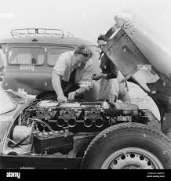
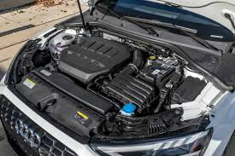
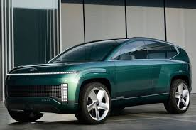

Evolution of Cars
Mechanical Vehicles
ECU Based Vehicles
Software Defined Vehicles
Up to ~1970s
Entirely mechanical
Carburetors, manual ignition, mechanical brakes
Simple tools, manual repair
Ford Model T,
VW Beetle (classic)
~1970s to 2000s
Mix of mechanical + electronic control
Electronic fuel injection,
ABS, basic sensors
Needs diagnostic tools for ECUs
1990s Honda Civic,
BMW E30
2000s ~ present
Dominated by electronics and software
AI-driven systems, autonomous driving, cloud updates
Require software updates, cyber maintenance
KIA EV6

Slide 6
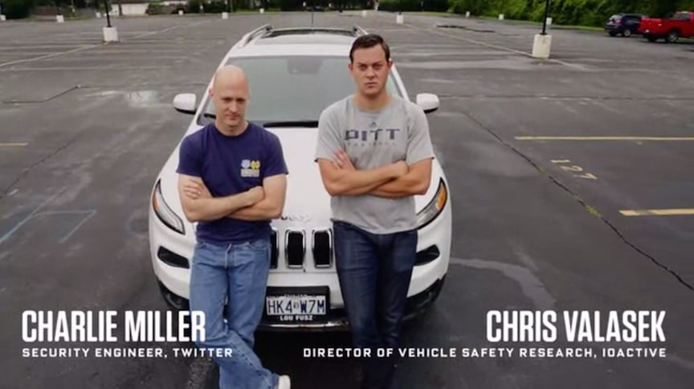
What Happens If We Ignore Security?
2015 Jeep Cherokee : A Case Study

Slide 7
2015 Jeep Cherokee : A Case Study
~Real-world vulnerability demonstration by security researchers
Background-
Vehicle: 2014 Jeep Cherokee
System Targeted: Uconnect Infotainment System (via cellular connection)
Researchers: Charlie Miller & Chris Valasek (White-hat hackers)
Method-
Exploited software vulnerability in Uconnect
Gained access to the vehicle’s internal CAN bus network
Remotely controlled:
Steering
Acceleration & braking
Dashboard display
Air conditioning & radio
Impact-
Demonstration published by WIRED with a live hack on a highway
Fiat Chrysler recalled 1.4 million vehicles — first cyber-related recall
Triggered government, industry, and regulatory attention
Outcomes-
Rise in automotive cybersecurity research & regulations
Introduction of:
ISO/SAE 21434 (Cybersecurity Engineering)
UNECE WP.29 cybersecurity regulation
U.S. SPY Car Act

Slide 8
How Could the Attack Happen if there no Security?
Entry Point: External Attack
Hacker connects through an insecure Wi-Fi or mobile network (example: fake OTA
update server, fake cloud service).
Network Access:
Hacker finds an open channel to the car’s Gateway ECU.
Send Malicious Messages:
Hacker sends a CAN message pretending to be from a Brake ECU.
Spread in Internal Network:
Since CAN is broadcast-based and unprotected, any ECU receiving the message could accept it.
Compromise the System:
The car wrongly applies brakes at high speed, causing an accident.

Slide 9
2. UNDERSTANDING THE PROBLEM

Slide 10
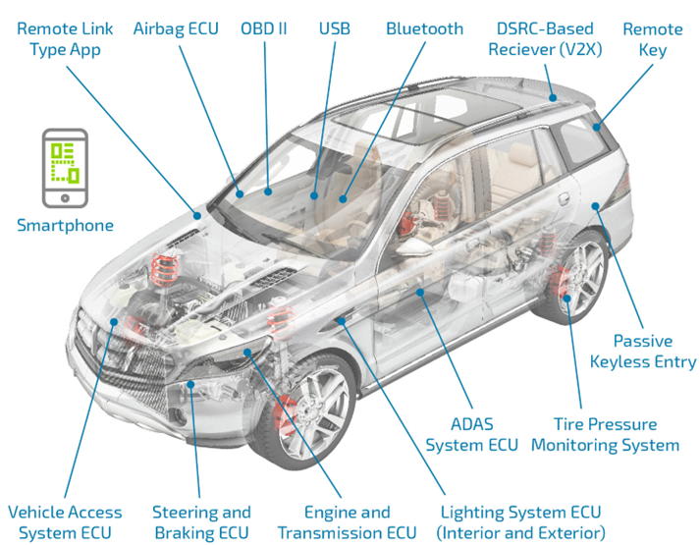
ATTACK SURFACES

Slide 11
Risk To Safety & Privacy
Safety Breaches:
Hackers could exploit vulnerabilities to manipulate critical systems like brakes, steering, and acceleration, leading
to accidents or even fatalities.
Data Theft:
Vehicles collect vast amounts of personal data, including location, driving habits, and even personal information through connected infotainment systems. This data could be stolen and misused for fraud, identity theft, or blackmail.
Control Over Vehicle Systems:
Attackers could gain control of vehicle systems, potentially disabling them, changing settings, or even remotely manipulating the vehicle's movement.
Ransomware Attacks:
Cybercriminals could use ransomware to encrypt vehicle systems, rendering them unusable until a ransom is paid.
Malicious Updates:
Over-the-air software updates, designed to improve vehicle performance, can be exploited by attackers to introduce malware or gain control of the vehicle.

Slide 12
2. Principles of Automotive Cybersecurity

Slide 13
Cryptography & Crypto Stack
Authentication & Authorization
Secure Boot & Firmware Integrity
Over-The-Air(OTA) & Update Security
Intrusion Detection & Monitoring

Slide 14
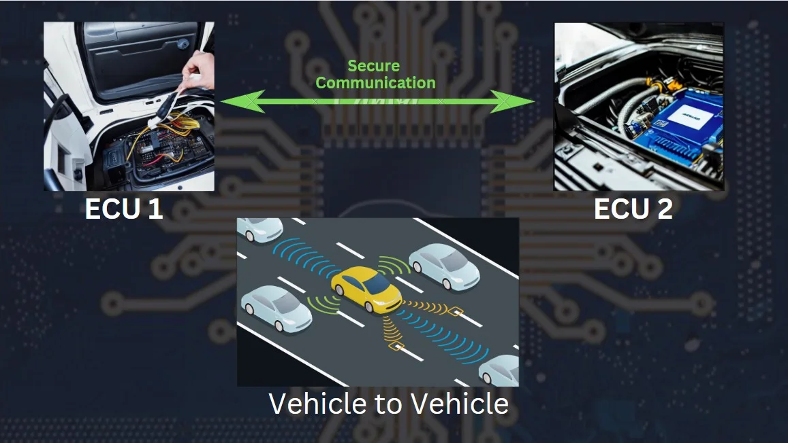
Cryptography
Cryptography is the science of securing communication between electronic
devices, like cars or ECUs, by encrypting data to prevent unauthorized access.
Cryptography transforms readable data (plaintext) into an encrypted, unreadable format .
The encrypted data is transmitted securely across the network.
Even if intercepted, unauthorized parties cannot interpret the encrypted data.
The intended receiver decrypts the ciphertext back into its original readable form (plaintext).

Slide 15
Crypto Stack
Crypto Stack | Purpose | Key Use Cases
1. PKI | Manages digital certificates for authentication. | OTA updates, ECU-to-ECU communication.
2.Digital Signatures | Verifies the source and integrity of data/software. | Firmware updates, secure boot validation.
3. Key Management | Controls generation, storage, and sharing of encryption keys. | ECU key exchange, data decryption authorization.
4. Encryption | Protects data via encoding. Symmetric = fast, Asymmetric = secure. | Vehicle-to-cloud communication, ECU data protection.
5. Hashing | Generates a fingerprint of data for integrity check | Secure boot, message verification in ECUs.

Slide 16
Authentication & Authorization
-Authentication verifies who the user or
device is.
How it is done:
Using passwords, biometrics (fingerprint, face ID), smart cards, or cryptographic keys.
The system checks if the credentials match a known identity.
-Authorization decides what an authenticated user or device is allowed to do.
How it is done:
After authentication, the system grants specific access based on roles or permissions (e.g., read, write, update).
Implemented through access control lists (ACLs), role-based access control (RBAC), or policy rules.
Authentication first ➔ Authorization next

Slide 17
Secure Boot & Firmware Integrity
Secure Boot
Ensures only trusted software runs during startup.
Verifies the digital signature of firmware before execution.
Stops the boot process or switches to safe mode if the signature is invalid.
Acts as the first defense layer for vehicle control systems.
Firmware Integrity
Ensures the software inside ECUs hasn’t
been tampered with.
Uses cryptographic hashes or digital
signatures for authenticity verification.
Integrity checks occur during boot
(Secure Boot) and runtime.
Protects critical components like braking, steering, and infotainment systems.

Slide 18


Over-The –Air & Update Security
OTA-
Enables remote delivery and installation of software updates to vehicles without requiring physical visits.
Allows manufacturers to update vehicle systems efficiently, improving performance and adding features.
Update Security-
Protects the update process through
encryption, authentication, and integrity
checks to prevent tampering.
Ensures updates are safe by allowing rollback to a previous stable version if the update fails or causes issues.

Slide 19
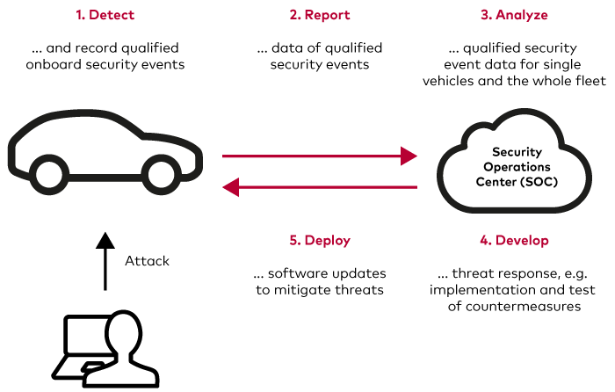
Intrusion Detection & Monitoring

Slide 20
3. How The Industry Protects Cars

Slide 21
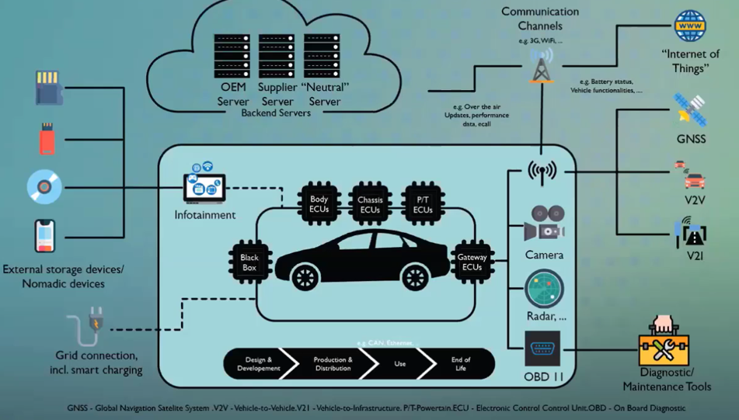
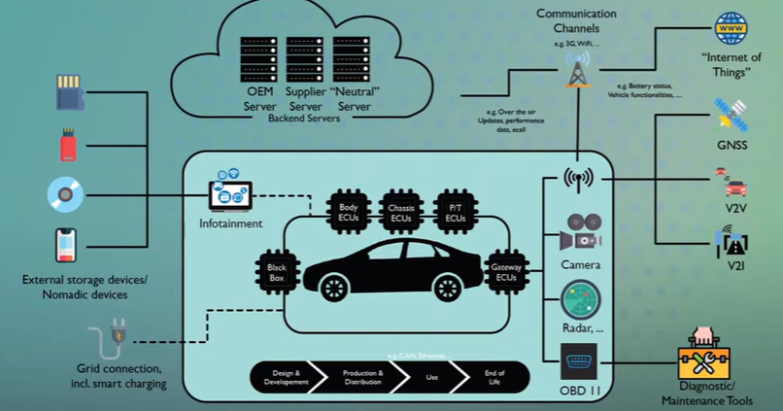

Slide 22
Defense-in-Depth Strategy
Designing Secure Architectures
Hardware-Based Security
Penetration Testing and Ethical Hacking
Incident Response Planning
Security Updates and Patch Management
Standards & Regulations

Slide 23
DEFENSE-IN DEPTH STRATEGY
What it is: Layered security approach to protect vehicle electronics from internal and external
threats.
How it is implemented:
Network Segmentation: Separate infotainment and critical driving systems (CAN, Ethernet zones).
Encrypted Communication: Secure in-vehicle (CAN encryption) and V2X
communications.
Access Controls: Restrict ECU, diagnostics, and OBD-II access to trusted users.
Firewalls & IDS: Deploy automotive firewalls and intrusion detection on vehicle networks.
Physical Protection: Lock wireless ports, USB, OBD, and other physical access points.

Slide 24
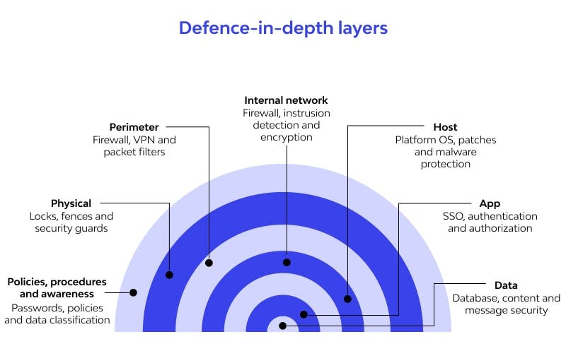
DEFENSE-IN DEPTH STRATEGY

Slide 25
Designing Secure Architectures
What: Embed cybersecurity into vehicle design to prevent system compromises.
How:
Secure Boot: Only allow authenticated firmware to run on ECUs.
Authentication: Validate communication between all vehicle nodes.
Zero Trust: No automatic trust — continuous verification within vehicle networks.
Fail-Safe Design: Systems like steering/braking switch to safe modes if
compromised.
Standards Compliance: Apply ISO/SAE 21434 cybersecurity processes from early
design

Slide 26
Hardware Based Security
What: Use specialized security hardware to protect sensitive operations and data.
How:
HSMs (Hardware Security Modules): Manage encryption, authentication securely inside ECUs.
Trusted Platform Modules (TPM):A secure environment for storing cryptographic keys, secrets, and other sensitive data
Secure Communication Acceleration: Hardware handles cryptography
without slowing vehicle networks.

Slide 27
Penetration Testing & Ethical Hacking
What : Identify and fix vulnerabilities in vehicle systems before attackers can exploit
them.
How :
External Attack Surface Testing: Target wireless interfaces (Bluetooth, Wi-Fi,
cellular).
Remote Attack Simulation: Test over-the-air (OTA) update systems and cloud APIs.
Fuzzing Tools: Send invalid data to ECUs to detect crash points and security flaws.
Full-System Red Teaming: Perform real-world simulated attacks on entire vehicles.

Slide 28
Incident Response Planning for Vehicles
What it is: Prepare systems and teams to quickly detect, contain, and recover from cyber
incidents.
How it is done:
Incident Playbooks: Define step-by-step actions for different types of automotive attacks.
Monitoring Systems: Use vehicle telematics and backend SOC for live detection.
Over-the-Air (OTA) Response: Deploy critical patches remotely if a vulnerability is found.
Containment Strategies: Disable or isolate affected ECUs/features safely during an attack.
Post-Incident Analysis: Forensic review of compromised systems to improve defenses.

Slide 29
Security Update & Patch Management
What: Keep vehicle software continuously protected against new cyber threats.
How:
Secure OTA Update Mechanisms: Ensure only signed, verified updates are
installed.
Patch Prioritization: Critical vulnerabilities fixed first with quick deployment.
Version Tracking: Maintain up-to-date records of software across vehicle fleets.
Update Notifications: Inform users about urgent updates when necessary.
Regulatory Compliance: Meet standards for software updates in vehicles.

Slide 30
Standards & Regulations
Standard/Regulation | Focus | Region
ISO/SAE 21434 | Cybersecurity in design & development | Global
UNECE WP.29 | Cybersecurity management + software updates | Europe, Asia
ISO 26262 | Functional safety | Global
NIST Framework | Risk-based cybersecurity approach | USA, Global
AUTOSAR | Secure vehicle software architecture | Global

Slide 31
4. Challenges & Future Trends

Slide 32
Challenges
Low awareness — Users don't realize cars can be hacked.
Don't want to pay — Users expect free security.
Unsafe connections — Users plug in devices carelessly.
Complex systems — Cars have many interconnected parts (sensors, apps, ECUs).
Long vehicle life — Cars stay on the road 10–15 years, but software gets outdated.
Lack of standards — No global rules for automotive cybersecurity yet.

Slide 33
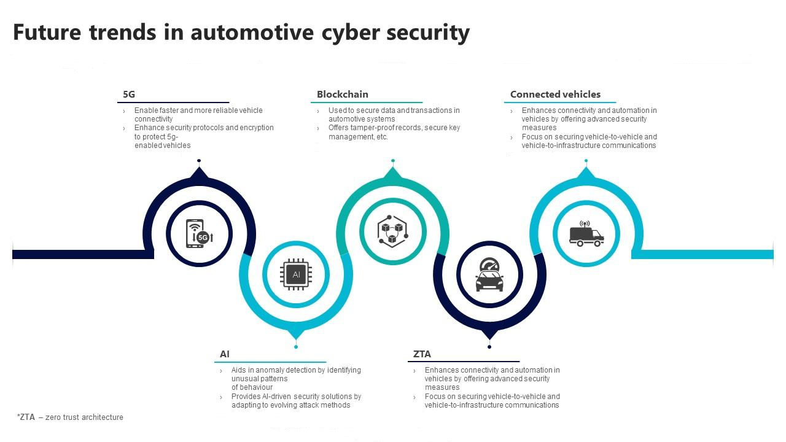
FUTURE TRENDS

Slide 34
6. SL PRODUCTS

Slide 35
