Slide 1


Slide 2
Rails Caching
Understanding and implementing

Slide 3
What is server-side caching?
Server-side caching is a process where data is stored in memory on the server instead of being requested on every page load. It is a common practice to use caching to prevent unnecessary queries.
It relieves pressure from the server by storing fragments of pages and avoiding the execution of scripts when they are already up to date.
Data can almost always be cached, storing page layouts/ static content/ blog articles etc.

Slide 4
How does it work?
Rails has a ‘cache’ method which takes a key as a parameter. This key is used for part of the name of the cached file.
A cached file is built using 3 different strings:
The directory of the file where the cache-block was called from.
A parameter given to the cache function, this can be a string, an ActiveRecord object or an array containing a mixture of both. When an ActiveRecord object is passed, the argument will contain the time the object was last updated.
An MD5 hash of the contents inside the cache-block.
On page load, if the ruby file contains any cache-blocks, Rails will try to resolve the above to an existing cache file stored on the server. If it is successful, Rails will load the contents of the cache instead of executing the code within the block. If it is unsuccessful Rails will execute the code block, saving the result to a cache.
When in production, viewing the log, you will see read and write entries for caches on each request to a controller. A successful cache-block read/write will be visible within the logs.

Slide 5
Using the project - WIP -
We have created an example project, implementing caching which you can get from here:https://bitbucket.org/bd-digital/rails-caching-investigation/overview
- WIP -

Slide 6
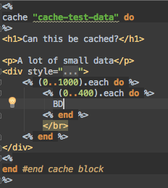
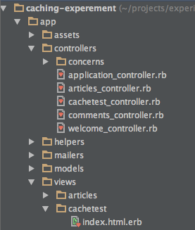
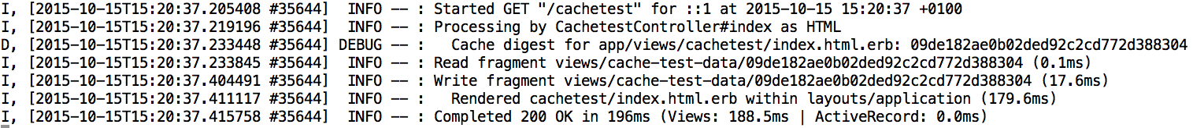
Example 1 – (1)
The file that we will be improving is ‘index.html.erb’ which is inside the ‘app/views’ directory.
The cache function is at the top of the page.
The code on the page executes a few loops to generate some text. This will be easily improved using caching.
The cache function tries to read from ‘views/cache-test-data/{MD5_hash}’.
But because this is the first time we are loading the page, the cache is not present.
This causes Rail to write a cache fragment with the parameters above. This fragment contains all of the content generated within the cache block.
As the cache file did not exist, the request took the maximum time to execute, 196ms.
We can see how the string was built:
-Location directory = ‘views’
-Parameter = ‘cache-test-data’
-MD5_hash of the cache-block

Slide 7
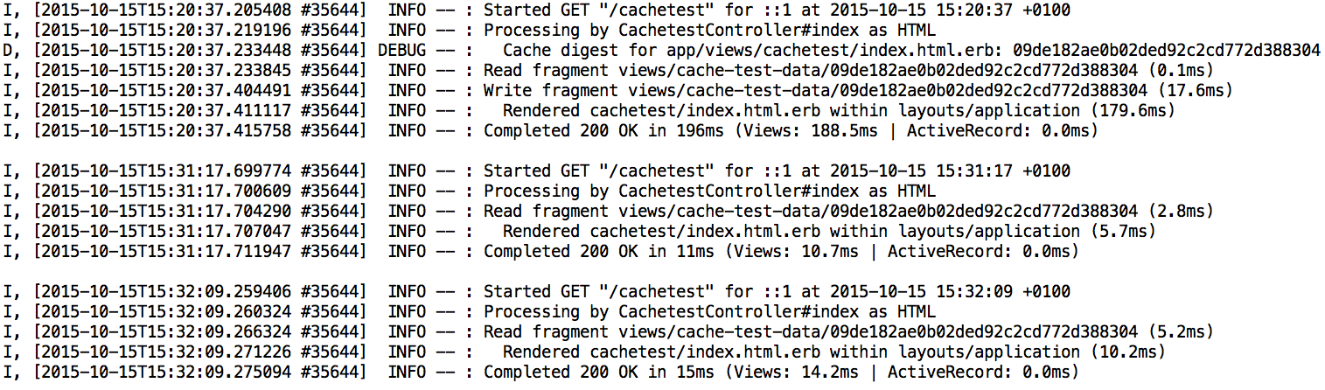
Example 1 – (2)
On the second visit to the page, it attempts to read from our cache.
This time, the cache exists, so Rails loads the data from here instead of executing the block between ‘cache do & end’. This results in an execution time of 11ms instead of 196ms, a saving of 94%
If we compare the first page load to 2 subsequent views, we can see that we have dropped from ~200ms to ~13ms.

Slide 8

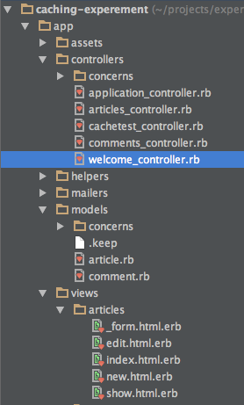
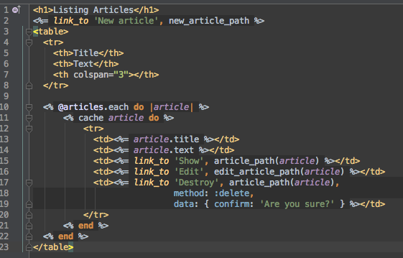
Example 2 – (1)
When using an ActiveRecord object as our key, the cache is stored using ‘{id}-{updated_at}’.
Now, if the object is updated, the cache key will be different and a new cache generated.
The article model class inherits from ActiveRecord::Base, which includes variables such as ‘updated_at’
In this view, we iterate over each article, caching them individually.
On the right is the example of storing individual article content.
This allows us to change just one article’s cache when needed.

Slide 9
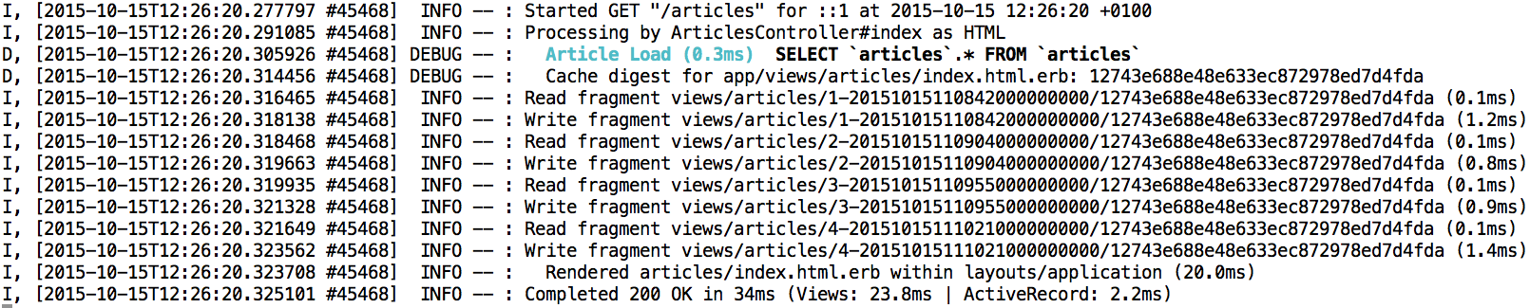
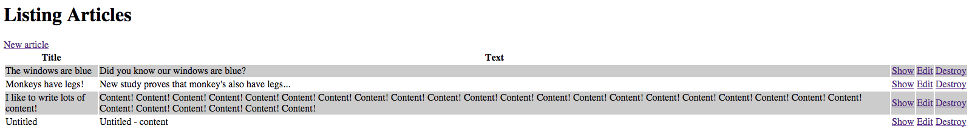
Example 2 – (2)
When there is no cache for an Article, it creates one using the key described in the previous slide.
Because we are executing the same code block, the final part of our cache name is the same for all articles. This way, if a single piece of code changes, all article caches will be updated.
There are 4 articles, which have all been cached. This has taken 34ms

Slide 10
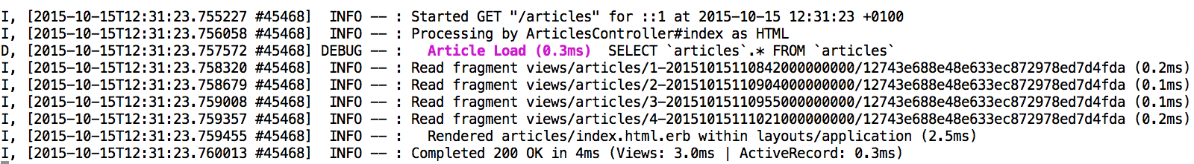
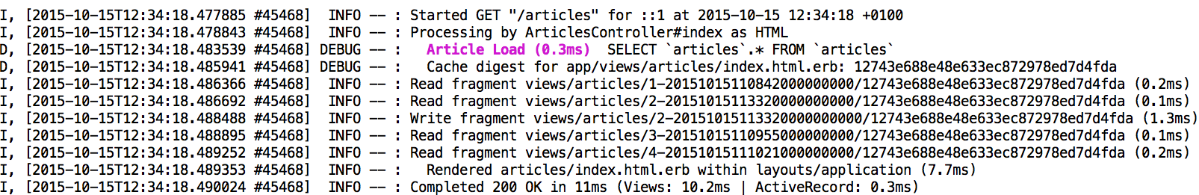
Example 2 – (3)
When the page is reloaded, Rails attempts to find a cache for each article.
The caches are found and the cache block’s script is not executed. This time the page only takes 4ms to load. A saving of 88%!
If we update article 2, and then reload the page. We can see that article 2’s cache is updated. Even when updating a single article’s cache this request is still 67% faster.

Slide 11

Example 3 – (1)
From the previous two examples, we can see how caching can greatly improve server side performance.
We can make this even more efficient!
We can nest the cache files, so that a cache file is created of the entire page, which contains smaller individual caches of articles.
But we need to think of a way so that when one article is changed, the whole page is re-cached using existing article caches and also new caches.
If we wrap the whole index page in a cache with a name such as ‘articles-all’ the first page view will create the cache but any other page views after that will also display the same cached data.
If any article is changed, the page will not display any new content.
This is because the cache title is just ‘views/articles-all/…’, nothing in the cache title has changed, so we need to somehow tie in a hook to the articles.

Slide 12
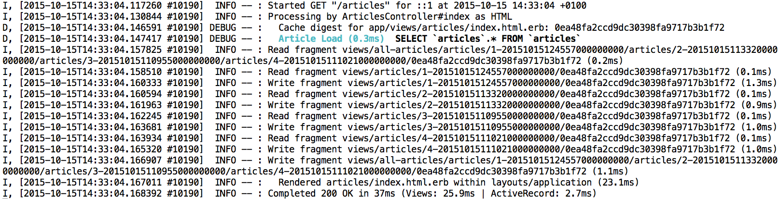
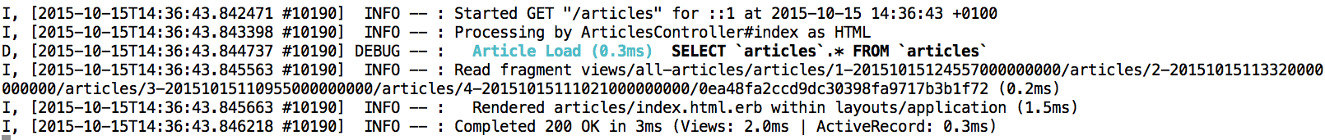
Example 3 – (2)
Our cache key is not limited to just a string or ActiveRecord object. We can use an array of all our articles, or a mixture of all three to create a key. You may wish to use a string to help identify what we are caching.
On our initial page view, Rails tries to read a cache file ‘views/all-articles/articles/1-../2-…’. This is because the cache key contains a list of when each article was last updated. If any of them have changed, a new cache file will be created.
When rewriting the ‘all-articles’ cache, Rails will check to see which articles have been updated. It will then re-cache only those changed articles.
On the second page load, nothing has changed in any of the articles which results in the cache being able to find the ‘all-articles’ file and serving it to the page in 3ms. A 92% saving!

Slide 13
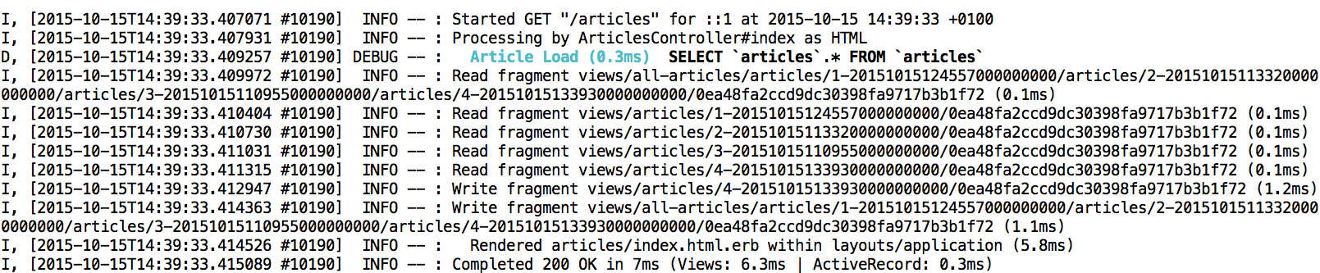
Example 3 – (3)
If we change one article, the ‘all-articles’ cache will need to be updated, but only one nested article cache will change.
Article 4 had it’s title changed. Which meant that it’s updated_at value was changed.
Article 4 has a new cache written and the ‘all-articles’ cache is then updated.
This request took 7ms compared to the 11ms we saw in example 2. A saving of 79% with nested caches compared to only 67% in example 2.

Slide 14
Conclusion
By using caching, the server can avoid potentially expensive computational tasks, loading data from it’s cache instead.
This decreases load time on pages but has as a downfall as well; the more caching being used, the more resources are used on the server to hold this information.
Caching can be a very effective tool for an app/website if you have sufficient resources.

Slide 15
Thank You

